Slide 1
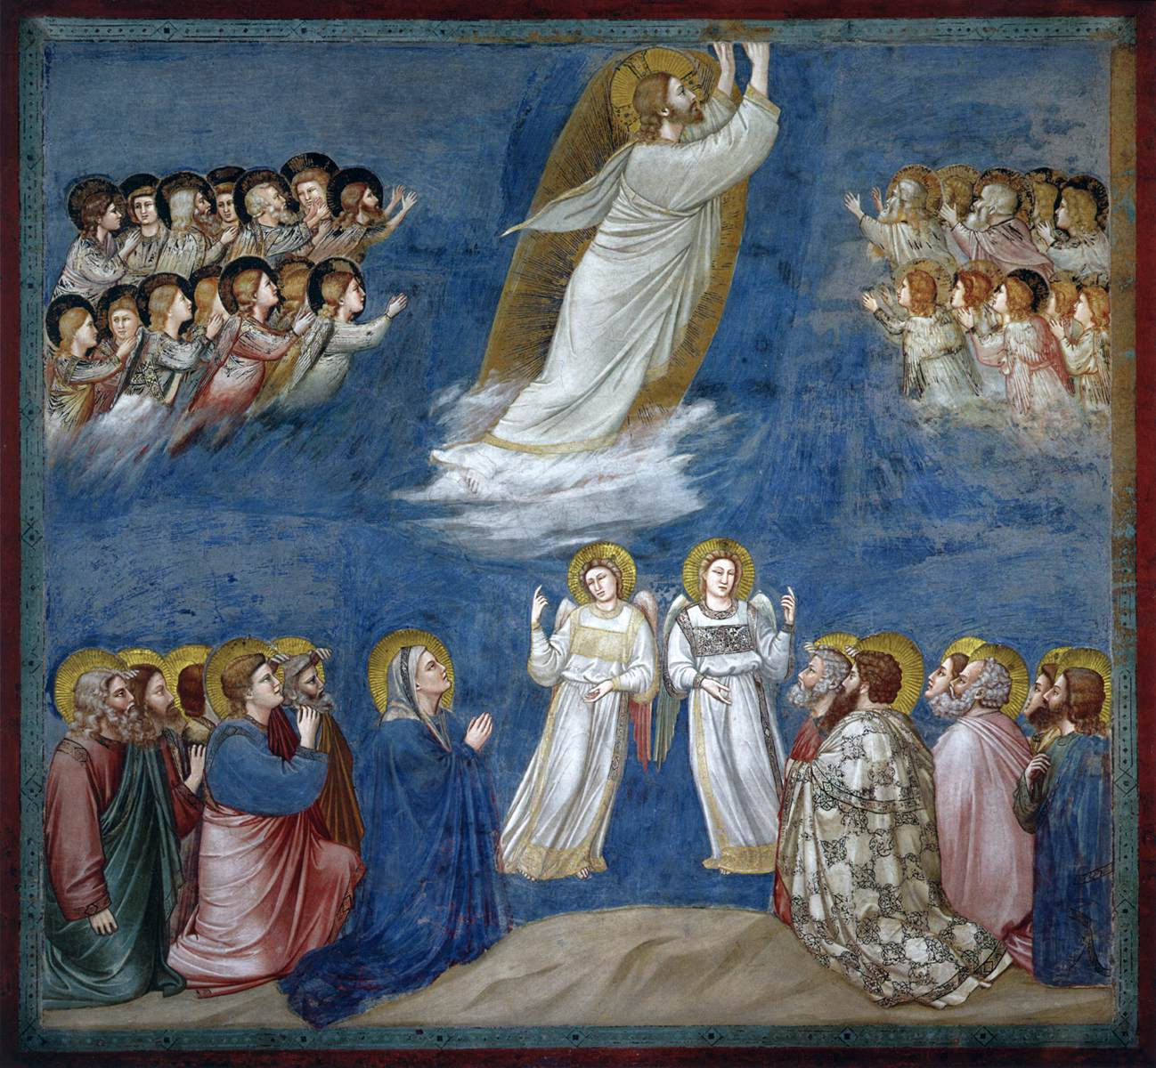



ASCENSION & PENTECOST
The journey through art and scripture for individual and group meditation.

Slide 2
Ascension Day.
Giotto.
The Ascension of Christ.
c.1304-06.
Fresco.
Scrovegni (Arena) Chapel,
Padua, Italy.
Acts 1:8-11.

Slide 3
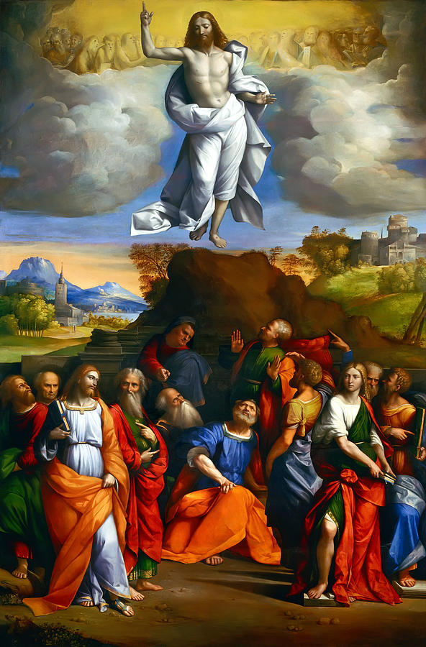
Ascension Day
Garofalo,
Ascension of Christ,
1510-20.
Galleria Nazionale d'Arte Antica,
Rome.
Acts 1:8-11.

Slide 4
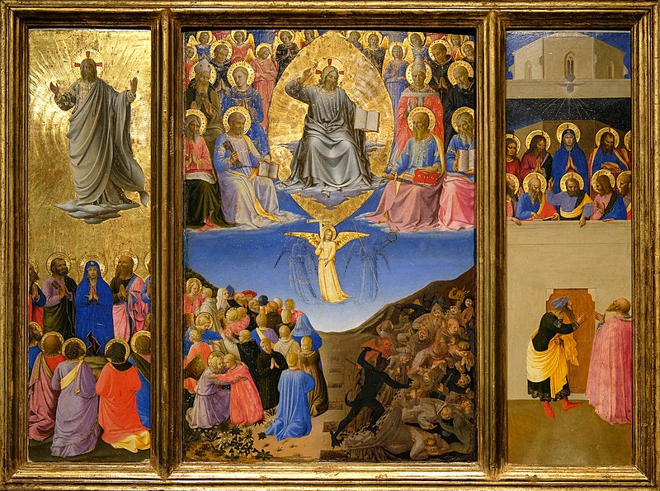
Fra Angelico, ‘The Ascension of Christ, The Last Judgement, Pentecost’. (Corsini Triptych) 1447-1448. Gardner Museum, Boston, Massachusetts, USA. Acts 2: 1-13

Slide 5
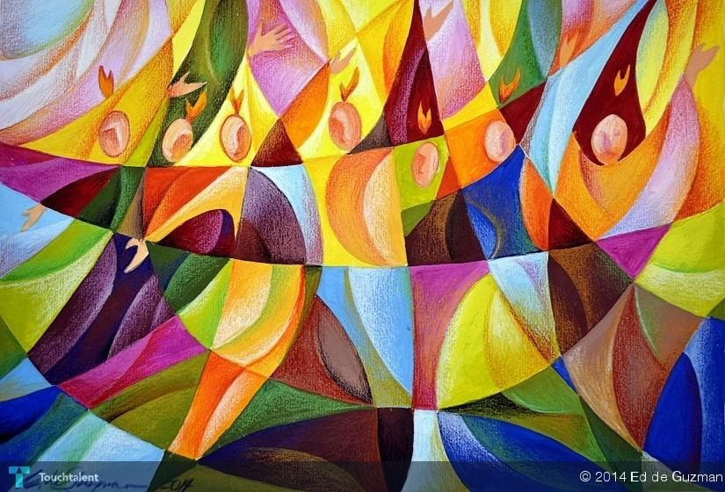
Edgardo de Guzman, Pentecost, 2014. Private Collection Acts 2: 1-13

