Slide 1
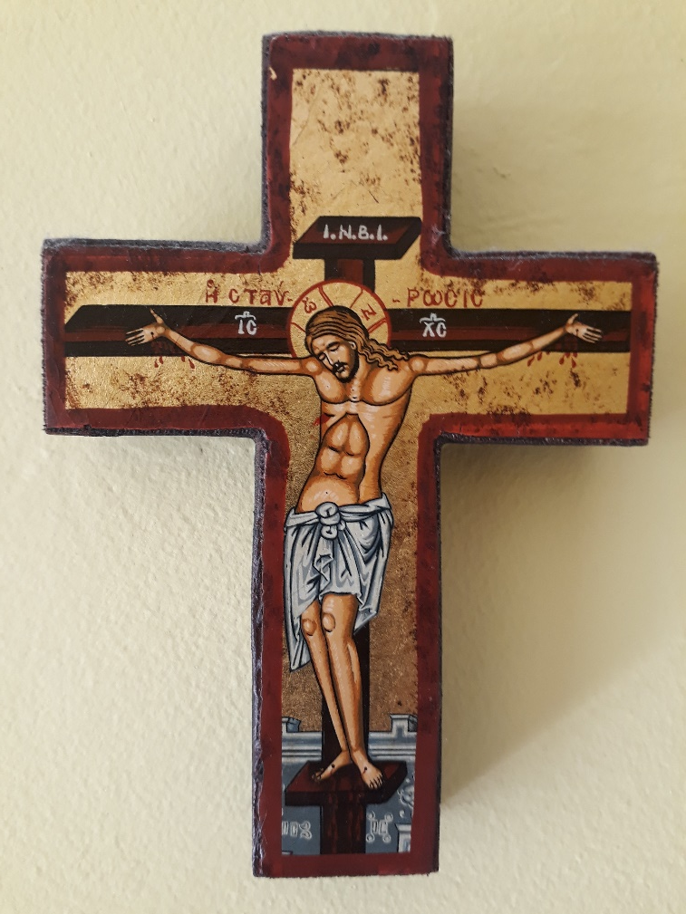



OUR EASTER JOURNEY
Through Art, Scripture and Meditation.
The Painters’ Path from Palm Sunday
to the Second Sunday after the Resurrection.

Slide 2
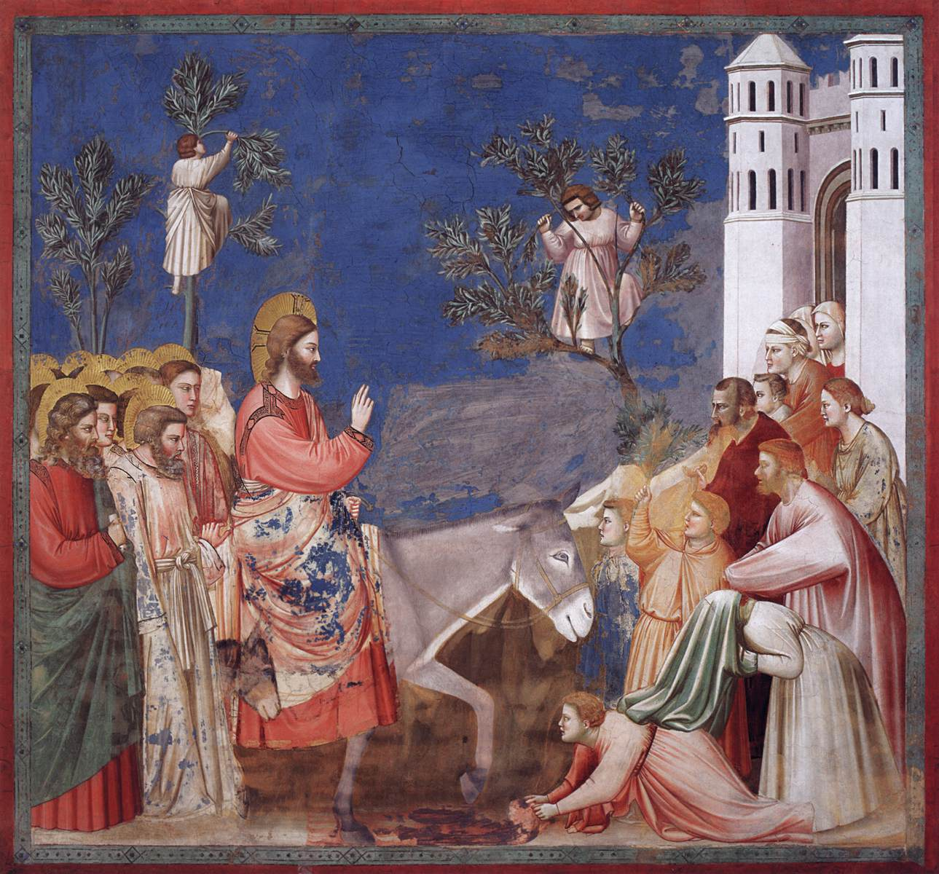
Palm Sunday.
The Entry into Jerusalem.
Giotto.
c.1304-06.
Fresco.
Scrovegni (Arena) Chapel,
Padua, Italy.
Matthew 21: 1-11.

Slide 3
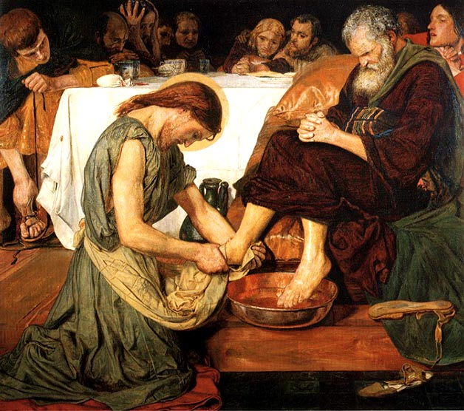
Maundy Thursday
Jesus Washing Peter’s Feet.
Ford Madox Brown.
1852-6.
Tate Britain
John 13: 1-38.

Slide 4
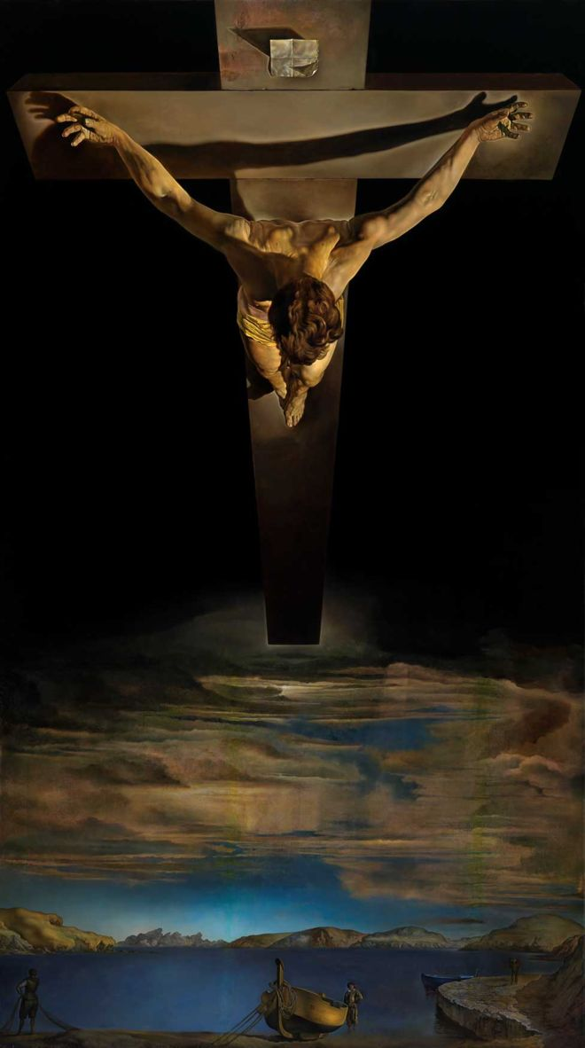
Good Friday.
Christ of St John of the Cross.
Salvador Dali.
1951.
Kelvingrove Art Gallery
& Museum, Glasgow.
John 18:1-19:42.

Slide 5
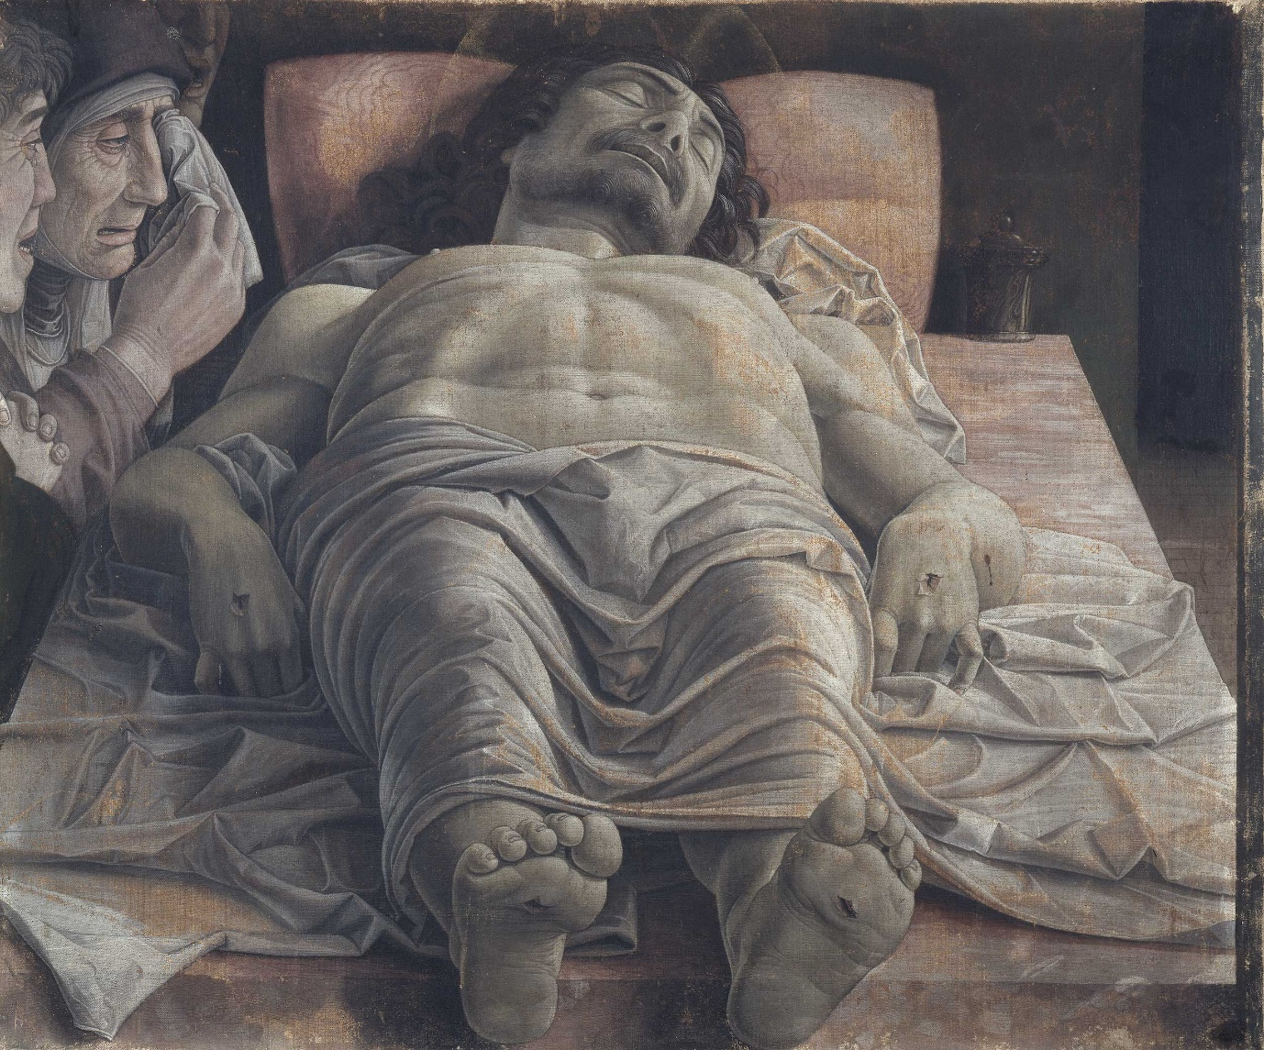
Holy Saturday.
Lamentation over the Dead Christ.
Andrea Mantegna.
c.1483.
Pinacoteca di Brera, Milan.
Mark 15:42–47.

Slide 6
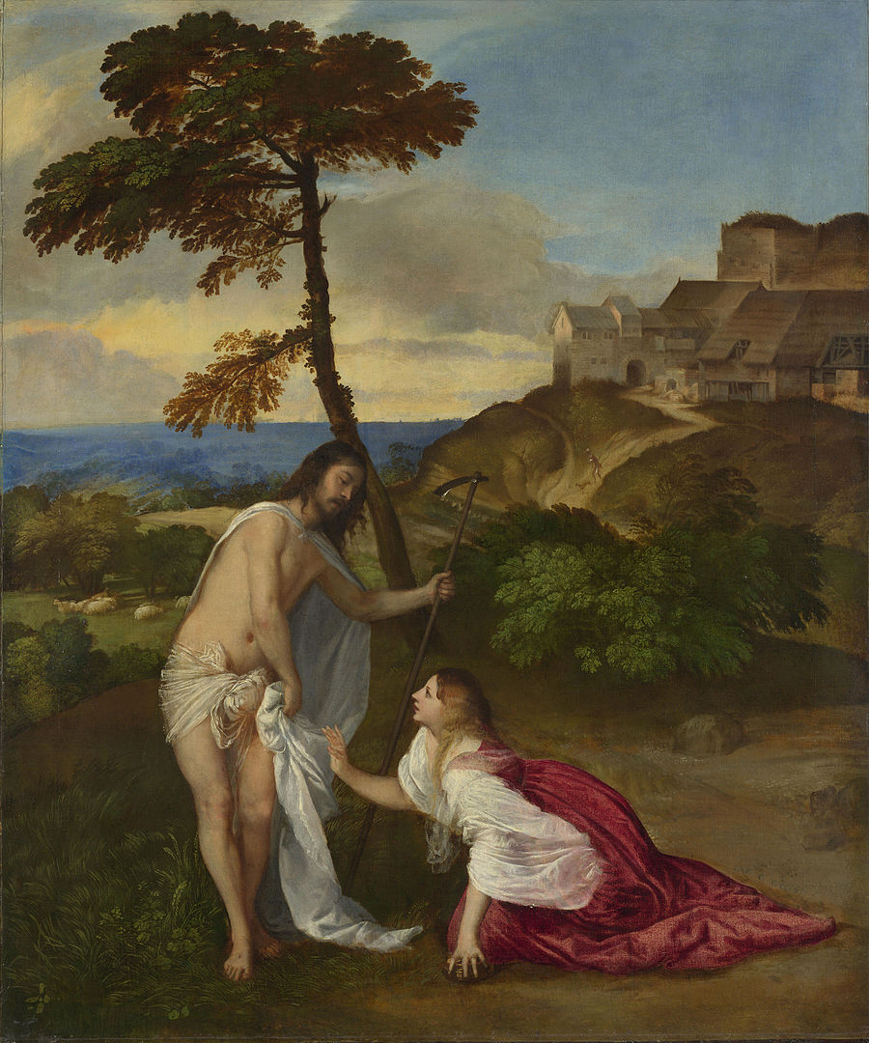
Easter Sunday.
Resurrection
(Noli Me Tangere).
Titian.
c.1514.
National Gallery, London.
John 20: 1-18.

Slide 7
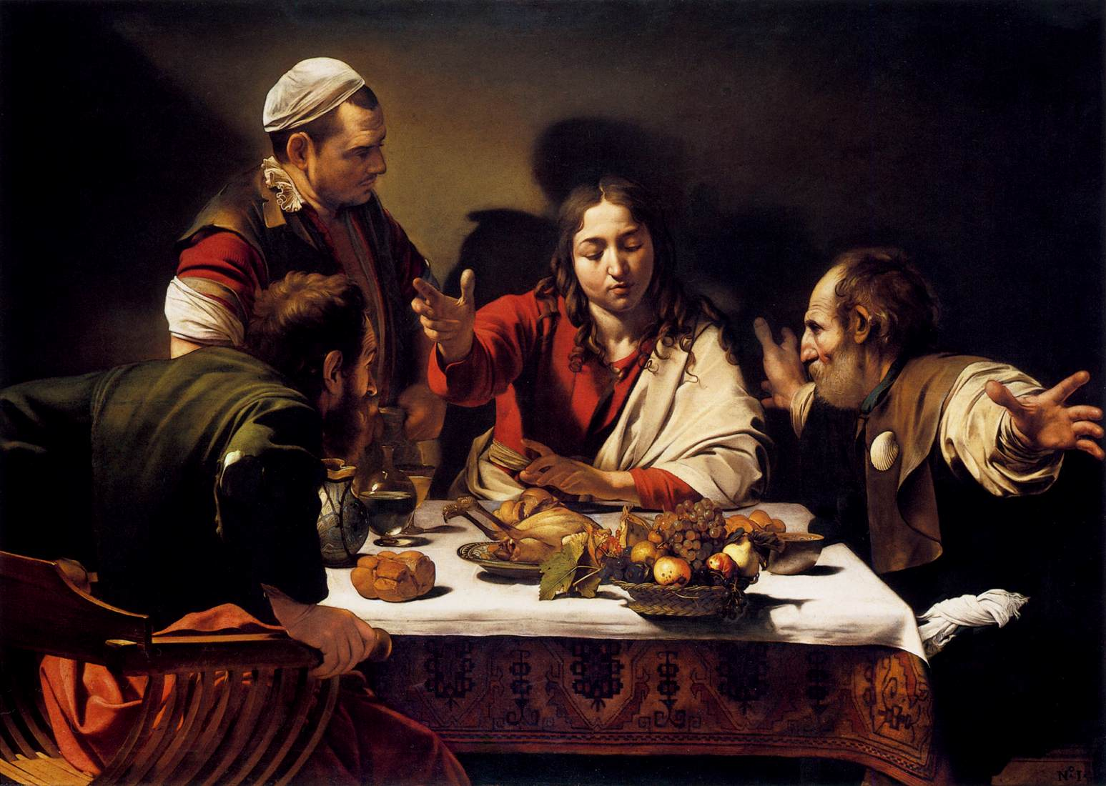
Easter Monday.
The Supper at Emmaus.
Caravaggio.
1601.
National Gallery,
London.
Luke 24: 13-35.

Slide 8
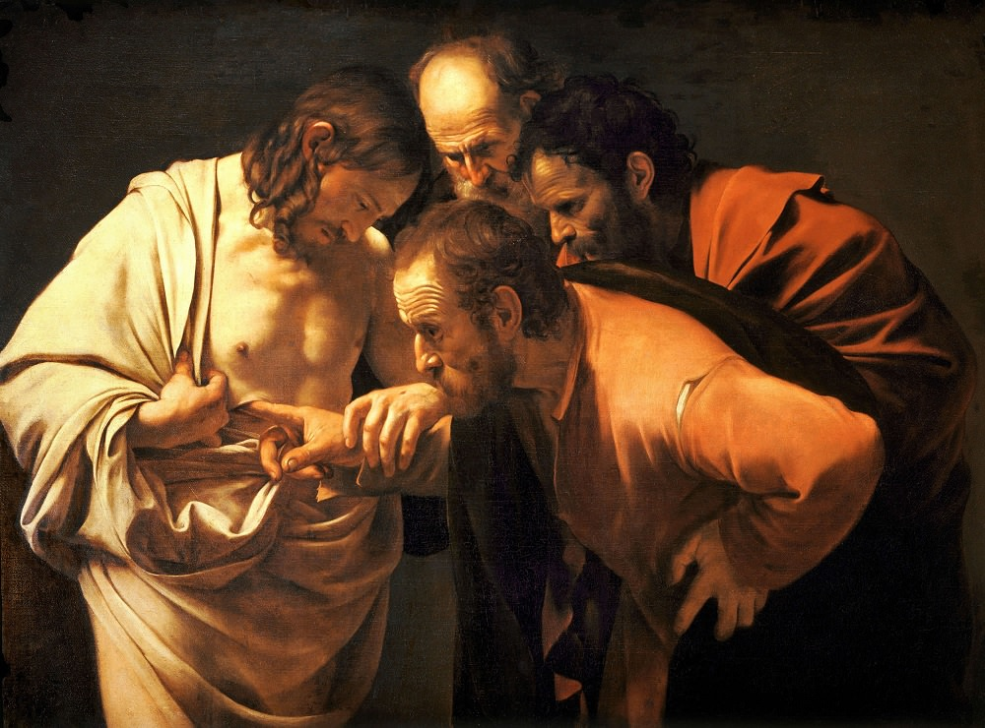
Sunday after the Resurrection.
The Incredulity of
St. Thomas.
Caravaggio.
1601-02.
Sanssouci, Potsdam, Germany.
John 20: 24-29.

