Slide 1
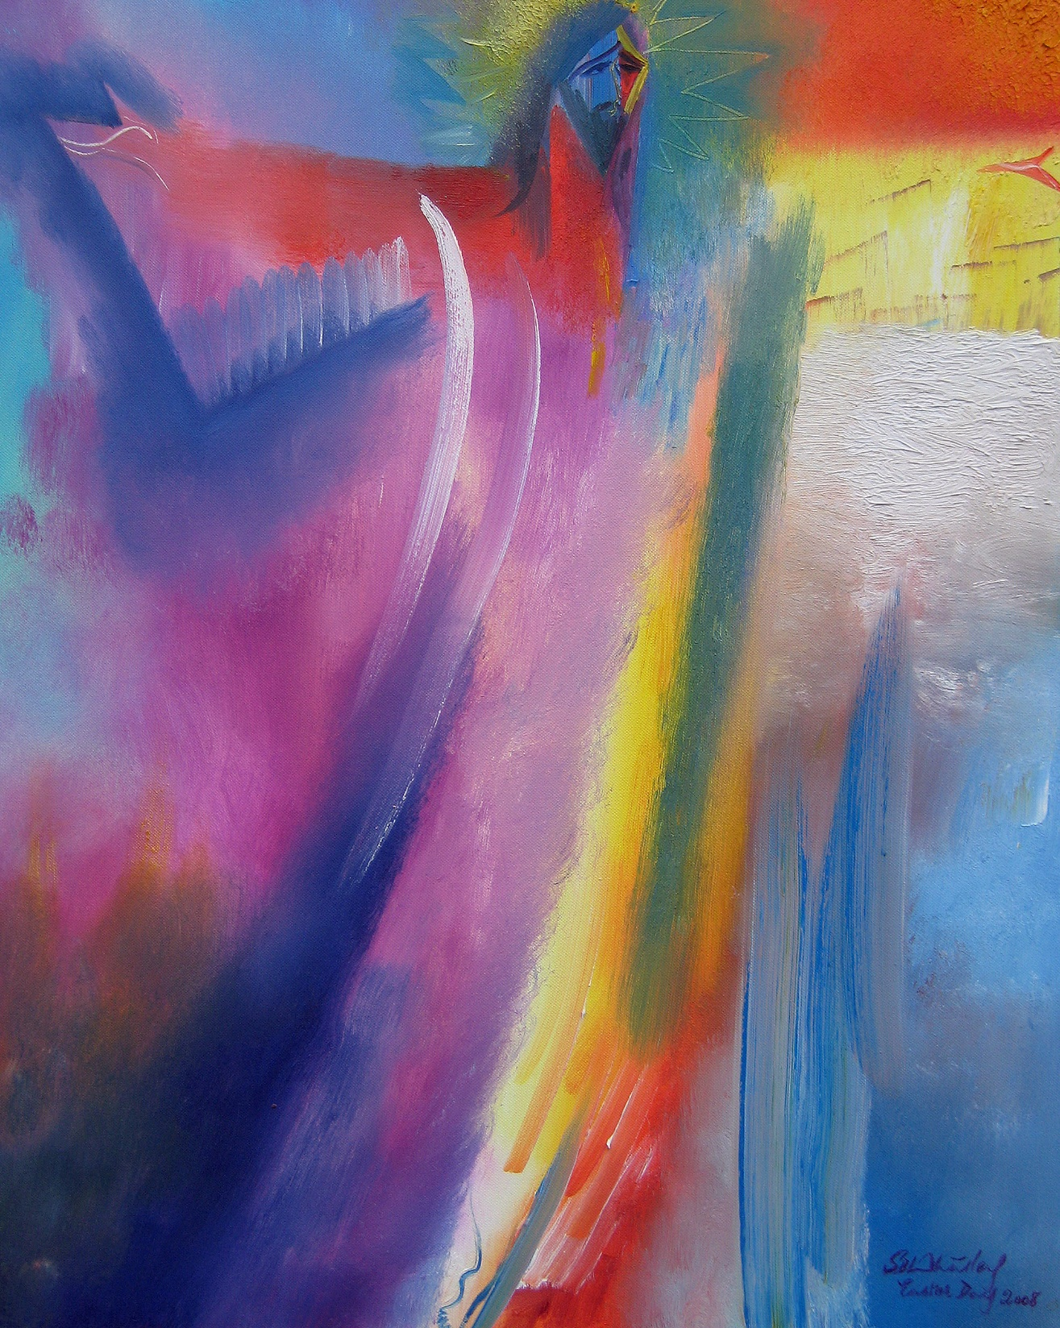
OUR EASTER JOURNEY The Painters’ Path: Palm Sunday to Pentecost

Slide 2
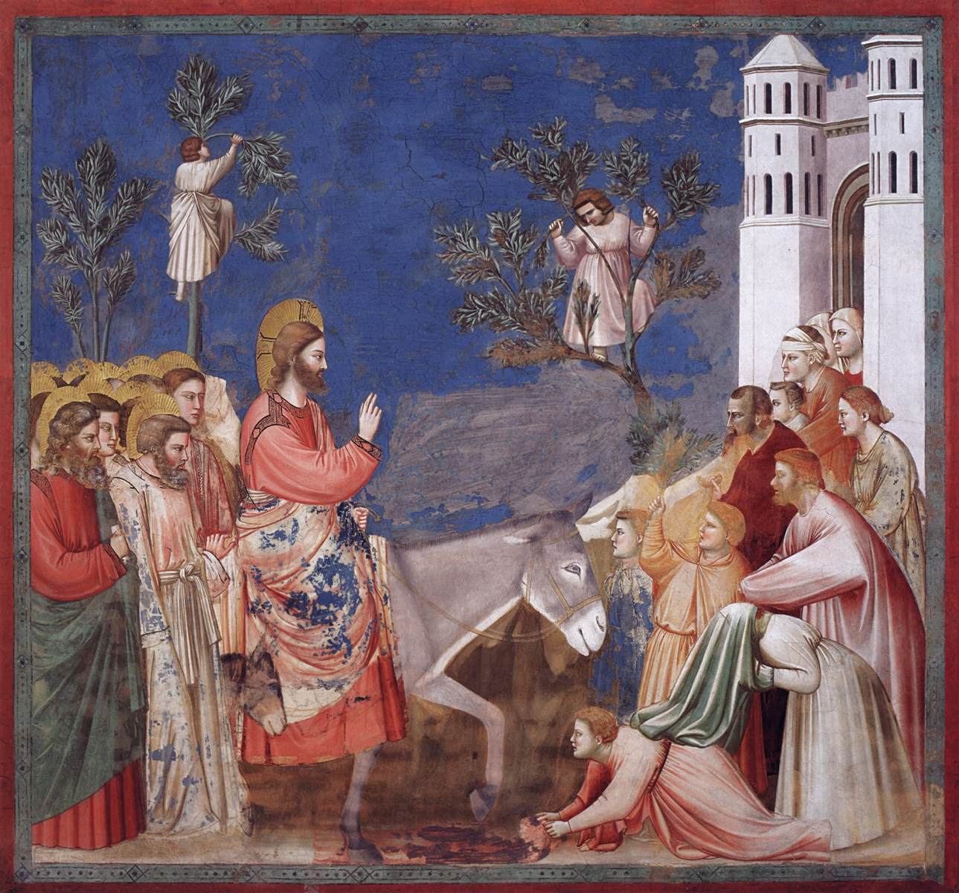
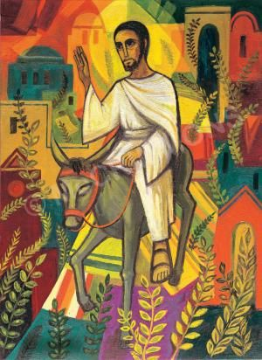
Palm Sunday - Matthew 21:1-11.
The Entry into Jerusalem. Giotto. c.1304-06. Benedictine Sisters of Turvey Abbey Fresco. Scrovegni (Arena) Chapel, Padua, Italy.

Slide 3
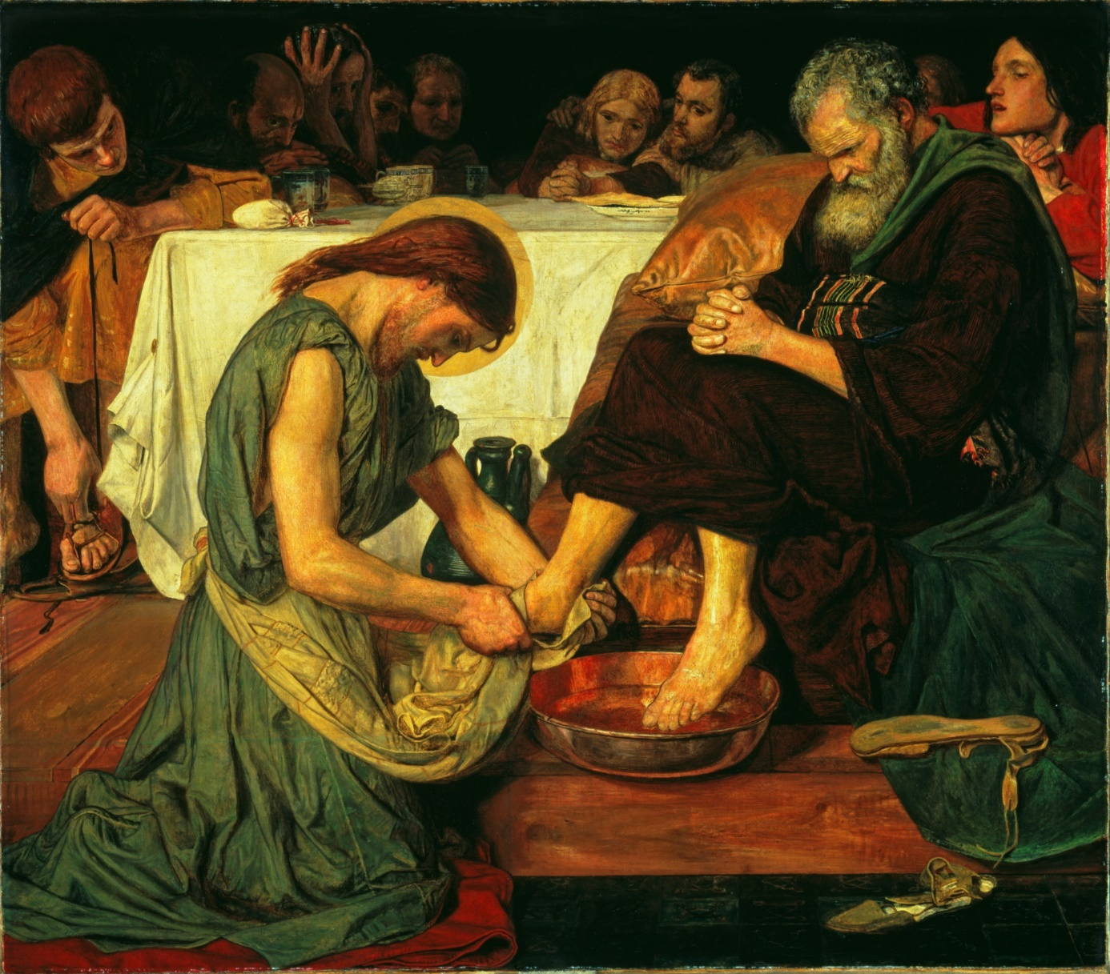
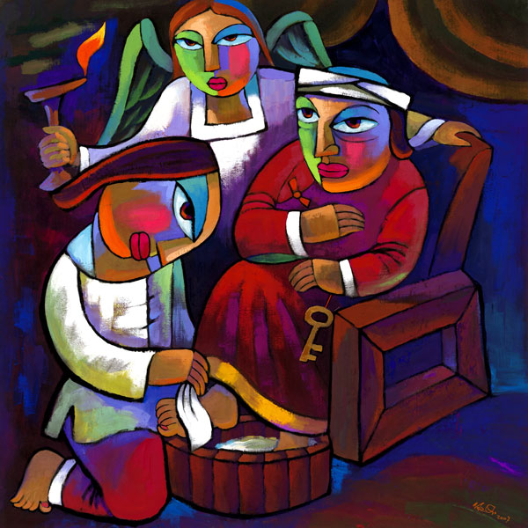
Maundy Thursday - John 13:1-38.
Jesus Washing Peter’s Feet. Ford Madox Brown.
1852-6. Tate Britain, London
Washing Disciples’ Feet. He Qui.

Slide 4
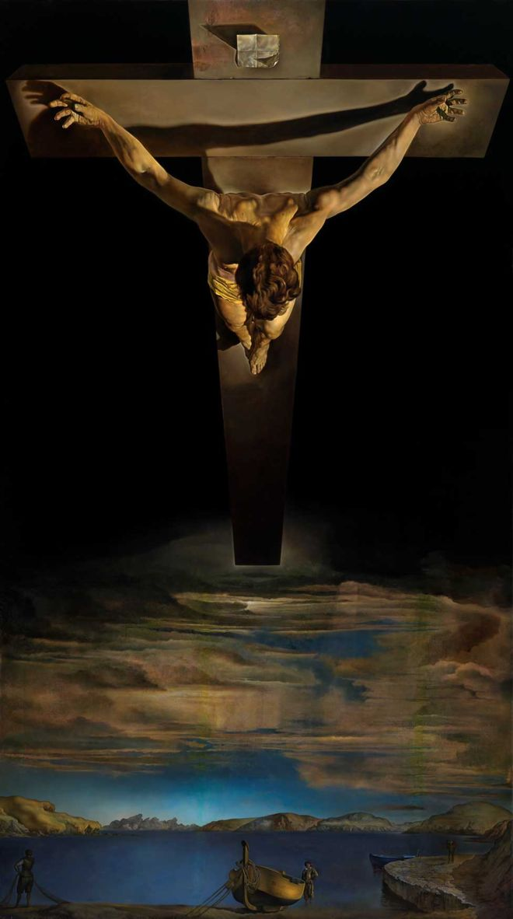
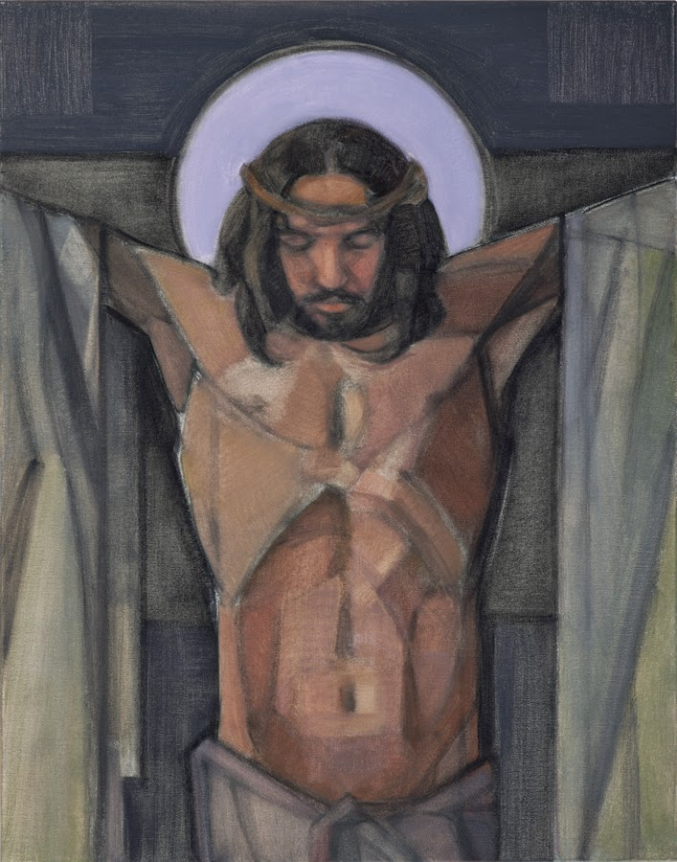
Good Friday
John 18:1-19:42.
Christ of St John of the Cross. Salvador Dali.
1951. Kelvingrove Art Gallery & Museum, Glasgow.
‘Jesus Dies on the Cross’ by Janet McKenzie

Slide 5
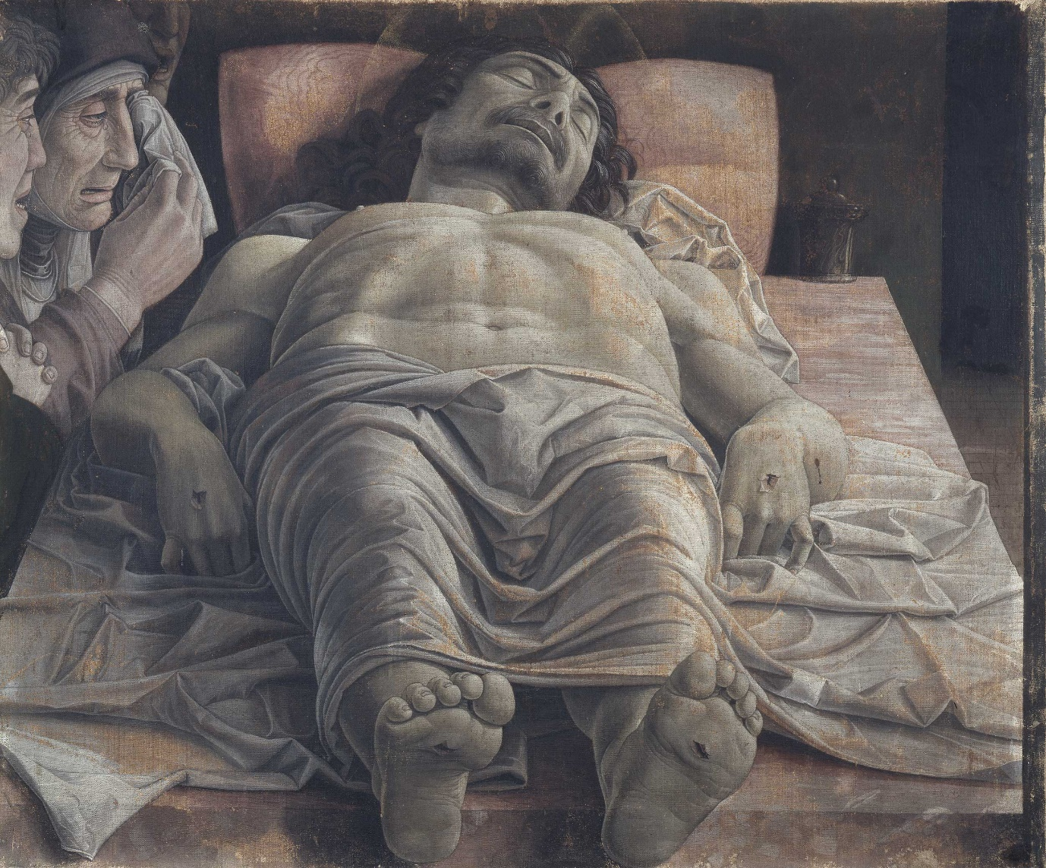
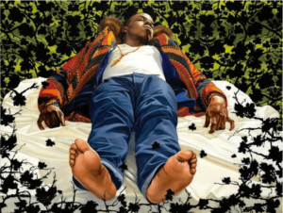
Holy Saturday - Mark 15:42–47.
Lamentation over the Dead Christ. Andrea Mantegna.
c.1483. Pinacoteca di Brera, Milan.
Lamentation over the Dead Christ. Kehinde Wiley/Le Petit Palais

Slide 6
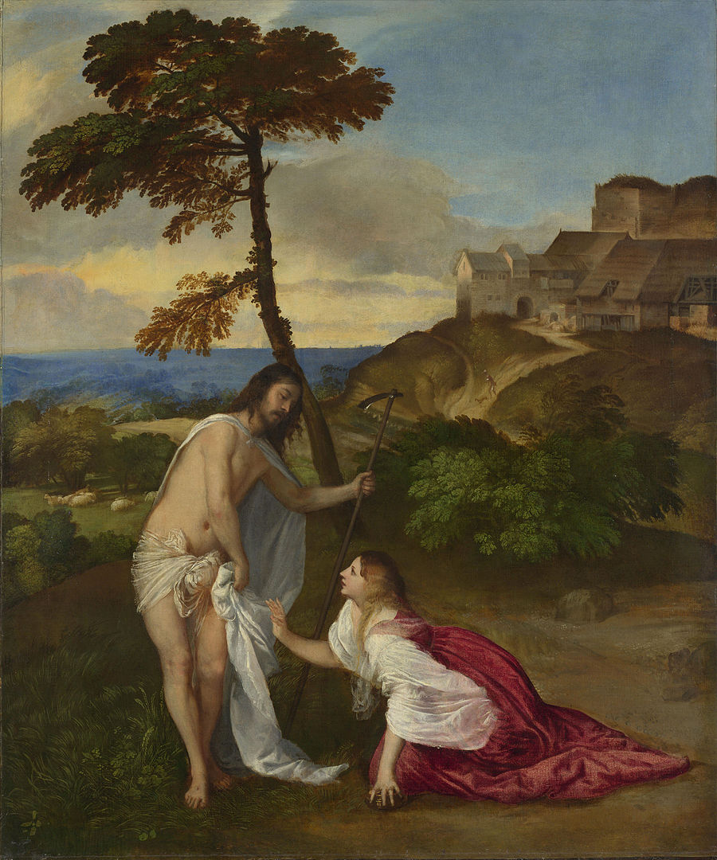
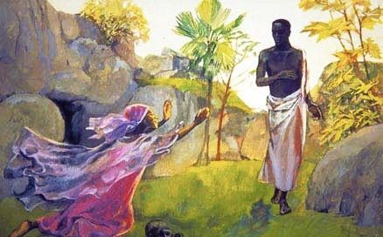
Easter Sunday - John 20:1-18.
Resurrection (Noli Me Tangere). Titian.
c.1514. National Gallery, London.
Resurrection (Noli Me Tangere). Jesus Mafa – Cameroon.

Slide 7
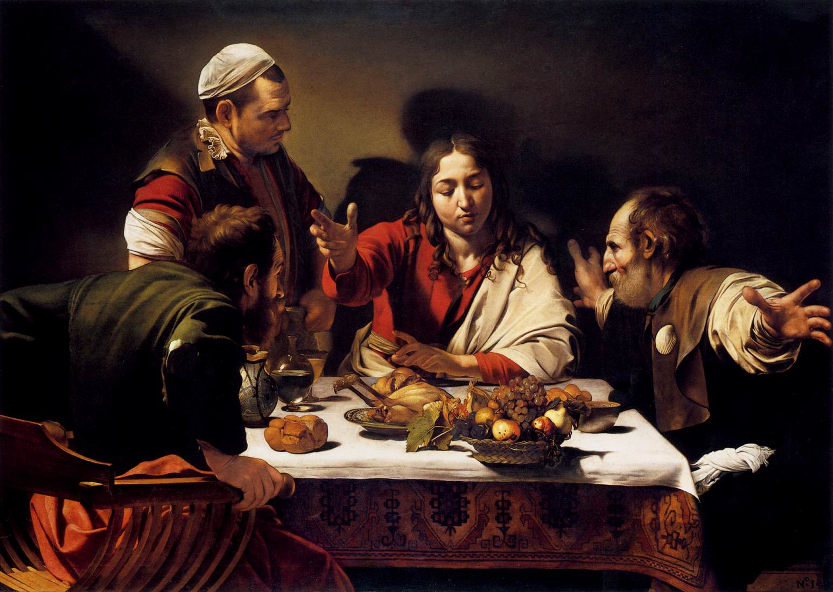
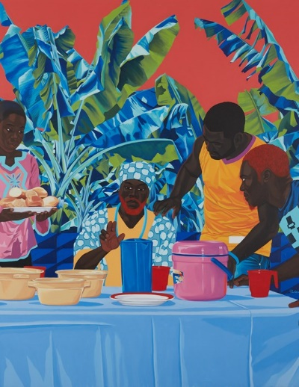
Easter Monday - Luke 24:13-35
The Supper at Emmaus. Caravaggio. 1601. National Gallery, London.
'Le souper a Penja‘. Marc Padeu. 2019.

Slide 8
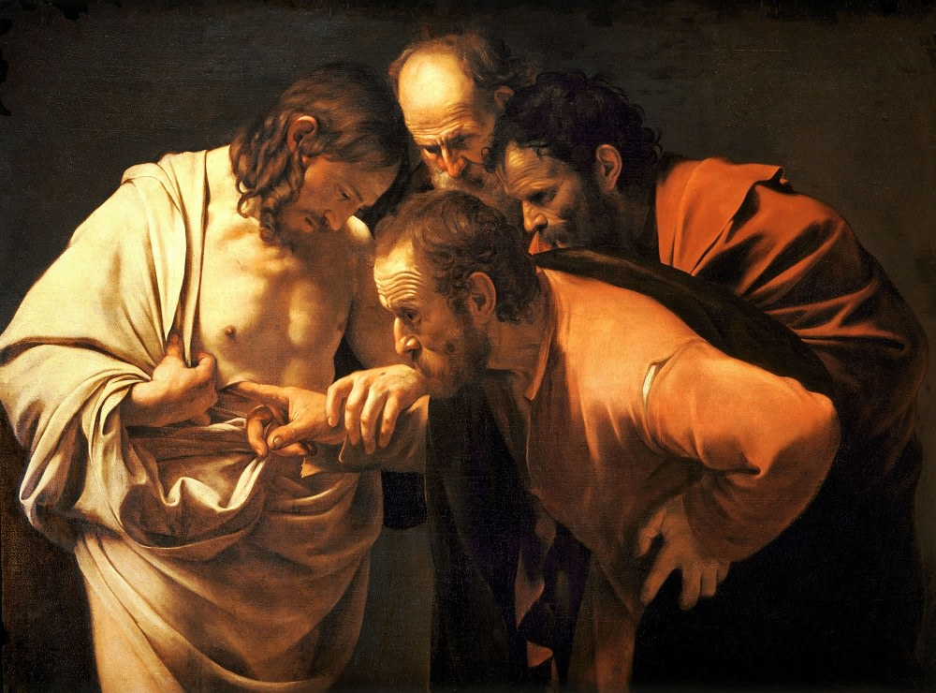
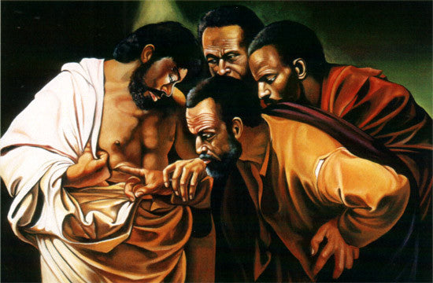
Sunday after the Resurrection – John 20:24 – 29.
The Incredulity of St. Thomas. Caravaggio.
1601-02. Sanssouci, Potsdam, Germany.
By Faith, Not By Sight. Alix Beaujour

Slide 9
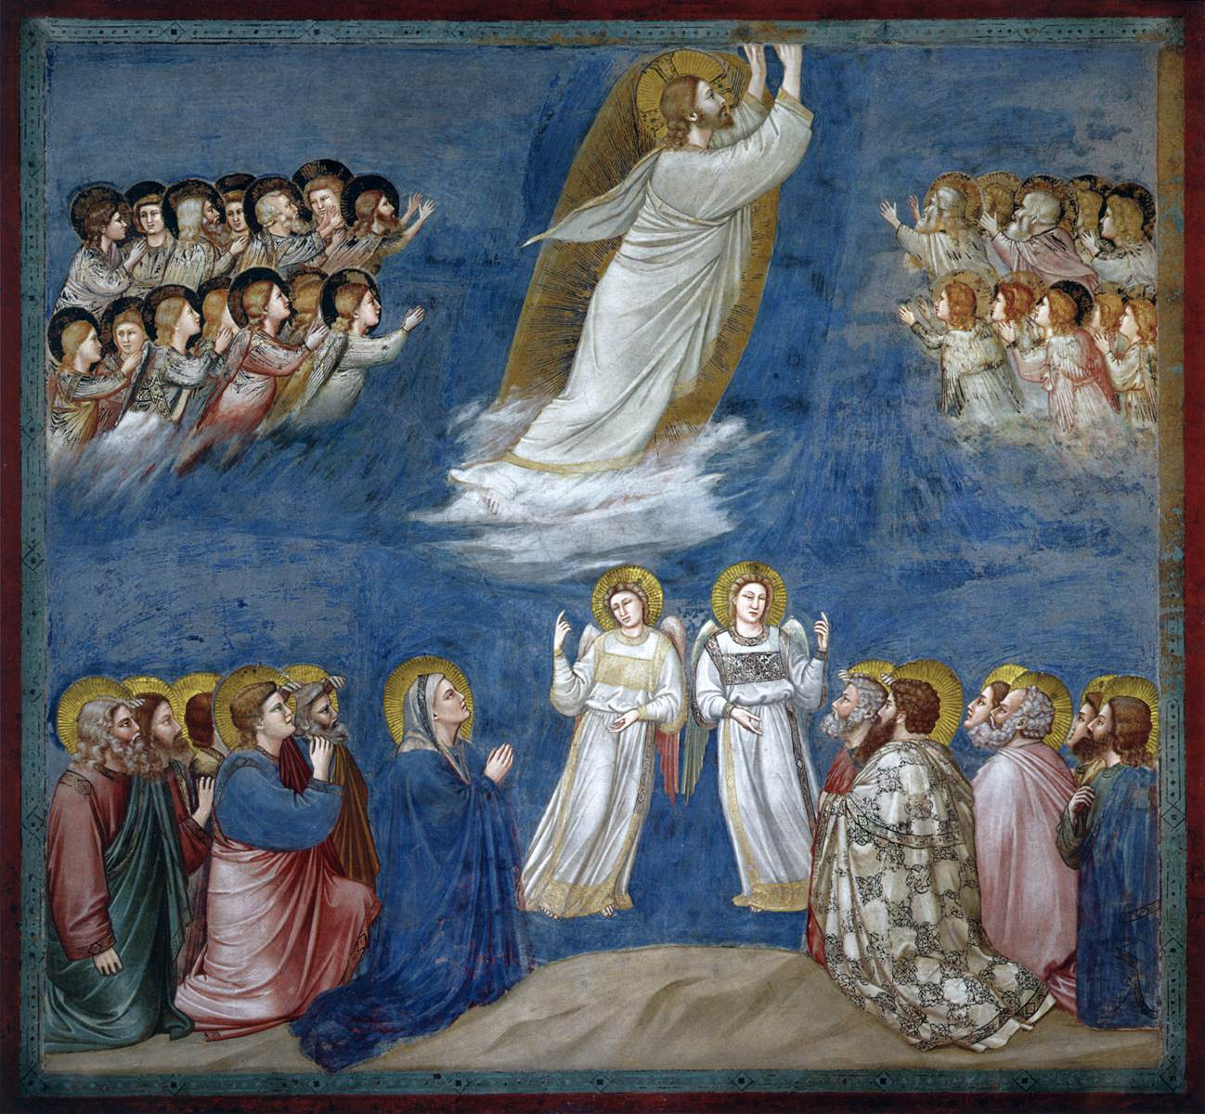
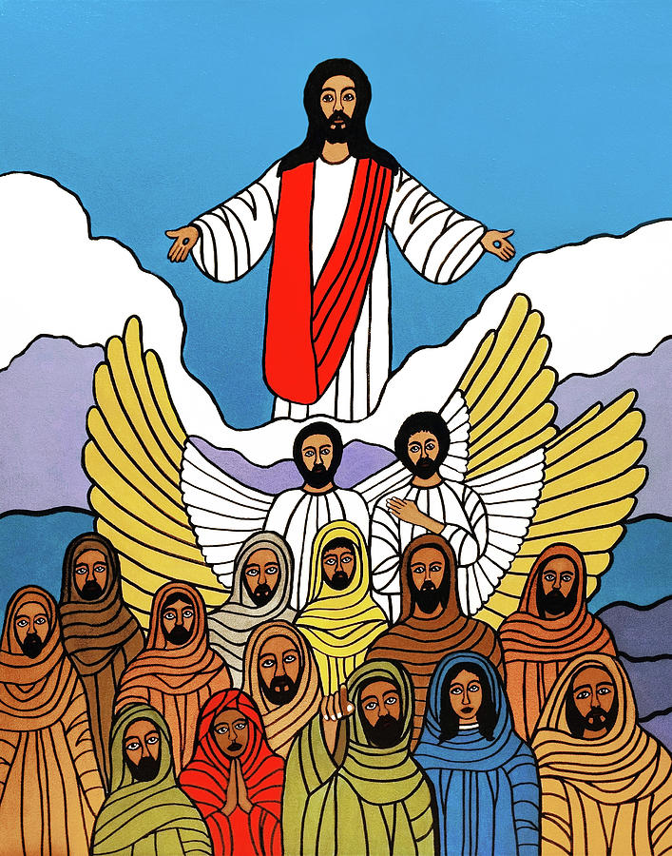
Ascension Day - Acts 1:8-11.
The Ascension of Christ. Giotto. c.1304-06. Ascension of Jesus. E.J. Lefavour Fresco. Scrovegni (Arena) Chapel, Padua, Italy. 2019. USA.

Slide 10
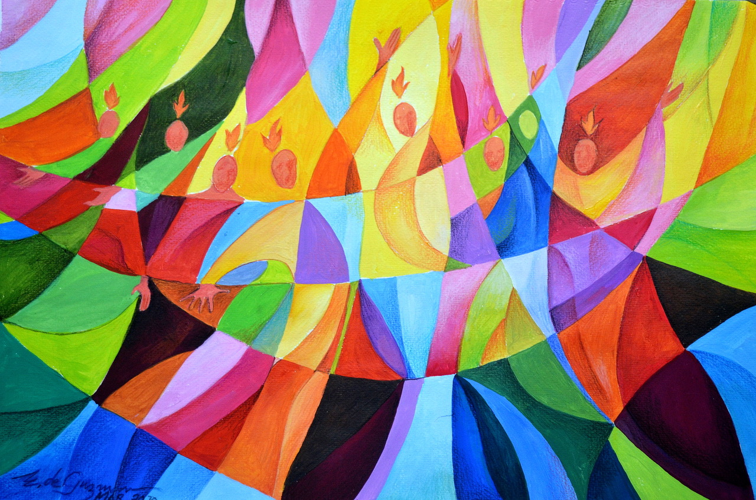
Pentecost.
Edgardo de Guzman.
2014.
Private Collection
Acts 2:1-13

