Slide 1
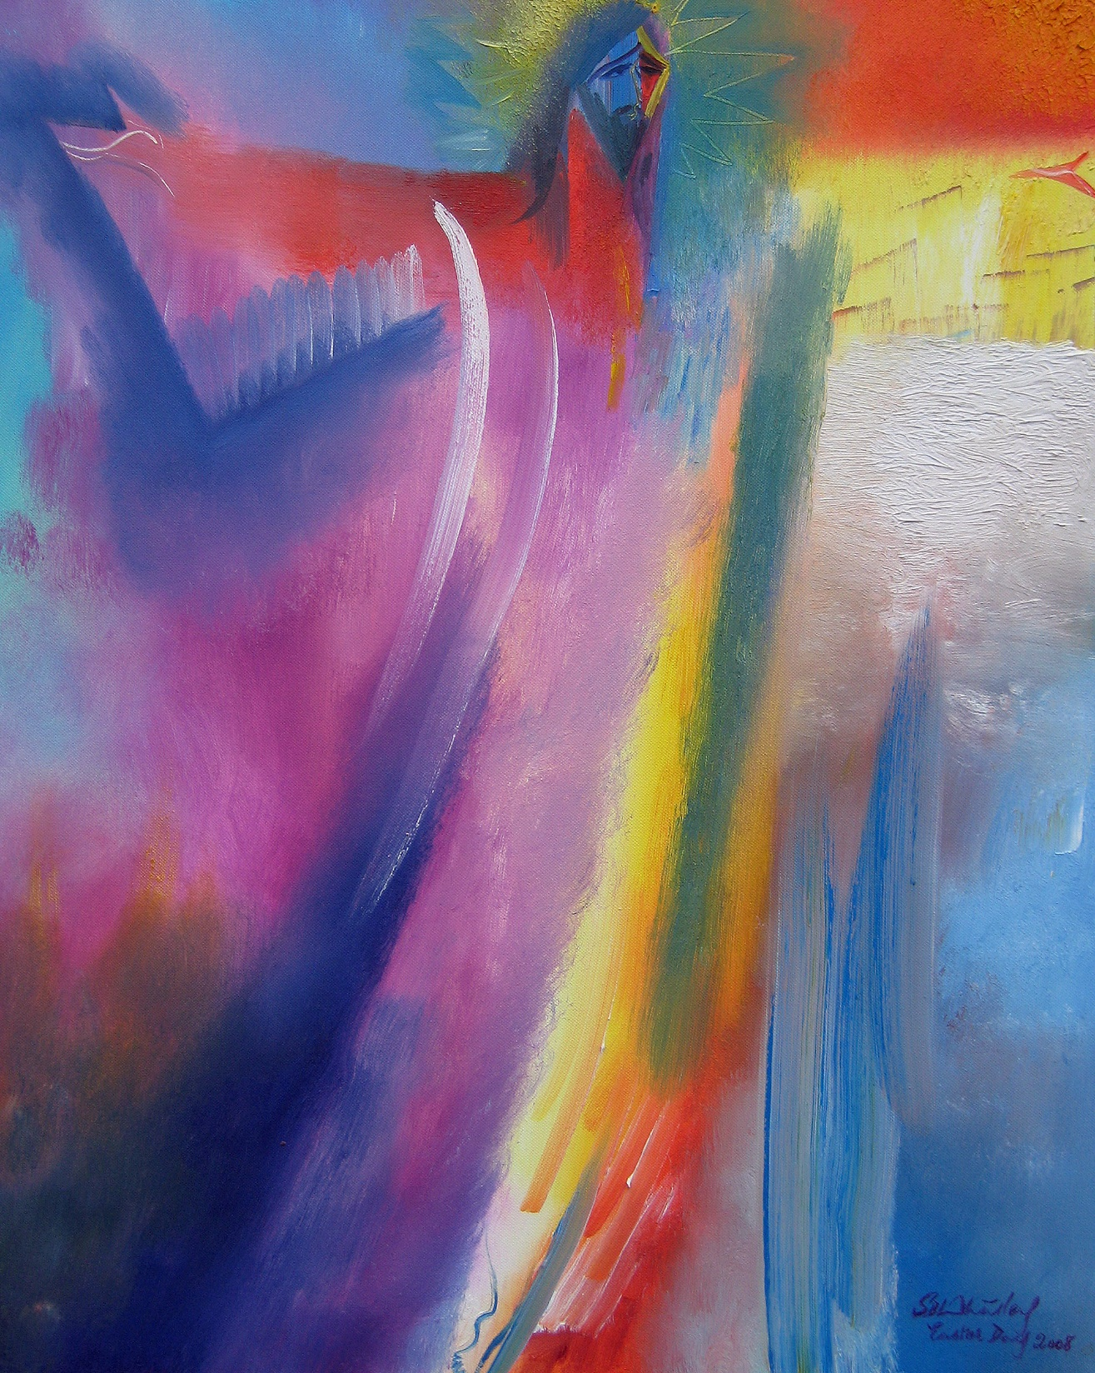
OUR EASTER JOURNEY The Painters’ Path: Palm Sunday to Pentecost

Slide 2
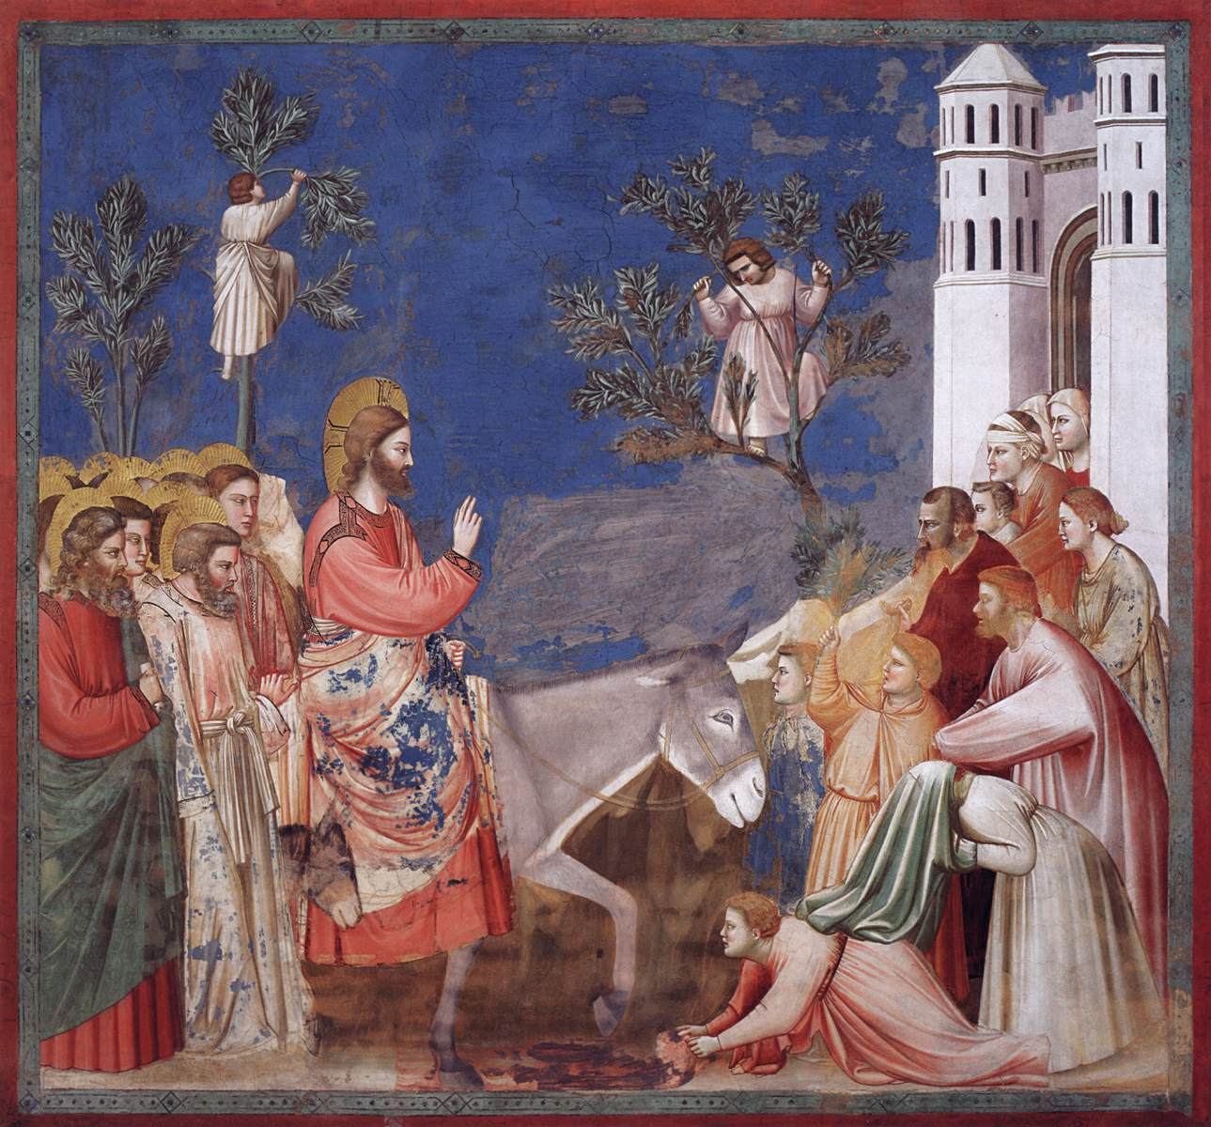
Palm Sunday.
The Entry into Jerusalem. Giotto. c.1304-06. Fresco. Scrovegni (Arena) Chapel, Padua, Italy.
Matthew 21: 1-11.

Slide 3
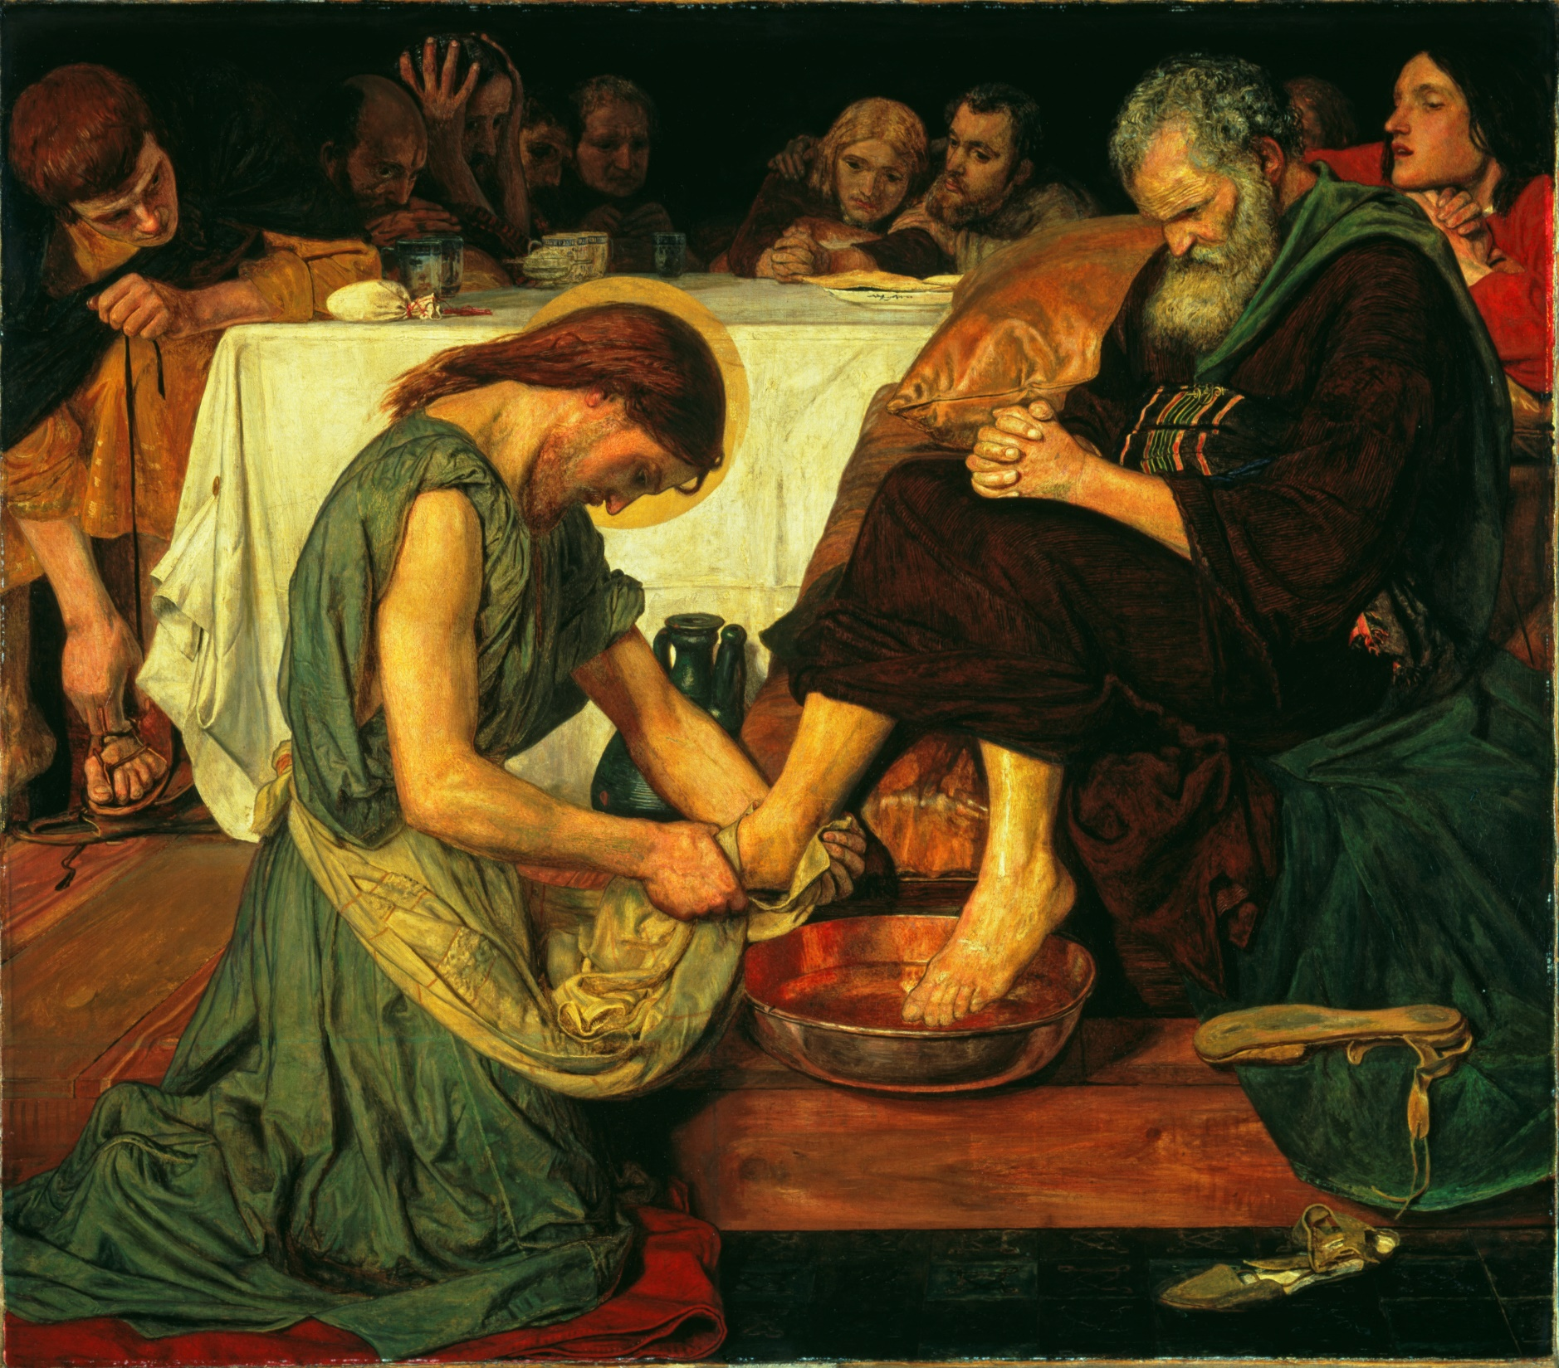
Maundy Thursday
Jesus Washing Peter’s Feet. Ford Madox Brown.
1852-6. Tate Britain
John 13: 1-38.

Slide 4
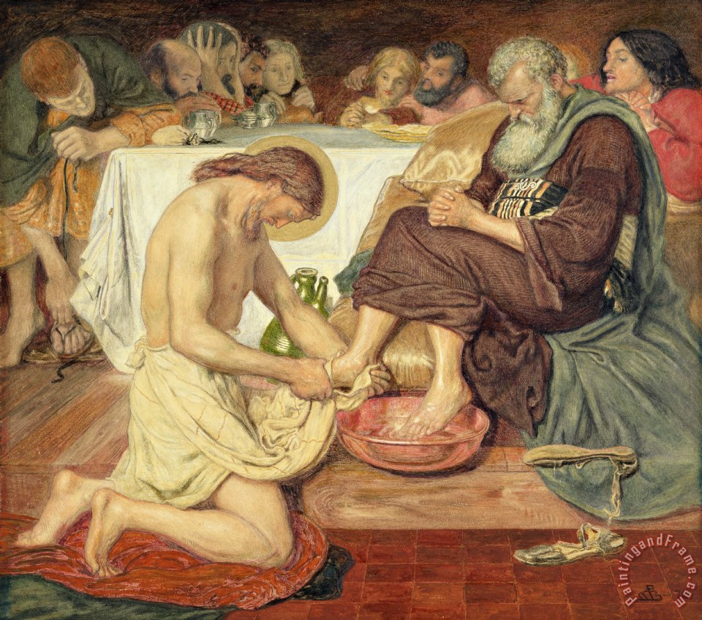
Maundy Thursday
Jesus Washing Peter’s Feet. Ford Madox Brown.
Original version

Slide 5
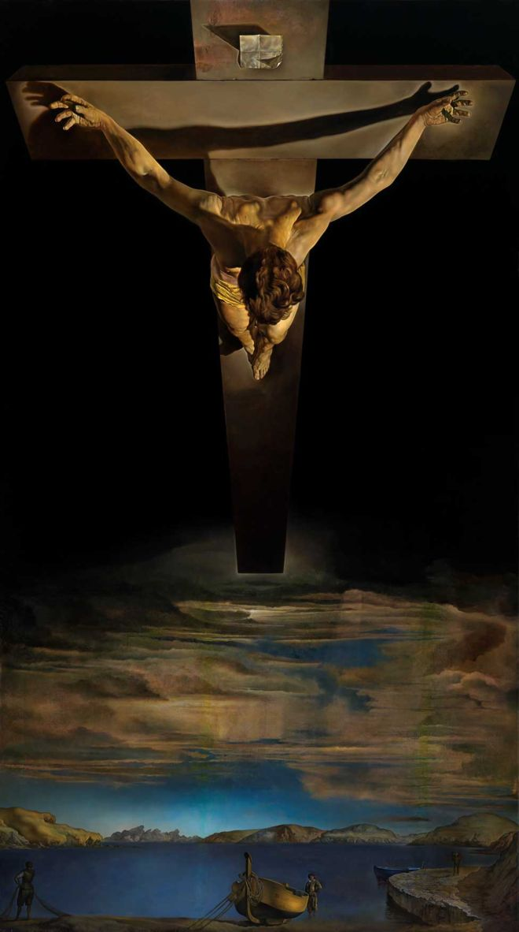
Good Friday.
Christ of St John of the Cross. Salvador Dali.
1951. Kelvingrove Art Gallery & Museum, Glasgow.
John 18:1-19:42.

Slide 6
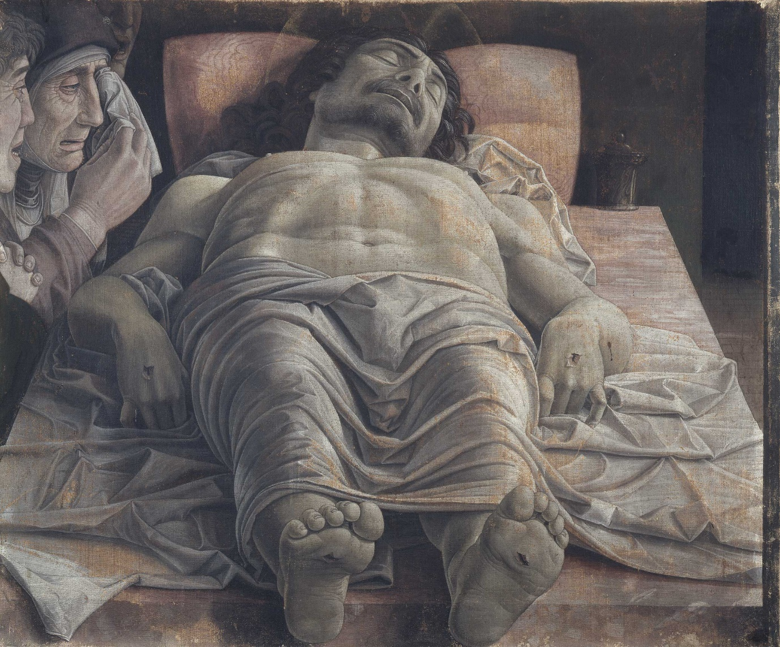
Holy Saturday.
Lamentation over the Dead Christ.
Andrea Mantegna.
c.1483. Pinacoteca di Brera, Milan.
Mark 15:42–47.

Slide 7
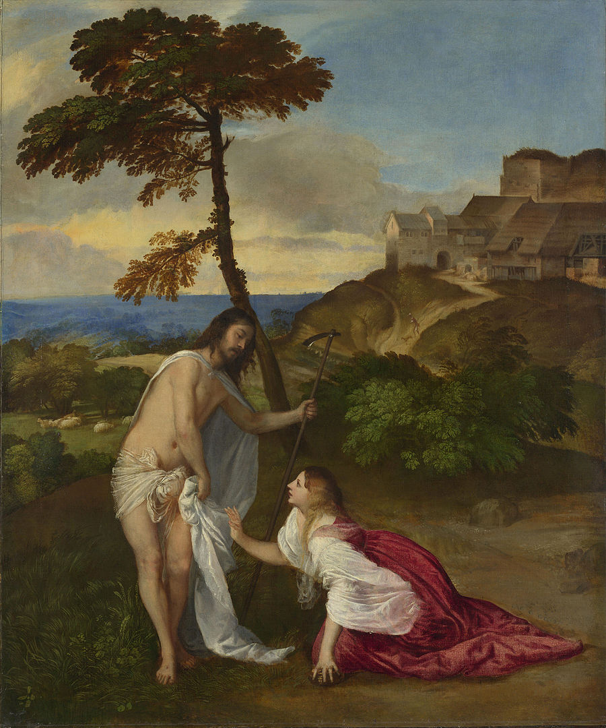
Easter Sunday.
Resurrection (Noli Me Tangere).
Titian.
c.1514. National Gallery, London.
John 20: 1-18.

Slide 8
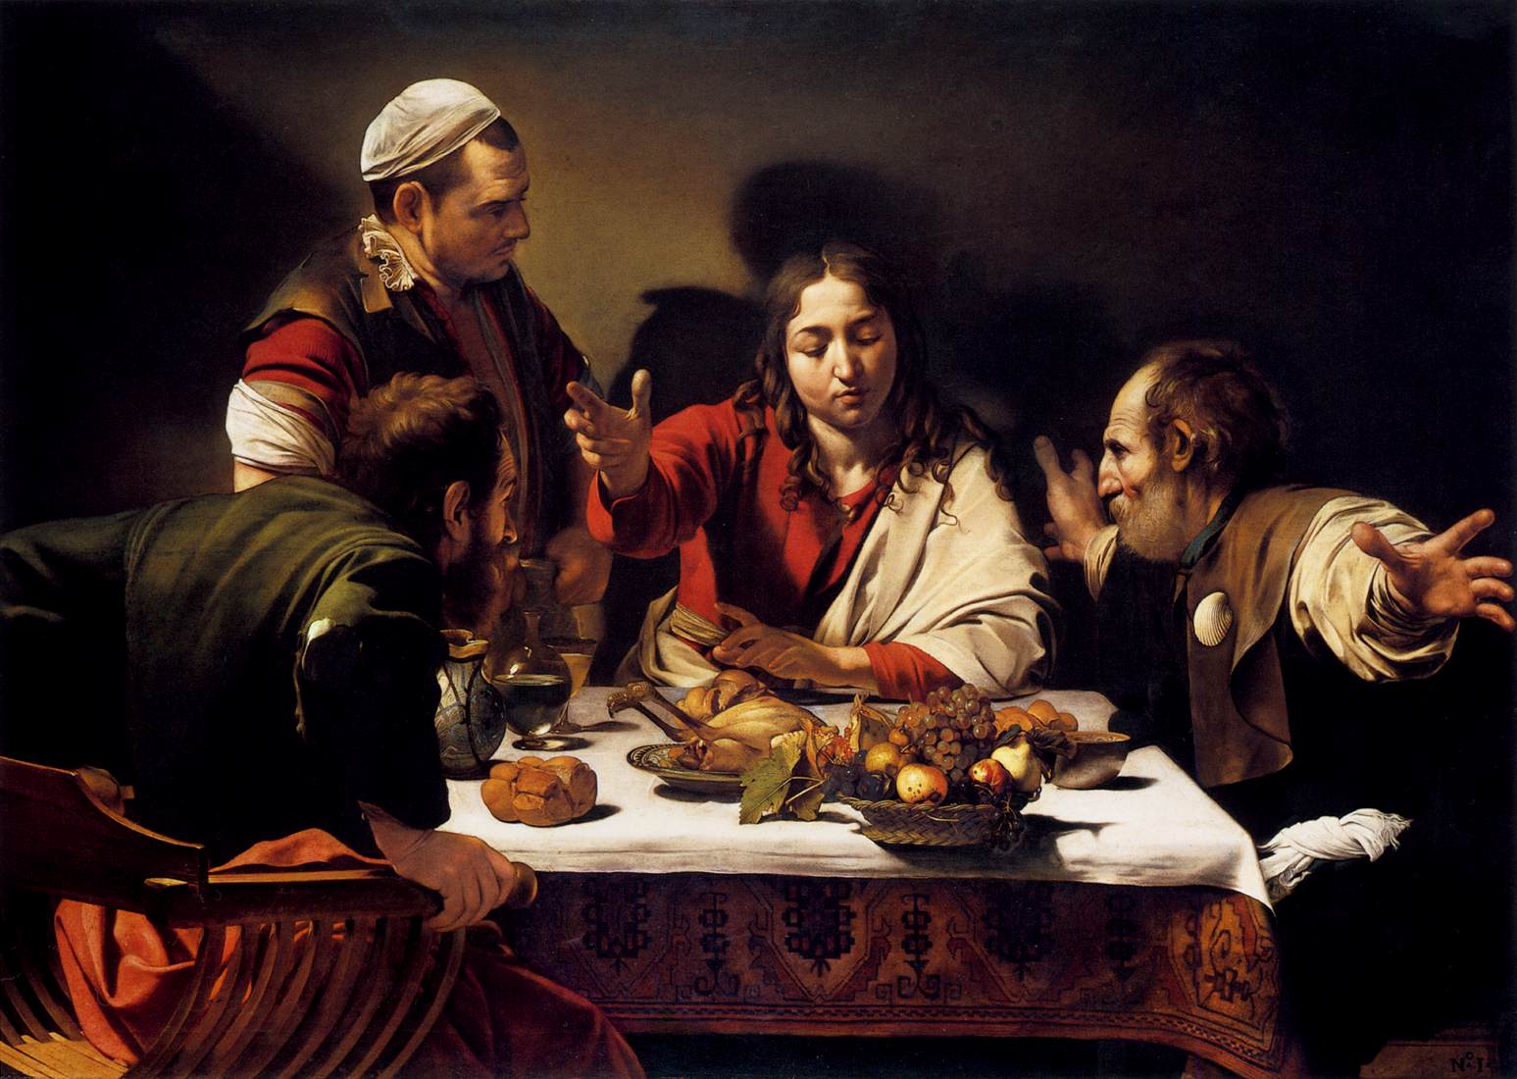
Easter Monday.
The Supper at Emmaus.
Caravaggio.
1601. National Gallery,
London.
Luke 24: 13-35.

Slide 9
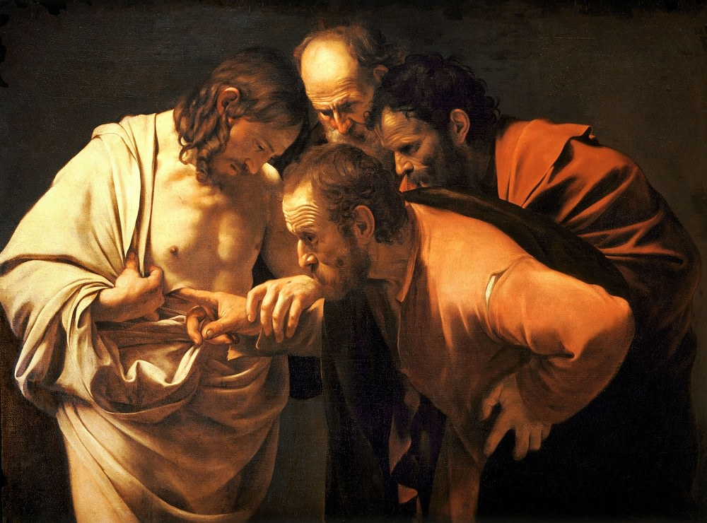
Sunday after the Resurrection.
The Incredulity of St. Thomas.
Caravaggio.
1601-02. Sanssouci, Potsdam, Germany.
John 20: 24-29.

Slide 10
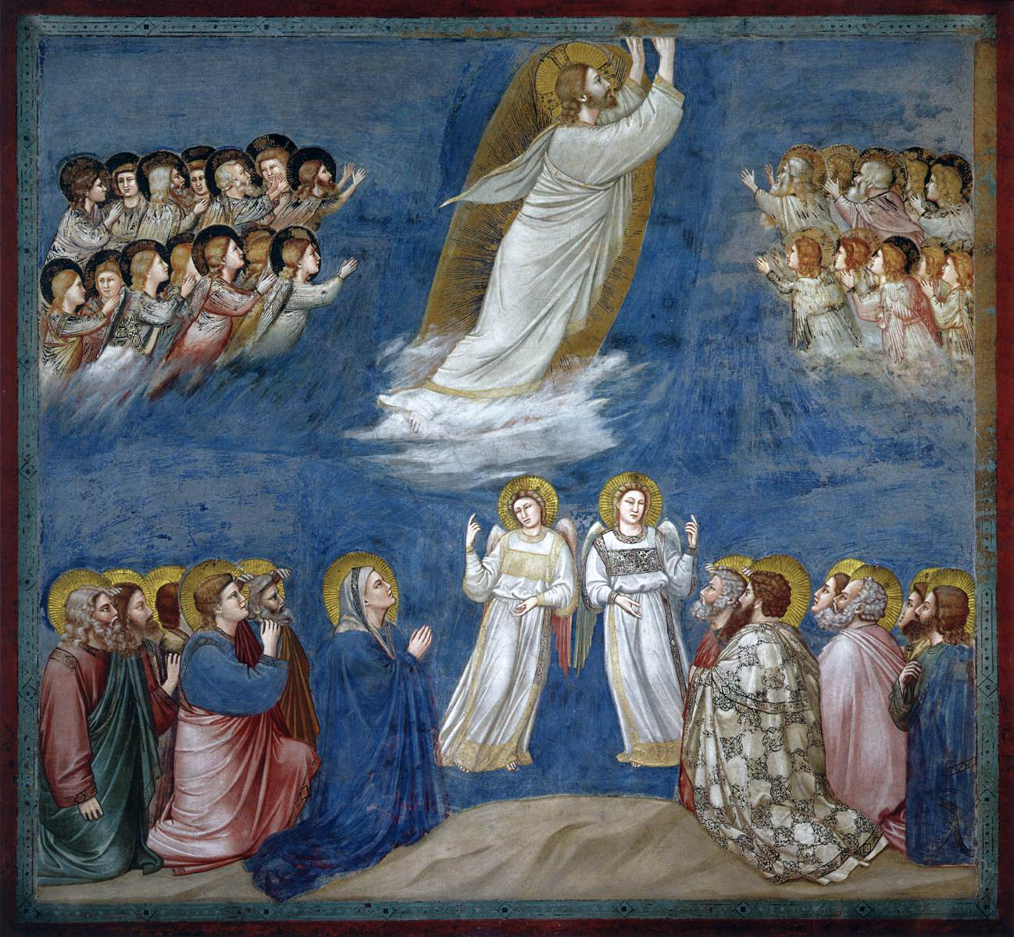
Ascension Day.
Giotto.
The Ascension of Christ. c.1304-06. Fresco. Scrovegni (Arena) Chapel, Padua, Italy.
Acts 1:8-11.

Slide 11
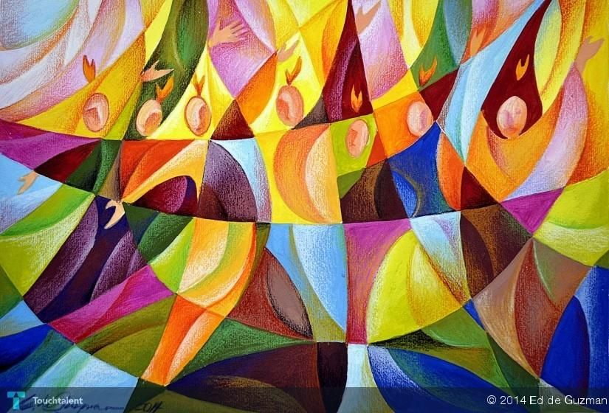
Pentecost.
Edgardo de Guzman.
2014.
Private Collection
Acts 2: 1-13

