Slide 1

Celebrate Creationtide: 1st September – 4th October
Scripture texts for Daily Prayer, Reflection & Action

Slide 2

1 Timothy 4:4
For everything created by God is good, and nothing is to be rejected if it is received with thanksgiving.

Slide 3
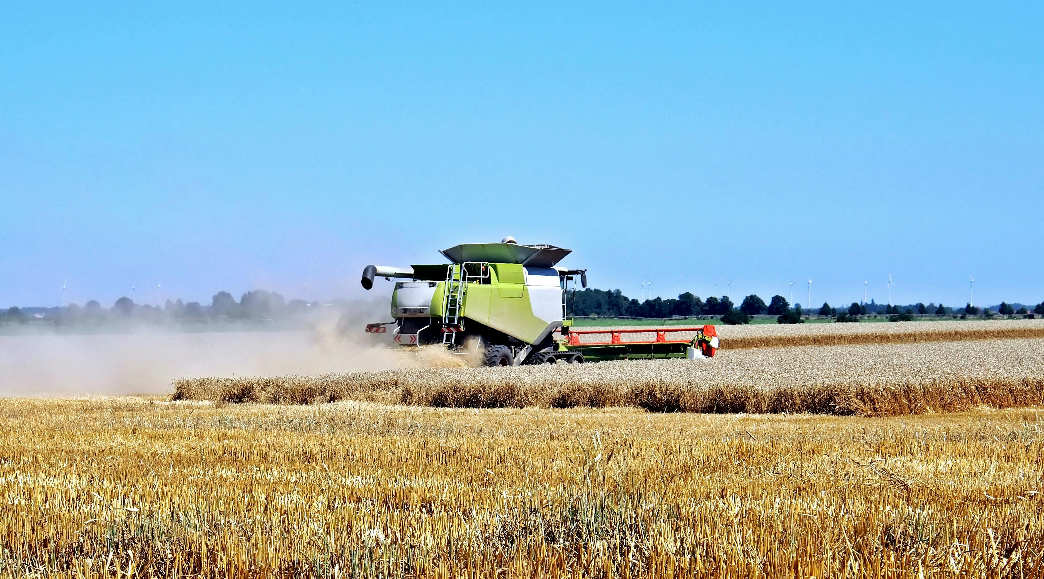
Exodus 23:10-11
“For six years you shall sow your land and gather in its yield, but the seventh year you shall let it rest and lie fallow, that the poor of your people may eat; and what they leave the beasts of the field may eat. You shall do likewise with your vineyard, and with your olive orchard.

Slide 4
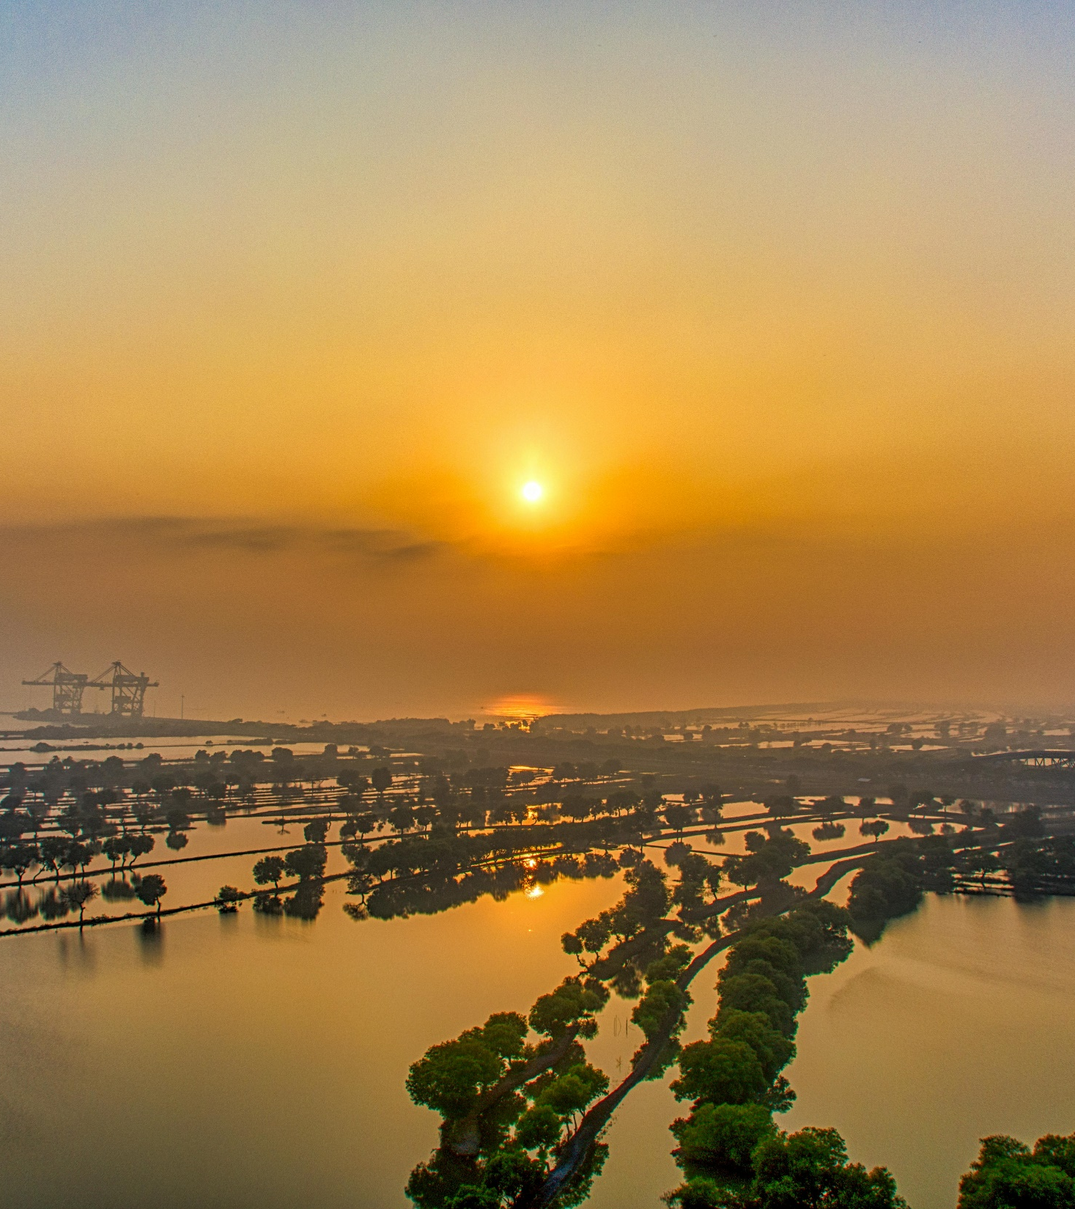
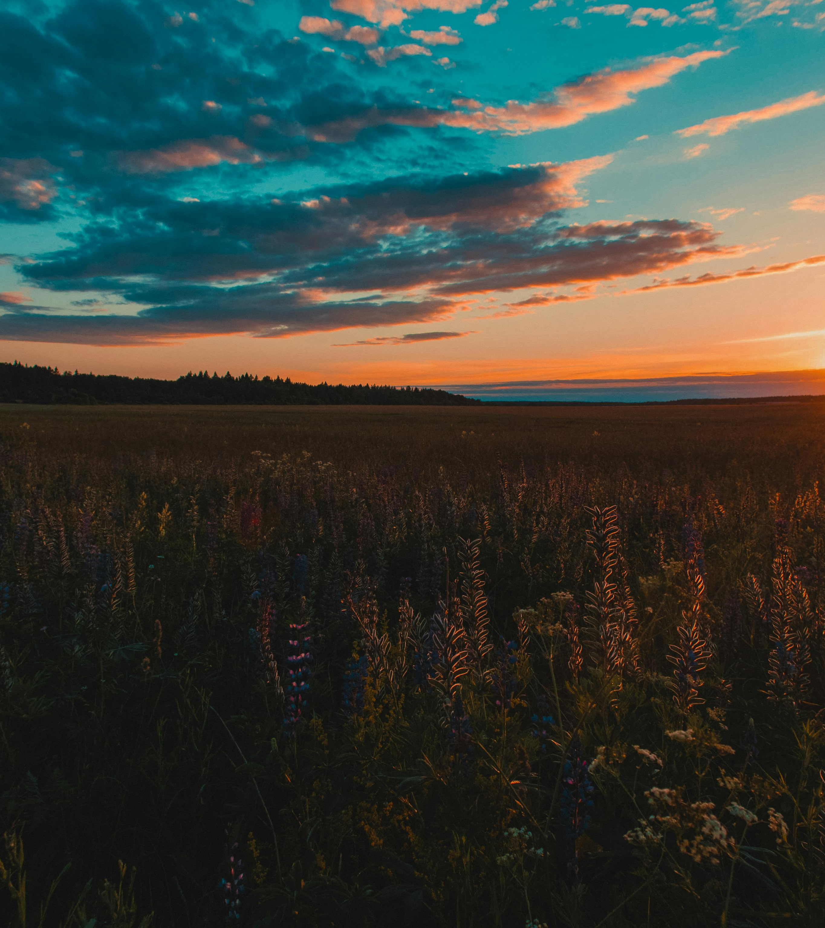
Nehemiah 9:6
“You are the Lord, you alone. You have made heaven, the heaven of heavens, with all their host, the earth and all that is on it, the seas and all that is in them; and you preserve all of them; and the host of heaven worships you.

Slide 5
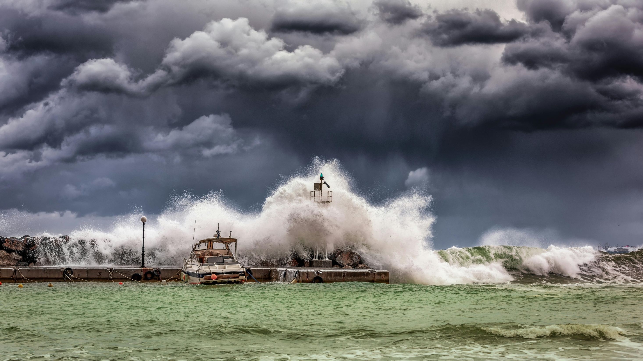
Psalm 95:5
The sea is his, for he made it, and his hands formed the dry land.

Slide 6
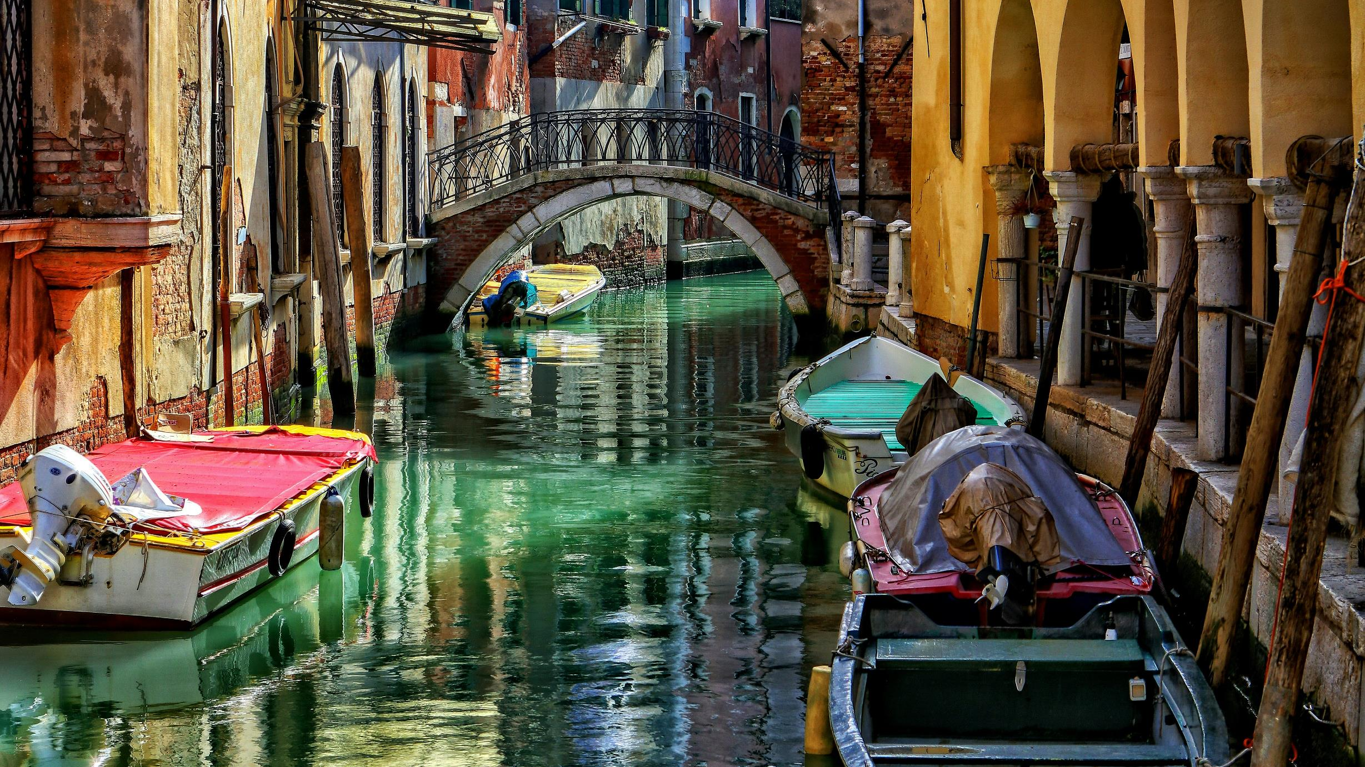
Psalm 24:1-2
The earth is the Lord's and the fullness thereof, the world and those who dwell therein, for he has founded it upon the seas and established it upon the rivers.

Slide 7
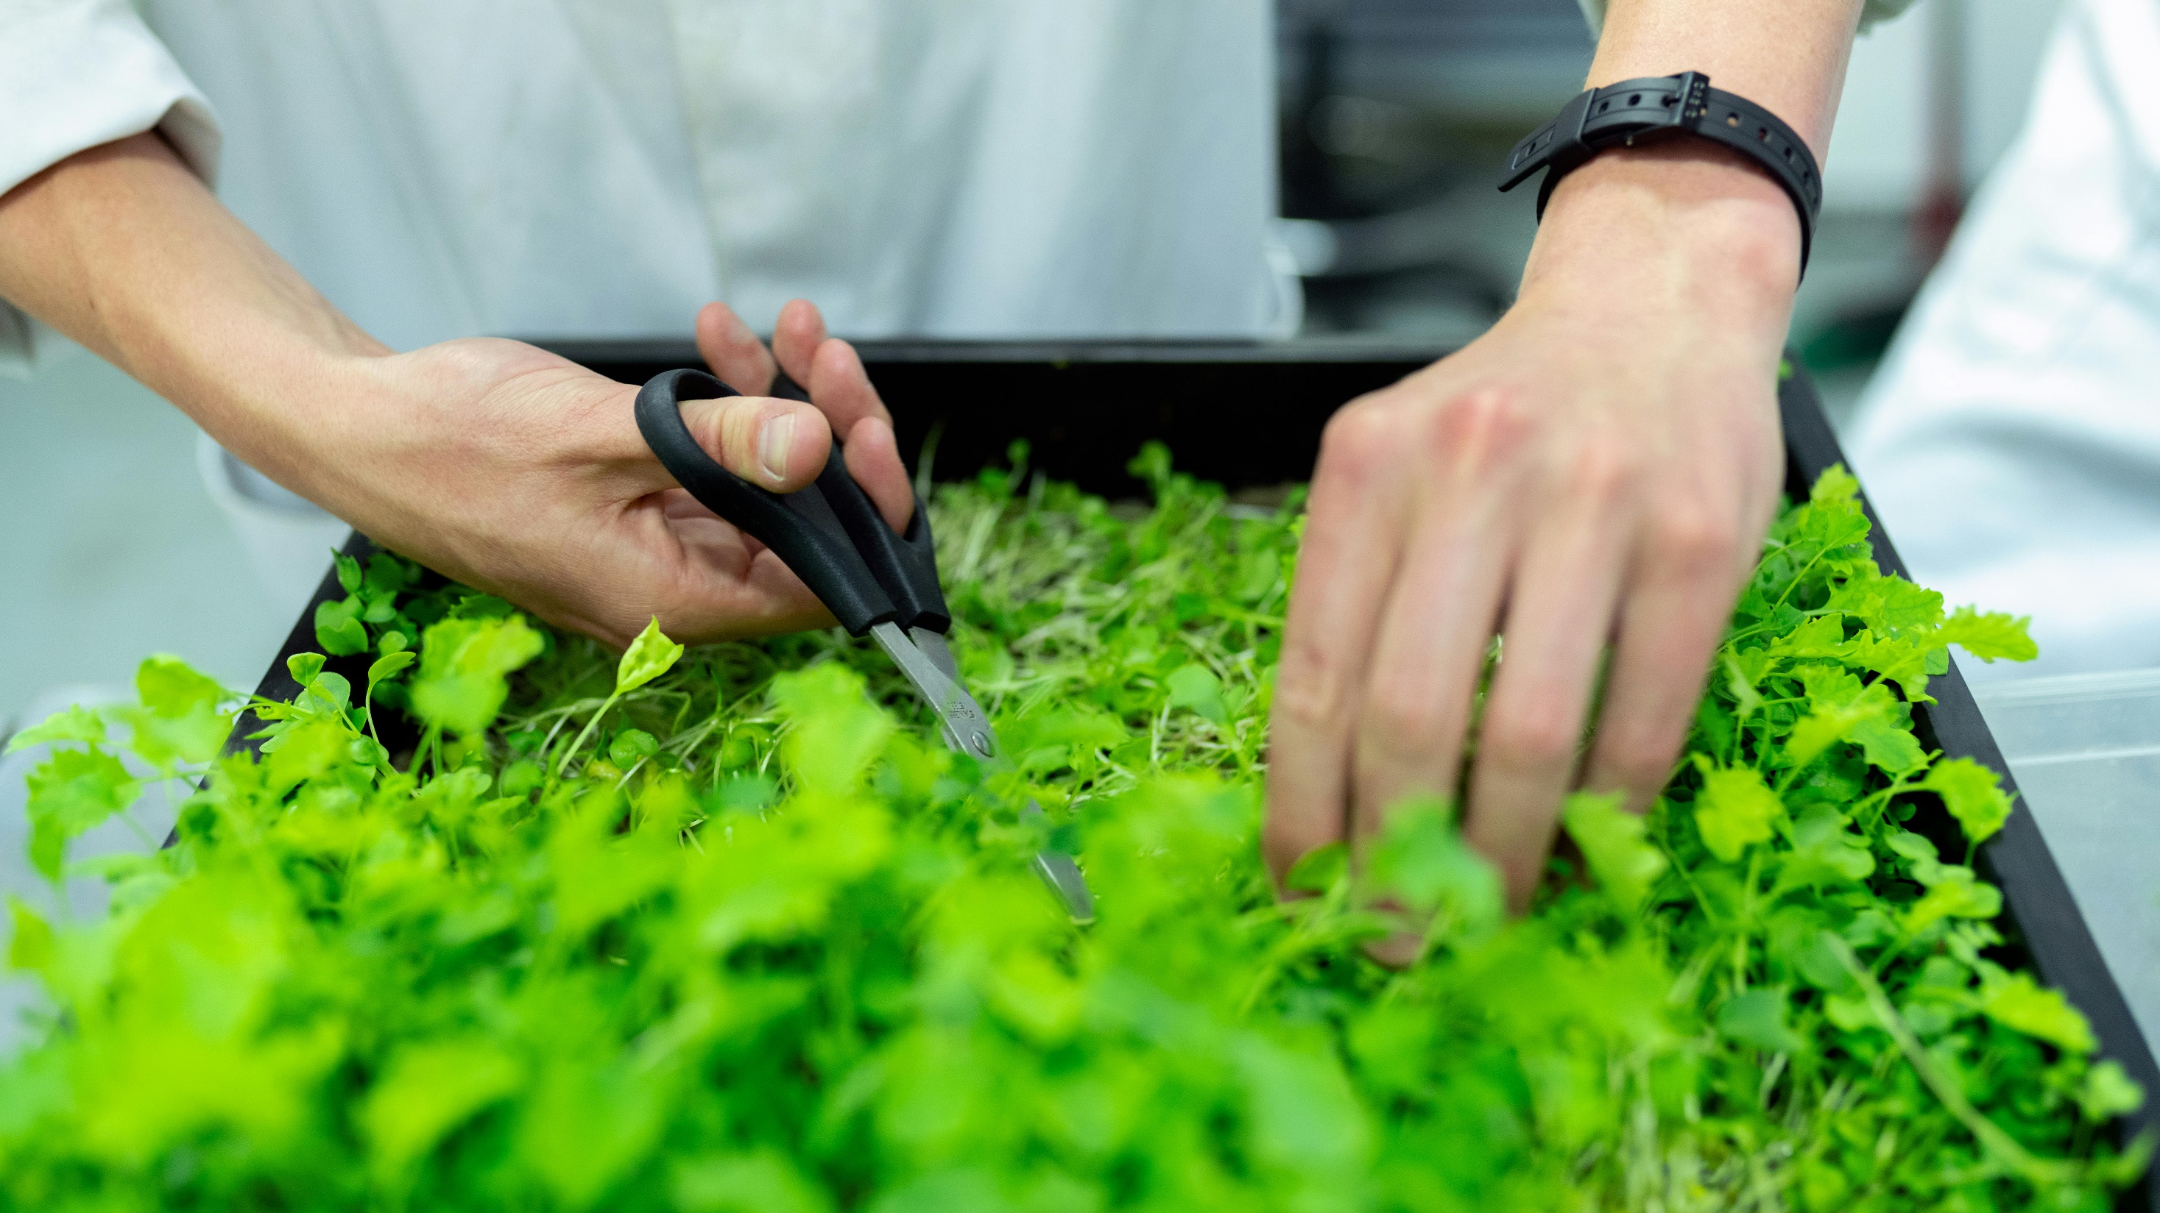
Philippians 2:4
Let each of you look not only to his own interests,
but also to the interests of others.

Slide 8
Pray, Reflect and Act this Creationtide.

