Slide 1
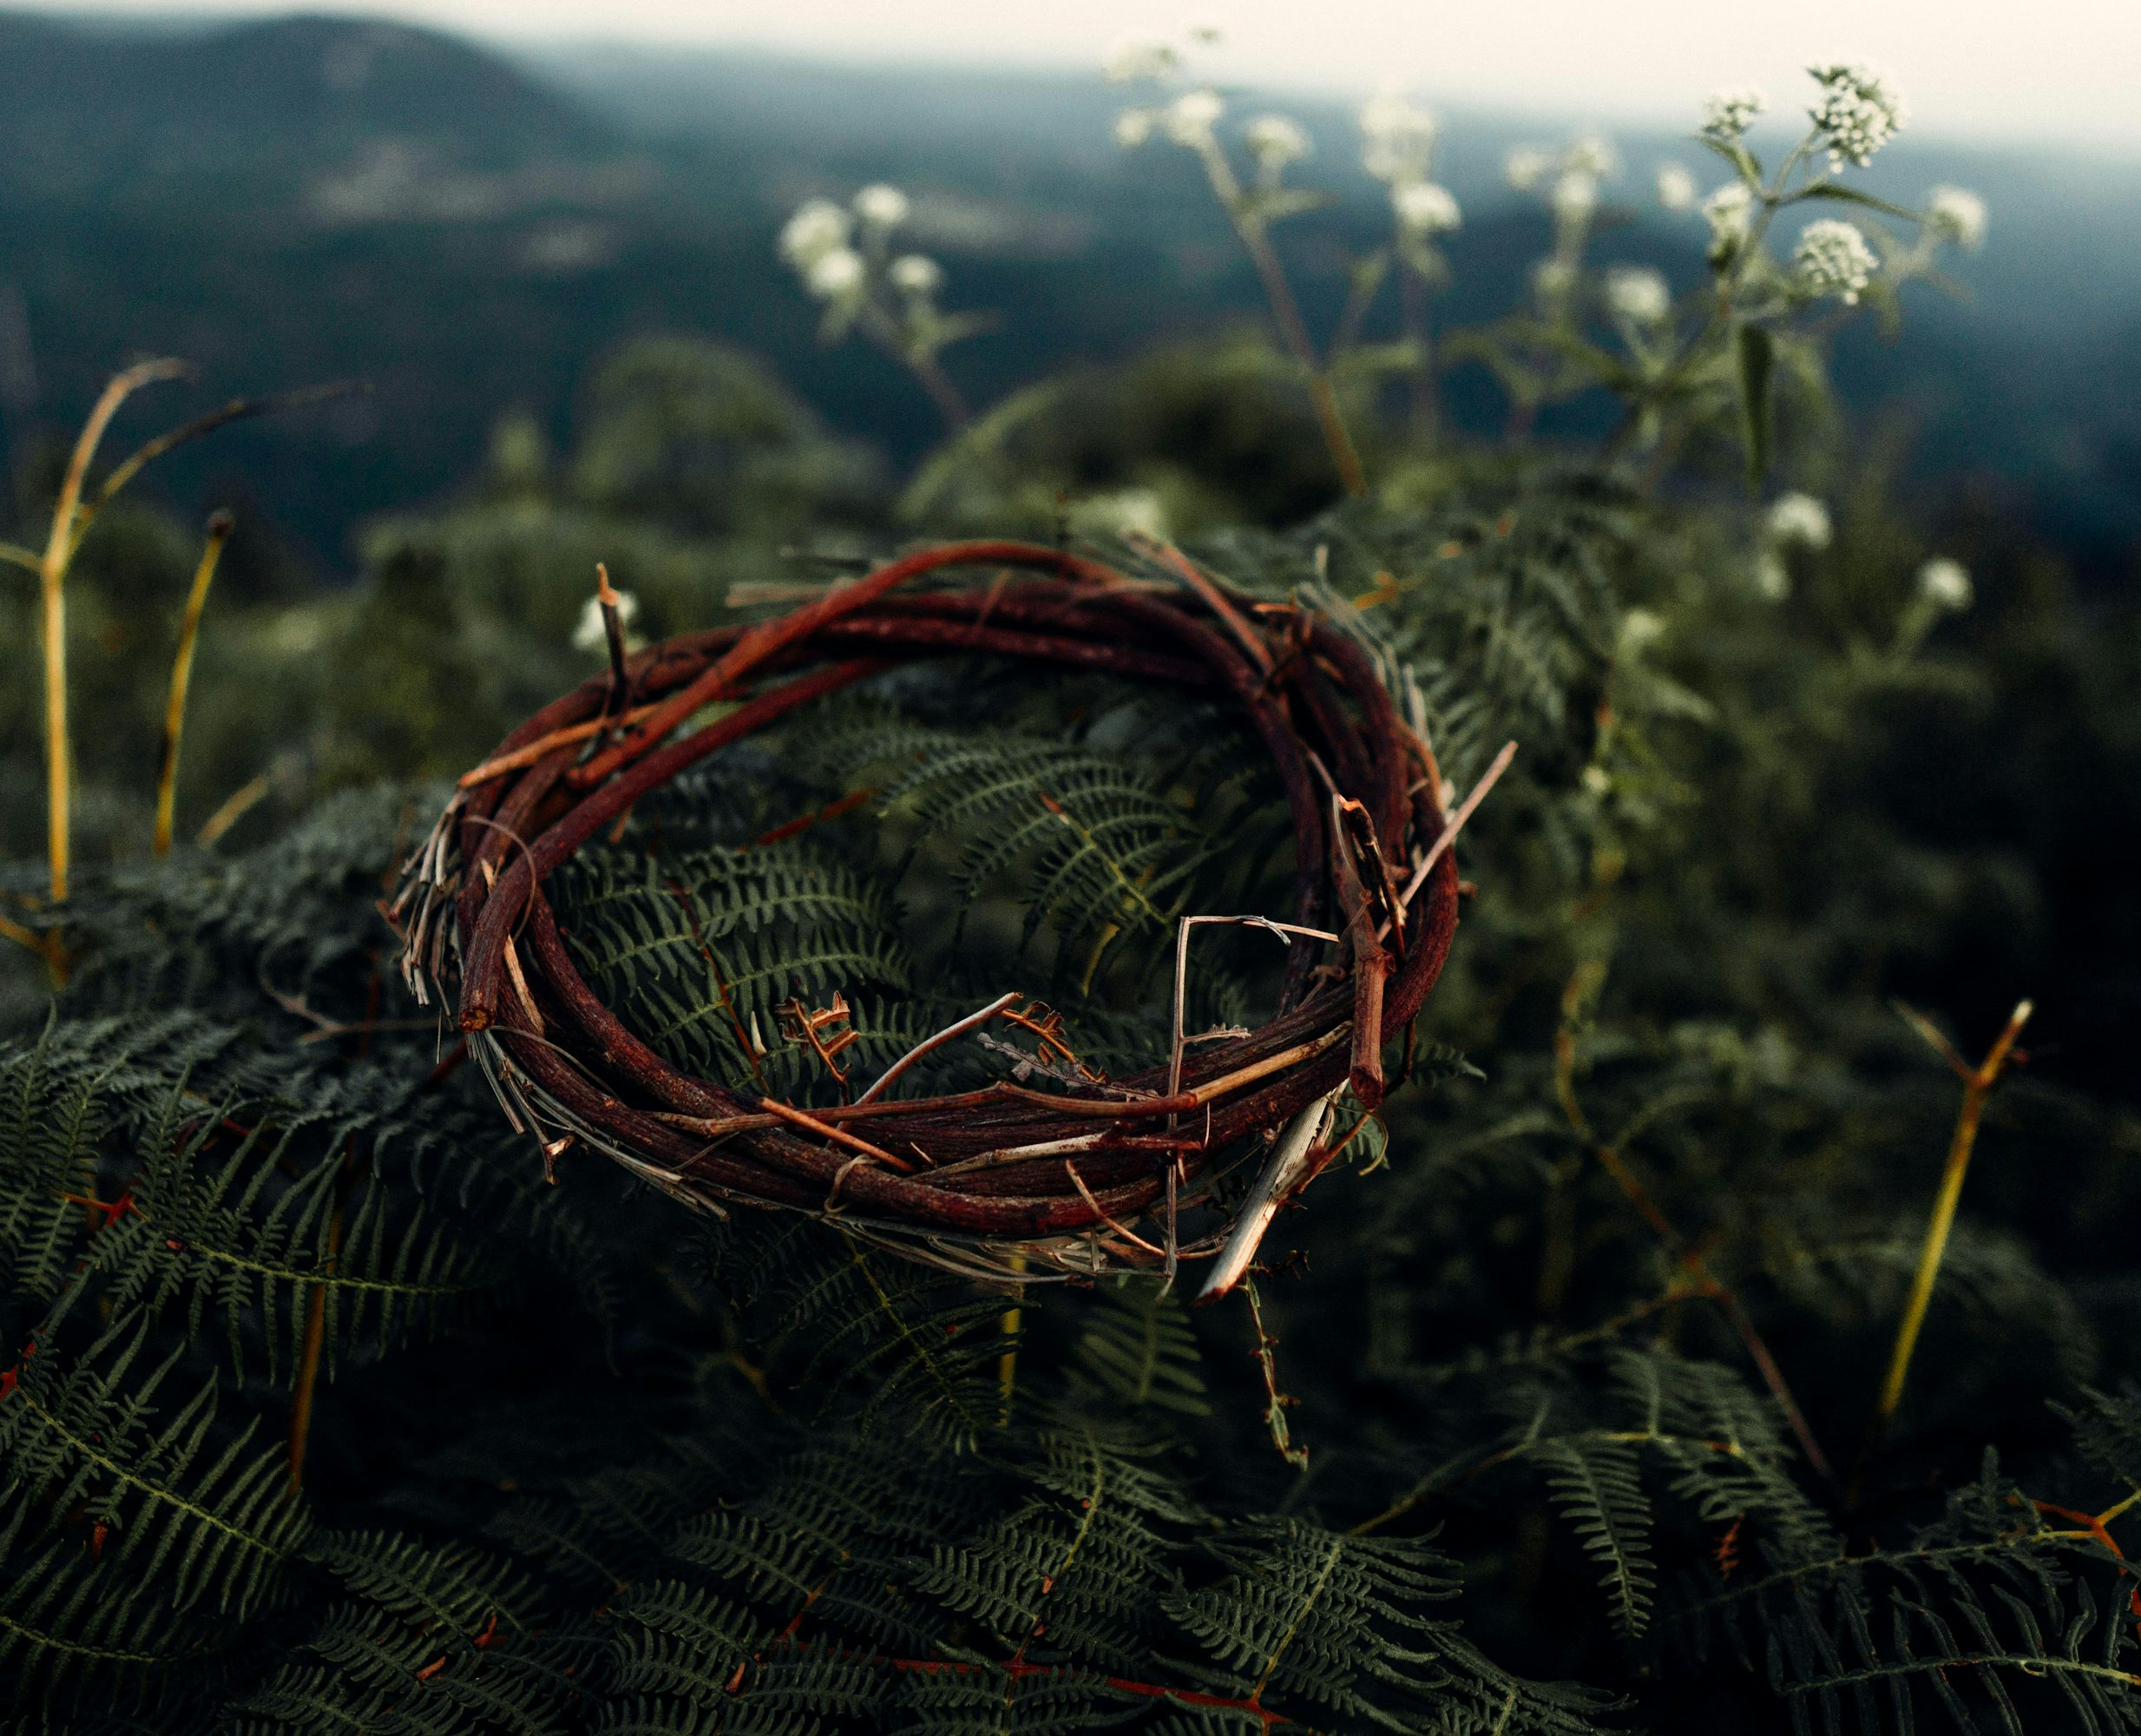

The Stations of the Cross -
poetry for prayer and reflection.
By Fr Mark Skelton, Plymouth Diocese.

Slide 2
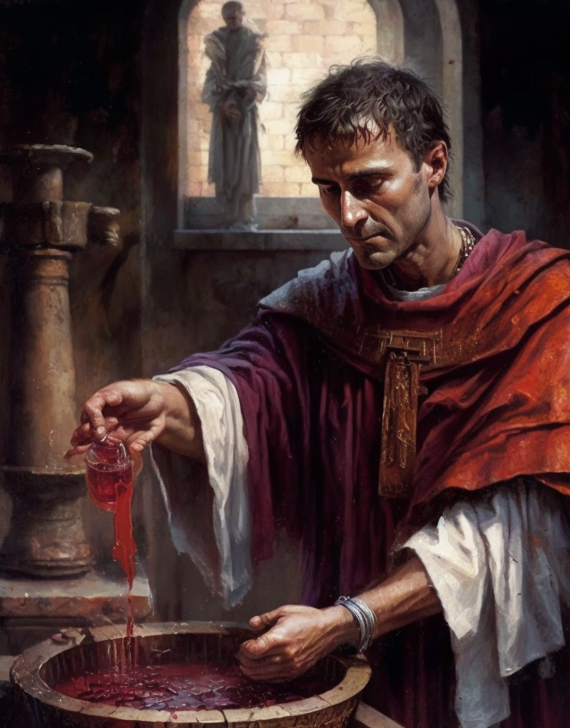

The First Station: Jesus is condemned to death
A bowl, a towel, a hurried rush
to wash away his guilt which clings
and stains his hands so used to death.
But here his heart hears innocence.
The one who stands and sees this bowl,
used in the coward’s craven act,
recalls last evening, as he knelt
and served in love those who have fled.

Slide 3
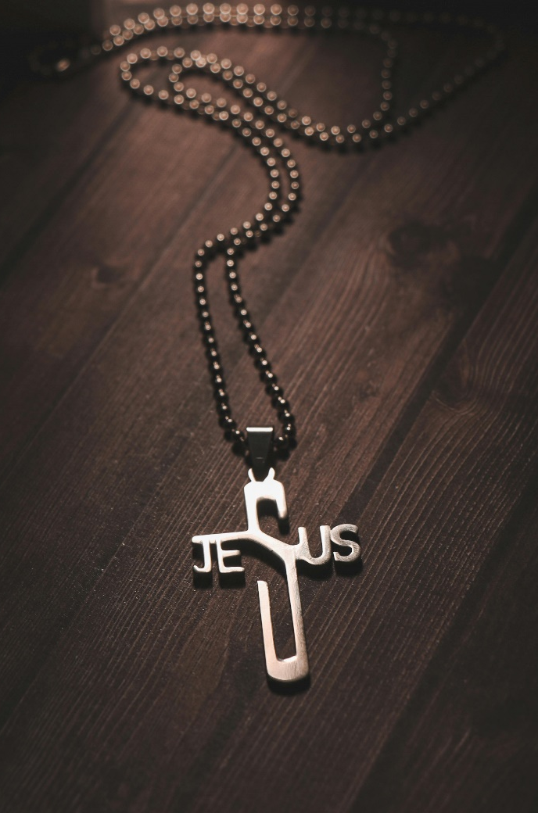
The Second Station: Jesus carries his cross
The wooden cross laid on an innocent;
the board on which his tapestry is framed.
A woven message, stretched for all to see,
to bring a clarity, a mark now named.
This mark, when used, tells that the sum is wrong.
It adds to more than counted or to less.
It needs to be re-totalled, re-aligned;
the message re-examined, re-assessed.
He bears this sign of wrongs, but not his own.
He carries other’s burdens to this throne.
This mark when used to show a lover’s love,
a shorthand hieroglyph of tenderness,
to grace a card, to make a letter sing,
a punctuation foretelling caress.
He bears, against all odds, what none will feel.
His love so unrequited yet so real.

Slide 4
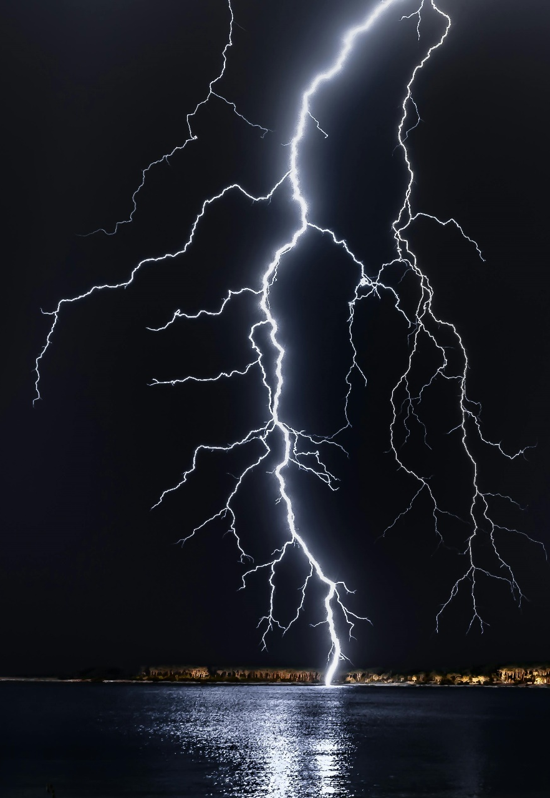
The Third Station: Jesus falls the first time
He crashes down beneath this torture tool;
the city’s hate, like storm clouds gather round.
One fluttered wing, in forests faraway,
we’re told unleashes storms to rend the earth.
This fall, unnoticed but by those who stand,
reverberates across the centuries’ span;
but does not grow in vengeful hate or force,
it builds in love, transfig’ring hate at source.

Slide 5
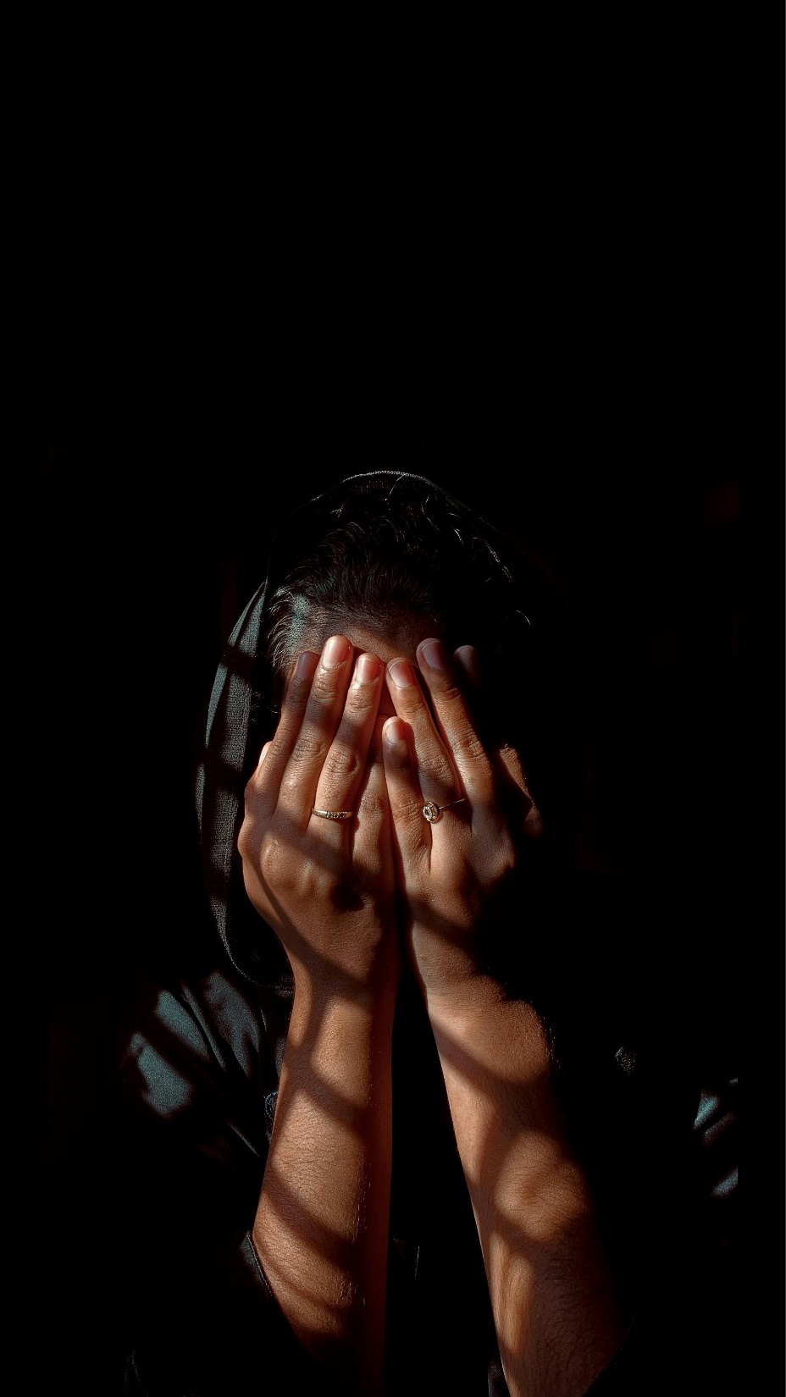
Fourth Station: Jesus meets his mother
The mother stretches out her grief
and feels the prophecy unfurled.
She cradled him in Temple’s court
and heard the old man speak his word.
And years of love unfold to this,
as son begins this final strain.
“And every wound you’ll know”; He’d said.
The mother sharing untold pain.

Slide 6
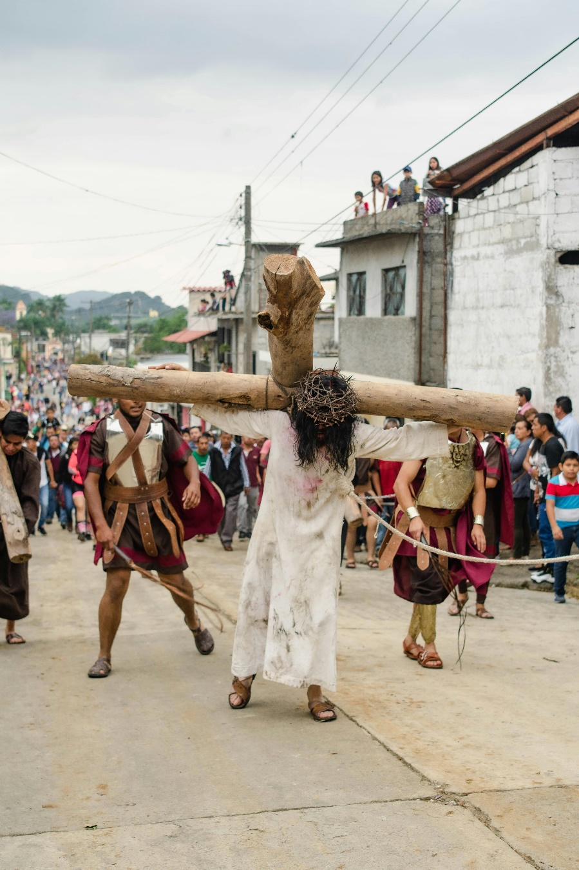
The Fifth Station: Simon of Cyrene
helps Jesus carry his cross
This man who came to see the crowds,
or maybe for a time of prayer.
Or did he stumble on this scene,
and stayed to watch or cringe or stare?
Dragged from the crowd against his will,
or was he pleased to take the weight?
And feel the splinters pierce his arms,
and hear the venom spat with hate?
Was he ashamed by city’s rage,
and did he try to shield the man?
And, as he smelt his sweat and fear,
Did he begin to understand?
We might not know, so lost in time,
what Simon thought, how could we find!
Yet sons, recorded in the tale,
are witness to their father’s mind.

Slide 7
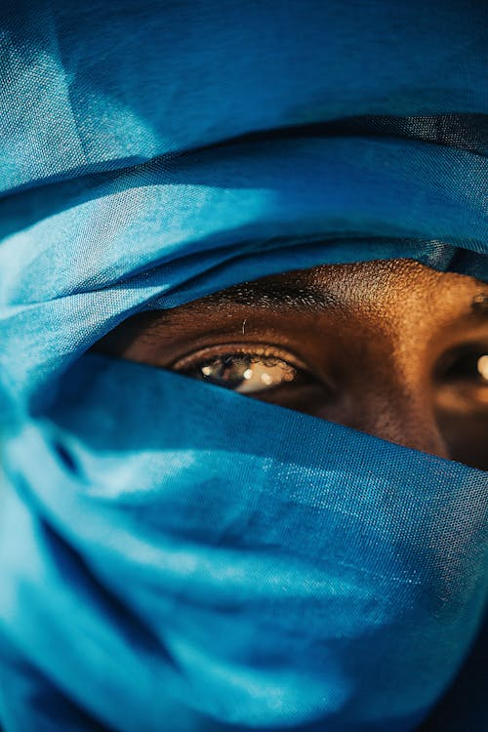
The Sixth Station: Veronica wipes the face of Jesus
An act of pointless love and care,
to wipe the blood and sweat, to loose the chain,
for still he'll climb and stumble on,
as wounds re-open, sweat streams from his pain.
'What waste of cloth, what waste of time'.
'What waste of oil!' was once the world's refrain.
Yet, from these acts of wasted love,
a different hope begins to move to reign.

Slide 8
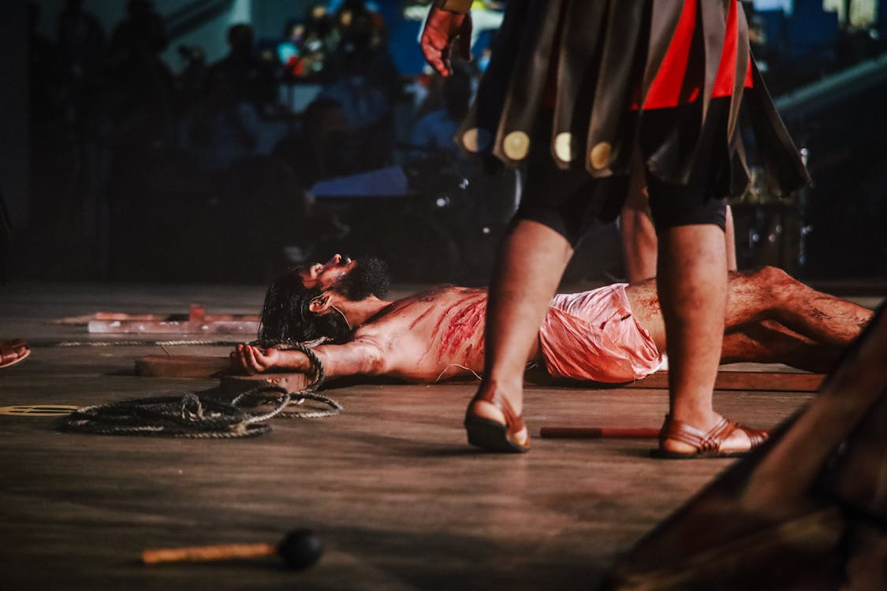
The Seventh Station: Jesus falls the second time
They stumble on this road of pain
and agony explodes again.
And Simon, though he holds the weight,
cannot take on the other’s fate.
We are not Islands; every one
is joined to other. But the Son,
though helped by Simon’s proferred hand,
must still endure his lonely plan.

Slide 9
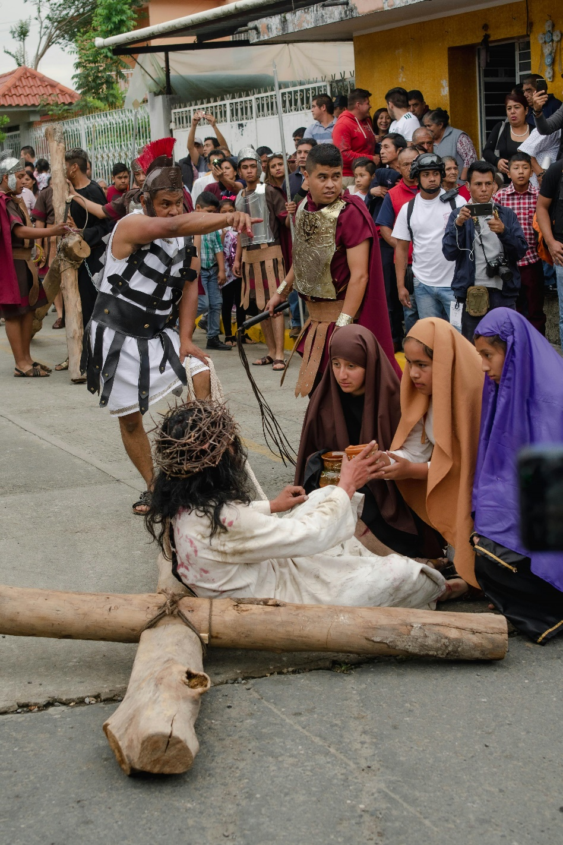
The Eighth Station: Jesus meets the women of Jerusalem
The one bent double who could see no light.
The one who cringed in fear upon the sand.
The one who walked behind her lifeless son.
The one who touched his cloak with trembling hand.
The one whose wedding feast he filled with wine
The one whose daughter he set free from chains.
The one he heard and healed at Jacob’s well.
The ones who saw their brother live again.
They stood and wept and mourned this gracious man
who gave them life and hope to be again.
And now in hopeless grief they lend their hearts
to bear him up this hill of endless pain.
We cannot know if this small act of love
gave him new heart upon this road of hate;
and yet, he spoke to them a comforting.
His death, their life, their happiness, his fate.

Slide 10
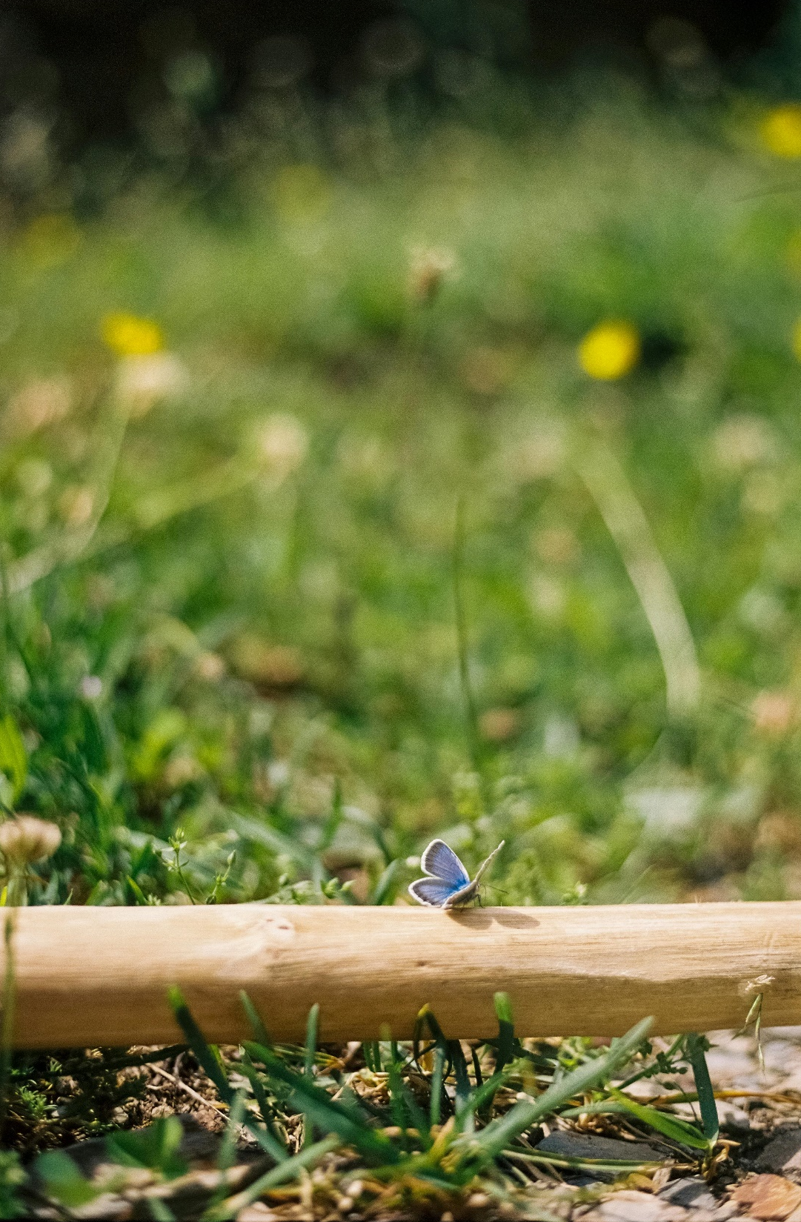
The Ninth Station: Jesus falls the third time
The load which crushes with its weight.
And even Simon cannot hold
this cross which pins the Christ to earth
like butterfly upon a board.
His beauty lost to those who will
not look beyond the ravaged face.
Yet now he rises, struggles on
to fill the dark’ning world with grace.

Slide 11
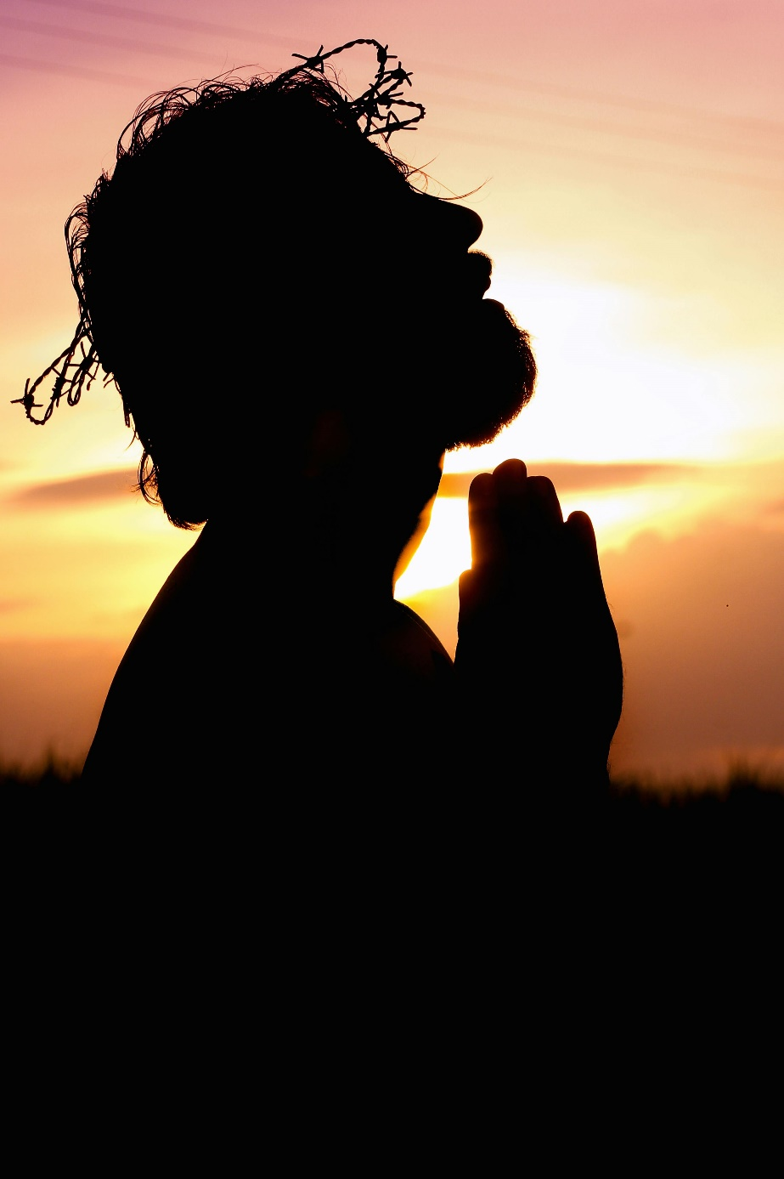
The Tenth Station: Jesus is stripped of his clothes
This man, he knew no hate
but gathered wastrels in his band.
He stood in honest openness
and sought to help them understand.
He used no verbal tricks to shield
his heart and stood without disguise.
He gave his love, an open gift,
to all who’d come, to all who’d cry.
Yet now he stands alone.
And brutal men force him to stand.
And cloth, which glued this bloody mess,
is ripped and torn by angry hands.
All hope seems gone; he cannot wield
the least defence ‘gainst prying eyes.
Yet, does his own attention shift,
to look beyond, where hate shall die.

Slide 12
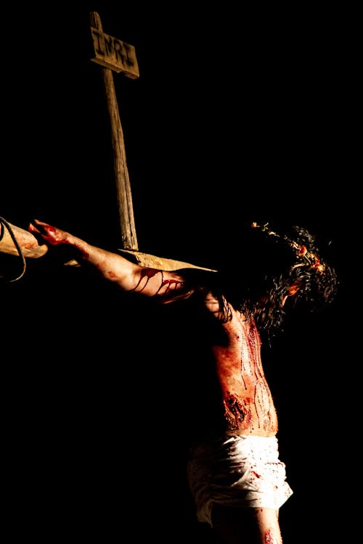
The Eleventh Station: Jesus is nailed to the cross
These hands, formed in his mother’s womb,
are moulded for the work ahead.
These hands which, raised above the crowd,
fed thousands with a loaf of bread.
These hands which, drawing in the sky,
could paint the Kingdom here on earth.
Or kneel, with bowl and jug and towel,
and teach his followers to serve.
These hands, which healed away the grief
and eased the pain, changed bad to good,
are taken now and held by force
and hammer blow skewers them to wood.

Slide 13
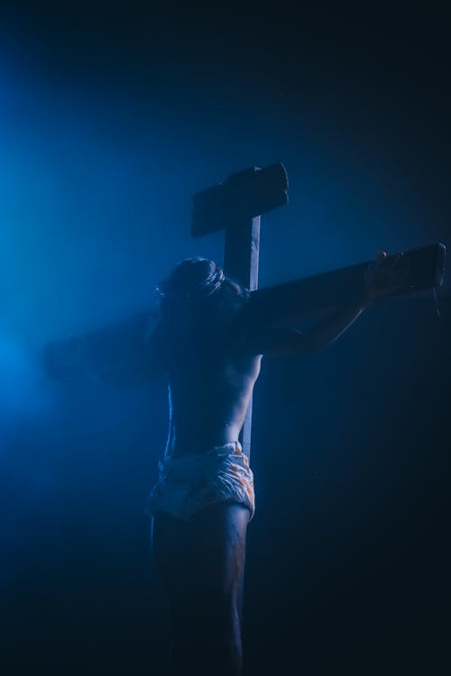
The Twelfth Station: Jesus dies on the cross
The harsh rake of his throat dredged raw with sand.
Each word rasped out in agony of pain;
and yet “Behold thy mother, take her hand.
Behold thy son, you called to love again”.
To ones who stand and jeer, so filled with hate,
he speaks forgiveness they’ll refuse to hear.
To one who struggles with what lies ahead
he whispers of a kingdom freed from fear.
Though, as he looks into the gath’ring storm,
in anguish searching for his Father’s face,
and cannot see, and cannot feel that love,
He offers up his heart, this mode of grace.
As darkness smothers, crushing out his life,
he calls an end to history’s demand.
And soldiers witness, though they know it not,
his opening out to all the Promised Land.

Slide 14
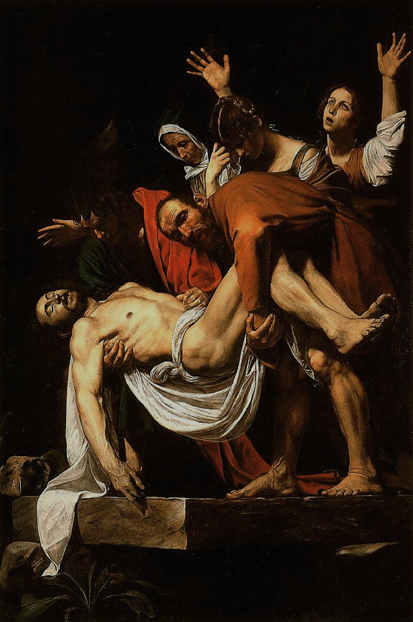
The Thirteenth Station: Jesus’ body is taken down from the cross
The body, lowered from its place of pain,
and held by loving mother once again.
The limbs, she once repaired from boyish scrapes,
lie lifeless, torn and ravaged by men’s hate.
And, as she feels hope end and cradles death,
can she recall the manger, his first breath.
Now women hold her grief and staunch her cries,
Then shepherds sang of hopes and floodlit skies.
His hands which drew to joy, which fed and blessed;
his feet which women washed with tears, caressed,
lie broken, skewered, mangled, crushed, destroyed.
And all His vision gone, His future void.
She reaches back in time to Simeon’s call,
when motherhood was young and it was all.
The sword he spoke of finds her flailing heart;
and grief flares out and rips her heart apart.
And yet, as darkness gathers overhead,
and she accepts this fact: her son is dead,
She cannot put aside the words He said,
and sees not thorns but gold to crown His head.
Caravaggio – Deposition of Christ, 1603-04, Vatican Museums

Slide 15
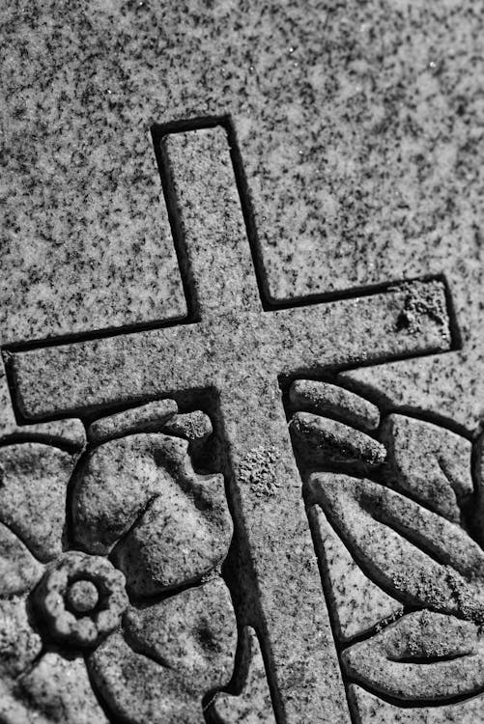
The Fourteenth Station: Jesus is laid in the tomb
His broken corpse laid down with love
in borrowed grave, in borrowed shroud.
His faithful few weep soft and sure,
others mourn, shamefaced, from the crowd.
Across the cave the stone is rolled,
to block the story moving through.
This body, battered, ravaged, cold,
will lie and rot, as bodies do.
This stone, a grey and pitted round,
stands in the breach to end the tale.
History's full stop, from here no sound
will issue. His truth now does fail.
Doesn't it?

Slide 16
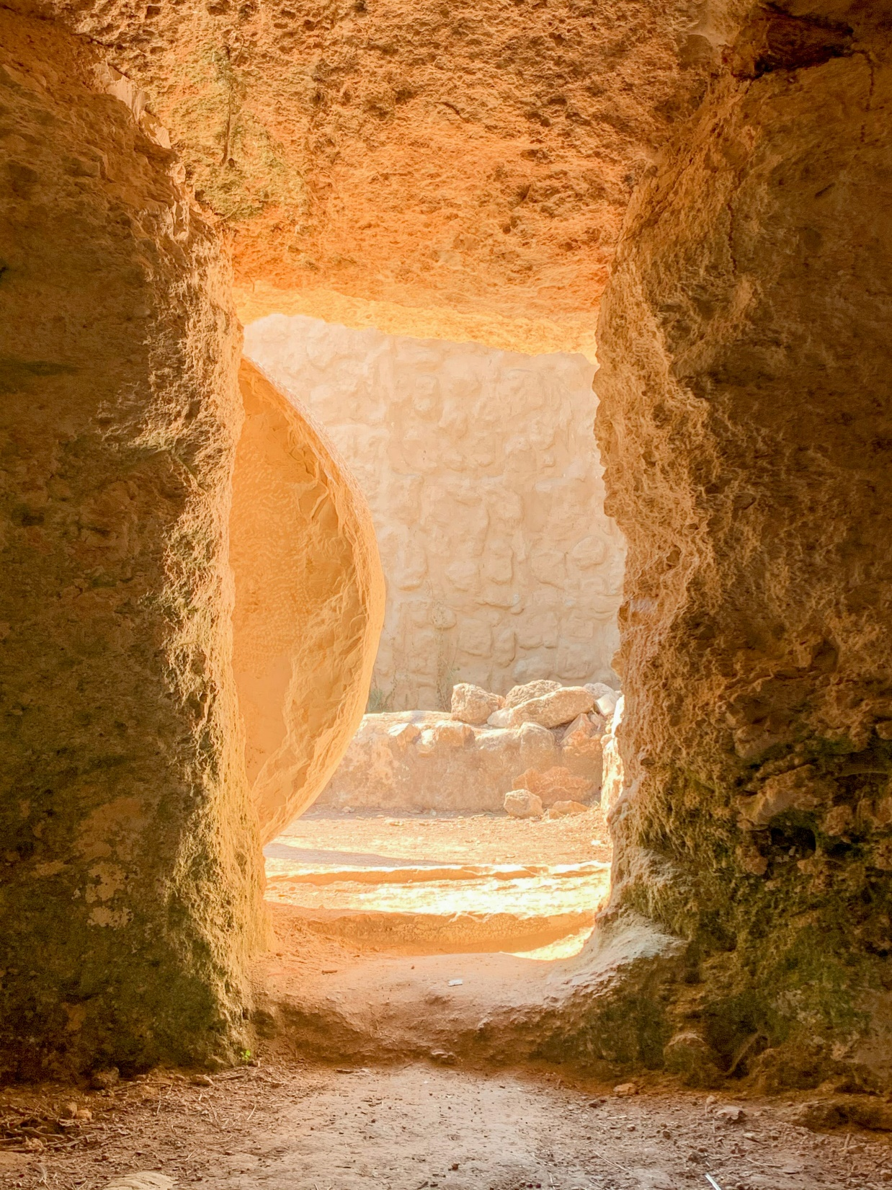

The Fifteenth Station: The Resurrection
This cave of death and nothingness
now echoes a new emptiness.
The stopped breath and stilled blood
now pulse and race a different life.
In gardens, coves, deserted roads,
He'll stand and greet and smile,
and none will see Him as He is.
Till being as He was
He'll speak their name,
or break the bread
or see the shoal,
and in these transformed moments
Risen Life will shine.

Slide 17

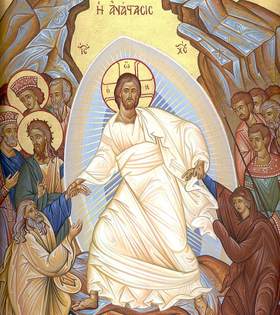
The Stations of the Cross -
poetry for prayer and reflection.
By Fr Mark Skelton.

