Slide 1
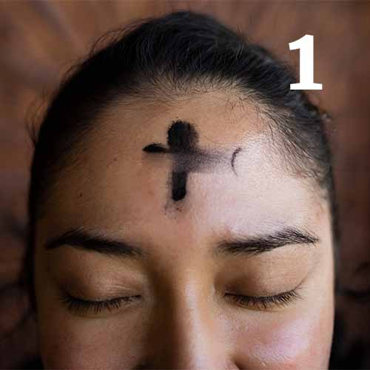

Ash Wednesday – 18th February
A pure heart create for me, O God, and give me again the joy of your help. Psalm 51: 3-19
Action: Ask God to guide and renew you throughout this Lenten season.

Slide 2
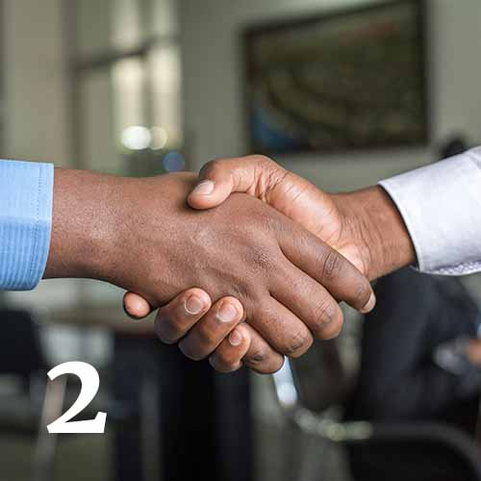
Thursday 19th February
Be reconciled to God… now is the favourable time. 2 Corinthians 5: 20 - 6:13
Action: Who do you need to be reconciled with today - in person or in prayer?

Slide 3
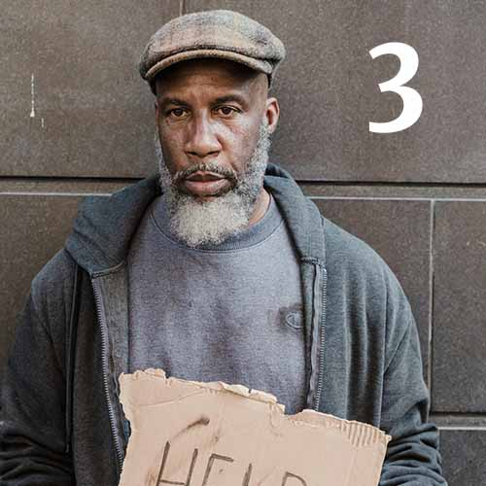
Friday 20th February
Your Father, who sees all that is done in secret, will reward you. Matthew 6:1-6; 16-18
Action: Support a homeless charity through a donation, by volunteering or through local advocacy.

Slide 4
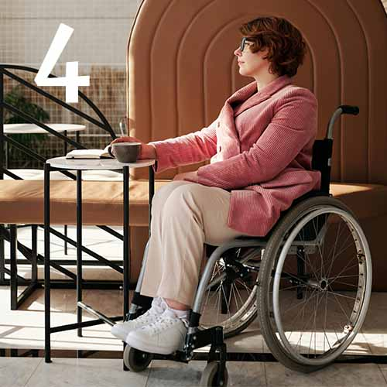
Saturday 21st February Harden not your hearts today, but listen to the voice of the Lord. Psalm 95:1-9
Action: In silence reflect on who you need to listen to this weekend.

Slide 5
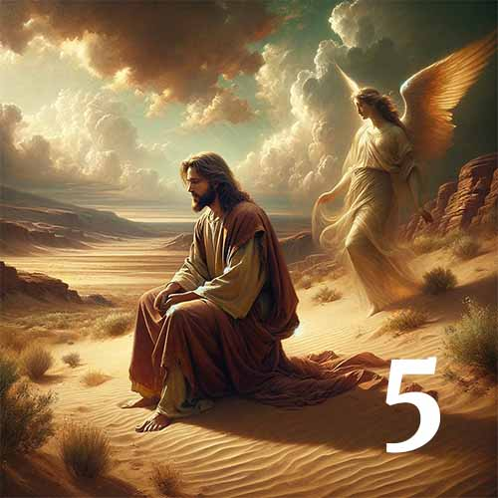
First Sunday of Lent – 22nd February
Jesus was tempted by Satan, and the angels looked after him. Mark 1:12-15
Action: Ask for strength when you are tempted and protection of God’s angels.

Slide 6

Monday 23rd February
What does the Lord require of you but to do justice, and to love kindness, and to walk humbly with your God?
Micah 6:6-8
Action: Where can you show justice, kindness or humility today?

Slide 7
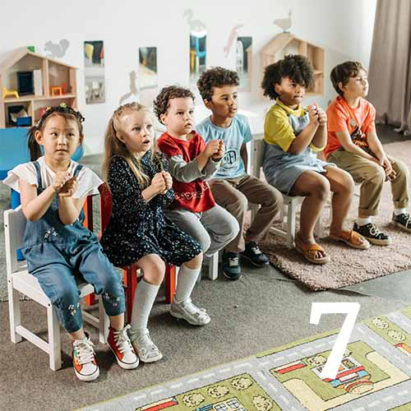
Tuesday 24th February
For you are all children of God, through faith in Christ Jesus. Galatians 3:23-29
Action: Can you help a child in need this month?

Slide 8
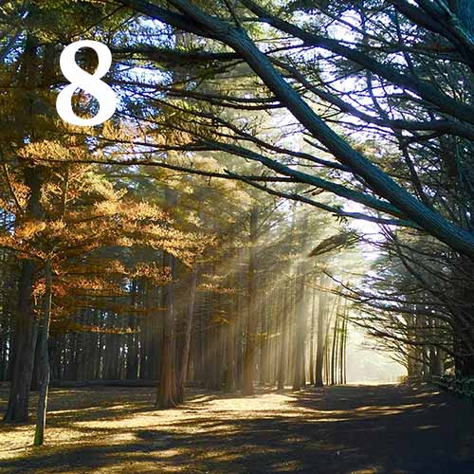
Wednesday – 25th February
Your ways, Lord, are faithfulness and love for those who keep your covenant. Psalm 25:4-10
Action: How can you be more faithful or loving in your home or neighbourhood?

Slide 9
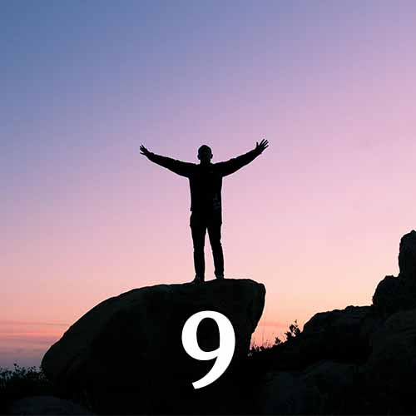
Thursday 26th February
God did not give us a spirit of timidity, but the Spirit of power and love and self control. 2 Timothy 1:6-14
Action: What do you need to do to be more confident in the Spirit?

Slide 10
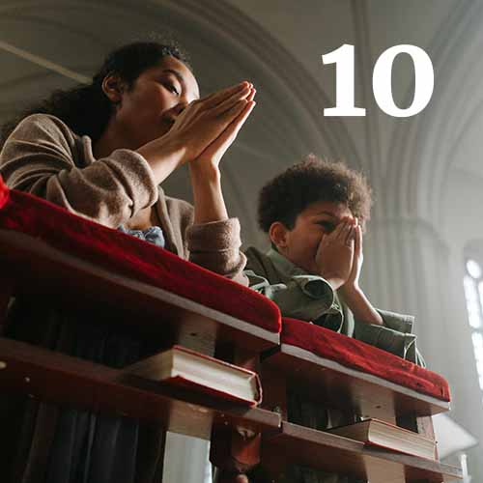
Friday 27th February
But they who wait for the Lord shall renew their strength. Isaiah 40:28-31
Action: Who needs your encouragement and support?

Slide 11
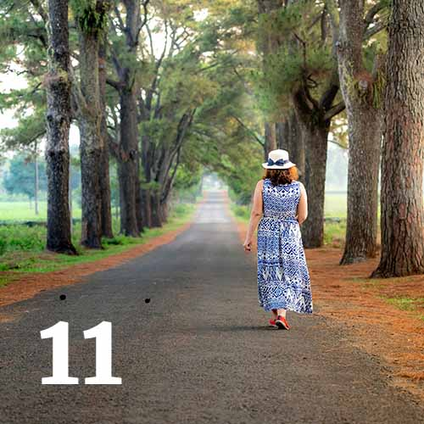
Saturday 28th February
Return to the Lord your God, for he is gracious and merciful, slow to anger, and abounding in steadfast love.
Joel 2: 12-13
Action: Where in your heart do you need to return to God? Begin the journey.

Slide 12
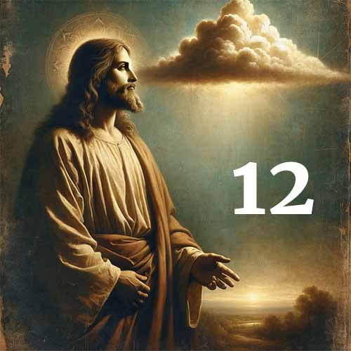
Second Sunday of Lent – 1st March
A voice from the cloud said, “This is my beloved Son, with whom I am well pleased; listen to him.” Matthew 17:5-8
Action: Choose a gospel story to read and reflect on this week.

Slide 13
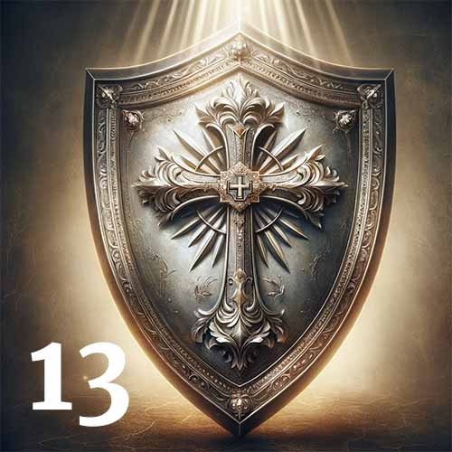
Monday 2nd March
Our soul waits for the Lord; he is our help and our shield. Psalm 33:1-22
Action: Pray for countries at war and who need God’s help and shield.

Slide 14

Tuesday 3rd March
Humble yourselves, therefore, under the mighty hand of God so that at the proper time he may exalt you.
1 Peter 5:6-11
Action: Look out for God’s hand at work in someone you see or speak to today.

Slide 15
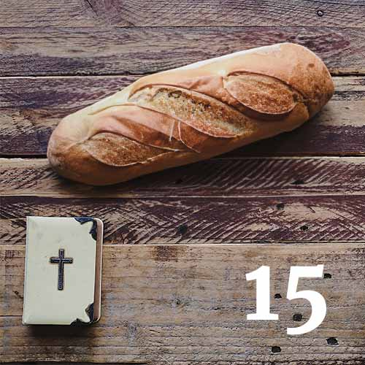
Wednesday – 4th March
Man does not live on bread alone but on every word that comes from the mouth of God. Matthew 4:1-11
Action: Say the Our Father slowly - give thanks for food and the opportunity to forgive others.

Slide 16
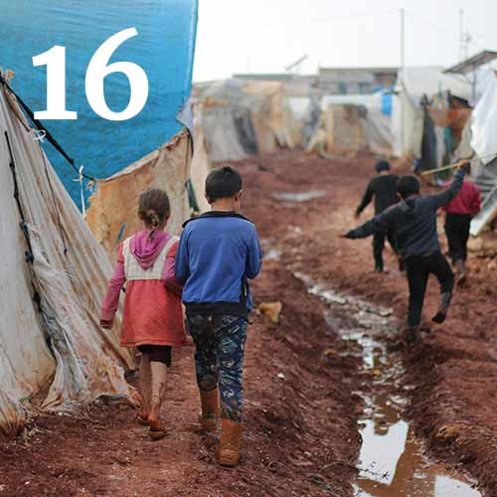
Thursday 5th March
Then you will call upon me and come and pray to me, and I will hear you. Jeremiah 29:12-14
Action: Pray for migrants still seeking safety and a place to call home.

Slide 17
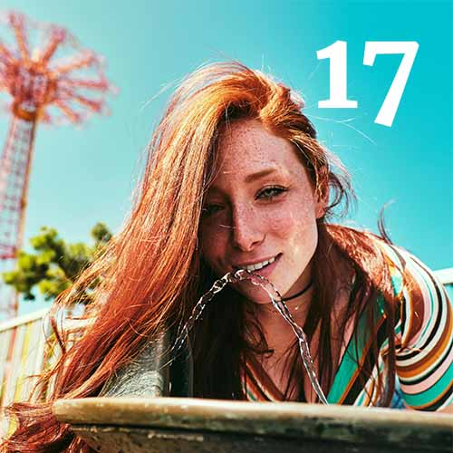
Friday 6th March
My soul thirsts for God, for the living God. When shall I come and appear before God? Psalm 42
Action: Donate to a water charity for those who don’t have access to clean water.

Slide 18

Saturday 7th March
Is not this the fast that I choose: to loose the bonds of wickedness, … to let the oppressed go free, and to break every yoke? Isaiah 58:6-12
Action: How can you challenge an injustice today in your local community?

Slide 19
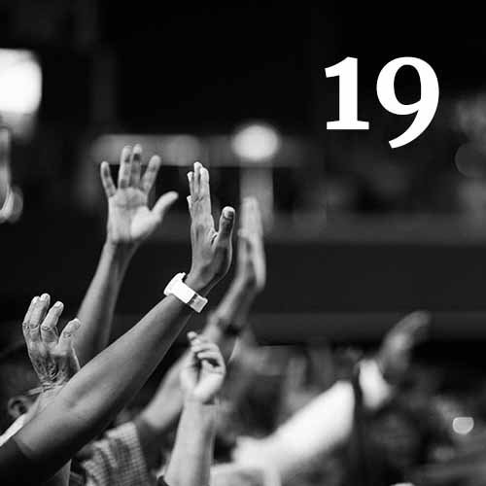
Third Sunday of Lent – 8th March
I am the resurrection and the life, says the Lord, whoever believes in me will never die. John 11: 17-27
Action: Pray for all those who do not believe in God. And for those who doubt in his love.

Slide 20
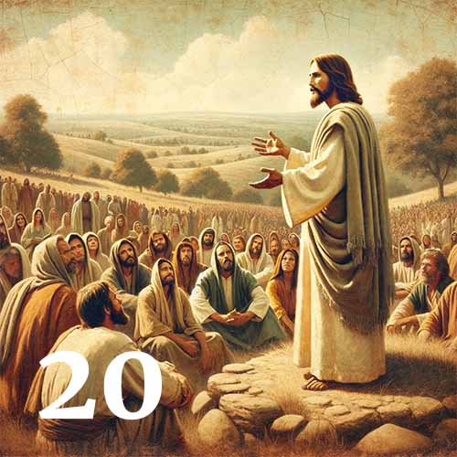
Monday 9th March
From that time Jesus began to preach, saying “Repent, for the kingdom of heaven is at hand.” Matthew 4:12-17
Action: What do you need to repent of and seek forgiveness for today?

Slide 21
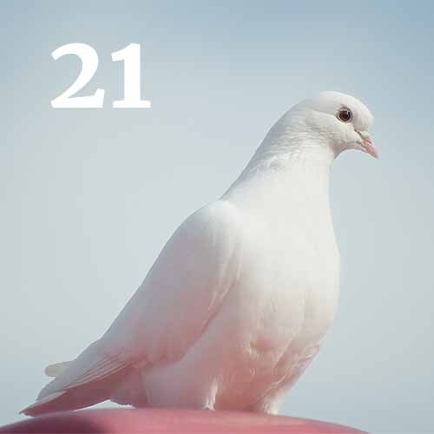
Tuesday 10th March
I have said these things to you, that in me you may have peace. In the world you will have tribulation. But take heart; I have overcome the world. John 16:4-33
Action: Pray for peace in war torn countries and closer to home wherever you see conflict.

Slide 22
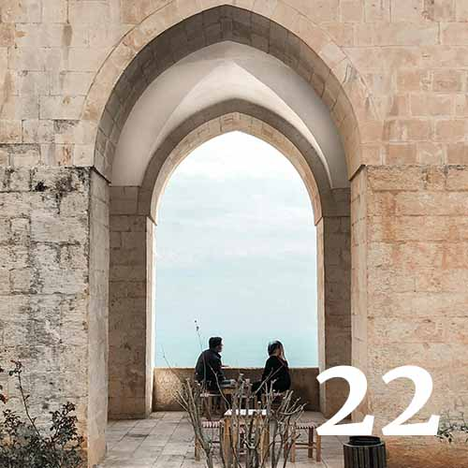
Wednesday 11th March
Wait for the Lord; be strong, and let your heart take courage; wait for the Lord! Psalm 27:1-14
Action: Who is an example of wisdom and patience for you? What can you learn from them?

Slide 23
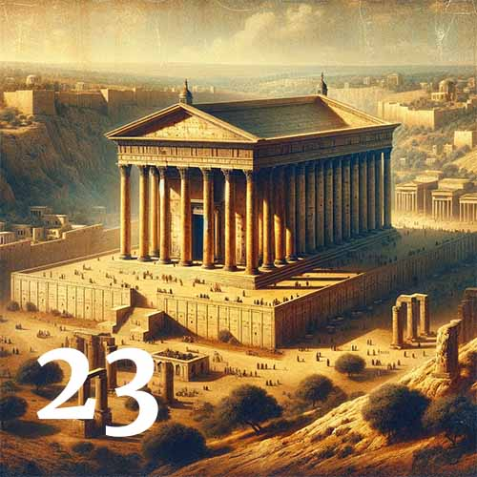
Thursday 12th March
Jesus answered them, “Destroy this temple, and in three days I will raise it up.” John 2:13-25
Action: Where in your home can you create a small sacred place to be with God?

Slide 24
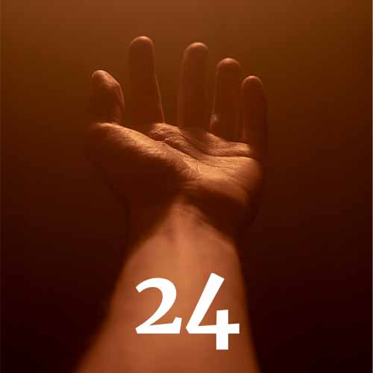
Friday 13th March
Therefore, the Lord waits to be gracious to you, and therefore he exalts himself to show mercy to you.
Isaiah 30:18-26.
Action: Who needs your mercy and God’s grace today?

Slide 25
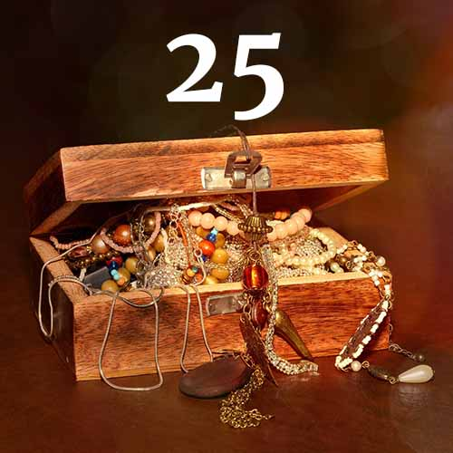
Saturday 14th March
For where your treasure is, there your heart will be also. Matthew 6:19-24
Action: What type of treasures are you drawn to? What treasures can you give away?

Slide 26
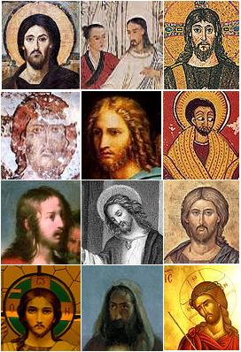
Fourth Sunday of Lent - 15th March
God loved the world so much that he gave his only Son; everyone who believes in him has eternal life. John 3:16-21
Action: Imagine Jesus looking at you with love. What would you like to say to him?

Slide 27
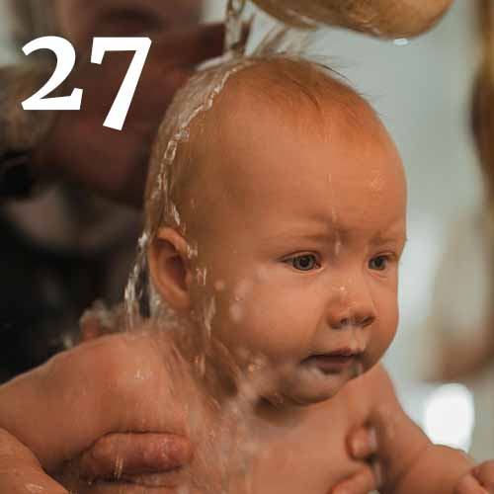
Monday 16th March
Jesus answered, “Truly, truly, I say to you, unless one is born of water and the Spirit, he cannot enter the kingdom of God. John 3:1-15
Action: What in your baptism can be renewed in Spirit today?

Slide 28
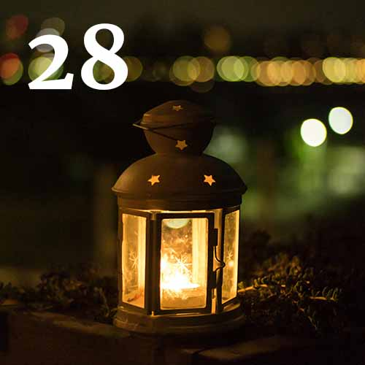
Tuesday 17th March
“I am the light of the world. Whoever follows me will not walk in darkness but will have the light of life.”
John 8:12-20
Action: How can you show someone Christ’s light today?

Slide 29
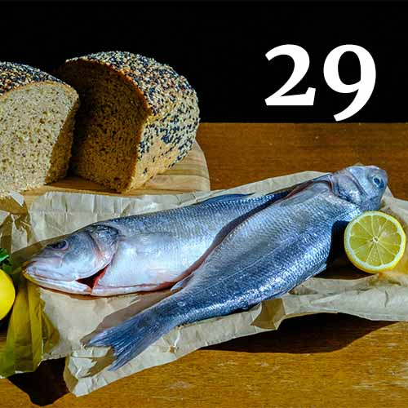
Wednesday 18th March
Jesus then took the loaves, and when he had given thanks, he distributed them to those who were seated. So also the fish, as much as they wanted. John 6:1-15
Action: Donate to a food charity and gives thanks for our supermarket staff.

Slide 30
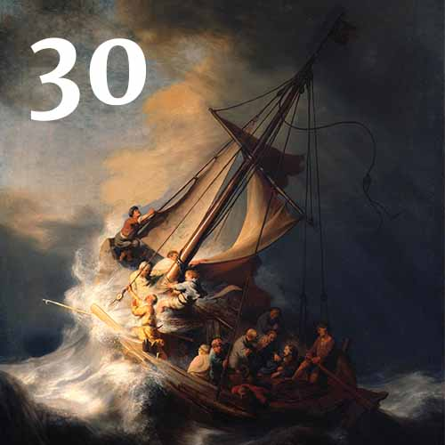
Thursday 19th March
When they had rowed about three or four miles, they saw Jesus walking on the sea and coming near the boat, and they were frightened. John 6:16-21
Action: What storm in your life or the life of someone you know needs the calm presence of Jesus?

Slide 31
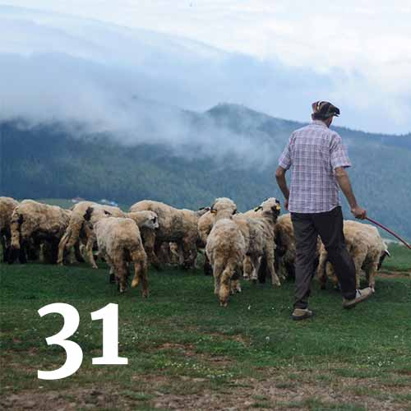
Friday 20th March
I am the good shepherd. I know my own and my own know me, … and I lay down my life for the sheep. John 10:1-18
Action: Pray for all farmers today – that they may be given fair wages for their produce.

Slide 32
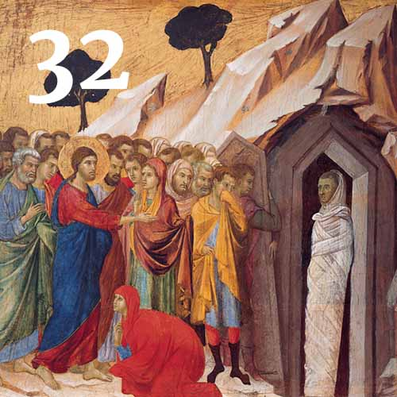
Saturday 21st March
When he had said these things, he cried out with a loud voice, “Lazarus, come out.” John 11:1-44
Action: Give thanks for someone you love who has died. May their spirit be alive in your memory.

Slide 33
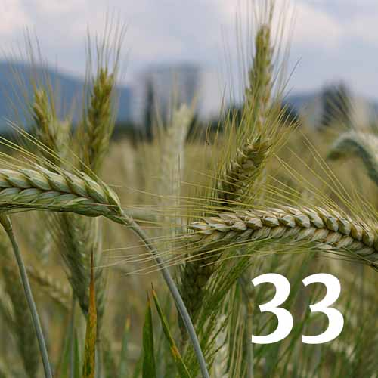
Fifth Sunday of Lent – 22nd March
Unless a grain of wheat falls into the earth and dies, it remains alone; but if it dies, it bears much fruit.
John 12:20-33
Action: How can your lifestyle help to combat climate change?

Slide 34
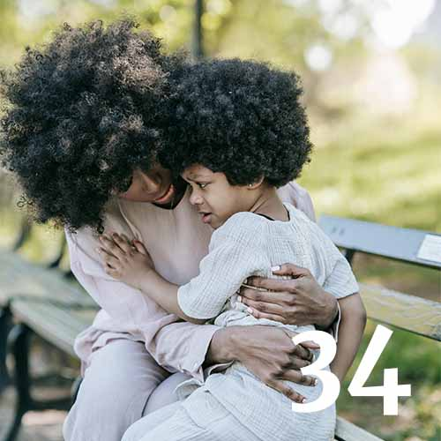
Monday 23rd March
Rejoice in hope, be patient in tribulation, be constant in prayer. Romans 12:9-21
Action: Pray for someone in distress and those who support them.

Slide 35
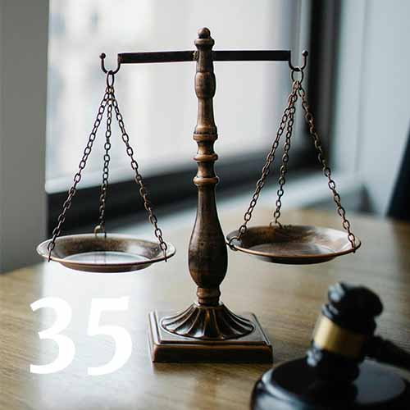
Tuesday 24th March
Seek good, and not evil, that you may live; and so the Lord, the God of hosts, will be with you, as you have said. Amos 5: 5-15
Action: Pray for our legal system – that it may provide justice for victims.

Slide 36
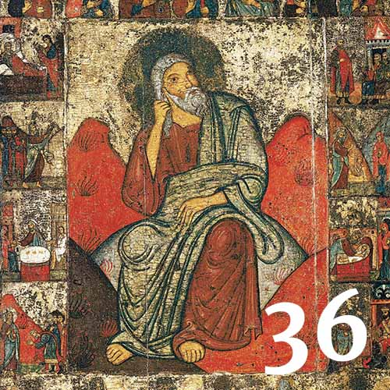
Wednesday 25th March
Now faith is the assurance of things hoped for, the conviction of things not seen. Hebrews 11:1-40
Action: What do you need to do to deepen your faith today?

Slide 37
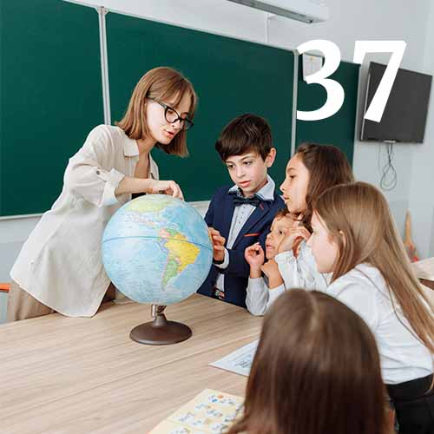
Thursday 26th March
So we, though many, are one body in Christ, and individually members one of another. Romans 12:3-8
Action: Pray for our schools and education systems and for all the children that are in their care.

Slide 38
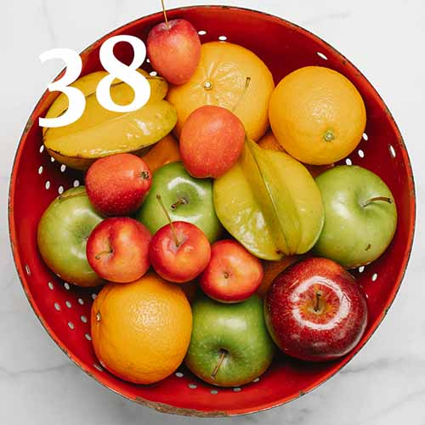
Friday 27th March
Oh, taste and see that the Lord is good! Psalm 34: 1-18
Action: Reflect on this verse at one of your mealtimes today and before you go to sleep.

Slide 39
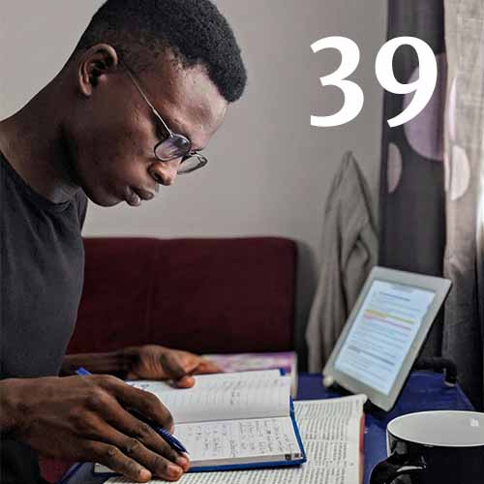
Saturday 28th March
Only let your manner of life be worthy of the gospel of Christ. Philippians 1:12-30
Action: Read the Letter to the Philippians and see how God speaks to you in this Letter.

Slide 40
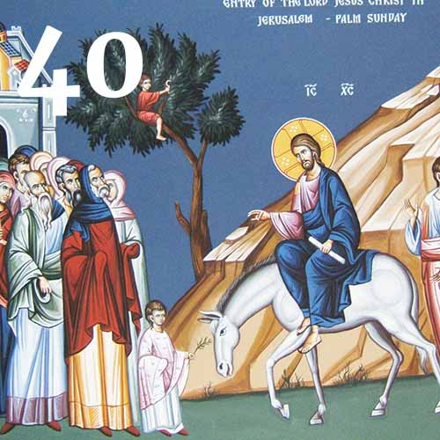

Palm Sunday – 29th March
Blessed is he who comes in the name of the Lord! Mark 11:1-11
Action: Decide how you will prepare to meet Jesus as we begin Holy Week.

Slide 41
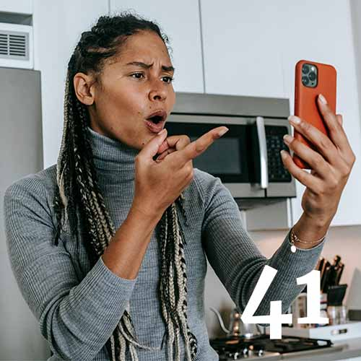
Monday 30th March
My God, my God, why have you forsaken me? Psalm 22: 1-31
Action: Comfort someone in person, on the phone, online or in prayer who feels forsaken.

Slide 42
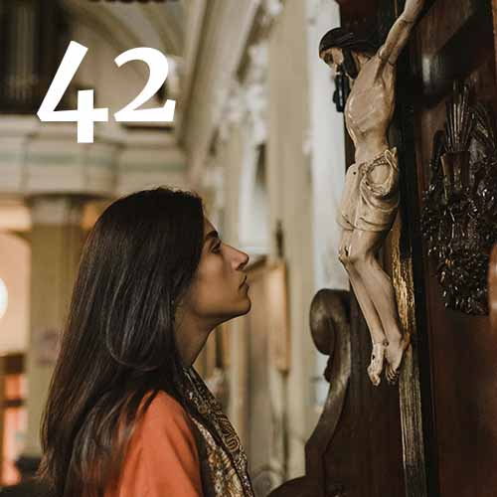
Tuesday 31st March
At the name of Jesus every knee should bow, in heaven and on earth and under the earth. Philippians 2:1-11
Action: Spend 10 minutes either kneeling or sitting quietly in praise and thanksgiving of Jesus.

Slide 43
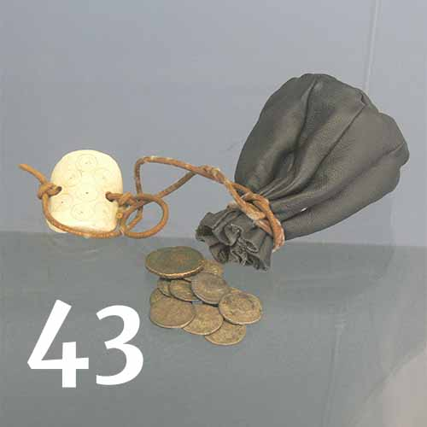
Wednesday 1st April
Then Judas Iscariot, who was one of the twelve, went to the chief priests in order to betray him to them.
Mark 14:1-11
Action: Let us ask for forgiveness for any betrayal of God or of others in our lives.

Slide 44
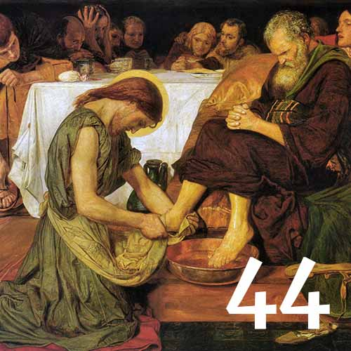
Maundy Thursday – 2nd April
Then he poured water into a basin and began to wash the disciples' feet and to wipe them with the towel that was wrapped around him.
John 13:1-30
Action: Who can you serve and how can you show them service?

Slide 45
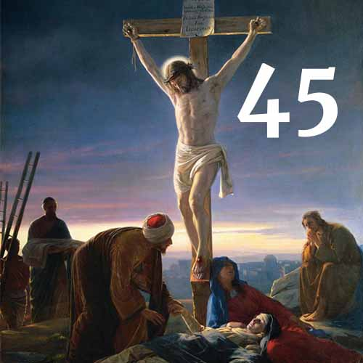
Good Friday – 3rd April
“It is finished,” and he bowed his head and gave up his spirit. John 19:16-30
Action: Imagine you are Mary seeing your son crucified as a common criminal.
Jesus, Lamb of God, who takes away the sin of the world, grant us your peace.

Slide 46
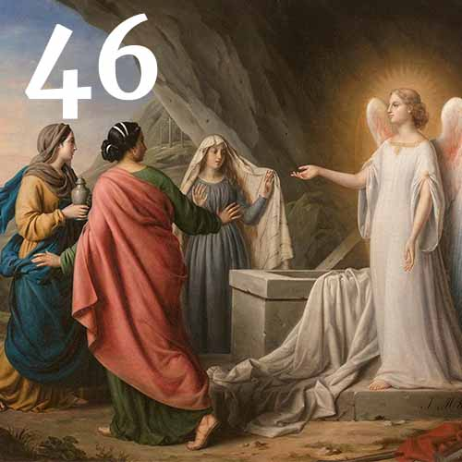
Holy Saturday – 4th April
“Do not be alarmed. You seek Jesus of Nazareth, who was crucified. He has risen; he is not here.” Mark 16:1-7
Action: In this in-between time let us wait and trust in the resurrection to come.

Slide 47
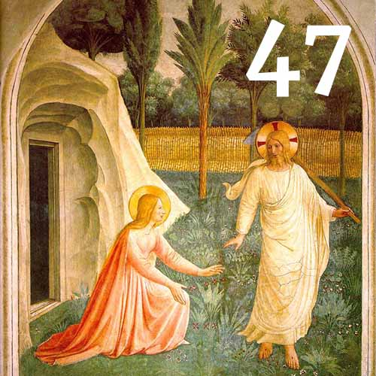
Easter Sunday – 5th April
Mary Magdalene went and announced to the disciples, “I have seen the Lord.” John 20:11-18
Action: Christ is risen Alleluia! Let us share the good news and witness new beginnings.

