Slide 1
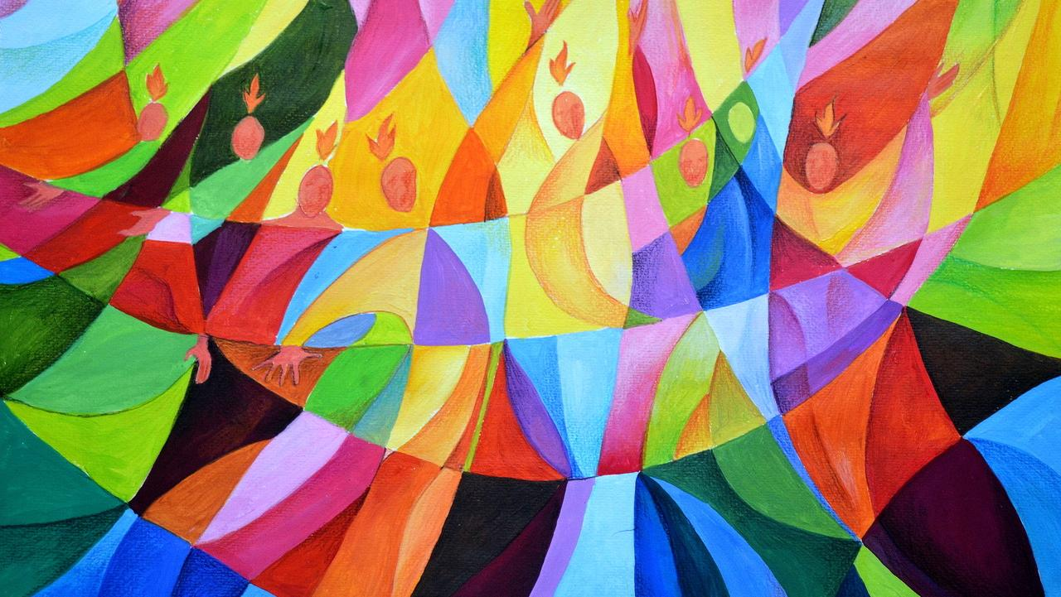
Pentecost Visual Novena

Slide 2
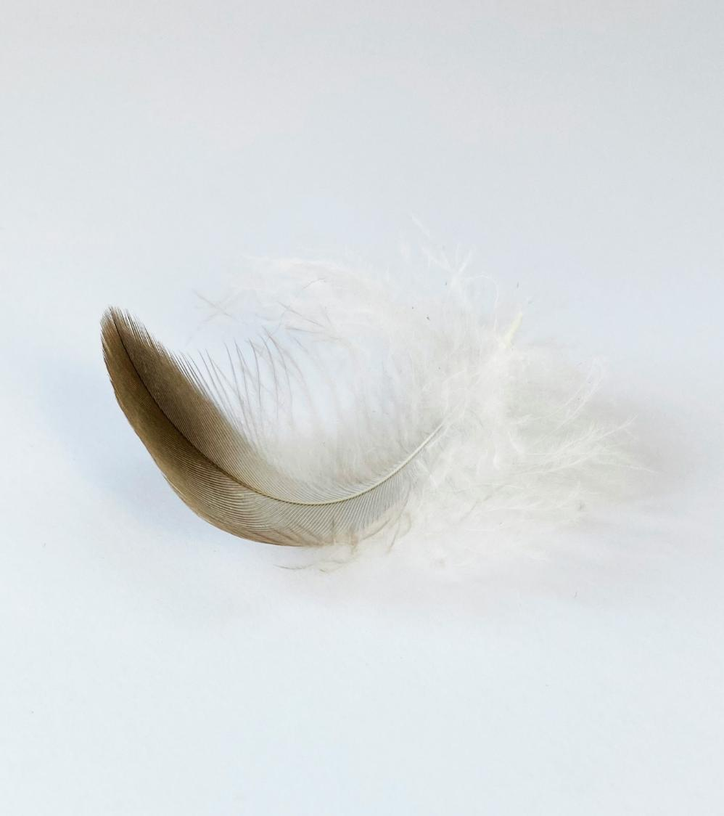

Day 1 - Opening Prayer Come Holy Spirit, fill the hearts of your faithful. And kindle in us the fire of your love. Send forth your Spirit and we shall be created. And you will renew the face of the earth.

Slide 3
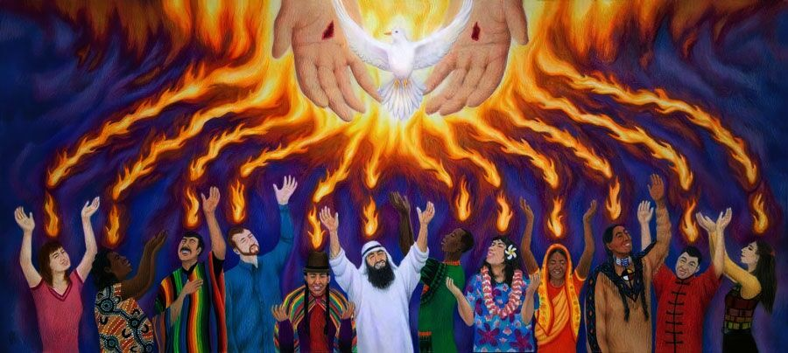

Slide 4
Day 2 - Opening Prayer Come Holy Spirit, fill the hearts of your faithful. And kindle in us the fire of your love. Send forth your Spirit and we shall be created. And you will renew the face of the earth.

Slide 5
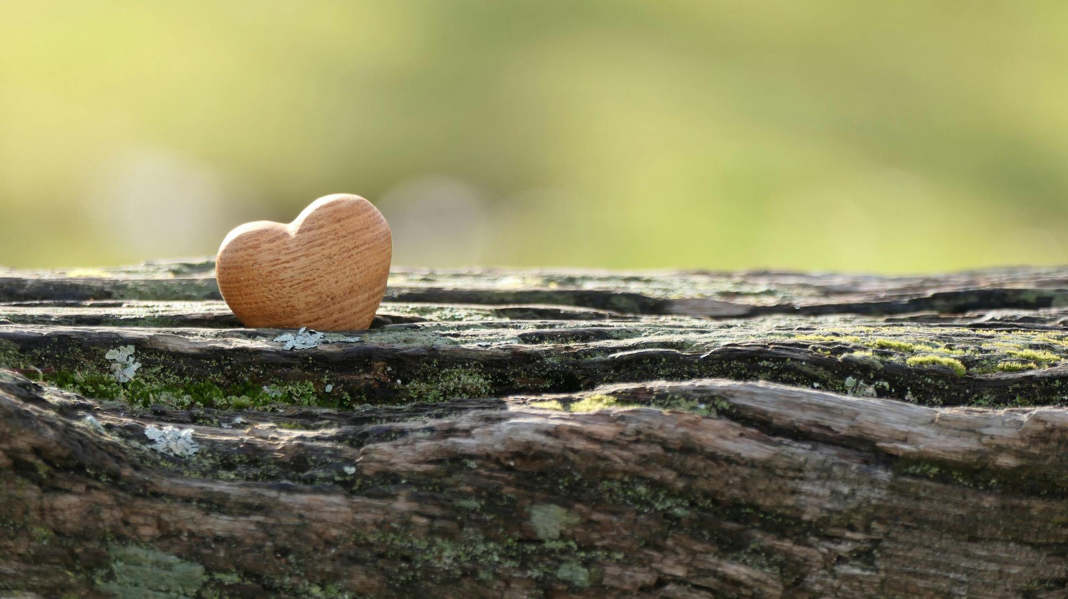

Slide 6
Day 3 - Opening Prayer Come Holy Spirit, fill the hearts of your faithful. And kindle in us the fire of your love. Send forth your Spirit and we shall be created. And you will renew the face of the earth.

Slide 7


Slide 8
Day 4 - Opening Prayer Come Holy Spirit, fill the hearts of your faithful. And kindle in us the fire of your love. Send forth your Spirit and we shall be created. And you will renew the face of the earth.

Slide 9


Slide 10
Day 5 - Opening Prayer Come Holy Spirit, fill the hearts of your faithful. And kindle in us the fire of your love. Send forth your Spirit and we shall be created. And you will renew the face of the earth.

Slide 11
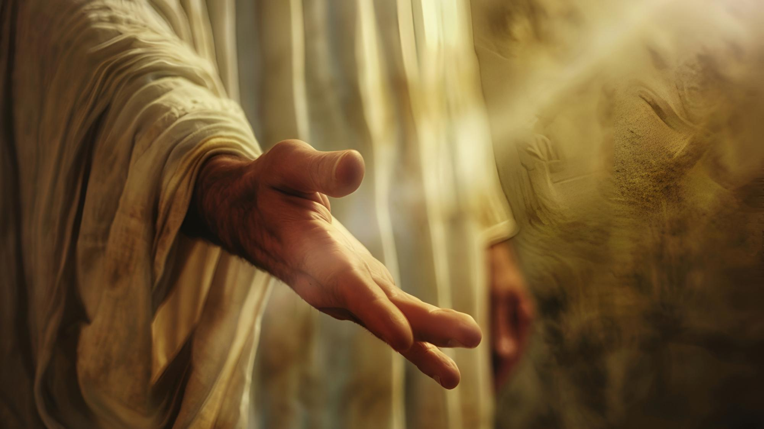

Slide 12
Day 6 - Opening Prayer Come Holy Spirit, fill the hearts of your faithful. And kindle in us the fire of your love. Send forth your Spirit and we shall be created. And you will renew the face of the earth.

Slide 13
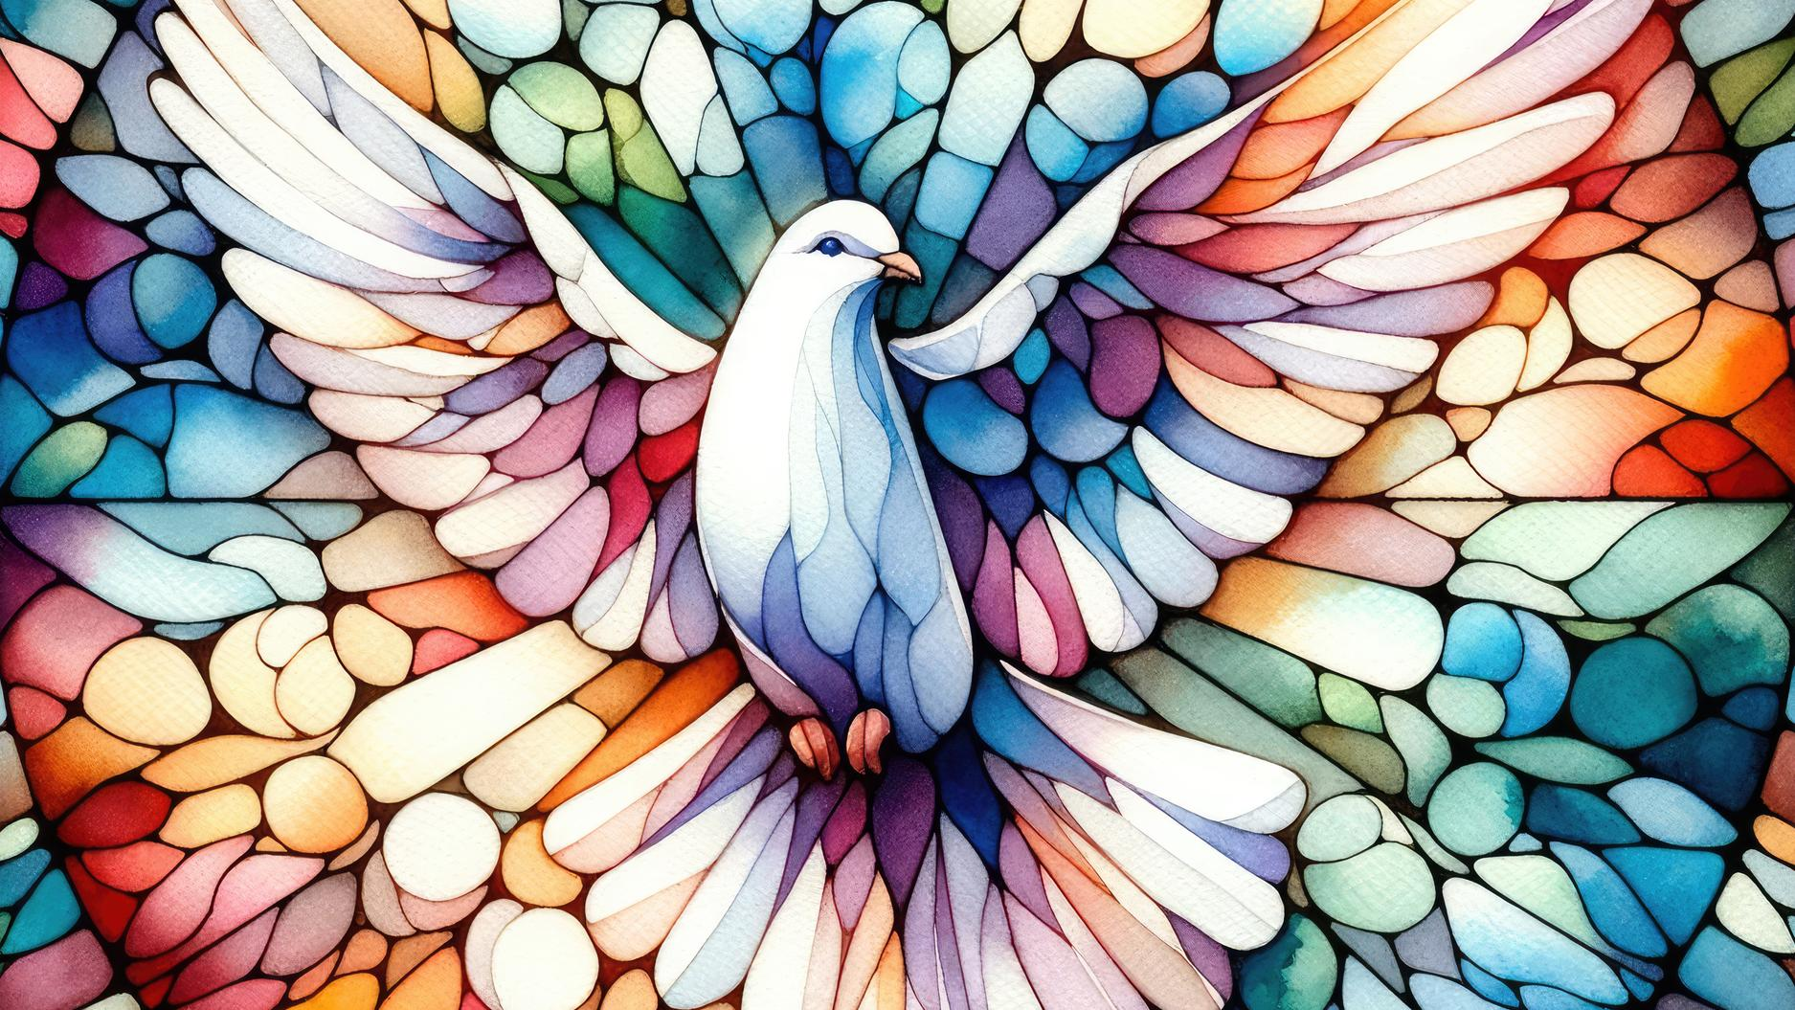

Slide 14
Day 7 - Opening Prayer Come Holy Spirit, fill the hearts of your faithful. And kindle in us the fire of your love. Send forth your Spirit and we shall be created. And you will renew the face of the earth.

Slide 15


Slide 16
Day 8 - Opening Prayer Come Holy Spirit, fill the hearts of your faithful. And kindle in us the fire of your love. Send forth your Spirit and we shall be created. And you will renew the face of the earth.

Slide 17
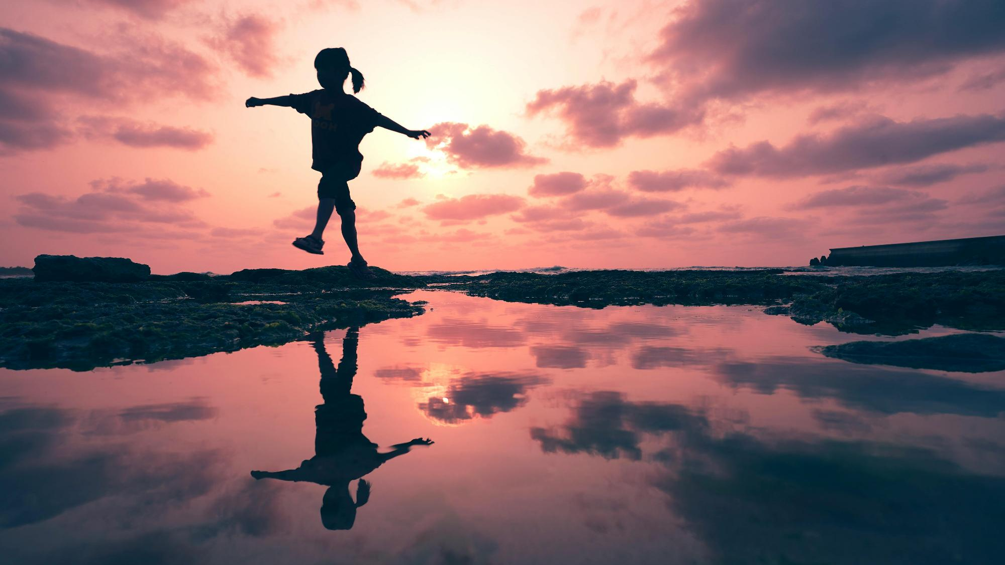

Slide 18
Day 9 - Opening Prayer Come Holy Spirit, fill the hearts of your faithful. And kindle in us the fire of your love. Send forth your Spirit and we shall be created. And you will renew the face of the earth.

Slide 19
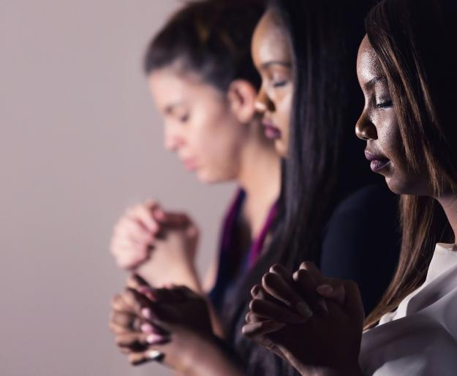
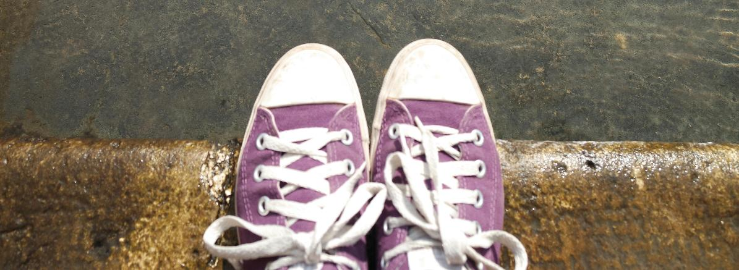
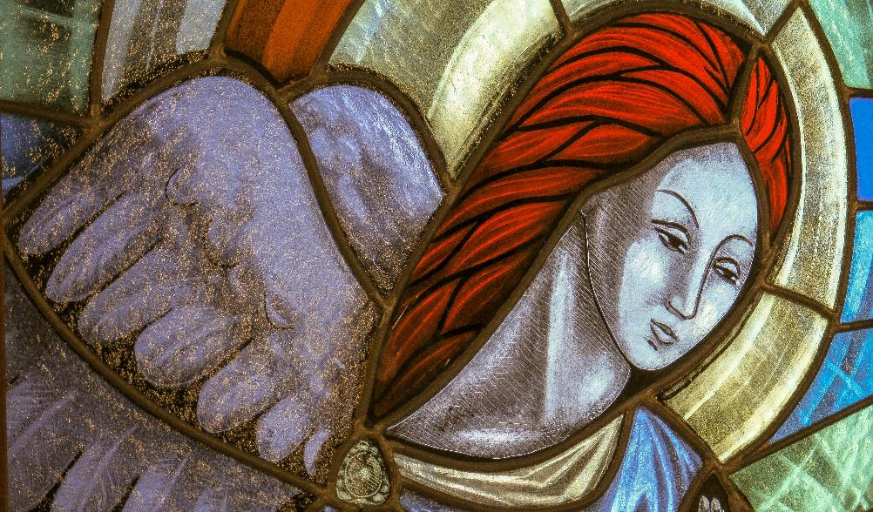
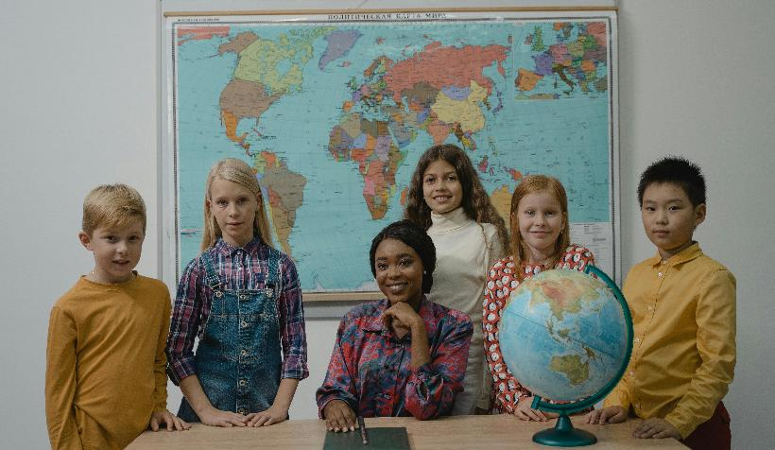

Slide 20
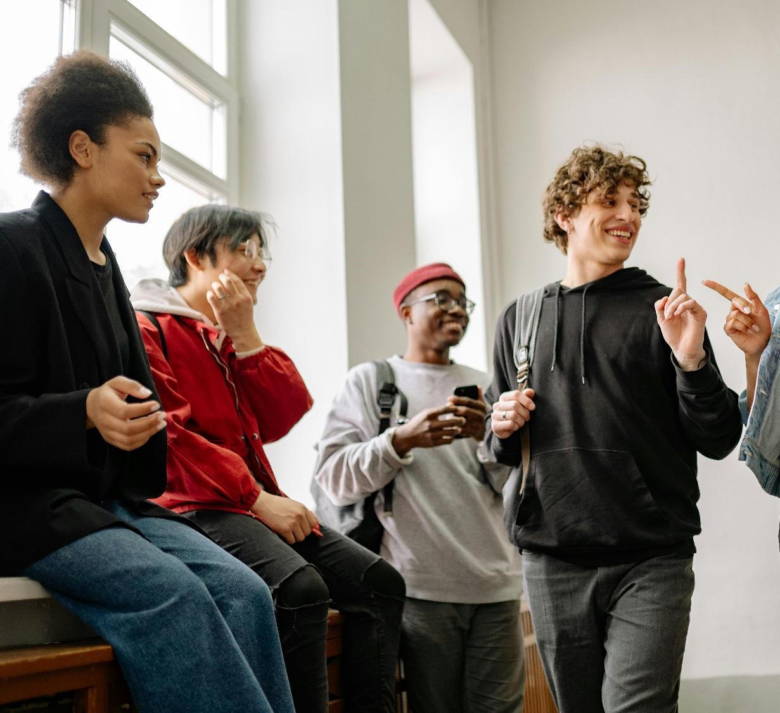
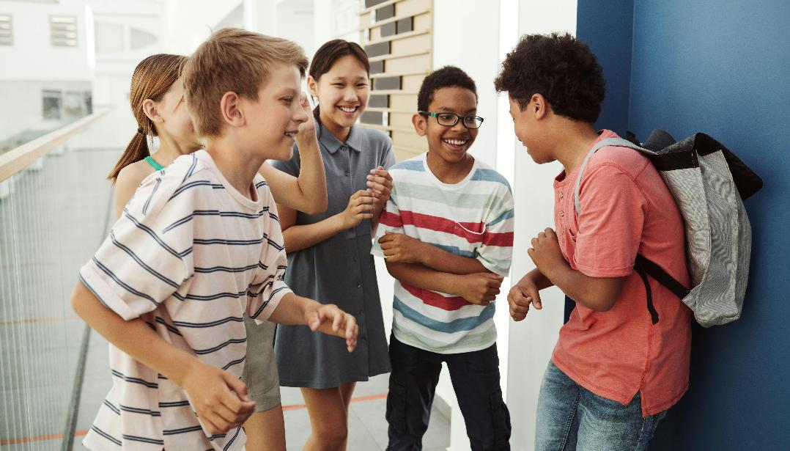
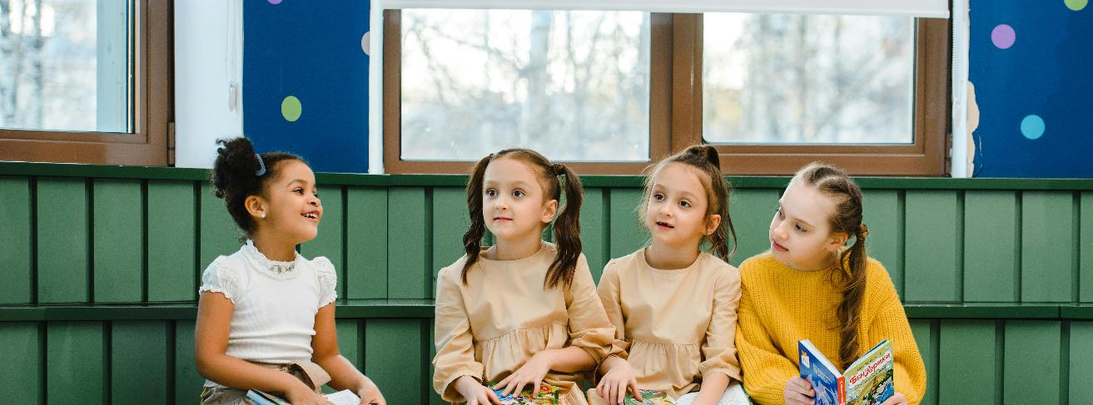
Happy Pentecost Day.
Are you ready to share the Gospel?

