Slide 1
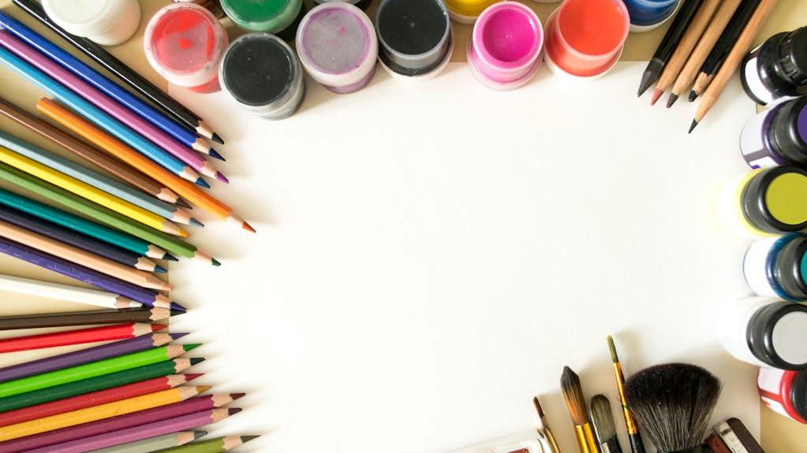
Searching for God? Lesson 1, Primary Three circles: looking at art to think about spiritual ideas.
Notes:
Searching for God? Lesson 1 Three circles: looking at art to think about spiritual ideas There are four primary and four secondary lessons in this project, which fit well together – but teachers are welcome to use some of them as they fit in with your own RE planning and schemes of work. Each lesson contains three or more learning activities – spread them out over two lessons or select the ones which fit your class learning needs best.
The partnership in creating these lessons with NATRE links powerfully to the Spirited Arts project NATRE runs each year. See examples and details here: https://www.natre.org.uk/about-natre/projects/spirited-arts/spirited-arts-gallery/2024/

Slide 2

Searching for God Art and Circles.
Creative and thoughtful RE Lessons which use inspirational art from the exhibition ‘Cloud of Witnesses’ Co-CURAted by ‘The God who Speaks.’
www.godwhospeaks.uk/cloud-of-witnesses-art-exhibition/
Notes:
In 2025, the Catholic Bishops’ Conference ran an art exhibition called ‘Cloud of Witnesses’. Seeking to represent different visions and insights from interfaith integrities, the exhibition was a big success. These art and RE lessons share their work. Artists were invited to show work which explored human searches for the divine in many and varied ways. Stunning work resulted, and the project enabled a link to be made to school RE. These lessons, four for primary RE and four for secondary RE, have been created to enable excellent RE which uses some of the art from the exhibition for the purposes of excellent school RE.

Slide 3

Searching for God: Aims These lessons aim to enable learners to: a. think about art works that express big ideas about God and spiritual questions. b. develop broad minded and open-hearted responses to the ideas of others. c. consider religious teachings about God for themselves. d. respond creatively for themselves to theological learning in RE. These aims mean each lesson intends to be theological, interfaith-informed, rooted in religious ideas and creative.
RE Lessons which use inspirational art from the exhibition ‘ClOUD OF WITNESSEs’ Co-CURATED BY ‘The God who Speaks.’
Notes:
The specific learning objectives of each of our four primary and four secondary lessons are given on the next slide, but these general aims fit in with the purposes of RE as they are articulated in various contexts, for Catholic schools, other schools with a religious character, community schools and academies. Teachers are invited to use these PPTs and the notepads that go with them containing additional resources, learning activities information and learning activities, in flexible ways that suit their own pupils. Seeking to represent different visions and insights from interfaith integrities, the exhibition ‘Cloud of Witnesses’ was a big success. These art and RE lessons share the work.

Slide 4

Searching for God: Aims for this lesson. Learners will be able to: a. think about 3 art works that use a circle to express an idea about God. b. respond to the three artworks by thinking about emotions and ideas. c. consider spiritual ideas from sacred texts about God for themselves. d. respond creatively to the learning for themselves in RE.
RE Lessons which use inspirational art from the exhibition ‘ClOUD OF WITNESSEs’ CO-CURATED BY ‘The God who Speaks’
Notes:
The specific learning objectives of each of our four primary and four secondary lessons are given on this slide. Our general aims fit in with the purposes of RE as they are articulated in various contexts, for Catholic schools in the RED, for other schools with a religious character, community schools and academies in relation to Agreed Syllabuses and the RE Council’s Statement for Entitlement for RE (which DfE are alert to in their current curriculum review).
Teachers are invited to use these PPTs and the notepads that go with them containing additional resources, learning activities information and learning activities, in flexible ways that suit their own pupils. Seeking to represent different visions and insights from interfaith integrities, the exhibition ‘Cloud of Witnesses’ was a big success. These art and RE lessons share the work.

Slide 5

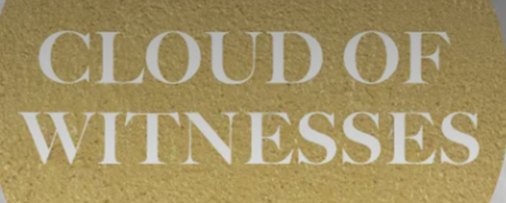
Searching for God
Notes:
In 2025, the Catholic Bishops’ Conference ran an art exhibition called ‘Cloud of Witnesses’. Seeking to represent different visions and insights from interfaith integrities, the exhibition was a big success. These art and RE lessons share their work. Artists were invited to show work which explored human searches for the divine in many and varied ways. Stunning work resulted, and the project enabled a link to be made to school RE. These lessons, four for primary RE and four for secondary RE, have been created to enable excellent RE which uses some of the art from the exhibition for the purposes of excellent school RE.

Slide 6

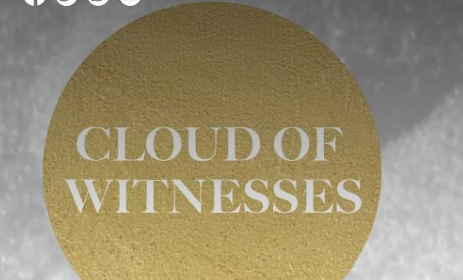
In 2025, in London, an Art exhibition called ‘Cloud of Witnesses’ showed lots of artists’ works about God. They explored faith in God and doubt. From different religions and no religion, these artworks show us some creative ways to explore some of life’s biggest questions.
Cloud of Witnesses
Notes:
In 2025, the Catholic Bishops’ Conference ran an art exhibition called ‘Cloud of Witnesses’, digitally available here: https://www.godwhospeaks.uk/cloud-of-witnesses-art-exhibition/ ‘The God who Speaks’ is a digital space where Catholic Biblical insights and visions are shared. Artists were invited to show work which explored human searches for the divine in many and varied ways. Stunning work resulted, and the project enabled a link to be made to school RE. These lessons, Four for primary RE and four for secondary RE, have been created to enable excellent RE which uses some of the art from the exhibition for the purposes of excellent school RE. Seeking to represent different visions and insights from interfaith integrities, the exhibition was a big success. These art and RE lessons share their work.

Slide 7
Circles
Circles are everywhere. Think of some!
The Sun. The Earth. Our eyes. The shape of water in a puddle. The middle letters in the word ‘LOOK’. The shape of a cake, or a pizza. Crop circles. Can you think of some more?
We use circles in maths and geometry. And people make signs and symbols all the time. And the circle is a favourite symbol. What does it mean when we say: ‘Round and round we go.’ ‘The Circle of Life’ or ‘Rings for our fingers’. ‘All hold hands and dance round the circle’. Do you know any more?
All the amazing religions of the world use the circle as a symbol. The Buddha gave us the Wheel of Life. Sikhs wear a steel circle on their wrist as a sign of God. A crescent moon is a symbol for Islam. Christians remember a round stone that was rolled away on Easter morning: a sign of new life.
We will look at three artworks that make a circle into a spiritual symbol. Different pupils can read aloud from the slides, but everyone: LISTEN and THINK!
Notes:
Obviously, you could show pupils some examples of these ‘circle symbols’ – there are hundreds…
It works very well to have volunteer or chosen pupils read aloud from the slides to aid concentration. Make space for discussion and response of course.
The concepts here can look hard, but we are confident pupils will respond imaginatively.

Slide 8
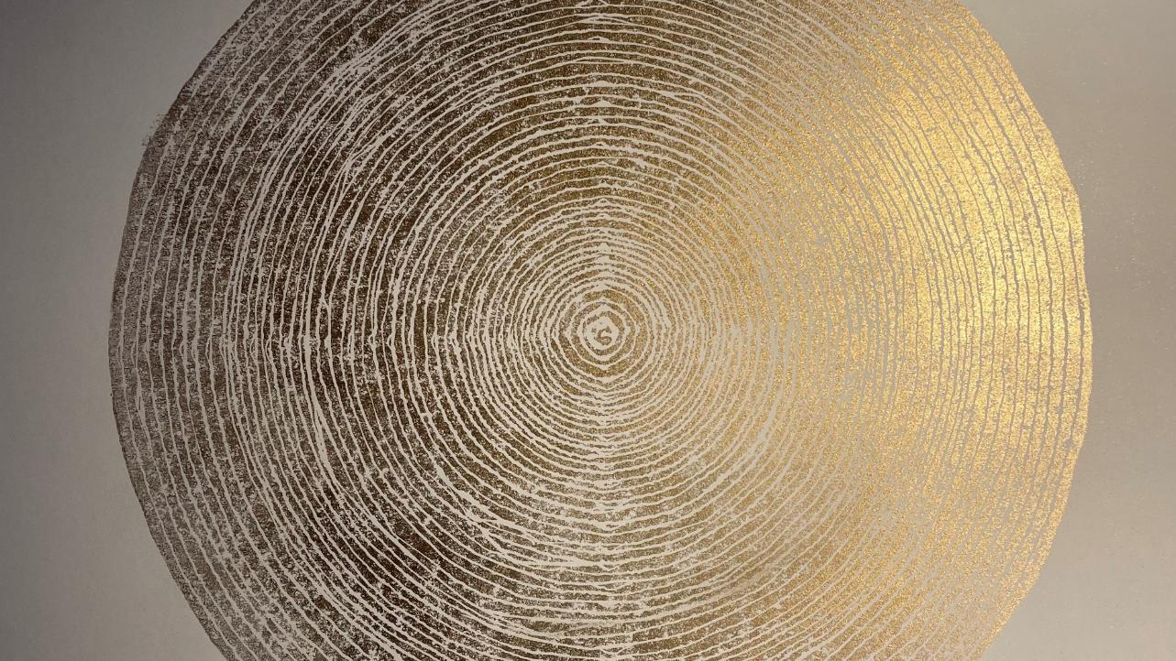
Notes:
Looking at the art work is an important part of learning – too often lessons and pupils skip to the explanation. But there’s such a benefit in ‘having a good stare’ and a good think.

Slide 9
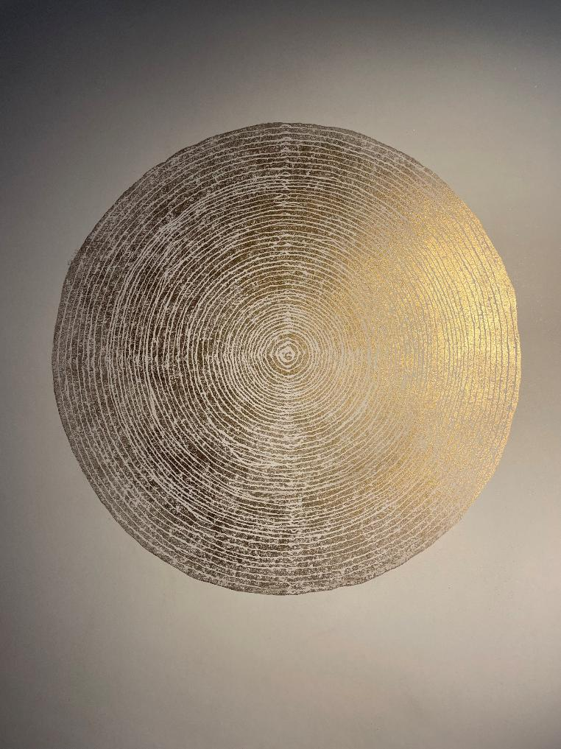
Six pieces of information about the art.
The work of art is called ‘Life 1’
Svetlana, the artist is a Christian.
She made 10 copies of this.
There are 51 line circles – of gold in the print.
Psalm 51 (in the Bible) is a prayer for forgiveness
The Psalm asks God: ‘let me hear joy and gladness’ The artwork connects ideas about hearing and heartbeats to prayer, forgiveness and joy.
Notes:
Ask pupils to say what they see first. Svetlana suggests that reading Pslam 50 and then 51 makes even more sense of the work.

Slide 10
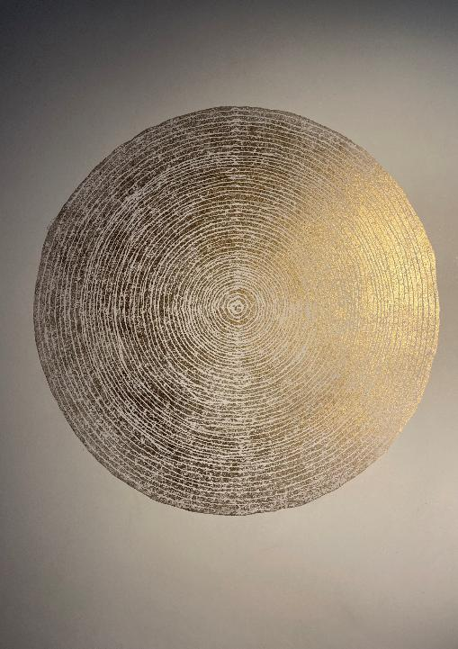
Life 1 - A print from a handmade linocut, gold ink on 300g white Somerset paper, one edition of 10. Size: 50cm x 70cm. 2024 www.svetlanaatlavina.com
Svetlana is a Christian artist who makes work out of all kinds of materials, and she’s interested in connections, childhood, thinking as visualised and memories.
She currently works on a project ‘All is One’, focused on the transcendent, the ‘big beyond’.
This art is called ‘Life 1’. It is part of a project called ‘All is One.’’
Notes:
This also calls to mind a slice of a tree, revealing its growth rings: another instance of the ‘circle of life’?

Slide 11

In the Jewish and Christian Bible, Psalm 51 is a prayer for forgiveness. Psalm 51 verse 8 says: ‘Let me hear joy and gladness; let the bones you have crushed rejoice.’
This work is made of 51 gold lines, which are a symbol of the sound of the human heart, vibrating as it pumps.
Humans are alive while this sound lasts. When the heart stops, life stops. Our ability to hear is part of being alive too.
What does it mean for the prayer ‘let me hear joy and gladness’ to be answered?
Notes:
Jewish and Christian scripture:
Psalm 50:
1. The Mighty One, God, the Lord, speaks and summons the earth from the rising of the sun to where it sets.
2 From Zion, perfect in beauty, God shines forth.
3 Our God comes and will not be silent;
a fire devours before him, and around him a tempest rages.
4 He summons the heavens above, and the earth, that he may judge his people:
5 “Gather to me this consecrated people, who made a covenant with me by sacrifice.”
6 And the heavens proclaim his righteousness, for he is a God of justice.

Slide 12
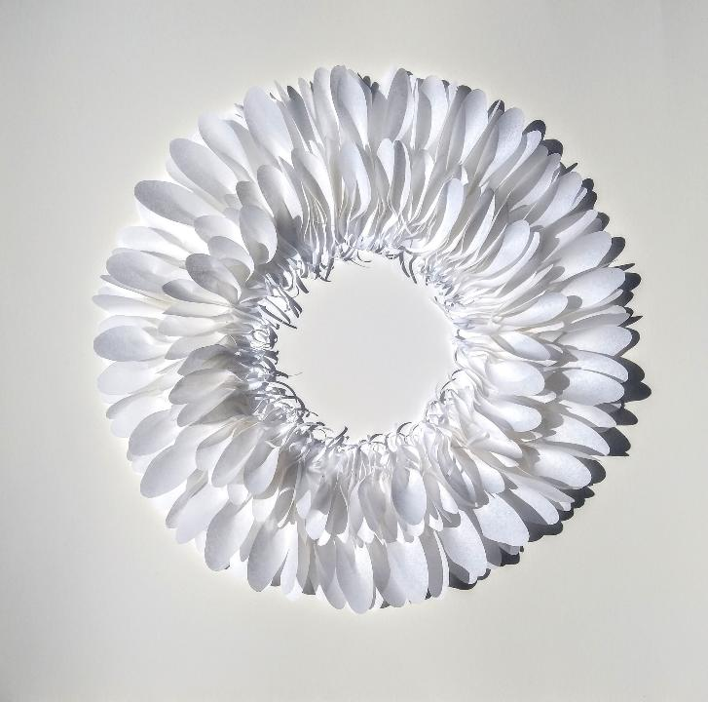
‘Feathers: Shield’ by Carole Bury
6 pieces of information about the art.
The artist made this work by folding and stitching paper feathers, then organising them into two rings
There are 300 paper feathers in the whole work.
The work is 44cm by 44cm – spread your hands to get a feel for the size of it.
Carole is interested in the ways light shines through paper and makes shadows that keep changing.
Carole says the work is a ‘circle of stillness.’
She says the work is ‘a kind of meditation.’
Notes:
Again, good to get pupils to look at this before they are ‘given the facts’. Imagination reigns!

Slide 13
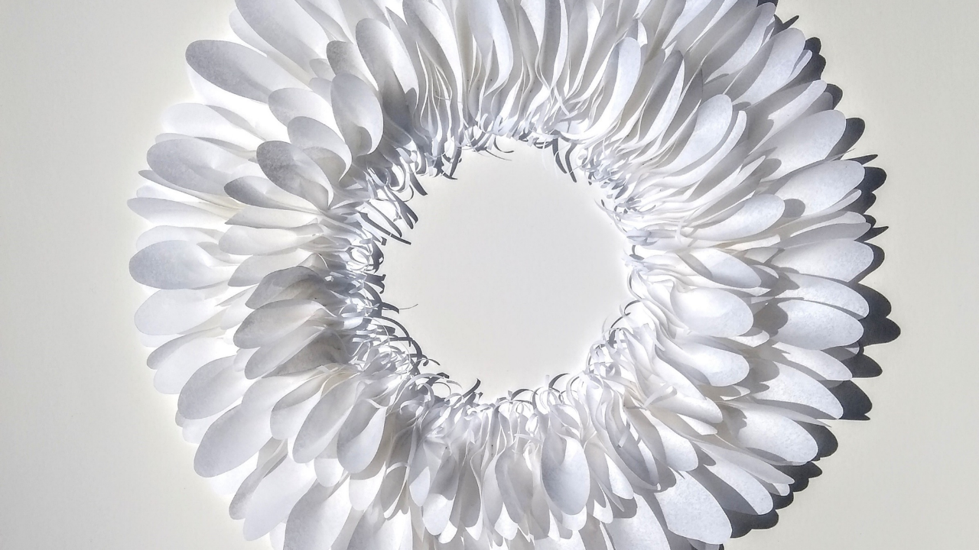
Psalm 91: 4 -
“God will cover you with his feathers,
and under his wings you will find refuge;
his faithfulness will be your shield.”
Notes:
What do you see? Delicate paper feathers. Light and shade. Two circles wit the same centre – the centre is nothing, it is a space created by the circle around it.
Clearly, someone has worked hard on this creation.

Slide 14
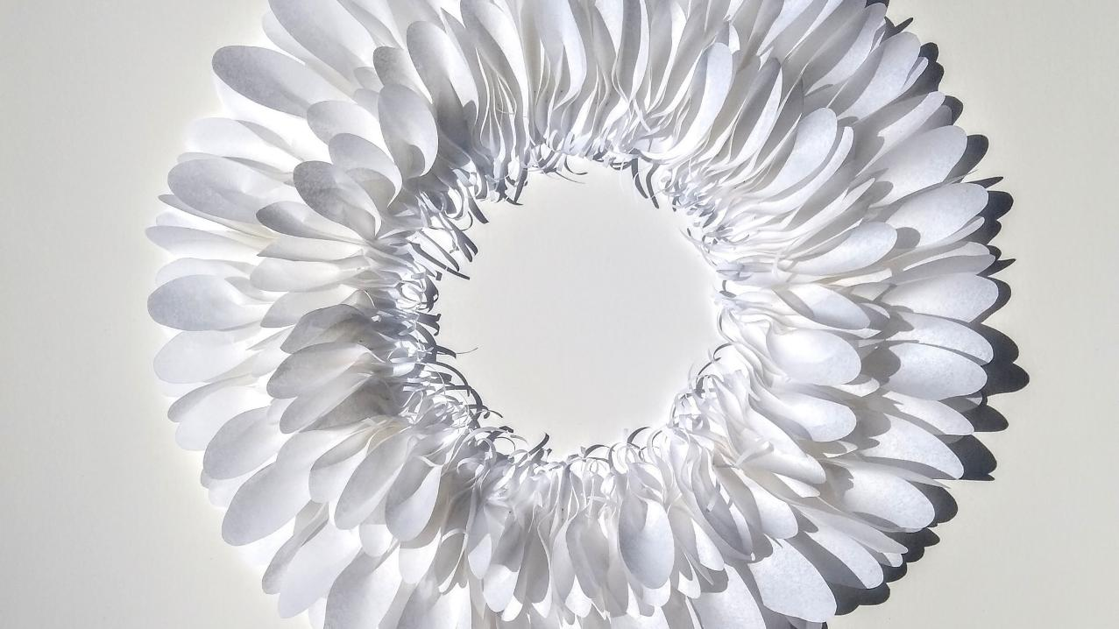
Carole Bury made “Feathers: Shield” in 2021. www.carolebury.com
It’s a double ring, made of 300 paper feathers. Each feather is unique, each one cut-out, curled, folded, hand-stitched and knotted into the circle. Making this took ages - care, precision, quiet, rhythm, repetition were needed.
Carole is interested in the ways light shines through paper and makes shadows that change: “Resting with these simple shapes offers a space to receive love and strength from Jesus.”
Carole’s gallery notes for this work say: “Making every paper feather takes time. Each stitch is like a prayer. Like embracing God.”
Making the art is like a kind of meditation. It can help a person to feel the breath of God. No words or images are used – it’s just a circle of Stillness, but it can open the mind to beauty and to the presence of the Beloved.
Notes:
Psalm 91: 4 is a reference point for this art work. New International Version:
“God / He will cover you with his feathers,
and under his wings you will find refuge;
his faithfulness will be your shield and rampart..”

Slide 15
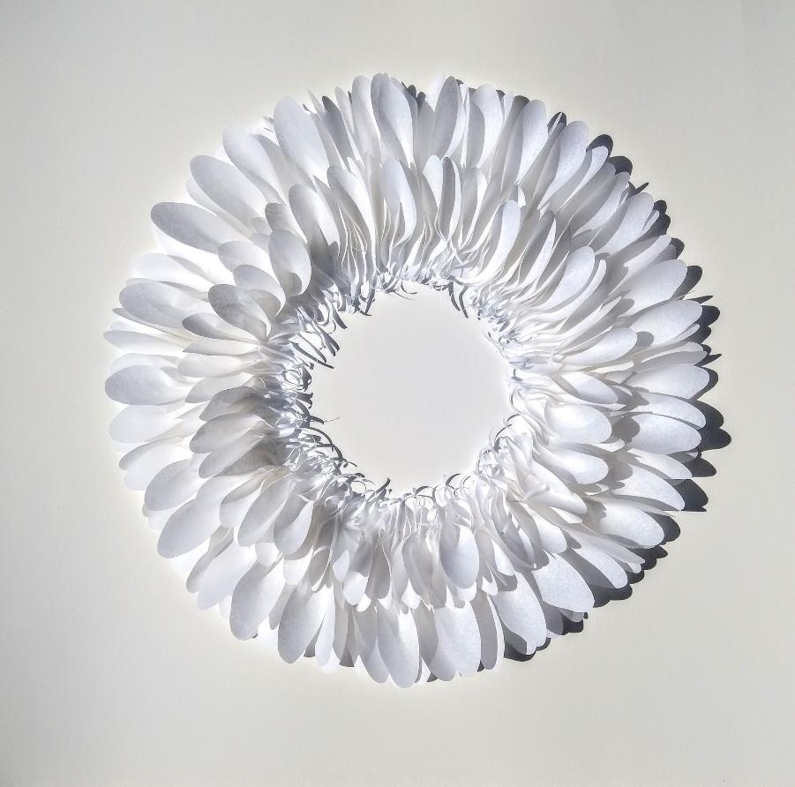
Questions to discuss
How would you explain this work of art to someone who had never seen it?
What do you like about the art work?
Carole uses words like ‘prayer’, ‘meditation’ and ‘stillness’ to talk about the work. How do you respond?
It is called ‘Feathers: Shield’. Of course, a ‘shield’ made of ‘feathers’ would be no use. What made her choose this title do you think?
What else would you like to say about the art?
Notes:
‘Feathers: Sheild’. A paradoxical idea?
Maybe we should think of the fragility of all shields, or the ways that something like this could shield us by beauty?

Slide 16
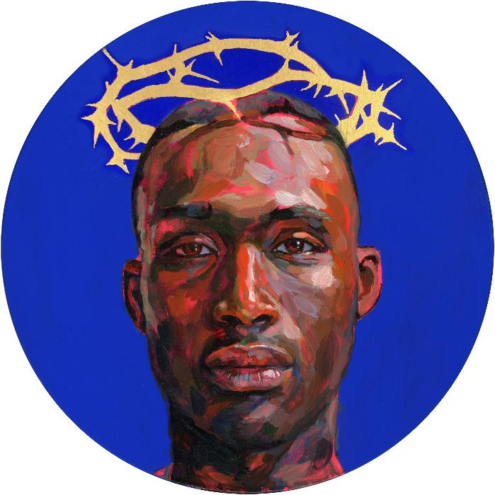
Six pieces of information about this art work. The artist, calls it ‘Blue Christ’.
The painting shows Jesus as a black man.
The crown of thorns is 24 carat pure gold.
The artist based her image of Jesus on a famous fashion model.
There is a connection between this painting of Jesus and the ‘Black Lives Matter’ movement.
The rich, deep blue paint in the background was especially made for this picture.
It is 25cm in diameter,
Notes:
Lorna May Wadsworth, Blue Christ, 2021

Slide 17

Lorna May Wadsworth, Blue Christ, 2021 Lorna, from Sheffield, is famous for painting famous people like two former Prime Ministers – Margaret Thatcher and Tony Blair; and film-maker, Richard Curtis. www.lornamaywadsworth.com The sitter for this arresting painting of Christ, crowned with a 24-carat gold crown of thorns, was the fashion model, Jamel Gordon-Lynch. ‘Blue Christ’ is a tondo, or circular portrait. Lorna wants to make people think again about Jesus and she challenges the normal conventions of how Jesus and his disciples are traditionally portrayed. Her work sometimes shows solidarity with the ‘Black Lives Matter’ movement.
Notes:
Lorna May Wadsworth, Blue Christ, 2021 www.lornamaywadsworth.com

Slide 18
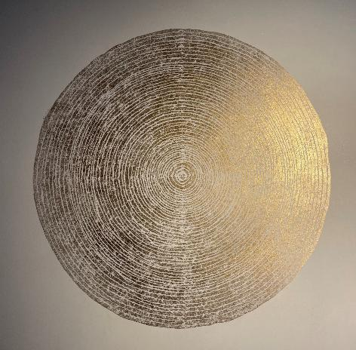
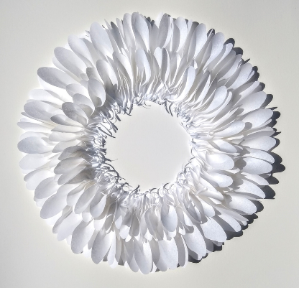
Think about all three of these art works… What questions would you like to ask?
Notes:
The comparison triad sheet on the next slide is a good way to elicit deeper thinking and ideas from pupils.

Slide 19
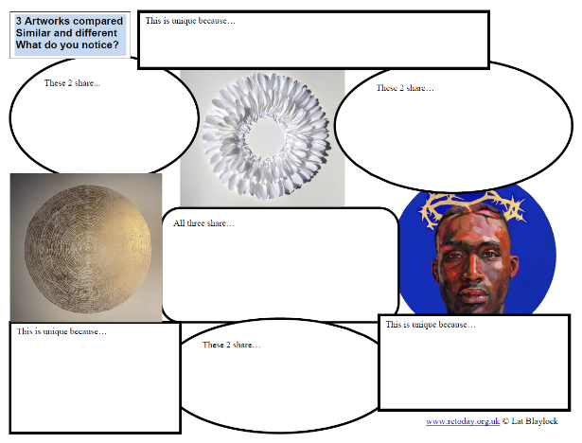
Work with a partner. Take this writing frame and use your imagination to fill it in. Look for similarities and differences between the three works of art you have been studying.
This activity makes you look and think and discuss the art carefully. Group up into 6s to share ideas – and add more to your fill-in sheet.
Notes:
Copy the sheet form the notepad one-between-two. A3 blow ups may be best. Think / talk / write / share / improve is a good process.

Slide 20
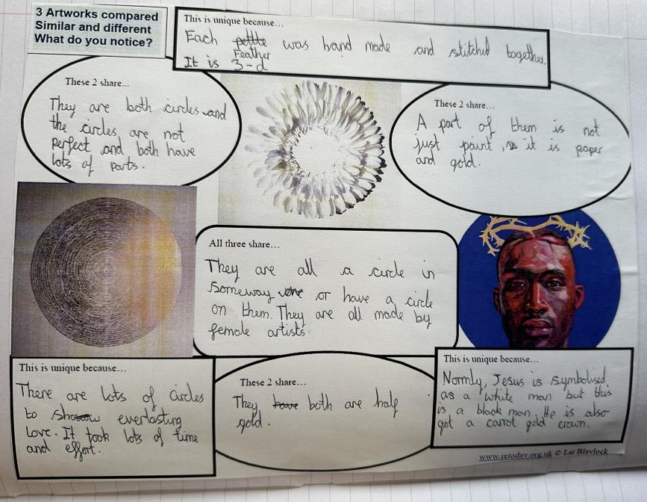
This comparison sheet enables pupils to have a closer look at the art and explore what the images might mean more deeply.

Slide 21
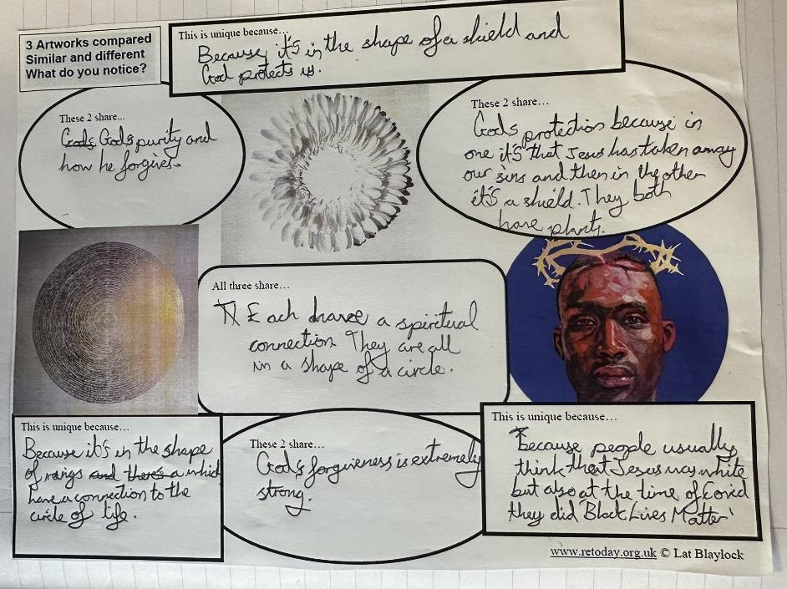
The pupil responds to the artwork with some very well-expressed spiritual points in this example.

Slide 22

Your task: Create an ‘art circle’ using a wise saying you choose. On the next slide: 5 examples of wise sayings about what lasts forever (like a circle) from different religions. Or choose your own!
Notes:
https://thenounproject.com/icon/circle-768814/ Image is free to use.
Draw pupils’ attention to the border – some words or text might go in here, or it can be used to highlight a part of what they express.

Slide 23
Wisdom from different religions. What are your thoughts?
These quotes connect in some ways to our theme of ‘circles’ Choose one, or another wise saying, to use in your ‘art circle’.
“Even a king or an emperor with heaps of wealth who rules a vast land cannot compare with an ant filled with the love of God.” Guru Nanak, in Sikh Scripture, the Guru Granth Sahib.
“Like a mother who protects her child, her only child, with her own life, one should cultivate a heart of unlimited love and compassion towards all living beings.” From Buddha’s Metta Sutta.
"And if you should count the favours of Allah, you would never be able to number them. Indeed, Allah is Forgiving and Merciful.“ Surah An-Nahl, 16:18, Muslim Qur’an.
“The steadfast love of the Lord never ceases. His mercies never come to an end.” Jewish Scriptures, Lamentations 3:22.
“I’m convinced that nothing can separate us from God’s love in Christ Jesus our Lord: not death or life, not angels or rulers, not present things or future things, not powers, or height or depth, or any other thing that is created.” Romans 8:35, Christian Bible.
Notes:
Obviously these scripture quotes could be unpacked in depth – it works quite well to ask pupils to think about all five and choose one. Enable an open discussion of what they mean.
Many other suitable quotations are available!!

Slide 24
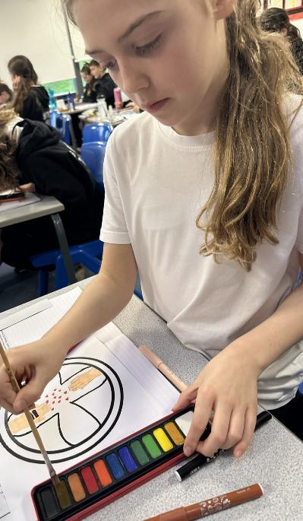
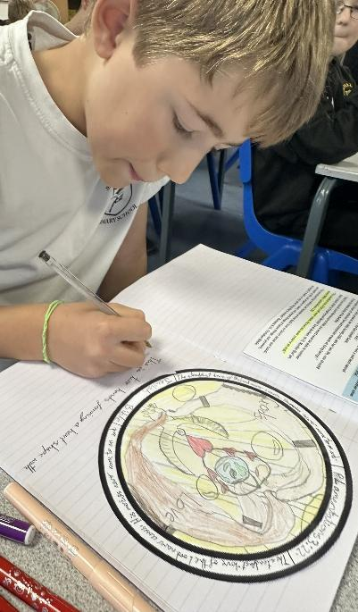
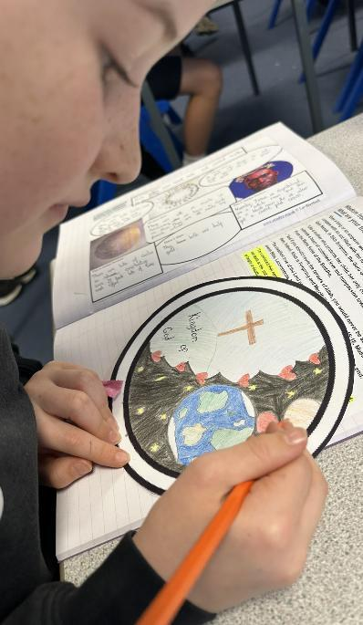

Slide 25
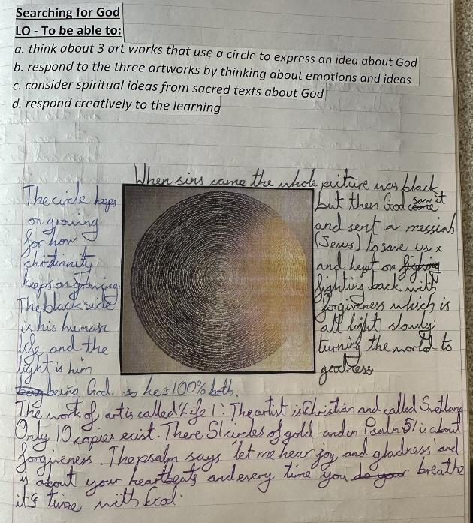
In this fine example of thinking – the pupil (11) makes profound links from the art and the scriptures to their own ideas about light, forgiveness, goodness, heartbeats and the ‘breath of God’

Slide 26
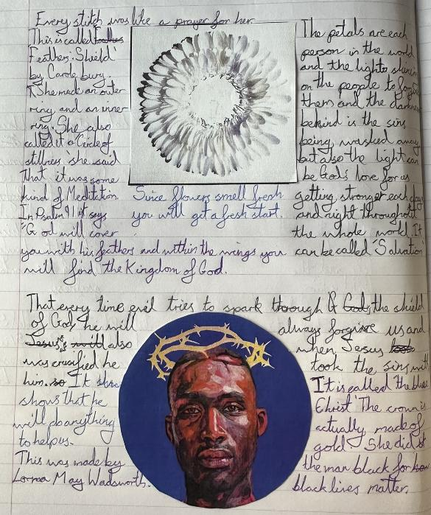
Here, the pupil (11) uses the information given in the lesson to interpret some deep concepts such as: the kingdom of God, the idea of ‘fresh starts’ and the ‘light of love’.
The artworks have enabled flexible and creative engagement with some key spiritual ideas.

Slide 27
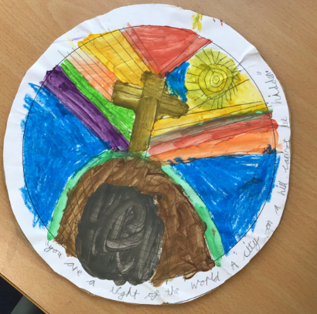
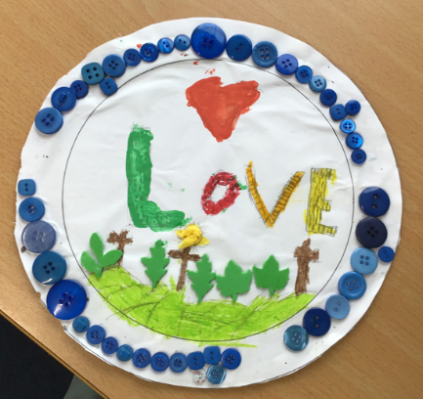
CLOUD OF WITNESSES – ART PROJECT
Thanks to the teachers and pupils in Year 4 who created these.
‘God is the Light of the World, a city on a hill which cannot be hidden.‘
‘The earth is protected by God and everyone knows they are safe.‘
Notes:
These really interesting responses enabled all pupils to select a ‘wise saying’ as the basis for their circle art. Invite your pupils to pick a favourite.

Slide 28
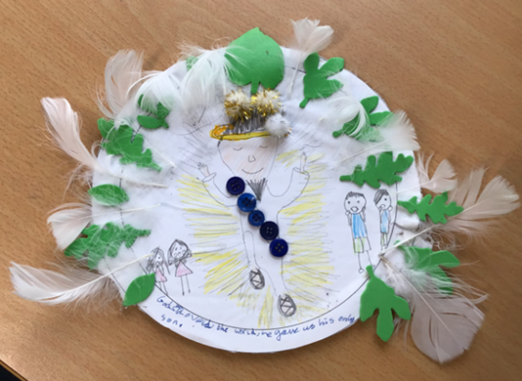
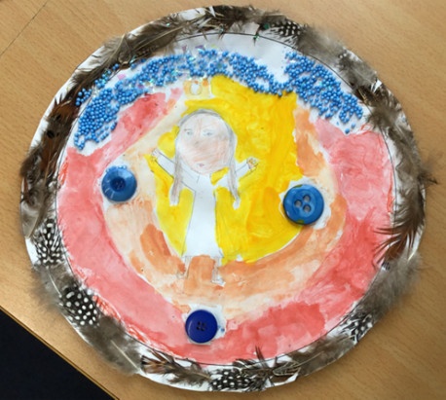
CLOUD OF WITNESSES – ART PROJECT
‘The feathers represent Gods world which he created. Jesus is in the middle – a gift from God and the Light is the Holy Spirit. ‘
‘My art piece reminds us that God loved the world so much, he gave us his only Son.‘

Slide 29
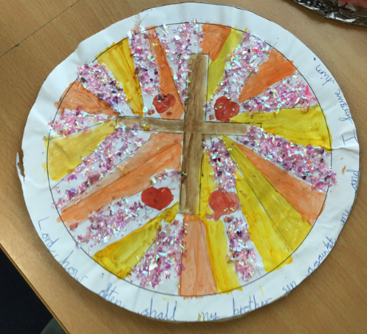
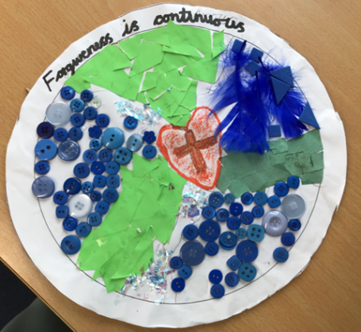
CLOUD OF WITNESSES – ART PROJECT
‘My picture is about forgiveness; God forgives us and we forgive others.‘
‘Forgiveness is always continuous.‘

Slide 30
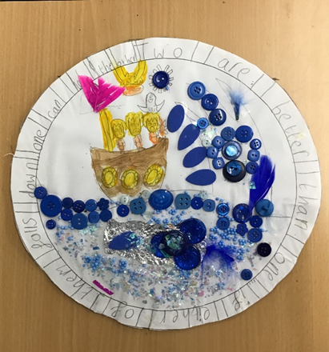
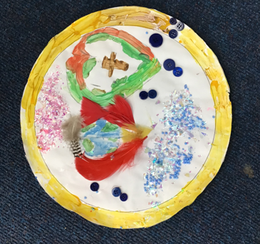
CLOUD OF WITNESSES – ART PROJECT
‘My picture is about forgiveness; God forgives us and we forgive others.‘
‘The World – God created this wonderful world and he has us in his hands.‘

Slide 31
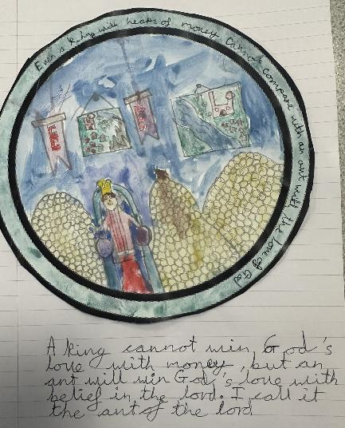
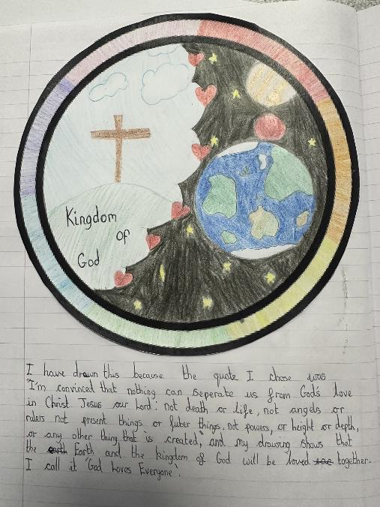
Right hand image -
‘God loves everyone’
The simplicity of the ideas expressed here is perhaps one way that the work has some spiritual power. The pupil clearly discerns and responds to the task with insight of their own.
- Left hand image ‘An ant will win with God’s love’
The Sikh teaching about the ultimate value of divine love is neatly illustrated here – look at the piles of meaningless money! I think that is the ant on top of the middle pile.

Slide 32
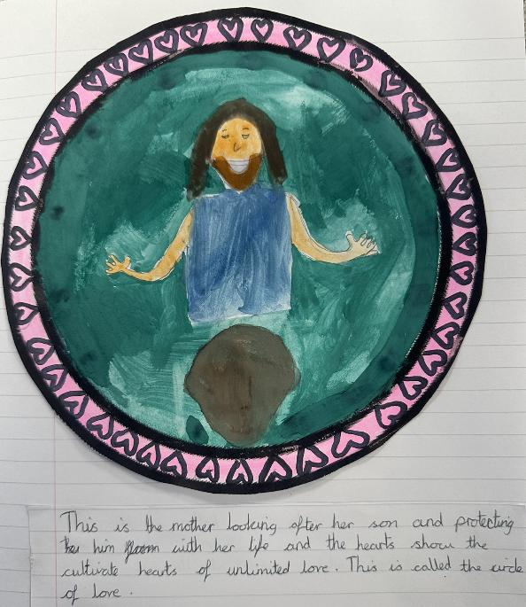
‘The Circle of Love’
Cultivate hearts of unlimited love.
This circle image is based on the way of the Buddha: “Like a mother who protects her child, her only child, with her own life, one should cultivate a heart of unlimited love and compassion towards all living beings.” From the Metta Sutta of the Buddha.

Slide 33



Partnership
Notes:
These lessons and resources have been created by Lat Blaylock and Fleur Dorrell in a partnership between the Catholic Bishops’ Conference through its work on the Bible (‘The God who Speaks’), NATRE (who run the Spirited Arts competition) and RE Today. The lessons are free to use, and suitable for RE in any school, connecting in many ways to different schemes of work , wherever pupils use critical and creative skills to explore theological and spiritual questions. https://www.godwhospeaks.uk/ We also thank teachers and pupils who have been involved in developing and trying out the lessons: your contribution has greatly improved the project!
We invite you to share interesting examples of your pupils’ work: lat@retoday.org.uk

Slide 34

Connections to the Catholic RE Directory
The RE Directory invites all pupils to engage with an ambitious RE curriculum focused on multiple disciplines in the pursuit of truth. These lesson ideas enable this aim.
By age 10, pupils will use critical and creative skills in RE by exploring creative and artistic opportunities and reflect on their learning, considering what it means to them (RED, p167).
This work might contribute to the studies in Branch 5 of the curriculum, ‘To the Ends of the Earth’ by enabling pupils to understand teaching about God the Holy Spirit, the gifts and fruits of the spirit, and some examples of artistic representation of the Spirit of God (RED p163).
The work also connects to Branch 6, Yr 6, Dialogue and Encounter, because it provides a spiritual space to consider the teachings of sacred texts from Dharmic (Sikh and Buddhist) sources (RED p183).
Notes:
These lessons and resources have been created by Lat Blaylock and Fleur Dorrell in a partnership between the Catholic Bishops’ Conference through its work on the Bible (‘The God who Speaks’), NATRE (who run the Spirited Arts competition) and RE Today. The lessons are free to use, and suitable for RE in any school, connecting in many ways to different schemes of work , wherever pupils use critical and creative skills to explore theological and spiritual questions. https://www.godwhospeaks.uk/ We also thank teachers and pupils who have been involved in developing and trying out the lessons: your contribution has greatly improved the project!
We invite you to share interesting examples of your pupils’ work: lat@retoday.org.uk

