Slide 1

Searching for God
Lesson 2
Primary
Special Spaces
Creative and thoughtful RE Lessons which use inspirational art from the exhibition ‘Cloud of Witnesses’ Co-CURAted by ‘The God who Speaks’
www.godwhospeaks.uk/cloud-of-witnesses-art-exhibition/
Notes:
In 2025, the Catholic Bishops’ Conference ran an art exhibition called ‘Cloud of Witnesses’ Seeking to represent different visions and insights from interfaith integrities, the exhibition was a big success. These art and RE lessons share their work. Artists were invited to show work which explored human searches for the divine in many and varied ways. Stunning work resulted, and the project enabled a link to be made to school RE. These lessons, four for primary RE and four for secondary RE, have been created to enable excellent RE which uses some of the art from the exhibition for the purposes of excellent school RE.

Slide 2

Searching for God: Aims –
These lessons aim to enable learners to: a. Think about art works that express big ideas about God and spiritual questions. b. Develop broad minded and open-hearted responses to the ideas of others. c. Consider religious teachings about God for themselves. d. Respond creatively for themselves to theological learning in RE.
These aims mean each lesson intends to be theological, interfaith-informed, rooted in religious ideas and creative.
RE Lessons which use inspirational art from the exhibition ‘ClOUD OF WITNESSEs’ CO-CURATED BY ‘The God who Speaks’
Notes:
A ‘lesson’ here might not be a single 45-minute learning slot – the activities include some that go deeper and some that give creative opportunities to pupils.
So maybe a lesson is two or more sessions, or maybe users will select the activities that work best for them.
The specific learning objectives of each of our four primary and four secondary lessons are given on the next slide, but these general aims fit in with the purposes of RE as they are articulated in various contexts, for Catholic schools, other schools with a religious character, community schools and academies. Teachers are invited to use these PPTs and the notepads that go with them containing additional resources, learning activities information and learning activities, in flexible ways that suit their own pupils. Seeking to represent different visions and insights from interfaith integrities, the exhibition ‘Cloud of Witnesses’ was a big success. These art and RE lessons share the work.

Slide 3

Searching for God: Aims for this lesson.
Learners will be able to:
a. Think about artworks that explore what makes a
space holy.
b. Develop open-hearted responses to the ideas of
others about holy spaces.
c. Consider the idea that God may be felt to be close
in some places and spaces.
d. Respond creatively for themselves to the ideas about holy spaces they meet.
Start the lesson with pupils on the next slide.
Notes:
The specific learning objectives of each of our four primary and four secondary lessons are given on this slide. Our general aims fit in with the purposes of RE as they are articulated in various contexts, for Catholic schools in the RED, for other schools with a religious character, community schools and academies in relation to Agreed Syllabuses and the RE Council’s Statement for Entitlement for RE (which DfE are alert to in their current curriculum review).
Teachers are invited to use these PPTs and the notepads that go with them containing additional resources, learning activities information and learning activities, in flexible ways that suit their own pupils. Seeking to represent different visions and insights from interfaith integrities, the exhibition ‘Cloud of Witnesses’ was a big success. These art and RE lessons share the work.

Slide 4
Searching for God?
Lesson 2
Special spaces? Holy places?
Notes:
There are four primary and four secondary lessons in this project, which fit well together – but teachers are welcome to use some of them as they fit in with your own RE planning and schemes of work.
The partnership in creating these lessons with NATRE links powerfully to the Spirited Arts project NATRE runs each year. See examples and details here: https://www.natre.org.uk/about-natre/projects/spirited-arts/spirited-arts-gallery/2024/

Slide 5

Searching for God: Can people find God in some particular places? Like a church?
A mosque?
A synagogue?
Or a street?
Some buildings are called ‘the house of God’ – churches, or mosques, or synagogues.
Some worshippers say they feel close to God in these buildings.
Other people say they feel close to God on the street, up a mountain, or down by the riverside.
And some people don’t believe in God.
What do you think?
If you wanted to go to a place to try and find God, where would you go – and why?
This lesson is about how three artists have explored the idea of holy spaces, and where you might come close to God.
Notes:
Introduce the work to pupils in these terms. You don’t have to use all four lessons in the sequence, though they will fit will with units of work about any theological topic in RE. We’ve written the primary lessons for KS2. You may want to adapt them for Yr3 abilities, but we have tried them out with Y4-6 and they work.
Expect pupils to gather and debate ideas in the first three lessons in ways that enable them to be creative for themselves in lesson 4. Referring to the final task throughout, this mini-unit of RE will help all pupils to bring their learning together in a final piece of work at the end. It’s important that they can create work they are proud of: time and quality resources are a great help with this.

Slide 6

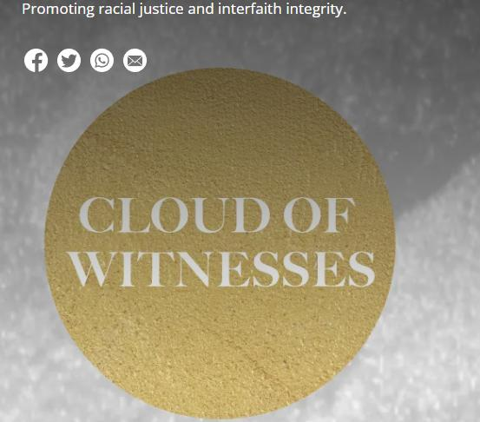
In 2025, in London, an Art exhibition called ‘Cloud of Witnesses’ showed lots of artists’ work about God.
They explored faith in God and doubt.
Some of the art is about how a place can make a person feel close to God.
From different religions and no religion, these art works show us some creative ways to explore some of life’s biggest questions.
Have a good look at the picture on the next slide.
Notes:
In 2025, the Catholic Bishops’ Conference ran an art exhibition called ‘Cloud of Witnesses’, digitally available here: www.godwhospeaks.uk/cloud-of-witnesses-art-exhibition/ ‘The God who Speaks’ is a digital space where Catholic Biblical insights, resources and visions are shared. Artists were invited to show work which explored human searches for the divine in many and varied ways. Stunning work resulted, and the project enabled a link to be made to school RE. These lessons, four for primary RE and four for secondary RE, have been created to enable excellent RE which uses some of the art from the exhibition for the purposes of excellent school RE. Seeking to represent different visions and insights from interfaith integrities, the exhibition was a big success. These lessons share their work.

Slide 7
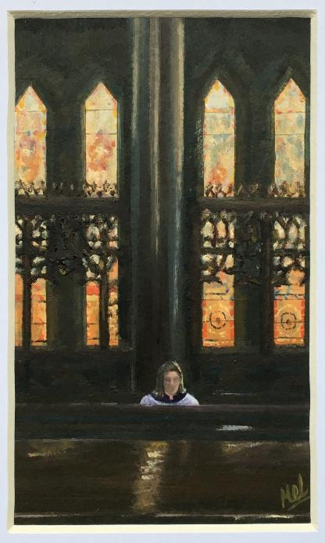
Mel Roskell used to sketch her friends in the choir as a girl. During Covid her choir were allowed to sing in church but they all had to be kept at a distance.
Mel drew a soprano singer sitting alone.
Do you think this was hard to paint, or easy? What do you notice about the picture?
What do you like?
What do you think the story of the picture might be?
If the person is praying, what might their prayer be saying to God?
“This image highlights strength, peacefulness, glorious light, sunshine. The church has stunning stained-glass windows.”
Do you agree?
Notes:
If you want to get pupils to really look carefully at the image, then ask them to sketch it before any of the questions come up. Give them 3 or 4 minutes to copy the picture. It really makes them attend to it well.

Slide 8
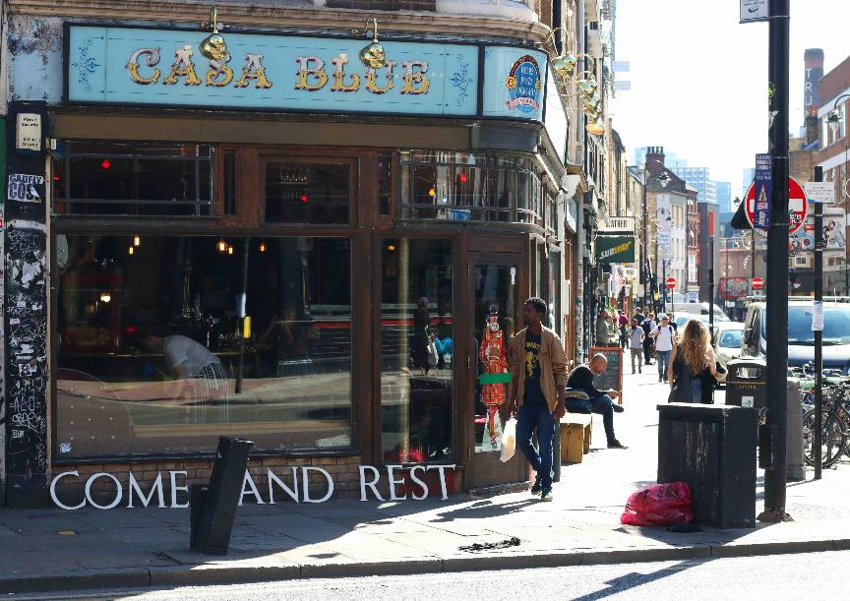
What makes a place spiritual, holy or special?
Bethnal Green Mission church was demolished and rebuilt.
The old church had the words of Jesus in huge letters on the wall: Come and Rest.
Artist Kirsty Kerr took the letters from the Bible text on tour. Here, to Casa Blue, a bar…
She took photos of them in different places.
What do you notice?
Notes:
The full text of Jesus’ saying is this: “Come to me all you who work hard and are heavily loaded or weighed down. I will give you rest.” Matthew 18:28

Slide 9
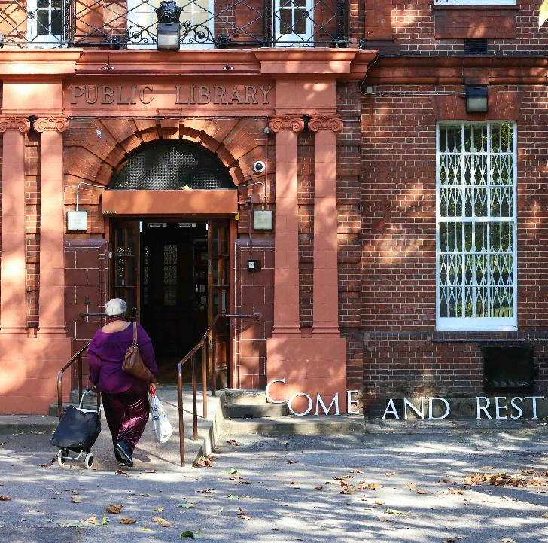
Kirsty is fascinated by sites of worship. She tries “to unearth the sacred in the everyday.”
What do you think she means by that?
In this photo she has put the words of Jesus outside the library.
Are libraries holy?
Do people ‘come and rest’ at a library?
Maybe a spiritual space can be wherever we find peace, calm, community, freedom and where we don’t have to pay money!
You can see some more of Kirsty’s pictures here: www.kirstykerr.com/projects/come-and-rest
Notes:
‘To unearth the sacred in the everyday’ talk to children and ask what they think this means. Maybe ‘to find signs of God in ordinary things’ or ‘to dig up holy feelings from Monday to Friday, not from going to church or mosque.’

Slide 10
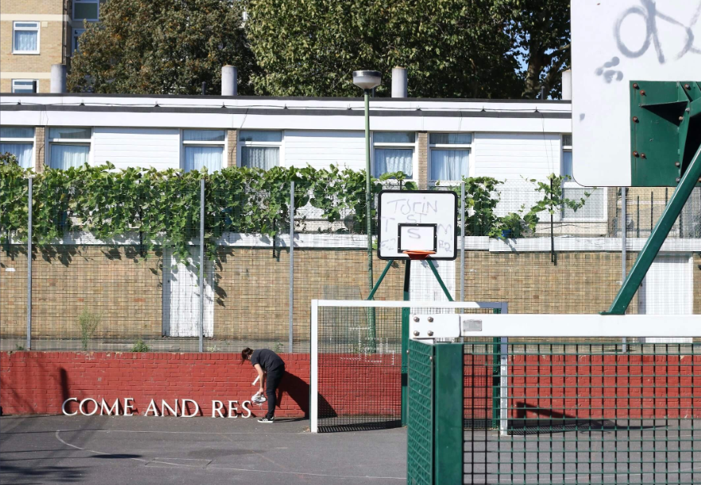
Here’s another one of Kirsty’s photos, this time just getting iready.
Do you like the idea that basketball and soccer might be places where we come and rest, even though we are very active in sport?
Notes:
Encourage pupils to think about ‘shalom’ – the concept of peace that is holistic and personal.
Kirsty says: “It really means a lot that my work can be used in this way, to help encourage young people to think deeply about spiritual questions and even start looking for 'the sacred' in their own everyday worlds!”

Slide 11
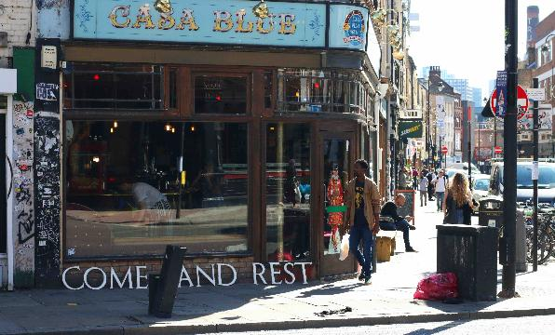
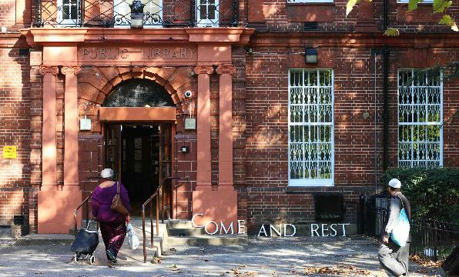
COME AND REST
Kirsty took 8 photos of the letters that say ‘Come and Rest’ in different places in Bethnal Green. She filmed people’s reactions. Some didn’t even notice, others found it moving.
The words have a gentle but surprising message to busy city life. Spelling them out was a kind of prayer. The photos symbolise the presence of God in ordinary places. God invites humans to ‘come and rest.’ The artwork is for everyone, not just for Christians.
The next slide gives you an idea based on Kirsty’s work.
Where else do people find rest in the city?
You can see more of this work here: www.kirstykerr.com/projects/come-and-rest
Notes:
This project is rather lovely because it ‘scatters’ the spiritual words of Jesus into the city streets, in ways that meet a shared human need for rest amidst business. Talk to pupils about this.

Slide 12
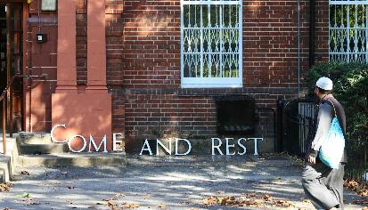
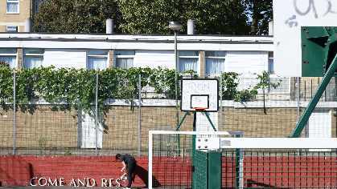
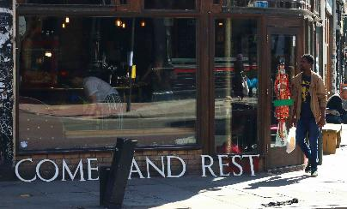
What if…
Consider how you could use Kirsty’s idea around school.
What if you took a simple spiritual message from a faith leader, made cut out letters (you can do them on A4 card) and set them up in surprising places around your school. Would people notice? Would they get the message? Could you take photos?
How could you share them?
Quotes you might use (or choose your own):
“Set my people free!” (Jewish, story of Moses)
“Truth is High!” (Sikh, Guru Nanak)
“I give you my peace” (Christian, Jesus)
“Walk to God and God runs to you” (Islam, Prophet Muhammad)
Notes:
This project is rather lovely because it ‘scatters’ the spiritual words of Jesus into the city streets, in ways that could meet a shared human need for rest amidst business. Talk to pupils about this.

Slide 13
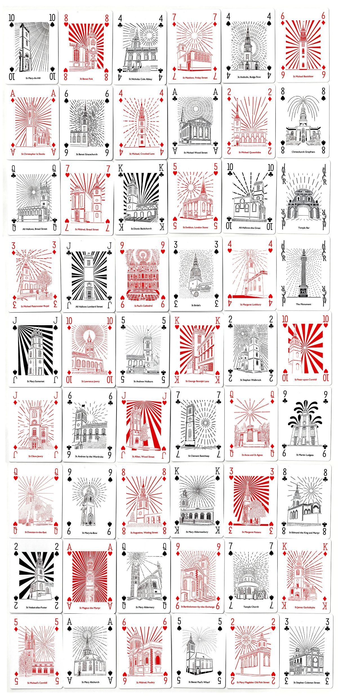
Chloe Campbell loves the work of the famous architect Sir Christopher Wren, who died in 1723.
300 years later, in 2023, she found out all about the 52 churches in London he designed. Some are still there today.
She made images of them all, as a ‘deck of cards’. Look at the next slide to see how brilliant they are close-up.
Notes:
The full deck of cards are amazing! This pic needs the next two slides to show some more detail.

Slide 14
Chloe Campbell.
Wren – 300: Playing Cards.
300 years after Sir Christopher Wren’s death, Chloe made playing cards of the 52 churches in the City of London built from his office. What an architect!
Chloe made a pack of playing cards framed on a white paper background. The original images are papercuts.
Papercutting involves cutting out of a design on paper with a scalpel where the finished papercut is one sheet of paper. See more of her amazing work at: www.chloecampbellart.com
Notes:
Some pupils may know Sir Christopher Wren already from the History curriculum as the architect of St. Paul’s Cathedral. Show some pictures! It is a place of national religious significance.

Slide 15
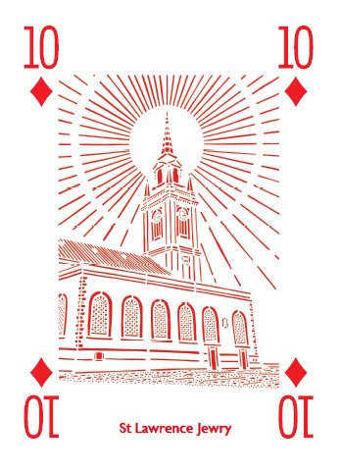
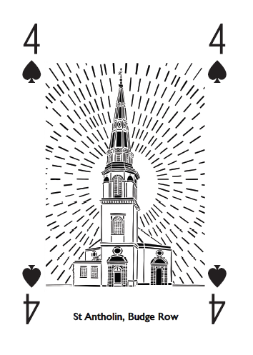
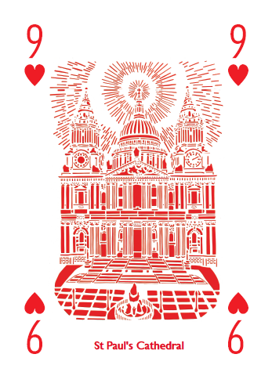
Chloe drew each image and cut it out by hand using a scalpel. She made a full deck:
Ace, King, Queen, Jack, 10, 9, 8, 7, 6, 5, 4, 3 and 2, Spades, Hearts, Diamonds, Clubs.
The original purpose of the churches was for Christians to worship God.
33 of the churches still exist, 19 are no longer with us. What do you like about her art?
What would you like to ask Chloe? To find out about Sir Christopher Wren?
Notes:
There is masses of info on the web about Wren. This is one useful starting point. https://heritagecalling.com/2023/02/24/a-brief-introduction-to-christopher-wren/

Slide 16
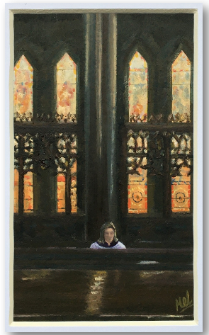
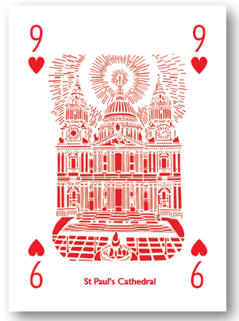
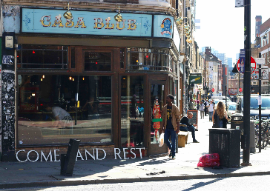
These three artists are all interested in holy words and sacred spaces.
Maybe we all need places to rest, to set aside, to look for peace.
What did you learn from the three artists? Which did you like best and why?
Notes:
Flexibility and choice in the task helps pupils to commit to their own creativity in exciting ways!

Slide 17

There are loads of holy buildings in the UK. Over 50,000 Christian churches, more than 2,200 Muslim mosques, hundreds of Sikh Gurdwaras, and hundreds of Jewish Synagogues and Hindu Mandirs.
Lots of these buildings are within a few miles of your school.
Which ones do you know?
Can you make a class list?
Notes:
https://thenounproject.com/icon/playing-cards-6344521/ Image free from the Noun Project

Slide 18

Your task:
Choice A:
To create a playing card that shows a national or a local example of the sacred space you have researched – in the style of Chloe Campbell.
Write about the building you picture.
Choice B:
To set up and take two photographs (learning from the examples we studied) of a spiritual saying in an unusual place around school.
Write a commentary on them that explains why they illustrate ‘sacred space’ really well.
Notes:
https://thenounproject.com/icon/playing-cards-6344521/ Image free from the Noun Project

Slide 19

Print the ‘two of hearts’ as a template for your ‘holy space’ playing card.
We suggest you make it large –
A4 or even A3.
When the class have all completed their chosen task, organise a gallery of photos and playing cards.
Notes:
https://thenounproject.com/icon/2-of-hearts-2486299/ Image free from the Noun Project
Pupils could research – or teachers could provide – images of sacred spaces near to the school. Most towns/cities/counties in the UK have 52 – or many more – sacred buildings. Or pupils could identify spaces they think are sacred / holy / deeply spiritually significant for themselves. Each pupil creates a ‘playing card’ – this template of the ‘Two of Hearts’ could be used because it gives space for pupils to create within it. But a simpler template could be used, and pupils could think about the way they want to set up their card design. Red and black are the traditional colours of course.

Slide 20
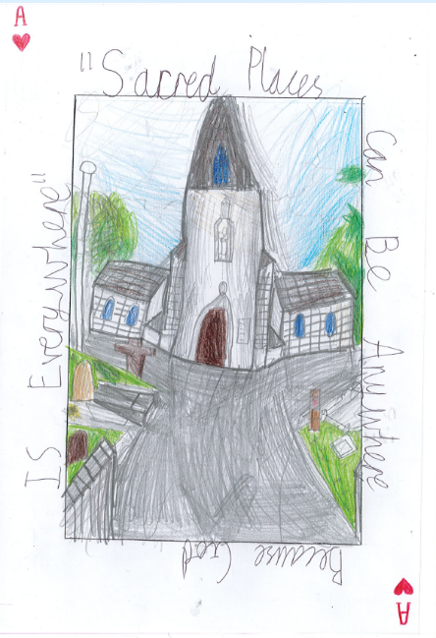
Anywhere is Sacred because God is Everywhere.
This pupil work shows how the ‘playing cards’ idea can be re-interpreted by a learner. The child is 8 years old.’
The ace of hearts!

Slide 21
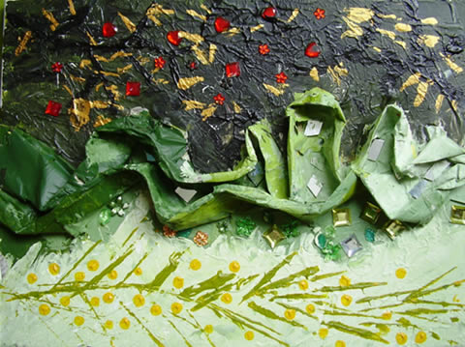
The Path You Follow
Amber, Warwickshire - Age 9
“This painting is called -
'My Spiritual Space: The Path You Follow.’
It is a painting about bad and good. There is a path running through it and this
is the path you follow through your spiritual life.
You can either choose to be on the dark and thorny side, or on the happy, bright, healthy side. I choose to stay on the bright side”

Slide 22
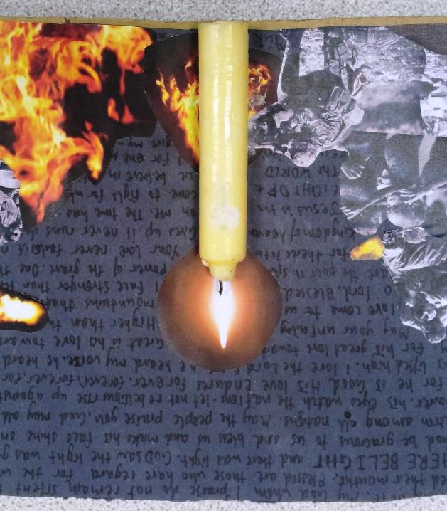
Ryan, 11, has responded to the ideas in these lessons about sacred space by creating this image, in which numerous bible texts about God the light make a background to the images of war and starvation.
He suggests: ‘God can be found wherever people bring light in darkness, not just in churches or cathedrals.’

Slide 23
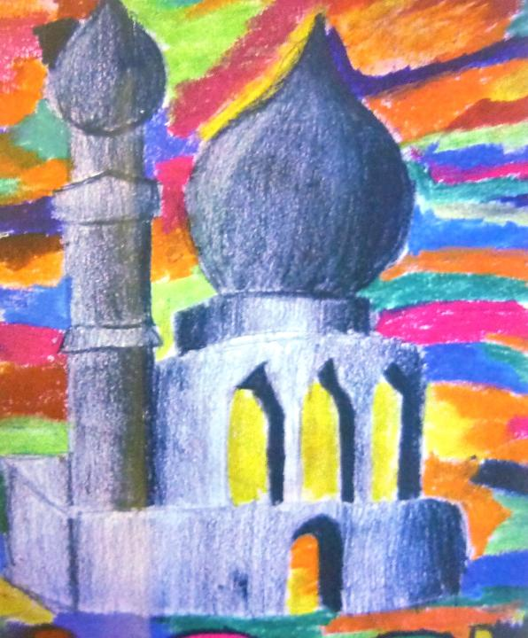
This example of work is beautifully made by a 9 year old:
‘We Muslims don’t draw God, but I have shown a mosque, a place where we can feel close to God, and the colours around it show the presence of Allah everywhere.’

Slide 24



Partnership
Notes:
These lessons and resources have been created by Lat Blaylock and Fleur Dorrell in a partnership between the Catholic Bishops’ Conference through its work on the Bible (‘The God who Speaks’), NATRE (who run the Spirited Arts competition) and RE Today. The lessons are free to use, and suitable for RE in any school, connecting in many ways to different schemes of work , wherever pupils use critical and creative skills to explore theological and spiritual questions. https://www.godwhospeaks.uk/ We also thank teachers and pupils who have been involved in developing and trying out the lessons: your contribution has greatly improved the project!

Slide 25

Connections to the Catholic RE Directory
The RE Directory invites all pupils to engage with an ambitious RE curriculum focused on multiple disciplines in the pursuit of truth.
These lesson ideas enable this aim.
By age 10, pupils will use critical and creative skills in RE by exploring creative and artistic opportunities and reflecting on their learning, considering what it means to them (RED, p167).
This work might contribute to the studies in Branch 5 of the Year 6 curriculum, ‘To the Ends of the Earth’ by enabling pupils to celebrate how Christians today meet Christ in the eucharist, in the scriptures, in prayer and in love for all people (RED p181).
Pupils can describe how Christians today bear witness to their faith now. (RED p181).
Notes:
These lessons and resources have been created by Lat Blaylock and Fleur Dorrell in a partnership between the Catholic Bishops’ Conference through its work on the Bible (‘The God who Speaks’), NATRE (who run the Spirited Arts competition) and RE Today. The lessons are free to use, and suitable for RE in any school, connecting in many ways to different schemes of work , wherever pupils use critical and creative skills to explore theological and spiritual questions. https://www.godwhospeaks.uk/
We also thank teachers and pupils who have been involved in developing and trying out the lessons: your contribution has greatly improved the project!
We invite you to share interesting examples of your pupils’ work: lat@retoday.org.uk

