Slide 1

Searching for God Lesson 3, Primary The symbol of Jesus: A Cross.
Creative and thoughtful RE Lessons which use inspirational art from the exhibition ‘Cloud of Witnesses’ Co-cURAted by ‘The God who Speaks’
www.godwhospeaks.uk/cloud-of-witnesses-art-exhibition/
Notes:
In 2025, the Catholic Bishops’ Conference ran an art exhibition called ‘Cloud of Witnesses’ Seeking to represent different visions and insights from interfaith integrities, the exhibition was a big success. These art and RE lessons share their work. Artists were invited to show work which explored human searches for the divine in many and varied ways. Stunning work resulted, and the project enabled a link to be made to school RE. These lessons, four for primary RE and four for secondary RE, have been created to enable excellent RE which uses some of the art from the exhibition for the purposes of excellent school RE.
This lesson uses art about Palm crosses to explore the meanings of the cross for Christians.

Slide 2

Searching for God: Aims These lessons aim to enable learners to: a. Think about art works that express big ideas about God and spiritual questions. b. Develop broad minded and open-hearted responses to the ideas of others. c. Consider religious teachings about God for themselves. d. Respond creatively for themselves to theological learning in RE. These aims mean each lesson intends to be theological, interfaith-informed, rooted in religious ideas and creative.
RE Lessons which use inspirational art from the exhibition ‘CLOUD OF WITNESSES’ Co-CURAted by ‘The God who Speaks’
Notes:
The specific learning objectives of each of our four primary and four secondary lessons are given on the next slide, but these general aims fit in with the purposes of RE as they are articulated in various contexts, for Catholic schools, other schools with a religious character, community schools and academies. Teachers are invited to use these PPTs and the notepads that go with them containing additional resources, learning activities information and learning activities, in flexible ways that suit their own pupils. Seeking to represent different visions and insights from interfaith integrities, the exhibition ‘Cloud of Witnesses’ was a big success. These art and RE lessons share the work. In 2025, the Catholic Bishops’ Conference ran an art exhibition called ‘Cloud of Witnesses’ Seeking to represent different visions and insights from interfaith integrities, the exhibition was a big success. These art and RE lessons share their work. Artists were invited to show work which explored human searches for the divine in many and varied ways. Stunning work resulted, and the project enabled a link to be made to school RE. These lessons, four for primary RE and four for secondary RE, have been created to enable excellent RE which uses some of the art from the exhibition for the purposes of excellent school RE. There are four primary and four secondary lessons in this project, which fit well together – but teachers are welcome to use some of them as they fit in with your own RE planning and schemes of work.
The partnership in creating these lessons with NATRE links powerfully to the Spirited Arts project NATRE runs each year. See examples and details here: https://www.natre.org.uk/about-natre/projects/spirited-arts/spirited-arts-gallery/2024/

Slide 3

Searching for God: Aims for this lesson. Learners will be able to: a. Learn facts and think about the symbolism of Christian crosses. b. Develop broad minded and open-hearted ideas about symbolism and the meanings of Jesus’ death. c. Consider a religious narrative – about Palm Sunday - for themselves. d. Respond creatively for themselves to learning about the cross in RE. Start the lesson with the class on the next slide.
Primary RE Lessons which use inspirational art from the exhibition ‘CLOUD OF WITNESSESS’ Co-cURATED BY The God who Speaks’
Notes:
The specific learning objectives of each of our four primary and four secondary lessons are given on this slide. Our general aims fit in with the purposes of RE as they are articulated in various contexts, for Catholic schools in the RED, for other schools with a religious character, community schools and academies in relation to Agreed Syllabuses and the RE Council’s Statement for Entitlement for RE (which DfE are alert to in their current curriculum review).
Teachers are invited to use these PPTs and the notepads that go with them containing additional resources, learning activities information and learning activities, in flexible ways that suit their own pupils. Seeking to represent different visions and insights from interfaith integrities, the exhibition ‘Cloud of Witnesses’ was a big success. These art and RE lessons share the work. (A lesson here might not be a single 45-minute learning slot – the activities include some that go deeper and some that give creative opportunities to pupils. So maybe a lesson is two or more sessions, or maybe users will select the activities that work best for them).

Slide 4

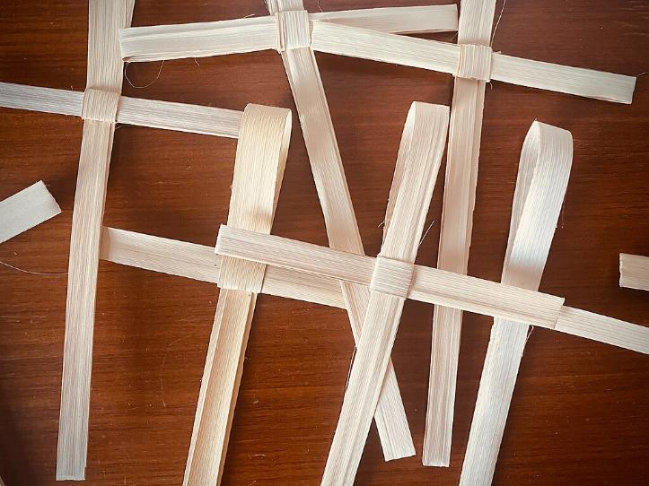
Searching for God Lesson 3
Palm Crosses
Notes:
Show some actual Palm Crosses if you can.
Introduce the work to pupils in these terms. You don’t have to use all four lessons in the sequence, though they will fit will with units of work about any theological topic in RE. We’ve written the primary lessons for KS2. You may want to adapt them for Yr3 abilities, but we have tried them out with Y4-6 and they work.
Expect pupils to gather, debate and use dialogue about the art they are looking at. Do this in ways that enable them to be creative for themselves. Help all pupils to bring their learning together in pieces of imagination-engaged work. It’s important that they can create work they are proud of: time and quality resources are a great help with this.
https://commons.wikimedia.org/wiki/File:Palm_Crosses_10_47_38_887000.jpeg – picture is free use

Slide 5
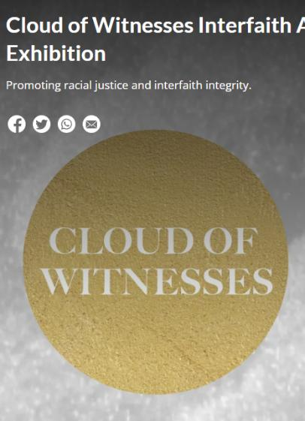

In 2025, in London, an Art exhibition called ‘Cloud of Witnesses’ showed lots of artists’ work about God. They explored faith in God and doubt. From different religions and no religion, these art works show us some creative ways to explore some of life’s biggest questions. In this lesson, one work of art will be considered. It looks simple in one way, but it can make you think deeply. Take your time.
Notes:
In 2025, the Catholic Bishops’ Conference ran an art exhibition called ‘Cloud of Witnesses’, digitally available here: https://www.godwhospeaks.uk/cloud-of-witnesses-art-exhibition/ ‘The God who Speaks’ is a digital space where Catholic Biblical insights and visions are shared. Artists were invited to show work which explored human searches for the divine in many and varied ways. Stunning work resulted, and the project enabled a link to be made to school RE. These lessons, four for primary RE and four for secondary RE, have been created to enable excellent RE which uses some of the art from the exhibition for the purposes of excellent school RE. Seeking to represent different visions and insights from interfaith integrities, the exhibition was a big success. These art and RE lessons share their work.

Slide 6
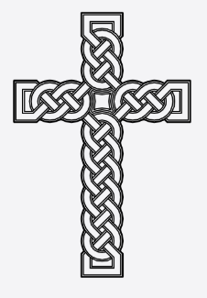




How do Christians use different crosses? For Christians, the sign of the cross is a reminder of… what? The love of God and the stories of Jesus.
Notes:
Do more work on different types of crosses if you like – these could be given to children to use as a basis for calligraphy – letter into the shape of each drawing the three words that sum up what this cross stands for – for example:
Crosses free to use from the Noun Project
https://thenounproject.com/browse/icons/term/cross/?qv=371962
https://thenounproject.com/browse/icons/term/cross/?qv=185506
https://thenounproject.com/icon/cross-993478/
https://thenounproject.com/icon/bible-5362955/
https://thenounproject.com/icon/crucifixion-of-jesus-5166462/

Slide 7
Quiz: which cross… a. Looks like ‘God’s point of view from above’? b. Is most linked to the Christian’s Holy Scripture? c. Makes you think of the robe Jesus wore? d. Shows what happened on Good Friday? e. Could be made out of one piece of rope – or carved in stone?
What other kinds and shapes of crosses have you seen? Why do you think there are so many?
Notes:
Crosses free to use for the Noun Project
https://thenounproject.com/browse/icons/term/cross/?qv=371962
https://thenounproject.com/browse/icons/term/cross/?qv=185506
https://thenounproject.com/icon/cross-993478/
https://thenounproject.com/icon/bible-5362955/
https://thenounproject.com/icon/crucifixion-of-jesus-5166462/

Slide 8
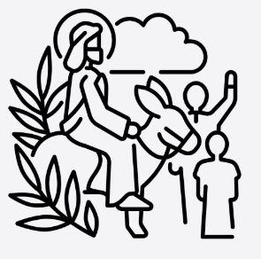
Palm Sunday Do you know the story? The next slide tells the Bible story – read it out loud.
Notes:
https://thenounproject.com/icon/palm-sunday-6525869/
Palm Sunday line drawing from the Noun Project
It is fine to use this text whether the pupils know the story, or it is new to them: using original Bible texts can open up possibilities for the children to be interpreters. Focus on skill-questions like these: are there any hidden messages in this story? What do you think St. Mark the writer would say was most important about this part of Jesus’ story?

Slide 9
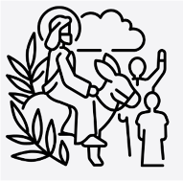
When Jesus and his followers approached Jerusalem… Jesus gave two disciples a task: “Go into the village over there. As soon as you enter it, you will find tied up there a colt that no one has ridden. Untie it and bring it here. If anyone says to you, ‘Why are you doing this?’ say, ‘Its master needs it, and he will send it back right away.’” They went and found a colt tied to a gate outside on the street, and they untied it. Some people standing around said to them, “What are you doing, untying the colt?” They told them just what Jesus said, and they left them alone.
This is a famous story in Jesus’ last days: it all happened on Palm Sunday in Jerusalem, 20 centuries ago. Just 6 days later, the crowd turned against Jesus and he was killed. Do you know how Christians today remember and celebrate Palm Sunday? They use Palm leaves. We will find out what happens.
Notes:
Test slightly simplified for readability from the Common English Bible.
Ask the pupils if they know about Palm Sunday, and how this story is commemorated these days around the world.
In 2025, the Catholic Bishops’ Conference ran an art exhibition called ‘Cloud of Witnesses’ Seeking to represent different visions and insights from interfaith integrities, the exhibition was a big success. These art and RE lessons share their work. Artists were invited to show work which explored human searches for the divine in many and varied ways. Stunning work resulted, and the project enabled a link to be made to school RE. These lessons, four for primary RE and four for secondary RE, have been created to enable excellent RE which uses some of the art from the exhibition for the purposes of excellent school RE.

Slide 10
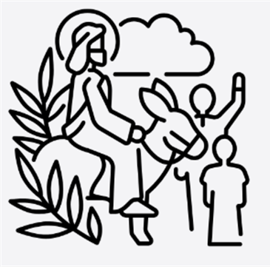
They brought the colt to Jesus and threw their clothes upon it, and he sat on it. Many people spread out their clothes on the road while others spread branches cut from the fields. Those in front of him and those following were shouting, ‘Hosanna! Blessings on the one who comes in the name of the Lord!’ Blessings on the coming kingdom of our ancestor David! Hosanna in the highest!” Jesus entered Jerusalem and went into the temple. After he looked around at everything, because it was already late in the evening, he returned to Bethany with the Twelve.
Notes:
Test slightly simplified for readability from the Common English Bible.
Ask the pupils if they know about Palm Sunday, and how this story is commemorated these days around the world.
In 2025, the Catholic Bishops’ Conference ran an art exhibition called ‘Cloud of Witnesses’ Seeking to represent different visions and insights from interfaith integrities, the exhibition was a big success. These art and RE lessons share their work. Artists were invited to show work which explored human searches for the divine in many and varied ways. Stunning work resulted, and the project enabled a link to be made to school RE. These lessons, four for primary RE and four for secondary RE, have been created to enable excellent RE which uses some of the art from the exhibition for the purposes of excellent school RE.

Slide 11
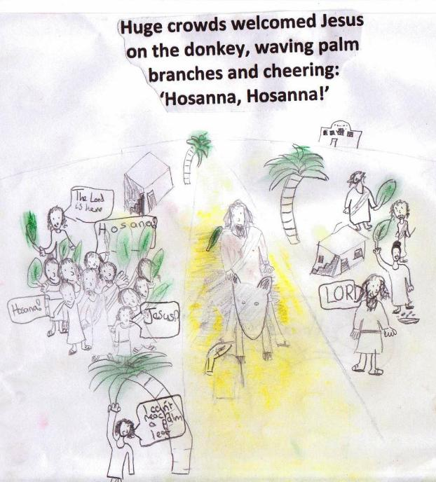
Bethan, 8, made this picture of Jesus riding into Jerusalem. What do you think is good about her work? How has she made the figure of Jesus stand out? Can you remember what ‘Hosanna’ means?
Notes:
Thanks to the three teachers and different pupils involved in making the art we’ve used here. See so much more at ‘Spirited Arts’ – the web gallery.

Slide 12
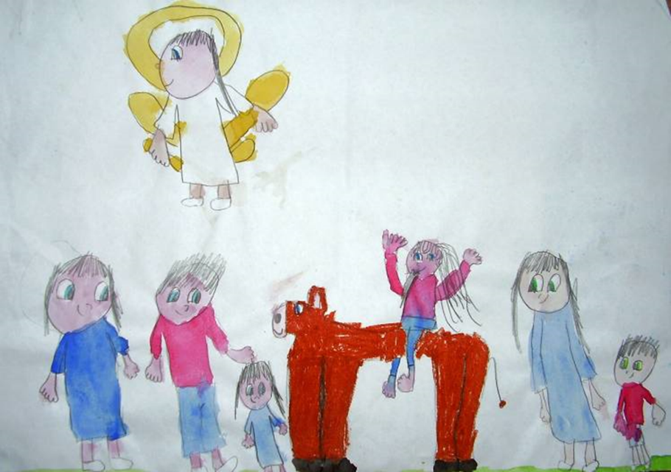
Palm Sunday by 8YO Emilia “My picture is based on Palm Sunday and it is called ‘Waiting for Jesus in Surprise.’ My picture shows that everybody was surprised to see Jesus riding on a donkey as he came into Jerusalem. It shows that on that day, everyone loved Jesus, and Jesus loves everyone.”
Notes:
Emilia had seen Christopher Gosey’s painting in Orthodox style, ‘Our Lord’s Entry into Jerusalem’. It’s brilliant. Here’s a link: https://www.facebook.com/photo.php?fbid=3455547887883792&id=221590854612861&set=a.378783388893606

Slide 13
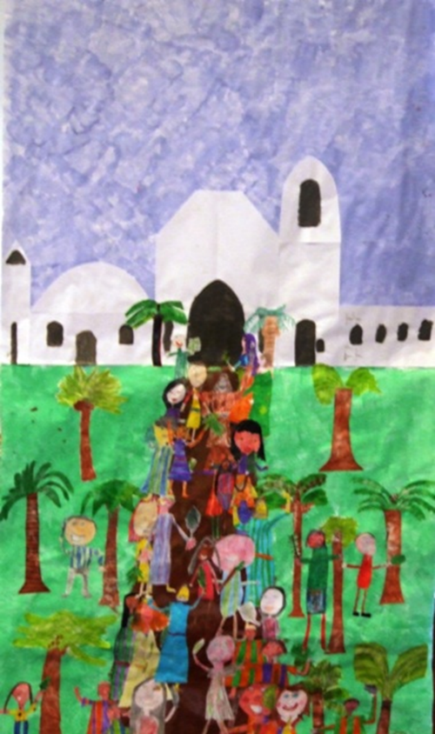
Palm Sunday Celebrations
9 YOs at Alexander Hosea School made a collage of the story of Palm Sunday. Tell your partner what you think it might look like, and then you will see it.
The city of Jerusalem is in the distance.
The picture is from Jesus’ own point of view: it’s like you are on the donkey with him.
We counted 12 Palm Trees.
How many people?
How have the artists shown that this is a celebration?
Notes:
Show pupils a range of images about the Palm Sunday story, maybe including indoor and outdoor worship, from around the world – include art and photos. Flickr has over 60 000 photos to choose from. https://www.flickr.com/search/?text=palm+Sunday

Slide 14
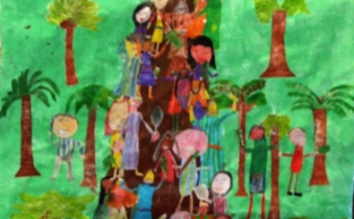
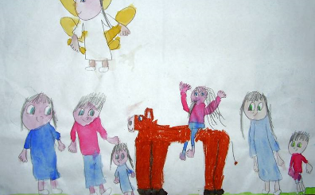
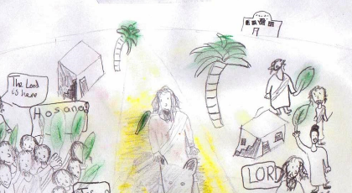
What did you like about each piece of art?
On the next slide, you will see – and find out about - a modern piece of art connected to the story.
Can you see or guess any connections from the 20-centuries old story of Jesus on the donkey and what happens in church today?
Is the story connected to peoples’ lives in today’s world? How?
Notes:
Show pupils a range of images about the Palm Sunday story, maybe including indoor and outdoor worship, from around the world – include art and photos. Flickr has over 60 000 photos to choose from. https://www.flickr.com/search/?text=palm+Sunday

Slide 15
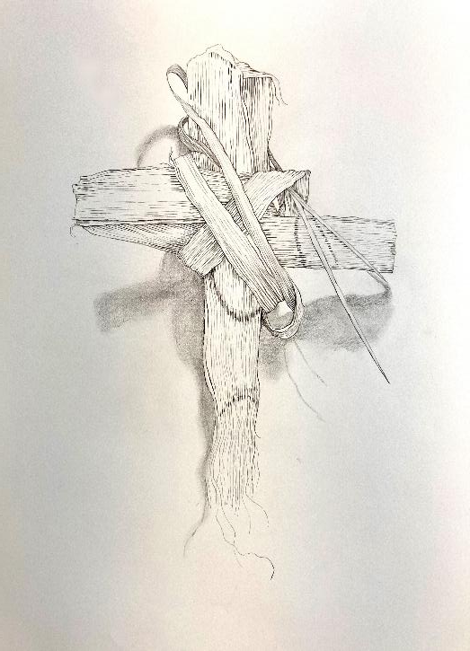
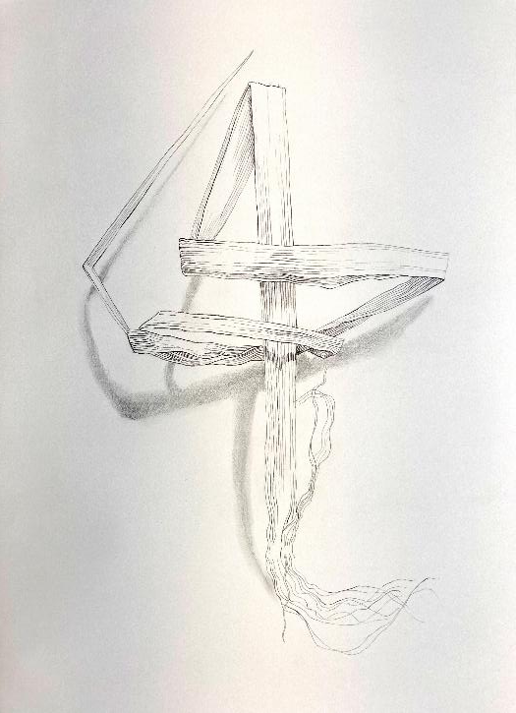
unravelling
Notes:
Ask the children to ‘have a good stare’ and share what they see. Good art education always starts with looking and moves on to words later.
Make sure they know what the word ‘unravelling’ means: ‘coming apart’.

Slide 16
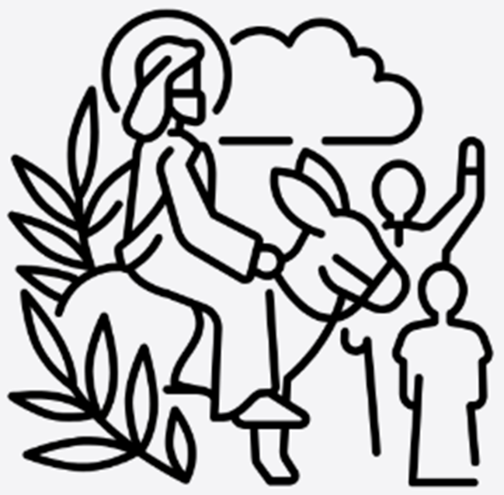
Shaeron Caton Rose Unravelling, 2021 www.shaeron.com Shaeron is a Christian, so she is interested in how Bible stories like ‘Palm Sunday’ relate to our lives. She believes that faith is rather deep and rather wide: symbols can connect us up to the past, and to people all over the world. In 2021 it was the first Covid lockdown in Lent, the period before Easter. Shaeron sent palm leaves though the post to 14 friends. She asked: ‘please make a palm cross and tell me about you during the pandemic.’ When she got the crosses back, she left them to one side for three days before opening the parcels – a safety rule. She felt that opening her friends’ packages was like Easter – finding the beauty, meaning and personal connection in the envelopes! She made two drawings of Palm Crosses being unravelled as a way of thinking about how faith might help some people in hard times.
Notes:
Read the story of Shaeron’s drawings about the Palm Crosses with the class.
Teach the class more about the customs and uses of palm crosses: Many churches celebrate Palm Sunday using Palm Crosses. These are made from dried palm leaves, folded together in a clever way to make the shape of a cross. It’s a symbol that links to several parts of the Easter story. Some Christians keep the Palm Crosses all year, then burn them to make ash to use on the following Ash Wednesday. Find out more about Ash Wednesday.

Slide 17
unravelling
Notes:
Now they know the ‘story’ of the unravelling palm crosses, what are the learner’s further thoughts?

Slide 18
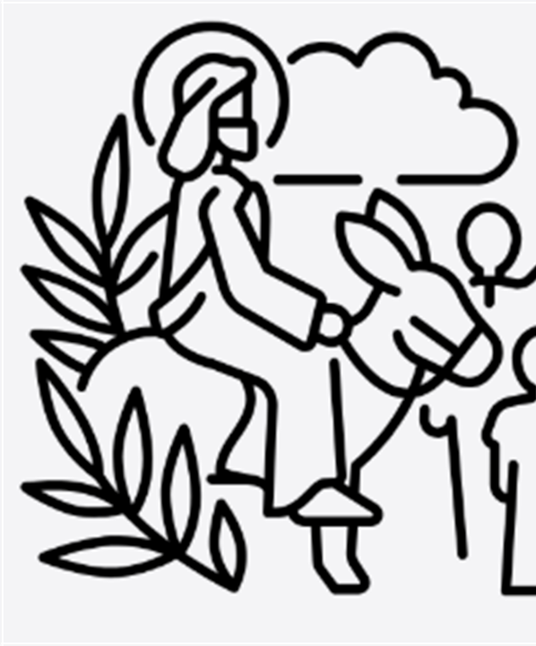
Shaeron Caton Rose Unravelling, 2021 www.shaeron.com Questions for discussion: 1. ‘Unravelling’ is about things being taken to pieces. Why do you think Shaeron chose this title? 2. On Palm Sunday, Jesus gets a big welcome, He’s praised by huge cheering crowds. He has a good day. What unravelled for Jesus in the next few days, and why? 3. Good Friday is a story about a tragic death. So why is it called ‘Good’? 4. Is a Palm Cross a symbol of sadness, or hope, or danger – or something else?
Many churches celebrate Palm Sunday using Palm Crosses.
These are made from dried palm leaves, folded together in a clever way to make the shape of a cross.
It’s a symbol that links to several parts of the Easter story.
Some Christians keep the Palm Crosses for nearly a year, then burn them to make ash to use on the following Ash Wednesday. Ash is a symbol of sorrow. Christians make a sign of the cross in ash on their foreheads on Ash Wednesday.
Notes:
Read the story of Shaeron’s drawings about the Palm Crosses with the class.
Teach the class more about the customs and uses of palm crosses: Many churches celebrate Palm Sunday using Palm Crosses. These are made from dried palm leaves, folded together in a clever way to make the shape of a cross. It’s a symbol that links to several parts of the Easter story. Some Christians keep the Palm Crosses all year, then burn them to make ash to use on the following Ash Wednesday. Find out more about Ash Wednesday.
Here are some possible answers to the questions:
Maybe Shaeron felt her life unravelling in the Covid times, when everyone was sick and worried. Maybe she wanted to connect to Jesus’s story.
Jesus’ life unravelled – he went from being the one everyone loved to a victim getting crucified. His followers all unravelled too – from shouting his praise, many of them turned out to be a bit cowardly ,maybe?
Good Friday is ‘good’ for Christians because of Easter Sunday. Christians believe Jesus showed the strength f love and forgiveness in the way he died, and when he came alive again, he proved that Love is more powerful than hatred or death.
It could be a symbol for all three of these things, but mostly perhaps for Jesus’ way of showing the power of love.

Slide 19
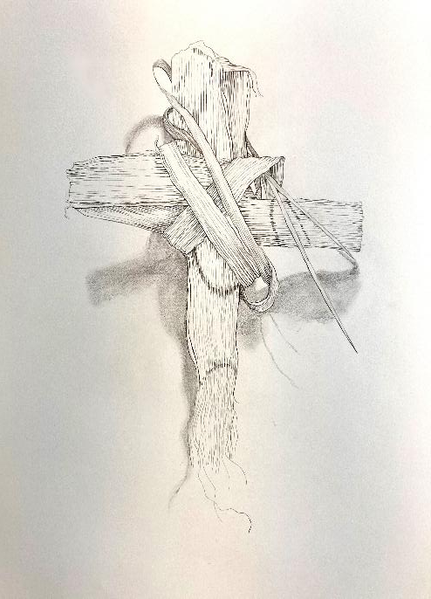
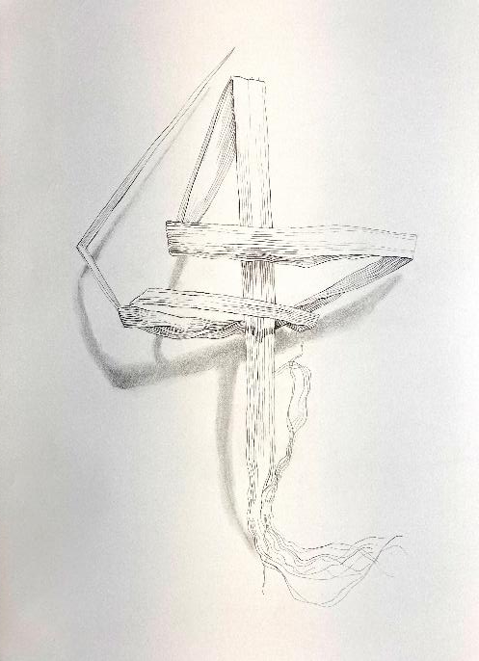
unravelling
Notes:
Another chance to have a good stare. What do pupils now know? What difference does it make? What do they like/dislike?

Slide 20
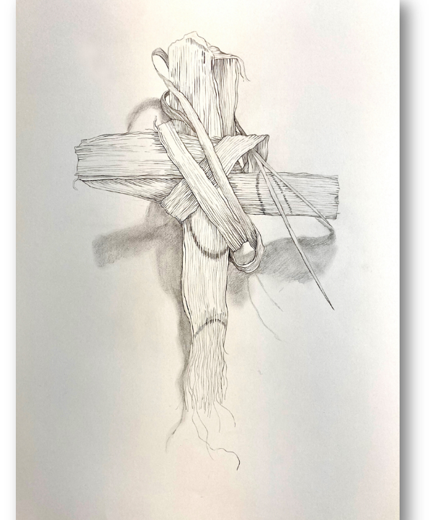
What did people think? What do you think?
We asked people to look at Shaeron’s unravelling Palm Crosses. What did they think?
“What I liked about these is the careful line drawing of a process of unravelling. She makes you think about taking a Palm Cross to bits.”
“I keep a Palm Cross on the window of my house all year. I like these pictures because I realised that when my life is unravelling (seems to happen often), that is what happened to Jesus too. I find this kind of comforting.”
“This reminded me that the story of Jesus getting shouts of ‘Hosanna’ on Sunday is followed by him getting all the ‘crucify him’ shouts on the Friday. From Palm to Cross is a short journey.”
“It’s such an interesting piece of art because something natural – a leaf – has been dried, reshaped into a well- known symbol – a cross – then taken to pieces very carefully, so it becomes this artwork.”
Without copying these ideas, write a sentence of your own that says what you think about the art.
Notes:
If you get pupils to write their contributions on post it notes they can be easily collected, shared and displayed. Please send us examples to lat@retoday.org.uk

Slide 21
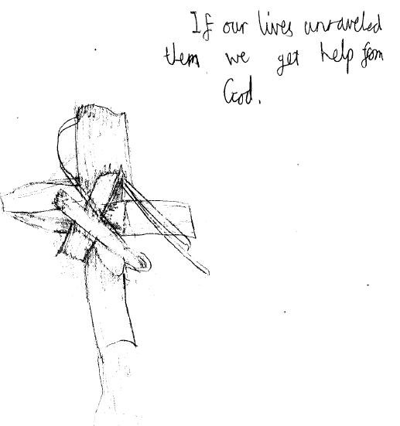
This response to the art from an 8YO pupil illustrates how art in RE can sometimes be simply profound.

Slide 22
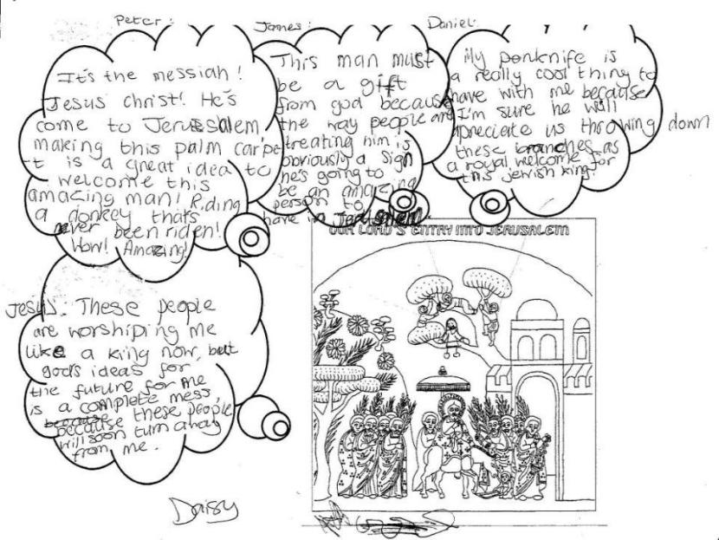
In this lovely piece of work Daisy, 9, responds to Christopher Gosey’s painting of ‘Our Lord’s Entry into Jerusalem’ by imagining all the thoughts of some of the crowd on that day. The activity is fun – but also leads her to profound use of concepts like ‘messiah’ and ‘worship’ – as well as considering Jesus’ own awareness of his destiny.
Notes:
See the painting here: https://curiouschristian.blog/2013/09/01/entry-into-jerusalem-ethiopian-style/

Slide 23
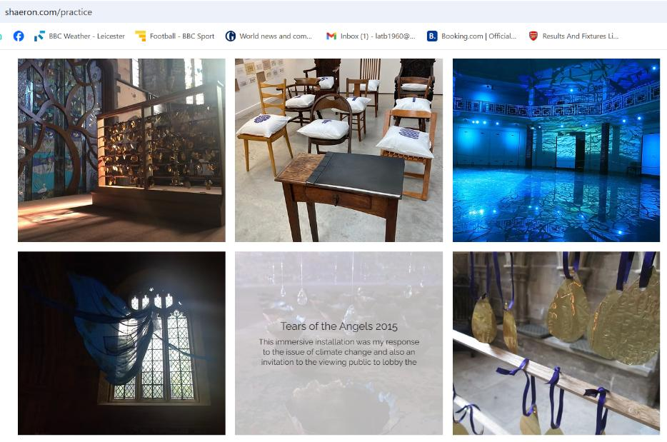
Have a look at Shaeron’s website for lots more examples of her beautiful, intriguing and wistfully spiritual art. www.shaeron.com/practice
Notes:
There are many treasures on the website. It’s worth spending a few minutes looking at other examples of her art as a class. Plenty to choose from!

Slide 24

Display: Make ‘Palm Crosses’ out of strips of paper
Use long thin strips of paper – any colour, made by guillotining A3 paper into strips longways about 1.5-2cm wide. Maybe shades of green would look good? Other colours might have different symbolism?
Show children how to fold these into the shape of a cross and give them several strips to try out.
When they have got the hang of it, ask them to write a prayer or reflection based on the work onto one strip, and then fold it into a cross.
Pin these to a mount board to make a display for the whole class or school.
Display them somewhere that others can see – and add a cross or crucifix if they want to.
Notes:
Here’s an online tutorial about making a palm cross from a strip leaf – or a strip of paper: https://www.youtube.com/watch?v=znDyR8_POCU
Writing the prayer or reflection: see next slide for some prompts pupils might use.

Slide 25
Writing my prayer or reflection about the Palm Cross.
Choose three or four of these prompts to use for your own prayer or reflection – or do it all in your own words.
“Dear God, thank you for…”
“When times are hard, we need…”
“If our lives unravel, then we get help from…”
“Jesus, give us strength to…”
“My reflection on the Palm Cross is…”
“God, help us to…”
“What helps us in hard times is…”
Notes:
Here’s an online tutorial about making a palm cross from a strip leaf – or a strip of paper: https://www.youtube.com/watch?v=znDyR8_POCU
Writing the prayer or reflection: some pupils will not need any prompts for this, but those who are unsure how to write may find it helpful to choose a few from these seven.

Slide 26
Many kinds of crosses, many different meanings. How would you explain the meaning of the Palm Cross to children three years younger than you? Make a labelled diagram? Write a short talk?
Notes:
Crosses free to use for the Noun Project
https://thenounproject.com/browse/icons/term/cross/?qv=371962
https://thenounproject.com/browse/icons/term/cross/?qv=185506
https://thenounproject.com/icon/cross-993478/
https://thenounproject.com/icon/bible-5362955/
https://thenounproject.com/icon/crucifixion-of-jesus-5166462/

Slide 27

Final discussion
“What should we do when life unravels, like it did in Covid, or like it did for Jesus in the week before he got crucified?”
Notes:
Curriculum often seems to make little space for this kind of conversation. Give it some time, some air, some space. Pupils often have surprising and important things to say about a question like this, and a spiritual education needs to give these opportunities.

Slide 28



Partnership
Notes:
These lessons and resources have been created by Lat Blaylock and Fleur Dorrell in a partnership between the Catholic Bishops’ Conference through its work on the Bible (‘The God who Speaks’), NATRE (who run the Spirited Arts competition) and RE Today. The lessons are free to use, and suitable for RE in any school, connecting in many ways to different schemes of work , wherever pupils use critical and creative skills to explore theological and spiritual questions. https://www.godwhospeaks.uk/ We also thank teachers and pupils who have been involved in developing and trying out the lessons: your contribution has greatly improved the project!

Slide 29


Connections to the Catholic RE Directory
The RE Directory invites all pupils to engage with an ambitious RE curriculum focused on multiple disciplines in the pursuit of truth. These lesson ideas enable this aim.
By age 9, pupils will be gaining an overview of the events of Holy week and Easter. They will respond for themselves to challenges to make connections between the stories and their own experiences, emotions and beliefs, reflecting on their learning, considering what it means to them (RED, p141, 143)).
This work might contribute to the studies in Branch 5 of the Year 5 curriculum, ‘To the Ends of the Earth’ by enabling pupils to consider and celebrate how Christians today can develop virtues: patience, faith, hope and love. (RED p151).
Pupils can consider some different meanings for the cross of Christ and all its symbolism.
Notes:
These lessons and resources have been created by Lat Blaylock and Fleur Dorrell in a partnership between the Catholic Bishops’ Conference through its work on the Bible (‘The God who Speaks’), NATRE (who run the Spirited Arts competition) and RE Today. The lessons are free to use, and suitable for RE in any school, connecting in many ways to different schemes of work , wherever pupils use critical and creative skills to explore theological and spiritual questions. https://www.godwhospeaks.uk/ We also thank teachers and pupils who have been involved in developing and trying out the lessons: your contribution has greatly improved the project!
We invite you to share interesting examples of your pupils’ work: lat@retoday.org.uk

