Slide 1

Searching for God
Lesson 4, Primary.
If Jesus came to our town…
Creative and thoughtful RE Lessons which use inspirational art from the exhibition ‘Cloud of Witnesses’ Co-cURAted by ‘The God who Speaks’
www.godwhospeaks.uk/cloud-of-witnesses-art-exhibition/
Notes:
In 2025, the Catholic Bishops’ Conference ran an art exhibition called ‘Cloud of Witnesses’ Seeking to represent different visions and insights from interfaith integrities, the exhibition was a big success. These art and RE lessons share their work. Artists were invited to show work which explored human searches for the divine in many and varied ways. Stunning work resulted, and the project enabled a link to be made to school RE. These lessons, four for primary RE and four for secondary RE, have been created to enable excellent RE which uses some of the art from the exhibition for the purposes of excellent school RE.
This lesson uses art about Palm crosses to explore the meanings of the cross for Christians.

Slide 2

Searching for God: Aims
These lessons aim to enable learners to: a. Think about art works that express big ideas about God and spiritual questions. b. Develop broad minded and open-hearted responses to the ideas of others. c. Consider religious teachings about God for themselves. d. Respond creatively for themselves to theological learning in RE.
These aims mean each lesson intends to be theological, rooted in religious ideas and creative.
RE Lessons which use inspirational art from the exhibition ‘THE CLOUD OF WITNESSES’ Co-cURATED BY ‘The God who Speaks.’
Notes:
The specific learning objectives of each of our four primary and four secondary lessons are given on the next slide, but these general aims fit in with the purposes of RE as they are articulated in various contexts, for Catholic schools, other schools with a religious character, community schools and academies. Teachers are invited to use these PPTs and the notepads that go with them containing additional resources, learning activities information and learning activities, in flexible ways that suit their own pupils. Seeking to represent different visions and insights from interfaith integrities, the exhibition ‘Cloud of Witnesses’ was a big success. These art and RE lessons share the work. In 2025, the Catholic Bishops’ Conference ran an art exhibition called ‘Cloud of Witnesses’ Seeking to represent different visions and insights from interfaith integrities, the exhibition was a big success. These art and RE lessons share their work. Artists were invited to show work which explored human searches for the divine in many and varied ways. Stunning work resulted, and the project enabled a link to be made to school RE. These lessons, four for primary RE and four for secondary RE, have been created to enable excellent RE which uses some of the art from the exhibition for the purposes of excellent school RE. There are four primary and four secondary lessons in this project, which fit well together – but teachers are welcome to use some of them as they fit in with your own RE planning and schemes of work.
The partnership in creating these lessons with NATRE links powerfully to the Spirited Arts project NATRE runs each year. See examples and details here: https://www.natre.org.uk/about-natre/projects/spirited-arts/spirited-arts-gallery/2024/

Slide 3

Searching for God: Aims for this lesson.
Learners will be able to: a. Learn facts about stories of Jesus from the Gospels. b. Develop broad minded and open-hearted ideas about what is important in the stories of Jesus today. c. Consider gospel narratives, asking and answering the question: what if Jesus came to our town? d. Respond creatively for themselves to learning about Jesus.
Start the lesson with the class on the next slide.
Primary RE Lessons which use inspirational art from the exhibition ‘CLOUD OF WITNESSES’
Co-cURATED BY The God who Speaks’
Notes:
The specific learning objectives of each of our four primary and four secondary lessons are given on this slide. Our general aims fit in with the purposes of RE as they are articulated in various contexts, for Catholic schools in the RED, for other schools with a religious character, community schools and academies in relation to Agreed Syllabuses and the RE Council’s Statement for Entitlement for RE (which DfE are alert to in their current curriculum review).
Teachers are invited to use these PPTs and the notepads that go with them containing additional resources, learning activities information and learning activities, in flexible ways that suit their own pupils. Seeking to represent different visions and insights from interfaith integrities, the exhibition ‘Cloud of Witnesses’ was a big success. These art and RE lessons share the work. (A lesson here might not be a single 45-minute learning slot – the activities include some that go deeper and some that give creative opportunities to pupils. So maybe a lesson is two or more sessions, or maybe users will select the activities that work best for them).

Slide 4

Searching for God
Lesson 4
If Jesus came to our town…
Can you imagine what the stories about Jesus from the bible would be like if they happened where you live?
Notes:
Suggest some examples to pupils: what stories do they know about Jesus’ birth at Christmas? If Jesus was born in Luton or Manchester or Newcastle, would he be born in a bus shelter? Would dustbin emptiers come to visit, instead of shepherds? Play around with this idea as much as the children can – it is fun…

Slide 5

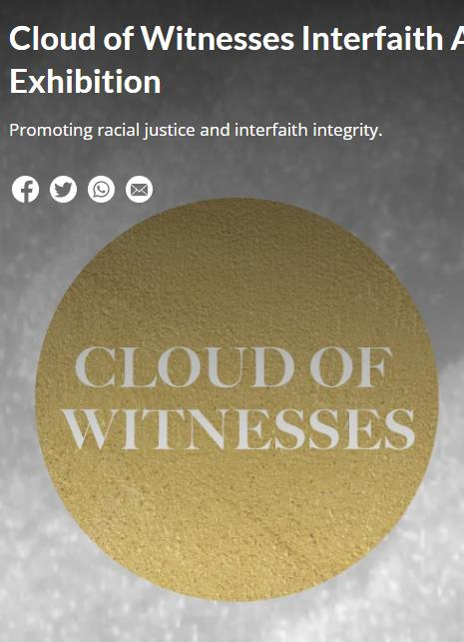
In 2025, in London, an Art exhibition called ‘Cloud of Witnesses’ showed lots of artists’ work about God.
They explored faith in God, stories from holy books and ideas about God for today’s world.
These artworks show us some creative ways to explore some big questions.
In this lesson, you will look at two artworks that make Jesus’ stories come alive for our day and age.
You can try this idea out for yourself.
Think deeply. Take your time.
Notes:
In 2025, the Catholic Bishops’ Conference ran an art exhibition called ‘Cloud of Witnesses’, digitally available here: www.godwhospeaks.uk/cloud-of-witnesses-art-exhibition/ ‘The God who Speaks’ is a digital space where Catholic Biblical insights and visions are shared. Artists were invited to show work which explored human searches for the divine in many and varied ways. Stunning work resulted, and the project enabled a link to be made to school RE. These lessons, four for primary RE and four for secondary RE, have been created to enable excellent RE which uses some of the art from the exhibition for the purposes of excellent school RE. Seeking to represent different visions and insights from interfaith integrities, the exhibition was a big success. These art and RE lessons share their work.

Slide 6

Bethlehem
Egypt
The River Jordan
Nazareth
Capernaum
Galilee
Tyre and Sidon
Decapolis
Jerusalem
Jericho
Samaria
Gadera
Bethany
The Mount of Olives
Jesus was a travelling man.
With his disciples, he walked everywhere.
Here are some places he visited –
do you know what happened in some of these places?
Imagine if Jesus came to your town!
Notes:
It’s a simple point, but notable: from Nazareth to Jerusalem is about 100 miles, many days walk. The Gospels imply that Jesus made this trip, up and down, at least three times.

Slide 7
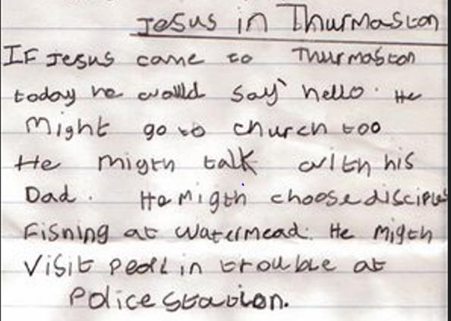
We asked Carole, age 7, what it would be like if Jesus came to her town. She wrote her ideas down.
Thurmaston, in Leicester, is where Carole goes to school.
What does Carole know about Jesus?
That he was religious. That he called God his ‘father’ or ‘dad’.
That he had disciples who were fishermen. That he helped people in trouble.
Notes:
The RE curriculum often seems to make little space for this kind of conversation. Give it some time, some air, some space. Pupils often have surprising and important things to say about a question like this, and a spiritual education needs to give these opportunities. Watermead is where you go fishing if you live in Thurmaston.

Slide 8
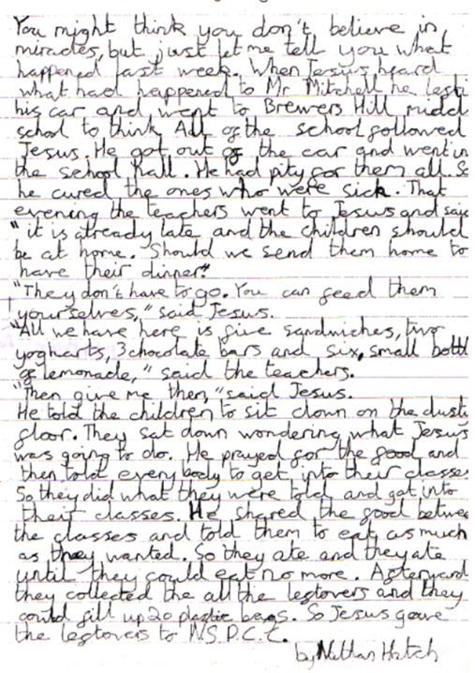
Jesus feeding a huge crowd with a child’s packed lunch
The famous story of the feeding of 5,000 people with just five loaves and two fish is in all four of the Gospels: Matthew, Mark, Luke and John.
Nathan, aged 11, goes to Brewer’s Hill School. He re-imagined the story as if it was happening here and now.
Read his version out loud and look at the Bible story too. What do you think Nathan has done that is clever here? What connects his story to the Bible in detail?
Notes:
The next slide puts the two texts next to each other.

Slide 9
Feeding the 5,000, Matthew 14:13-21, Common English Bible
Jesus… withdrew in a boat to a deserted place by himself. When the crowds learned this, they followed him on foot from the cities. When Jesus arrived and saw a large crowd, he had compassion for them and healed those who were sick. That evening his disciples came and said to him, “This is an isolated place and it’s getting late. Send the crowds away so they can go into the villages and buy food for themselves.”
But Jesus said to them, “There’s no need to send them away. You give them something to eat.”
They replied, “We have nothing here except five loaves of bread and two fish.”
He said, “Bring them here to me.” He ordered the crowds to sit down on the grass. He took the five loaves of bread and the two fish, looked up to heaven, blessed them and broke the loaves apart and gave them to his disciples. Then the disciples gave them to the crowds. Everyone ate until they were full, and they filled twelve baskets with the leftovers. About five thousand men plus women and children had eaten.
Notes:
The next slide puts the two texts next to each other.

Slide 10

Constance Mackintosh Smith wanted to create an artwork about Jesus for today.
Some art makes it look as if Jesus is lost in the past, from long ago, nothing to do with us.
But Constance wanted to imagine Jesus ‘down your street’.
How do you think she might have done this?
The next slide shows her work.
Notes:
The RE curriculum often seems to make little space for this kind of conversation. Give it some time, some air, some space. Pupils often have surprising and important things to say about an imaginative question like this, and a spiritual education needs to give these opportunities.

Slide 11
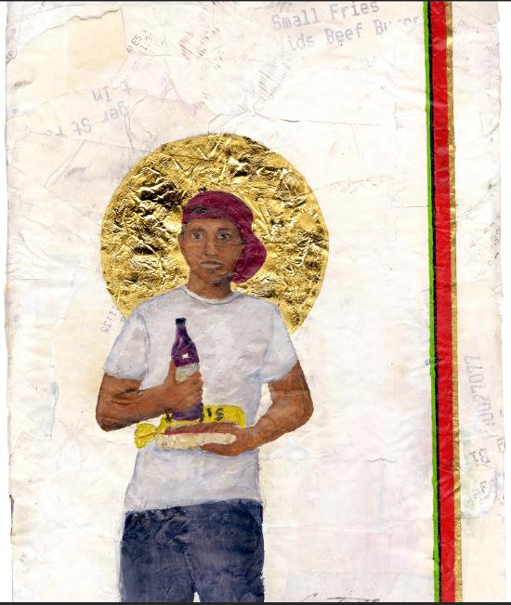
This work of art is by Constance MacIntosh Smith. It is called -
‘Our Lord of East London’ (2021).
Discuss what you see with a partner.
Can you see that the background is made of till receipts from a shop? Why?
Look for some details. Can you see a sliced Hovis loaf of bread? A cheap bottle of red wine? A golden halo? A baseball cap, jeans and a tee shirt?
Is this a surprising picture of Jesus to you? What do you like / dislike about it?
What words describe the expression on the young man’s face?
No one knows what Jesus actually looked like, but Constance gives her idea. Why do you think she chose to portray Jesus like this?
What two questions would you like to ask the artist?
Notes:
The observational questions on this slide lead into the theological ones which follow on the next slide – pupils will need teacher input to do the ‘digging deeper’ suggested.

Slide 12
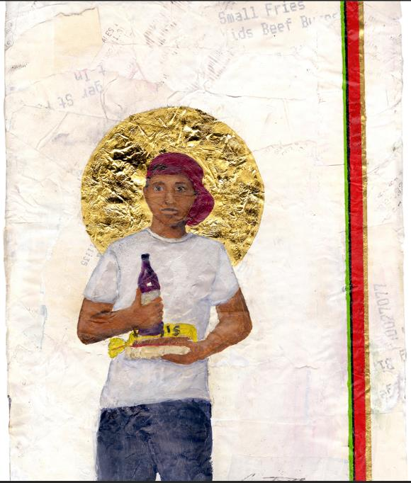
Digging deeper -
Constance MacIntosh Smith.
‘Our Lord of East London’ (2021).
In Saint John’s Gospel the writer says:
‘The Word became flesh and lived among us, full of grace and truth.”
This idea is called ‘incarnation’. Christians believe God became human in Jesus.
What messages about Jesus has the artist put into her painting?
‘God was Man in Palestine / And lives today in bread and wine’ (from a poem by John Betjeman).
Why do you think the artist chose to include the bread and wine in the picture?
Notes:
These questions are more theological – students will need teacher input to do the ‘digging deeper’ suggested. Constance is giving one view of Jesus of course – and when RE uses this kind of material, it’s important to note that the gospel text is fixed, but interpretations are fluid. So we don’t here tell pupils how to interpret the Bible – we invite them to join in an exploration of different messages in the work.

Slide 13
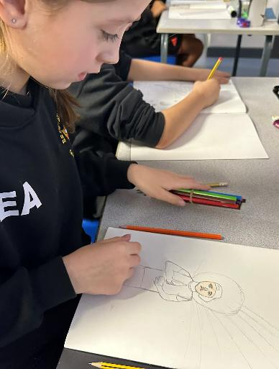
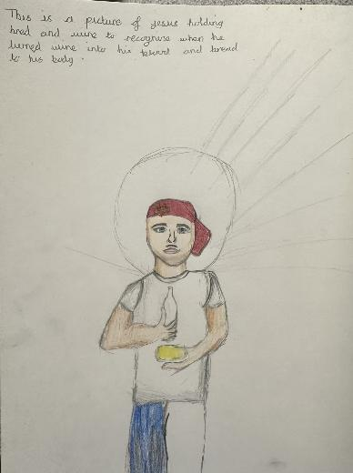
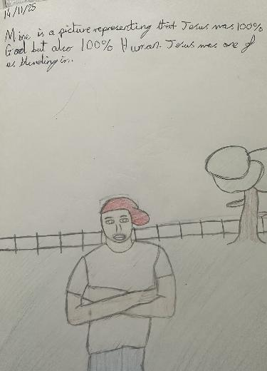
These children, aged 9, were interested in Constance MacIntosh Smith’s way of showing Jesus – as one of us, God living with us, incarnated.

Slide 14
Bible teachings and ideas about Jesus from the Christian New Testament
How do you think the art works we have looked at are connected to the ideas in these Bible quotes?
Discuss carefully… these are hard ideas…
In the Bible, in the letter to the Hebrews, 1:1-3, the writer says this about God in Jesus:
“In previous times, God spoke to our ancestors in many and various ways through the Prophets, but in these last days he has spoken to us through his Son… through whom he created the universe. He – Jesus - is the reflection of God’s glory, the perfect expression of God’s very being.”
In the Bible, Mark 14:22-24, the Gospel writer describes Jesus’ Last Supper:
“While they were eating, Jesus took bread, and after he had pronounced the blessing, he broke it and gave it to them, saying, “Take it; this is my body.” Then he took a cup, and after offering thanks he gave it to them. After they all drank from it, he said to them, “This is my blood of the covenant, which will be shed on behalf of many.”
Notes:
Slightly abbreviated from the text of the New Catholic Bible. (I would recommend either the GNB Catholic edition or the ESV CE for Catholic schools)
Make sure your learners are familiar with the meanings of key words: Prophet / Son of God / Glory of God / Blessing / Covenant. Possible answers: Constance is trying to show that Jesus is ‘one with us’. Constance is suggesting that God is found in ordinary time and ordinary places. Constance implies that bread and wine at Eucharist are ordinary as well as holy.’

Slide 15
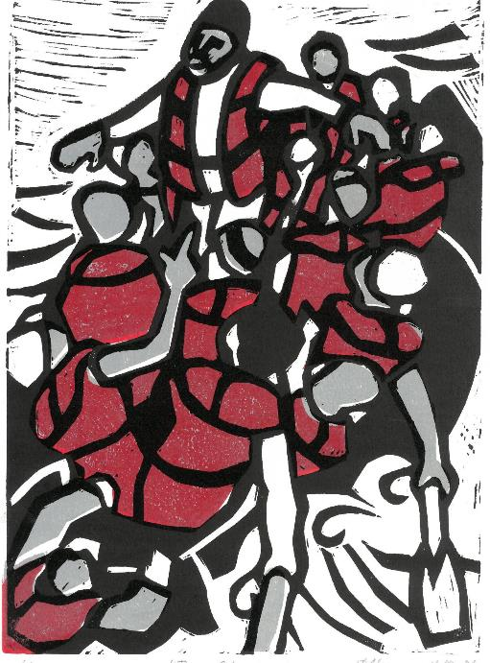
Have a good look at David Robinson’s lino cut print of a Bible story about Jesus before you read anything about it.
What colours are used?
What is happening?
What do you think the artist might be expressing?
Two stories are connected by this print, one from the Bible over 20 centuries ago, one from the news in the UK today.
Read and hear the Bible story from the next slide.
Notes:
Pupils may not immediately see the connections David makes here: give them a little time, and maybe a little hint.

Slide 16

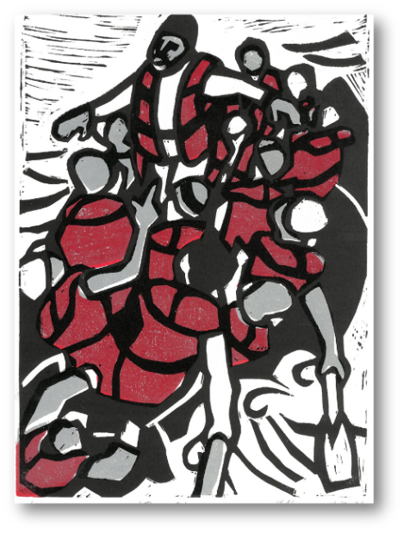
Jesus stops a storm - Mark 4:35-41 - Common English Bible.
“Later that day, when evening came, Jesus said to them, “Let’s cross over to the other side of the lake.” They left the crowd and took him in the boat just as he was. Other boats followed along.
Gale-force winds arose, and waves crashed against the boat so that the boat was swamped. But Jesus was in the rear of the boat, sleeping on a pillow. They woke him up and said, “Teacher, don’t you care that we’re drowning?”
He got up and gave orders to the wind, and he said to the lake, “Silence! Be still!” The wind settled down and there was a great calm. Jesus asked them, “Why are you frightened? Don’t you have faith yet?”
Overcome with awe, they said to each other, “Who then is this? Even the wind and the sea obey him!”
Notes:
Click the icon if you want to hear the gospel aloud.

Slide 17
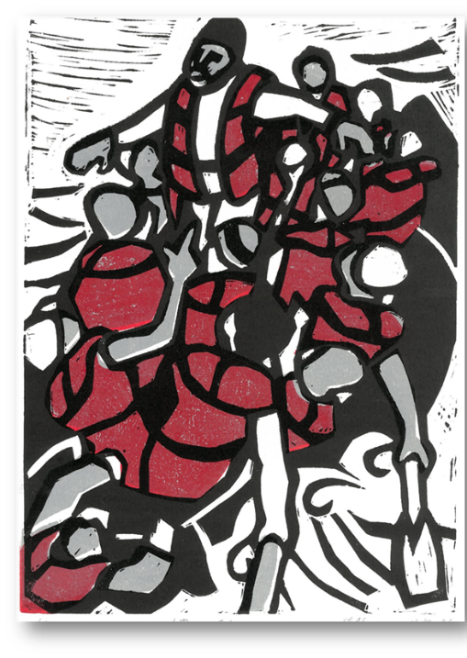
David Robinson, Jesus Calms the Storm, 2024 www.davidrobinsonartist.com
David is a Christian artist from Porthcawl in Wales.
This is a famous story from Jesus’ life, the stilling of a deadly dangerous storm on the Sea of Galilee. David shows Jesus not in a fishing boat, but in a boat of displaced people. It is like the pictures of small boats of refugees we see on the news pretty often, Desperate people from across the world making dangerous journeys across the Mediterranean or the Channel. Look at their orange-browny-red life jackets: they don’t offer much protection from the dangerous high seas.
Is David suggesting that we can imagine Jesus standing with the refugees, maybe ‘stilling the storms’ in their hearts?
If Jesus came today, what storms would he calm?
If Jesus came today, what would he do for people who are desperate?
If you took another story of Jesus and made a work of art yourself to ‘make it up to date’ what would you paint and why?
What do you like and dislike in this painting and its meanings?
Notes:
David’s interpretation of the story has a social or ethical dimension – when RE uses this kind of material, it’s important to note that the gospel text is fixed, but interpretations are fluid. So we don’t here tell pupils how to interpret the Bible – we invite them to join in an exploration of different messages in the work. David’s Church, Porthcawl Tabernacle, has a useful website. Learners might find more to help them interpret and contextualise his work here. https://glannauogwr.cymru/en/english/

Slide 18
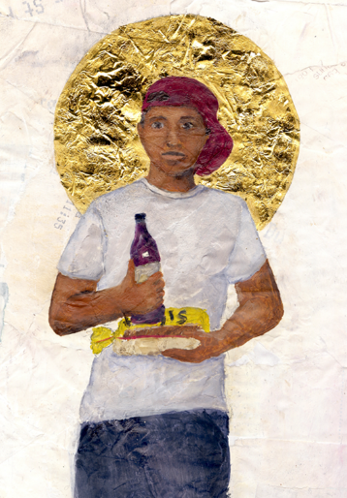
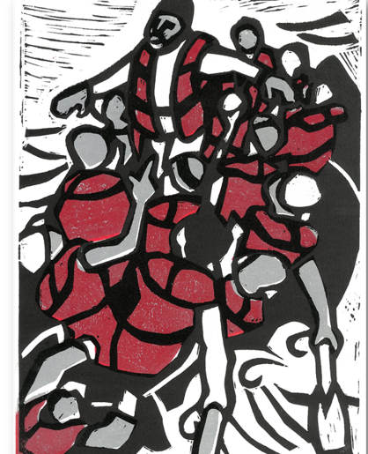
Two artists who are bringing the stories of Jesus ‘up to date.’
We asked you to think about this idea: what if Jesus came to your town?
Constance and David have made modern art about ancient stories.
You could do the same. If one of these stories of Jesus happened in your town, what would it be like?
The Baby in the Manger.
Jesus baptised in the River.
Jesus healing a blind person.
Jesus getting arrested.
The crucifixion.
Jesus back from the dead in a park.
The next 4 slides show responses to this idea. Then the three slides after that show work by some older students that might inspire you.
Notes:
When RE uses this kind of material, it’s important to note that the gospel text is fixed, but interpretations are fluid. So we don’t here tell pupils how to interpret the Bible – we invite them to join in an exploration of different messages in the work.

Slide 19
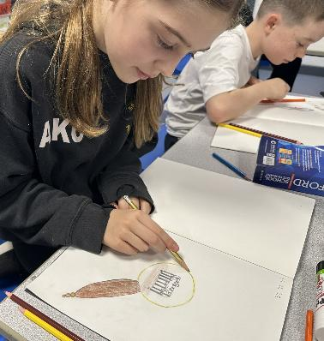
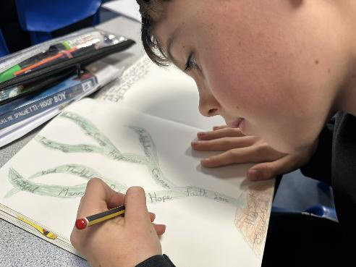
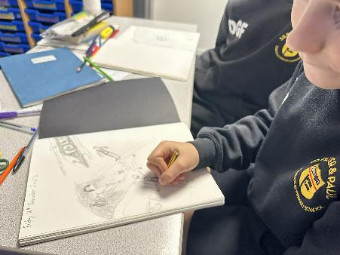
Pupils found these tasks very challenging – but really engaging too…

Slide 20
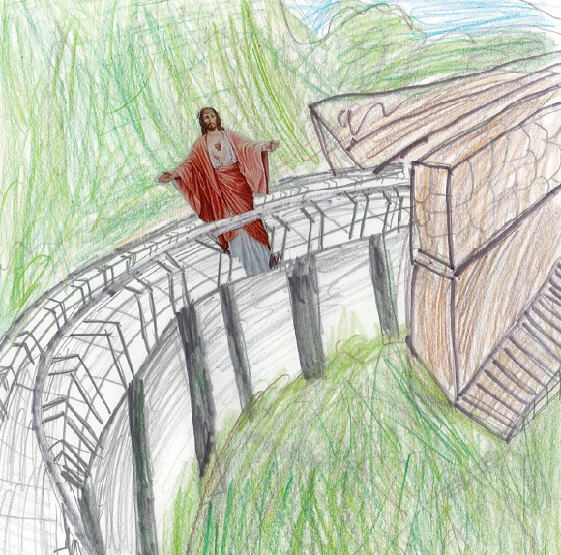
If Jesus came to New Mills!
A little idea from Year 4

Slide 21
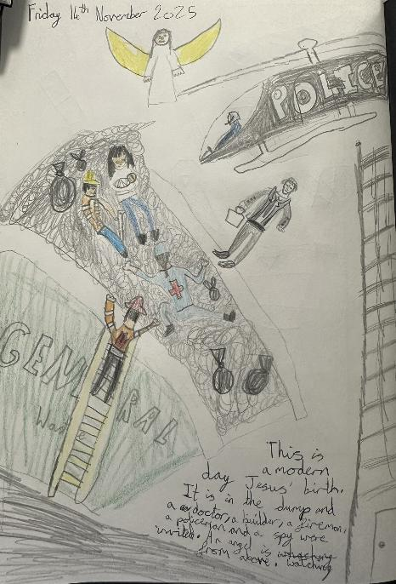
The idea of Jesus coming to our own times and places has really energised children in our try-out schools.
“This is a modern-day Jesus’ birth.
It is in the dump, and a doctor, a builder, a fireman, a policeman and a spy were invited. An angel is watching from above.”

Slide 22
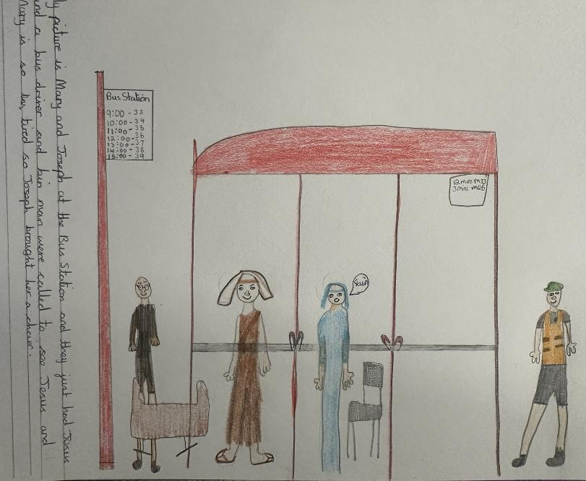
“My picture is Mary and Joseph at the bus station, and they just had Jesus. And a bus driver and a bin man came to see Jesus. Mary is so tired. Joseph brought her a chair.”

Slide 23
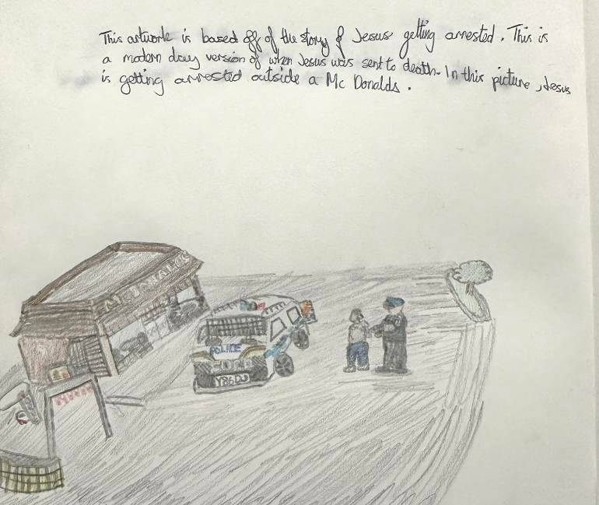
Here, instead of the Garden of Gethsemane, Jesus is arrested outside of MacDonalds.

Slide 24
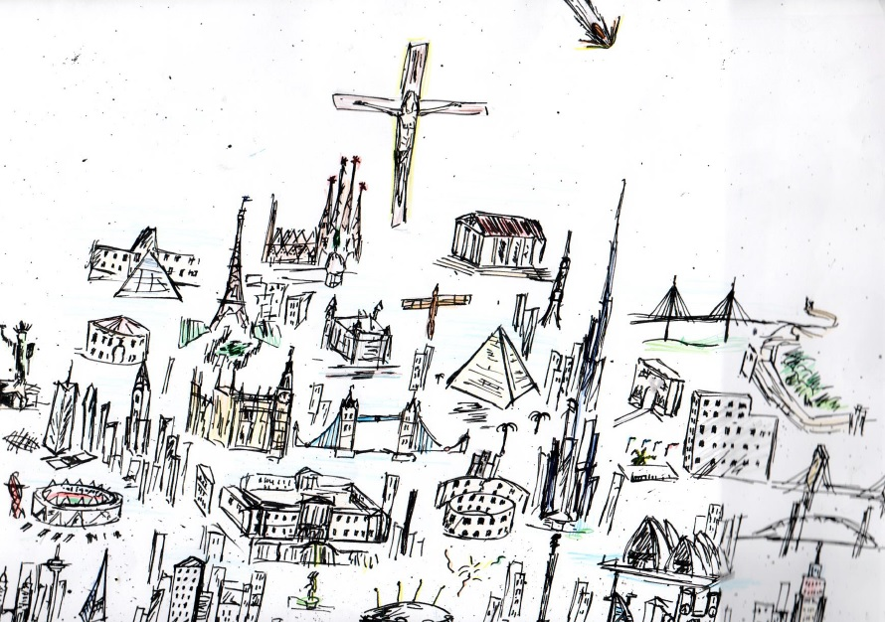
Benedict (10) Jesus is there for believers
"My picture shows Jesus on a cross on a hill made of lots of landmarks and monuments around the world – from Tower Bridge to Golden Gate, Sydney Harbour and the Wall of China.
Jesus is not in any particular place. He is there for everyone who believes in him. The burning meteorite is filled with the Holy Spirit wherever it hits, everyone in the landmark will be filled too. Jesus has a smile of kindness and forgiveness however much the pain."
Notes:
This really is a remarkable piece of work from ten year old Benedict, not only in the great line drawings but in the vision and interpretation.

Slide 25
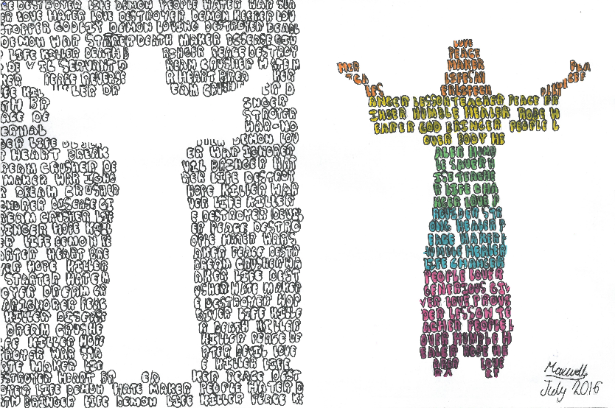
Maxwell is 11.
“My artwork is based on Jesus - the light of the world. I made the left side black and white because if he wasn’t there, there would be no light and there will be war, evil and arguments: no one will have a heart. On the other side it shows that Jesus is the light of the world and brings joy, happiness and peace to the world.
On my artwork I have been using kennings to explain the evil and the good and what it would be like without Jesus or with Jesus. For example, on the evil side it says “Life Killer; Peace Destroyer; Heart Breaker…” On the good side it says: “Peace Maker; Humble Healer; Lesson Teacher, People lover, Hope hearer.” I hope you enjoy my artwork.”

Slide 26
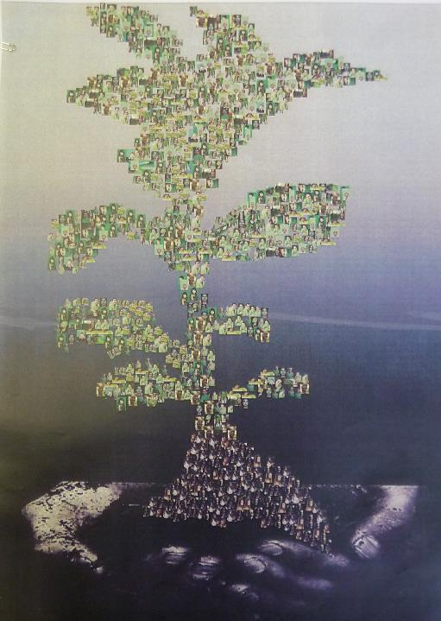
Resurrection – Tree of Life, by Keilah, 14
“In the Bible, Jesus Christ was sentenced to death. After being on the cross for six hours, Jesus called out to God; "My God, My God, why have you forsaken me?)" (Mark 15:34). Jesus said. 'It is finished.' With that he bowed his head and gave up his spirit." (John 19:30).
His body was then buried in a tomb. On the 3rd day: Jesus' body appeared to have gone. Because nobody had been in due to the large rock covering the entrance, they were very confused until approached by an angel, telling them that Jesus was alive. After many people had sightings of Jesus, it was clear to people that he had risen from the dead. This convinced people that he was actually the son of God.
This idea of new life and rebirth is what I based my artwork around. The final picture is a plant sapling made up of lots of little pictures of people from all around the world. The Bible teaches that God takes the forms of Father, Son and Holy Spirit. This message is that new life is based around others, their influences on us, and also their sacrifices. The plant is made up of people's faces because they represent the world and who Jesus set out to save. The hands represent Jesus holding us up to God (the bottom being black is towards the earth and as it gets higher it gets lighter to represent being lifted up) and protecting us. Because of Jesus’ love we will all be able to be with God and feel his love. The faces are of people of all ethnicities and from all around the world because it shows he went out to save lots of different people and not just one 'type' of person.”
Notes:
This is a long text, but worth reading with your pupils because it gives such a rich understanding of Jesus from a contemporary perspective.

Slide 27
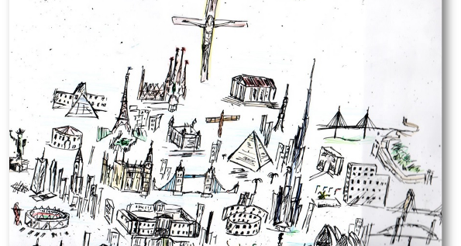
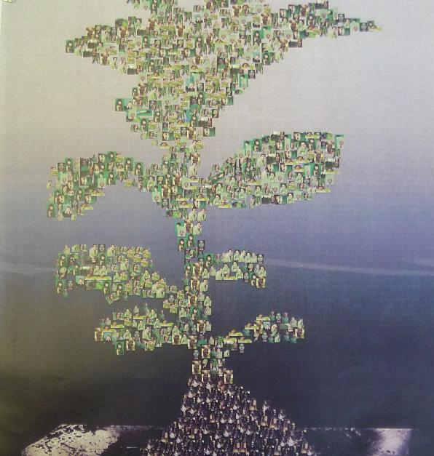
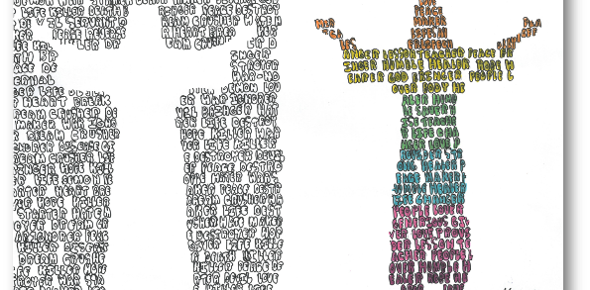
Notes:
A remarkable set of images here. Do send me some your own pupils do. lat@retoday.org.uk

Slide 28
If Jesus came to our town…
Create a picture of your own.
Stories you might choose:
The Baby in the Manger.
Jesus baptised in the River Jordan.
Jesus healing a blind person.
Jesus and the story of the Good Samaritan.
Jesus as the light of the world.
Jesus coming into the city riding a donkey.
Jesus getting arrested in a park.
The crucifixion at Calvary.
Jesus back from the dead in a park.
Notes:
Keep this activity quite simple. If you give pupils A4 paper, and a preprinted text of one of these stories, get them to spend planning time thinking about modern equivalents of the ancient stories, and then creating a simple image. Constance and David have done simple work, and this is part of what makes it striking. Please send us examples: lat@retoday.org.uk

Slide 29



Partnership
Notes:
These lessons and resources have been created by Lat Blaylock and Fleur Dorrell in a partnership between the Catholic Bishops’ Conference through its work on the Bible (‘The God who Speaks’), NATRE (who run the Spirited Arts competition) and RE Today. The lessons are free to use, and suitable for RE in any school, connecting in many ways to different schemes of work , wherever pupils use critical and creative skills to explore theological and spiritual questions. https://www.godwhospeaks.uk/ We also thank teachers and pupils who have been involved in developing and trying out the lessons: your contribution has greatly improved the project!

Slide 30
Connections to the Catholic RE Directory
The RE Directory invites all pupils to engage with an ambitious RE curriculum focused on multiple disciplines in the pursuit of truth. These lesson ideas enable this aim.
By age 9, pupils will use critical and creative skills in RE and will explore creative and artistic ways of connecting Gospel narratives to their own times and places (RED, p141).
This work might contribute to the studies in Branch 3 of the Year 4 curriculum, ‘Galilee to Jerusalem’ by enabling pupils to understand Jesus’s question: ‘who do people say that I am?’
They will use these activities to discern more about the identity of Jesus in His time and for us. (RED p137, 140).
The work also connects to Branch 5, Yr 6, ‘to the ends of the earth’ where pupils are invited to compare their own and others’ experiences, feelings and things that matter to them in the light of the Gospel stories they study (RED p182).
Notes:
These lessons and resources have been created by Lat Blaylock and Fleur Dorrell in a partnership between the Catholic Bishops’ Conference through its work on the Bible (‘The God who Speaks’), NATRE (who run the Spirited Arts competition) and RE Today. The lessons are free to use, and suitable for RE in any school, connecting in many ways to different schemes of work , wherever pupils use critical and creative skills to explore theological and spiritual questions. https://www.godwhospeaks.uk/
We also thank teachers and pupils who have been involved in developing and trying out the lessons: your contribution has greatly improved the project!
We invite you to share interesting examples of your pupils’ work: lat@retoday.org.uk

