Slide 1

Searching for God Secondary Lesson 1 God in Jesus?
Creative and thoughtful RE Lessons which use inspirational art from the exhibition ‘Cloud of Witnesses’ CO-CURATED by ‘The God who Speaks.’
www.godwhospeaks.uk/cloud-of-witnesses-art-exhibition/
Notes:
In 2025, the Catholic Bishops’ Conference in partnership with St John’s Church, Waterloo and Art & Christianity ran an art exhibition called ‘Cloud of Witnesses’. It represented different visions and insights from interfaith integrities. The exhibition was a big success. These art and RE lessons share some of their work. Artists were invited to portray art which explored human searches for the divine in many and varied ways. Stunning work resulted, and the project enabled a link to be made to school RE. These lessons, four for primary RE and four for secondary RE, have been created to enable excellent RE which uses some of the art from the exhibition for the purposes of excellent school RE.

Slide 2

Searching for God: Aims These lessons aim to enable learners to: a. Think about art works that express big Ideas about God. b. Develop broad minded and open-hearted responses to the ideas of others. c. Consider religious teachings about God in depth for themselves. d. Respond creatively for themselves to theological learning in RE.
RE Lessons which use inspirational art from the exhibition CO-CURATED BY ‘The God who Speaks’.
Notes:
The specific learning objectives of each of our four primary and four secondary lessons are given on the next slide, but these general aims fit in with the purposes of RE as they are articulated in various contexts, for Catholic schools, other schools with a religious character, community schools and academies. Teachers are invited to use these PPTs and the notepads that go with them containing additional resources, learning activities information and learning activities, in flexible ways that suit their own pupils. Seeking to represent different visions and insights from interfaith integrities, the exhibition ‘Cloud of Witnesses’ was a big success. These art and RE lessons share the work.

Slide 3
Searching for God
No one can draw God.
If God is real, then all our drawings would not be able to show how full of love, how amazingly powerful or how remarkably wise God is.
Some religions forbid humans from trying to draw God. They say: “Don’t try. You will only get it wrong!”
But many people in different religions do create artworks that say something about God.
Often, artists who are Jewish or Muslim, Christian or Hindu, use symbols to express their beliefs, ideas, visions or faith.
And non-religious people can use the arts to express their beliefs as agnostics or atheists as well.
We hope you find this artwork interesting – and that it enables you to explore art and God in depth for yourself. And then to make some of your own artwork.
Notes:
Introduce the work to pupils in these terms. You don’t have to use all four lessons in the sequence, though they will fit will with units of work about any theological topic in RE.
Expect pupils to gather and debate ideas in the first three lessons in ways that enable them to be creative for themselves in lesson 4. Referring to the final task throughout this mini-unit of RE will help all pupils to bring their learning together in a final piece of work at the end. It’s important that they can create work they are proud of: time and quality resources are a great help with this.

Slide 4
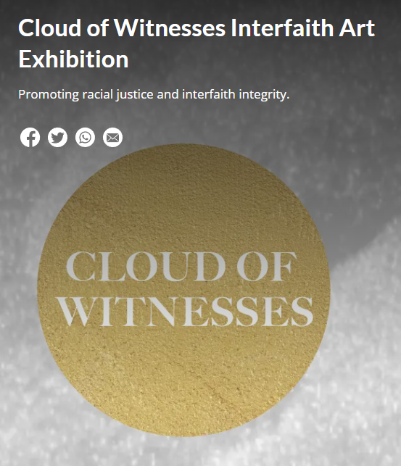
In the 2025 London Art exhibition ‘Cloud of Witnesses’ - 26 artists contributed some of their work. They explored faith, belief and doubt in relation to the Divine. From different religions to no religion, they show us some creative ways of exploring some of life’s biggest questions.
Notes:
In 2025, the Catholic Bishops’ Conference co-curated an art exhibition called ‘Cloud of Witnesses’, digitally available here: www.godwhospeaks.uk/cloud-of-witnesses-art-exhibition/ ‘The God who Speaks’ is a digital space where Catholic Biblical resources, insights, projects and visions are shared. For this art exhibition, artists were invited to show work which explored human searches for the divine in many and varied ways. Stunning work resulted, and the project enabled a link to be made to school RE. These lessons, four for primary RE and four for secondary RE, have been created to enable excellent RE which uses some of the art from the exhibition for the purposes of excellent school RE. Seeking to represent different visions and insights from interfaith integrities, the exhibition has created an ongoing conversation. These art and RE lessons share some of the work.

Slide 5
Searching for God? Lesson 1 Secondary God in Jesus?
Notes:
There are four primary and four secondary lessons in this project, which fit well together – but teachers are welcome to use some of them as they fit in with your own RE planning and schemes of work.
The partnership in creating these lessons with NATRE links powerfully to the Spirited Arts project NATRE runs each year. See examples and details here: https://www.natre.org.uk/about-natre/projects/spirited-arts/spirited-arts-gallery/2024/

Slide 6
Searching for God God in Jesus?
For Christians, God is best seen in Jesus.
God became human at bethlehem and the life of jesus is the life of god in human form. how do our artists reflect on this vision?
Notes:
In 2025, the Catholic Bishops’ Conference co-curated an art exhibition called ‘Cloud of Witnesses’ Seeking to represent different visions and insights from interfaith integrities, the exhibition was a big success. These art and RE lessons share their work. Artists were invited to show work which explored human searches for the divine in many and varied ways. Stunning work resulted, and the project enabled a link to be made to school RE. These lessons, four for primary RE and four for secondary RE, have been created to enable excellent RE which uses some of the art from the exhibition for the purposes of excellent school RE.
This particular lesson engages with the Trinitarian Christian vision that ‘God was in Christ, reconciling the world to Himself’ and that Jesus of Nazareth is revealed in the Gospels to be the Christ, the Son of the Living God, God among us – the incarnation of the Divine. RE lessons don’t teach these ideas in any coercive way: pupils with all different beliefs will engage in this study, but a full-hearted appreciation of the depth of Christian belief about God in Jesus is in focus in this learning.

Slide 7
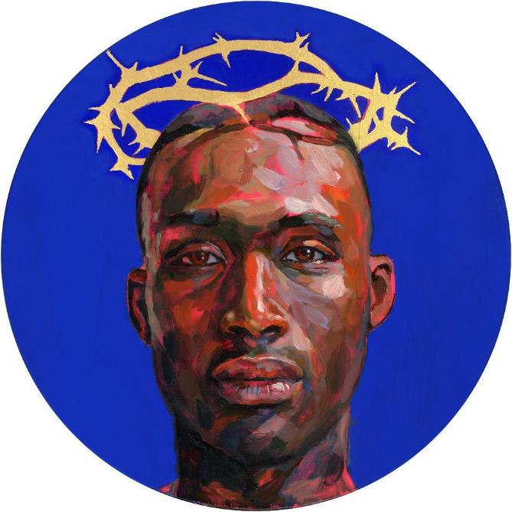
Begin by looking at this work of art, by Lorna May Wadsworth, called ‘Blue Christ’. Discuss what you see with a partner.
What colours of paint did Lorna choose?
How did she choose to show that this is a portrait of Jesus?
What emotions and feelings do you see in the artwork?
No one knows what Jesus actually looked like, but Lorna gives her idea. Why do you think she choose to paint a black Jesus?
What do you like and/or dislike about the image?
Notes:
The next four slides approach the learning through two vibrant and intriguing works of art that reflect on questions about who Jesus Christ is for us today. The fist slide in each case asks simple questions that encourage observational responses. The second of the slides asks theological and philosophical questions, which probably need more teacher input to guide discussion.

Slide 8

Digging deeper: Blue Christ by Lorna May Wadsworth
Quote: “This image of Jesus is thoughtful and brave, strong and human. The artist chose a black man as Jesus, maybe to make viewers think about the idea of Christ for everyone.”
If you were painting Jesus for a modern setting, what would you want to show?
A famous Christian hymn says: ‘The head that once was crowned with thorns / is crowned with glory now / a royal diadem adorns the Mighty Victor’s brow.’
Can you suggest three – or more - ways in which Jesus’ torture and crucifixion have been transfigured into a triumph, a victory?
Notes:
These discussion points ask theological and philosophical questions, which probably need more teacher input to guide discussion. It’s worth recording the best ideas the class come up with, and using them again later in your course.

Slide 9
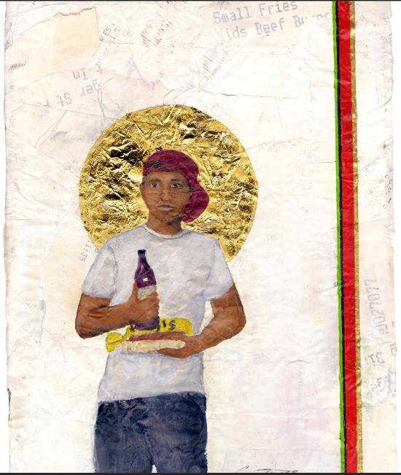
This work of art is by Constance MacIntosh Smith. It is called ‘Our Lord of East London’ (2021) Discuss what you see with a partner.
Can you see that the background is made of till receipts from a shop? Why?
Note the composition: using a loaf of Hovis, a cheap bottle of red wine, a golden halo, baseball cap, jeans, tee. Is this a surprising image of Jesus to you? What do you like / dislike about it?
What expression is that on the young man’s face?
What ideas, emotions and feelings do you think lie behind the artwork?
No one knows what Jesus actually looked like, but Constance gives her idea. Why did she choose to portray Jesus like this?
What two questions would you like to ask the artist?
Notes:
The observational questions on this slide lead into the theological ones which follow on the next slide – students will need teacher input to do the ‘digging deeper’ suggested.

Slide 10

Digging deeper Constance MacIntosh Smith. ‘Our Lord of East London’ (2021).
In Saint John’s Gospel the writer says: ‘The Word became flesh and lived among us, full of grace and truth.” This idea of incarnation, that God became human in Jesus, is important in making sense of this painting. What is the artist saying about Jesus?
‘God was Man in Palestine / And lives today in bread and wine’ (from a poem by John Betjeman). Why do you think the artist chose to include the bread and wine in the picture?
Notes:
These questions are more theological – students will need teacher input to do the ‘digging deeper’ suggested.

Slide 11
Bible teachings and ideas about Jesus from the Christian New Testament.
How do you think the two paintings we have looked at are connected to the ideas in these Bible quotes? Discuss carefully…
In the Bible, Mark 14:22-24, the Gospel writer describes Jesus’ Last Supper:
“While they were eating, Jesus took bread, and after he had pronounced the blessing, he broke it and gave it to them, saying, “Take it; this is my body.” Then he took a cup, and after offering thanks he gave it to them. After they all drank from it, he said to them, “This is my blood of the covenant, which will be shed on behalf of many.”
In the Bible, Letter to the Hebrews, 1:1-3, the writer says this about God in Jesus:
“In previous times, God spoke to our ancestors in many and various ways through the Prophets, but in these last days he has spoken to us through his Son… through whom he created the universe. He – Jesus - is the reflection of God’s glory, the perfect expression of his very being.”
Notes:
Slightly abbreviated from the text of the New Catholic Bible. (I would recommend either the GNB Catholic edition or the ESV CE for Catholic schools)
Make sure your learners are familiar with the meanings of key words: Prophet / Son of God / Glory of God / Blessing / Covenant.

Slide 12
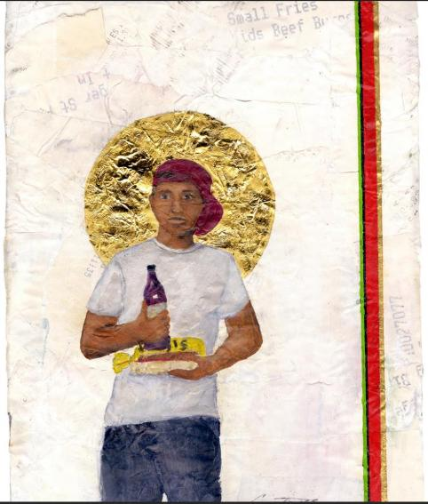

Discussion: how are the two works of art connected to these ideas: Bread and wine? The body and blood of Jesus? God speaking to us? A covenant between God and humanity? Sacrifice? The reflection of God’s Glory? God our creator? Blessing?
Notes:
This discussion topic is deliberately left open: students need space to develop their own expressions of understanding from the art, and interpretation is not like a maths question, so we try to make room for imagination and open thinking. If you – the teacher – want to, suggest possible answers like these:
‘In both paintings, Jesus is looking straight at you. Maybe the artist wants you to consider: do you believe him?’
‘Many famous works of art about Jesus make him look very God-like. But these two seem to focus on him being very much a human.’
‘I’m not a Christian and I don’t really believe in God. But these paintings make a connection to me because they show this very amazing person also like ‘someone down our street’ If Jesus was like this, I’d get it how people admire – or even worship – him.’

Slide 13
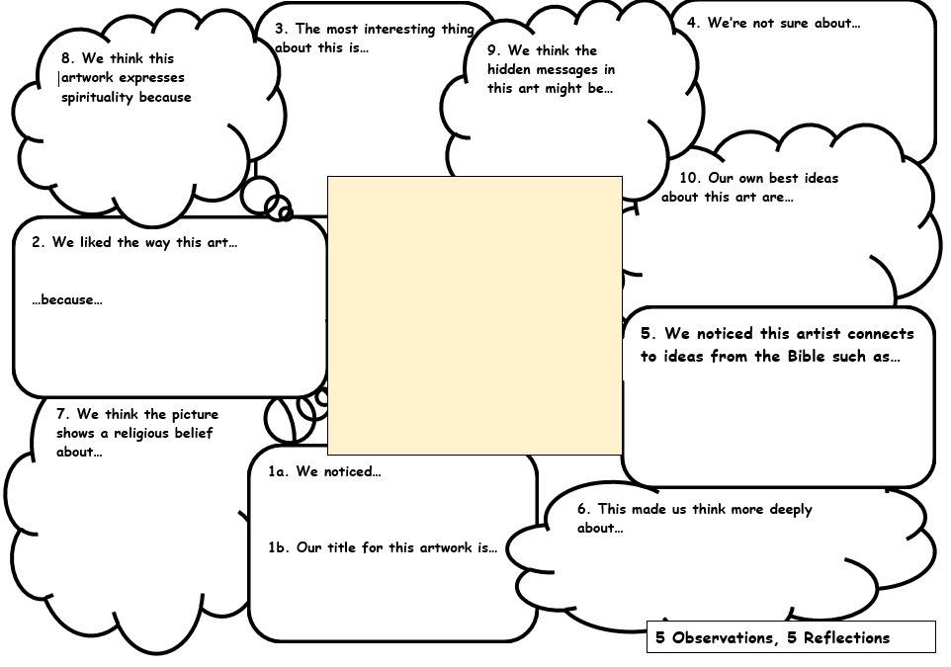
This thinking frame is called ‘5 Observations, 5 Reflections.’
With a partner choose which of the two art works you will work on and complete the thinking frame’s sections in number order (observe first, then reflect).
Discuss each section before you write.
Compare your work with other pairs and improve it.
Notes:
5 Observations and 5 Reflections is surprisingly powerful thinking frame. It may be useful to print out these double size. Pairs of students discuss and write together. Completing the thinking frame’s sections in number order means students observe first, then reflect – they go ‘twice round’ the picture.

Slide 14
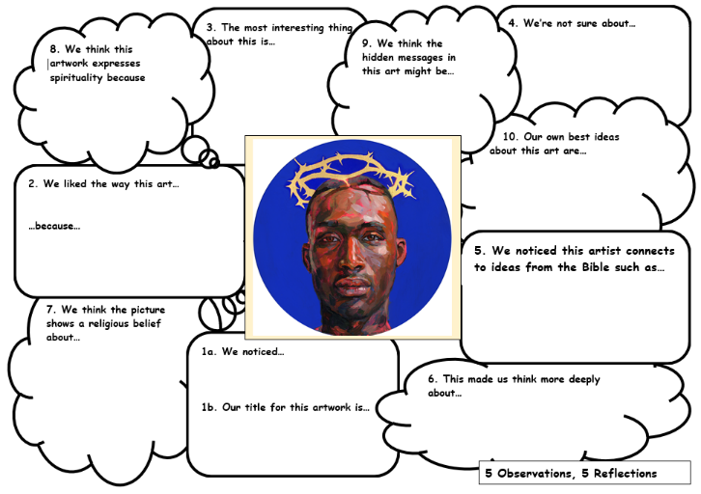
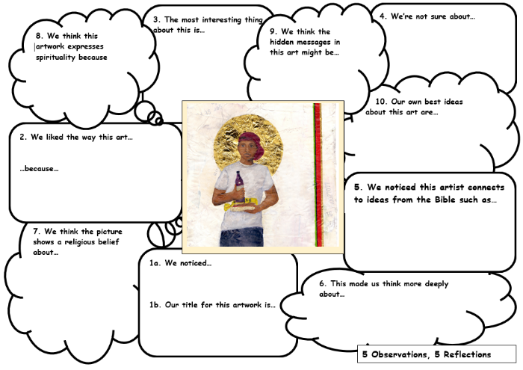
Critical ideas:
“I think both artists wanted to show that Jesus has relevance today.”
“I prefer the Blue Christ. A black Jesus reminds us that he was persecuted, marginalised and rejected.”
‘My favourite is ‘Our Lord of East London’. It hints that Jesus might be with us in bread and wine today.”
Connections: what do you think these images have to do with some big spiritual ideas:
Is God with us? Can people find holiness, peace, salvation or goodness in ordinary life? Why do millions remember and share Jesus with bread and wine at Eucharist / Mass?
Notes:
My suggestion is that you work in groups of 4, two each on each picture, then groups the fours up into eights to share each others’ ideas and improve their work. But there are lots of other ways to do this. See what will work best for your students.

Slide 15
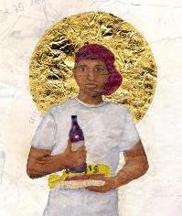

Four big ideas. What do you think? Rank these from 1-4: ‘wise to me’, downwards. A. Christians believe that Jesus came back from the dead, so these artists paint him as if he is alive in today’s world. It’s a good way to express their faith in the resurrection.
B. Both these artists are making Jesus look like ‘one of us.’ That is what Christians believe – God was in Jesus, reconciling us. So these kinds of painting are better than some old holy versions that show Jesus as very God-like – but out of touch.
C. I think it makes more historical sense to paint Jesus as a middle eastern Jewish man from 20 centuries ago, not to ‘modernise’ his story. He wasn’t African and he wasn’t from East London.
D. In both these pictures, the ‘here and now Jesus’ with his bread and wine and crown of thorns makes people think about the story in a fresh, new relevant way. That is what makes them so strong.
Notes:
Ranking can seem a crass thing to do – but it forces students to discuss, order their thoughts and be decisive. There’s no correct answer of course – the learning is in the process. Controversy and disagreement are good.

Slide 16
We invited young people to create artworks about God in Jesus for themselves, reflecting on big ideas and on Bible stories of Jesus. The next three slides show you some examples. You might like to select a saying or a story of Jesus to illustrate yourself. Or if you prefer a writing task, then consider: which actor would you select to play Jesus in a movie of his life, and why?

Slide 17
Daniel, 12, has created this image.
“Jesus calming the storm.
I did this with poster paint. I am symbolising Jesus’ power in his body language, facial expression and the composition of the scene. The boat is overwhelmed by the waves, but the waves are overwhelmed by Jesus. From his fingers, bolts of powerful light burst. He looks like he will when he is crucified because that is when his power was shown most”
Notes:
Bible reading: these Biblical stories may be unfamiliar to pupils. Read them aloud to explain the pictures from Mark 4: 35-41 (Jesus Calms the Storm), Mark 14: 27-31 (Peter denies knowing Jesus), Mark 16: 1-8 (the empty tomb of Jesus). Teachers might give pupils a wider choice of Gospel texts to work from in their own creative piece, or a free choice.

Slide 18
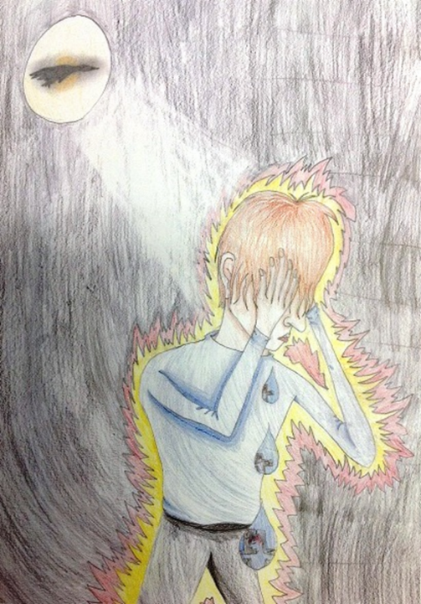
Forgive – Katie Holland age 11.
“The theme of my artwork is despair. Peter three times denied knowing Jesus. Also pictured is the feeling that the light and love of God will always be with you; even if you have done wrong, the Lord will guide you back towards the right path. Peter has made a mistake but Jesus was still willing to forgive.
This is a spiritual picture. I’ve hidden some images in it. The three tear drops flowing represent sorrow. The sun shines over the black background to symbolise the light still left in his soul. There is a silhouette of a dove in front of the sun: the peace and love of God will always stay with him, even in his darkest times.
The background is dark to represent sin. Peter is surrounded by yellow: he is scared for Jesus. The red shows that he is angry with himself. Peter wears modern clothing - people today can still make mistakes, but they can be forgiven too. I did a modern hair style.
The main point of the image is the brightness of the sun, which is a contrast to Peter’s action, but also the light of God’s love, leading him back towards the light.”
Notes:
Bible reading: these Biblical stories may be unfamiliar to pupils. Read them aloud to explain the pictures from Mark 4: 35-41 (Jesus Calms the Storm), Mark 14: 27-31 (Peter denies knowing Jesus), Mark 16: 1-8 (the empty tomb of Jesus). Teachers might give pupils a wider choice of Gospel texts to work from in their own creative piece, or a free choice.

Slide 19
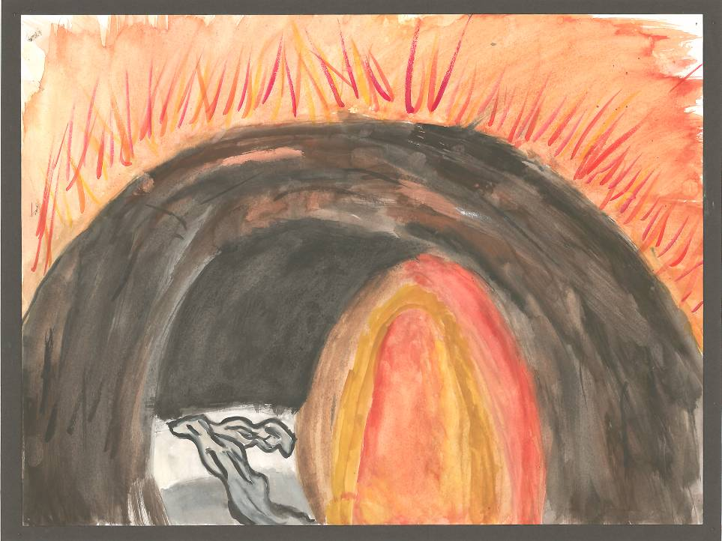
“Where is God? Not here.”
By Bola, age 12.
“I believe that the grave of Jesus was empty, I believe this because He lives today (in my heart).”
Notes:
Bible reading: these Biblical stories may be unfamiliar to pupils. Read them aloud to explain the pictures from Mark 4: 35-41 (Jesus Calms the Storm), Mark 14: 27-31 (Peter denies knowing Jesus), Mark 16: 1-8 (the empty tomb of Jesus). Teachers might give pupils a wider choice of Gospel texts to work from in their own creative piece, or a free choice.

Slide 20
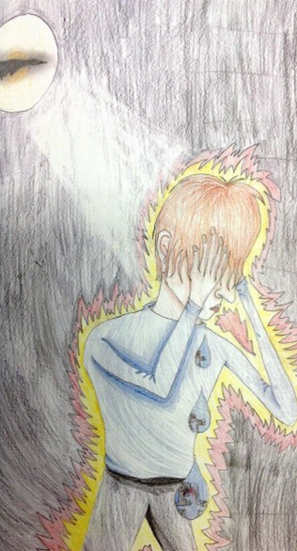
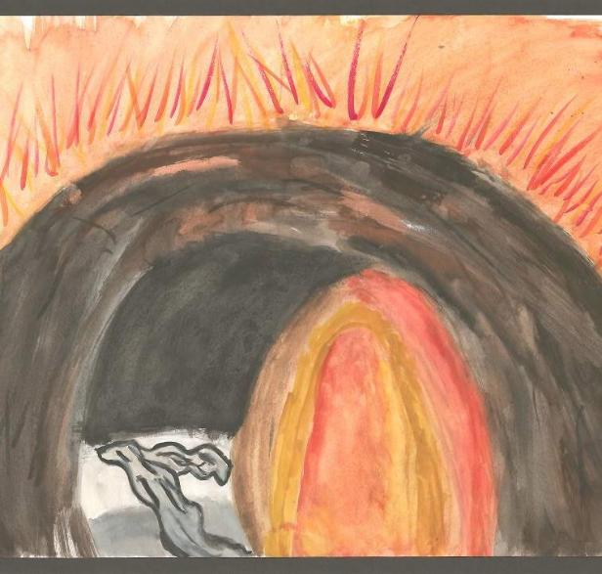
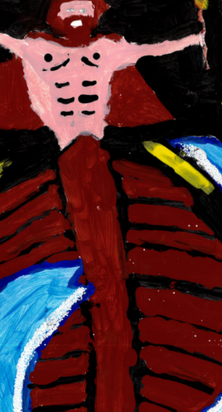
Which of the three young artists has made the most powerful image from Jesus’ life?
Notes:
Bible reading: these Biblical stories may be unfamiliar to pupils. Read them aloud to explain the pictures from Mark 4: 35-41 (Jesus Calms the Storm), Mark 14: 27-31 (Peter denies knowing Jesus), Mark 16: 1-8 (the empty tomb of Jesus). Teachers might give pupils a wider choice of Gospel texts to work from in their own creative piece, or a free choice.
These really are three spectacularly good examples of young people’s spiritual creativity. They will encourage your pupils to set a high bar in exploring sayings or teachings of Jesus in their own artwork.
The next slide suggests texts students might use for their own art – but any Gospel texts would be suitable. I’ve not taken texts from the Passion narratives here, preferring a focus on Jesus’ teaching and impact.

Slide 21
Making your own work of art about Jesus. You could use one of these sayings as inspiration – or choose your own text from the Gospels.
Jesus said: “In my Father’s house, there are many rooms. I go to prepare a place for you.”
Jesus said: “I am the resurrection, and the Life.”
Jesus said: “Come to me all you who are weary and heavily loaded. I will give you rest.”
Jesus said: “Blessed are the peace- makers. They will be called the children of God.”
Jesus said: “There is more joy in heaven over a sinner who repents than over 99 righteous people.”
Jesus said: “The kingdom of God is like a priceless pearl….”
Jesus said:
“I am the Light of the World.”
Notes:
You might use this slide to give students ideas, but it might work better to give them a Gospel to thumb through for themselves, or a much wider selection of Gospel narratives, teachings and examples.

Slide 22
Creativity: Think about what you admire from these two works of art that portray Jesus. As you devise your own work of art about Jesus, consider how you can use the insights of these two artists.
Notes:
Great RE often connects ancient Scripture with modern religious practice and challenges pupils to respond for themselves. This is intended to use that process.

Slide 23
Choose a task: Either… > Take a saying or a story of Jesus from the Gospels to illustrate yourself. Think about all the ways the artwork you have seen has worked well. Remember that for the world’s 2.6 billion Christians, Jesus is a holy, inspiring figure – and they often use symbols to show this. > Or, if you prefer a writing task, then consider: which actor would you select to play Jesus in a movie of his life, and why? Consider what kind of qualities Jesus had, and what kind of actor would be a good cast for the role in a new, modern movie of Christ’s life.
“As a Christian, Jesus is unique to me: the Trinitarian Christian vision is that ‘God was in Christ, reconciling the world to Himself’ and that Jesus of Nazareth is revealed in the Gospels to be the Christ, the Son of the Living God, God among us – the incarnation of the Divine.”
Of course, Muslims, Atheists and others don’t have the same high regard for Jesus. But understanding each others’ beliefs is what matters in RE.
Notes:
Good RE is never oversimplifies: the scripture quote here – and others used – are suitable, no harder than what pupils study in English, but not simple. Worth spending time making sure learners ‘get’ the big ideas.

Slide 24
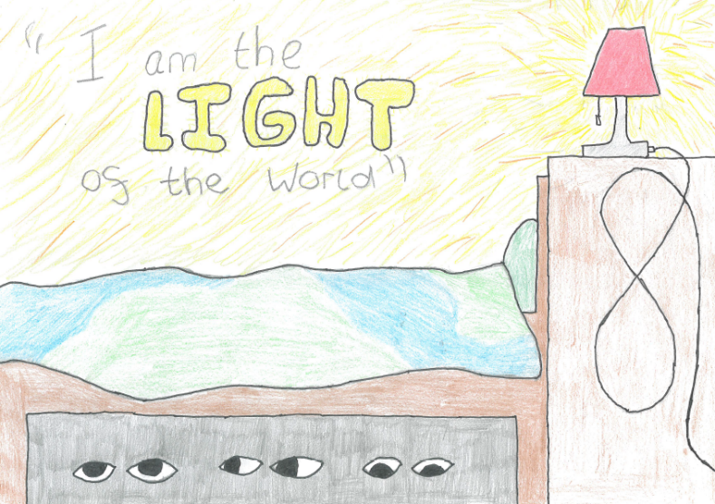
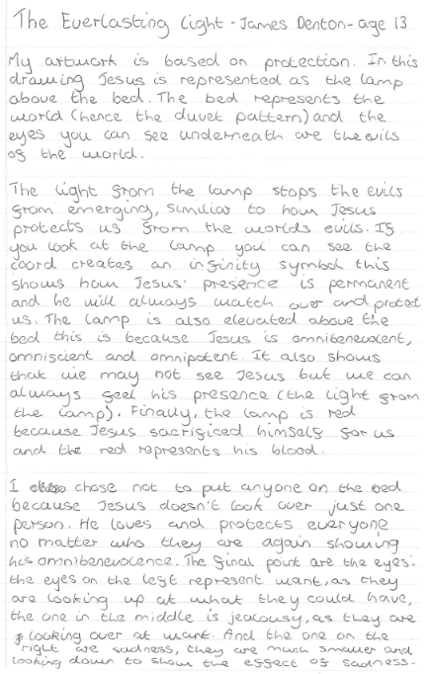
James, 13, Everlasting Light.

Slide 25
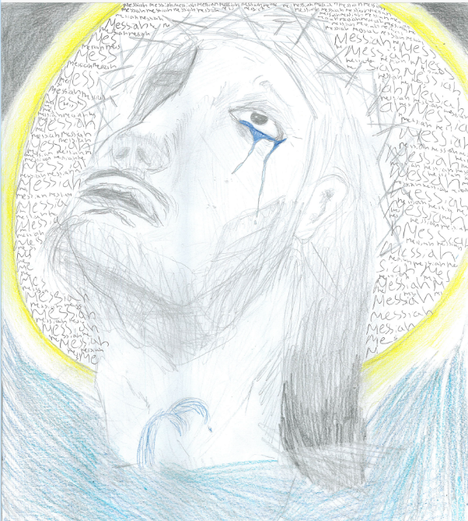
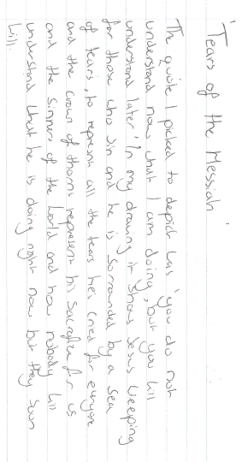

Slide 26
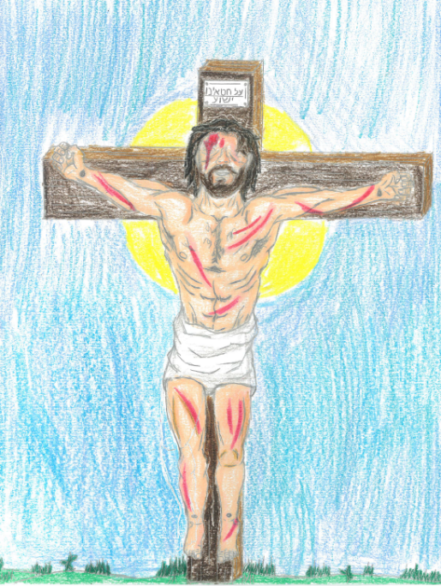
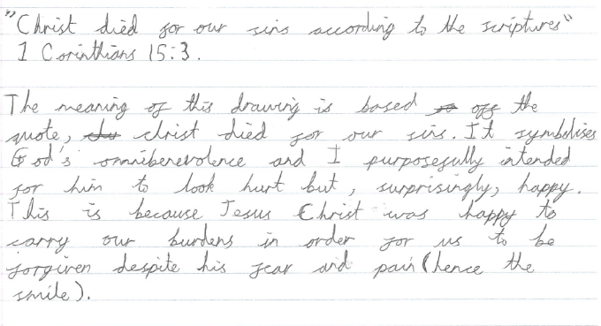
Jan is 13. He’s chosen Scripture teaching from Saint Paul.

Slide 27
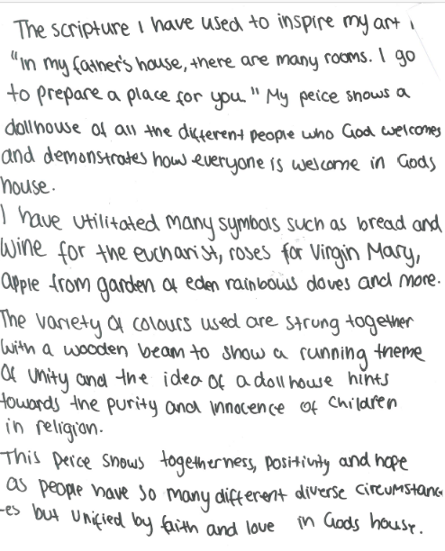
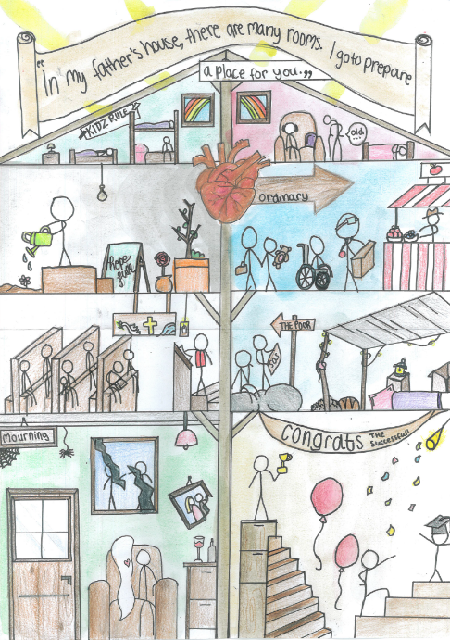
Emilia is 13

Slide 28
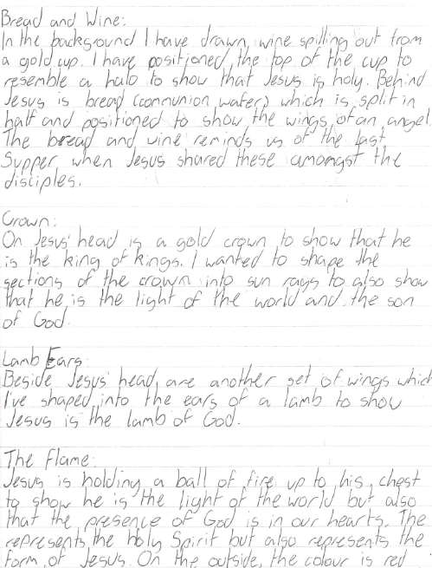
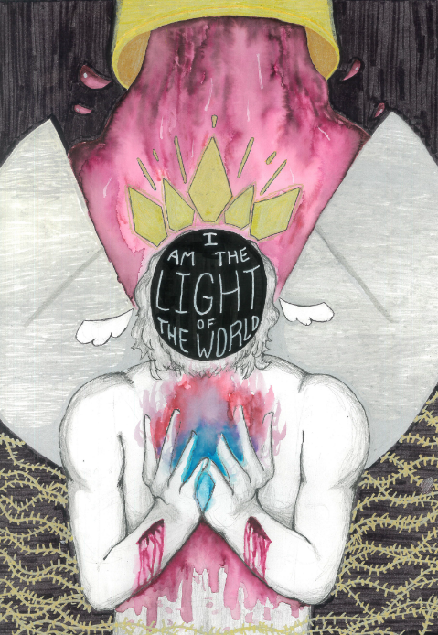
Jesus said ‘I am the light of the world.’ Hannah is 13.

Slide 29



Partnership
Notes:
These lessons and resources have been created by Lat Blaylock and Fleur Dorrell in a partnership between the Catholic Bishops’ Conference through its work on the bible (‘The God who Speaks’), NATRE (who run the Spirited Arts competition) and RE Today. The lessons are free to use, and suitable for RE in any school, connecting in many ways to different schemes of work , wherever pupils use critical and creative skills to explore theological and spiritual questions. https://www.godwhospeaks.uk/
Respondents, users of the lessons, anyone who wants to send in samples of pupils’; work, please contact me, Lat Blaylock, on lat@retoday.org.uk

Slide 30

Connections to the Catholic RE Directory
The RE Directory invites all students to engage with an ambitious RE curriculum focused on multiple disciplines in the pursuit of truth. Creative, critical thinking about key Christian ideas, visions and practice are highlighted. These lesson ideas enable these aims.
This work gives pupils a chance to express ideas about key religious teachings, EG from the Gospels. The focus of Year 7 is God’s revelation. Recognition of Jesus Christ as the incarnation of God and understanding of the divine Holy Spirit is central to study (RED p186)
By age 14 students will be able to offer explanations and comparisons of relevant works of art and reflect on and discuss artists’ intentions (RED, p241).
This work can contribute to students learning about key theological ideas such as creation and covenant or Imago Dei, Year 9 asks that they consider art as a human activity, and a divine reflection in human nature (RED p230).
Students are asked in these lessons to discern and interpret artworks that link to beliefs and practices in the life of faith, considering how artists communicate beliefs effectively (RED p238).
Notes:
Here are some connections to the RE Directory used in Catholic RE. They are illustrative rather than exhaustive and enable teachers to consider how to use these lessons in planned RE for 11-14s. They lessons are also usable by those working from many Agreed Syllabuses and other programmes of study, as well as with 14-16s taking Core RE courses or GCSE RS papers.
We invite you to share interesting examples of your pupils’ work: lat@retoday.org.uk

