Slide 1

Searching for God Secondary Lesson 2 Inter Faith Visions
Creative and thoughtful RE Lessons which use inspirational art from the exhibition ‘Cloud of Witnesses’ co-curated by ‘The God who Speaks.’
www.godwhospeaks.uk/cloud-of-witnesses-art-exhibition/
Notes:
In 2025, the Catholic Bishops’ Conference in partnership with St John’s Church, Waterloo and Art & Christianity ran an art exhibition called ‘Cloud of Witnesses’. It represented different visions and insights from interfaith integrities. The exhibition was a big success. These art and RE lessons share some of their work. Artists were invited to portray art which explored human searches for the divine in many and varied ways. Stunning work resulted, and the project enabled a link to be made to school RE. These lessons, four for primary RE and four for secondary RE, have been created to enable excellent RE which uses some of the art from the exhibition for the purposes of excellent school RE.

Slide 2

Searching for God: Aims These lessons aim to enable learners to: a. think about art works that express big ideas about God. b. develop broad minded and open-hearted responses to the ideas of others. c. consider religious teachings about God in depth for themselves. d. respond creatively for themselves to theological learning in RE.
RE Lessons which use inspirational art from the exhibition co-curated by ‘The God who Speaks’.
Notes:
The specific learning objectives of each of our four primary and four secondary lessons are given on the next slide, but these general aims fit in with the purposes of RE as they are articulated in various contexts, for Catholic schools, other schools with a religious character, community schools and academies. Teachers are invited to use these PPTs and the notepads that go with them containing additional resources, learning activities information and learning activities, in flexible ways that suit their own pupils. Seeking to represent different visions and insights from interfaith integrities, the exhibition ‘Cloud of Witnesses’ was a big success. These art and RE lessons share the work.

Slide 3
Searching for God: Aims for this lesson This lesson enables learners to: a. find out, and think about how Jewish, Christian, MUSLIM and Hindu artists express some big ideas about God. b. develop insight into some common ideas about God from different religions. c. consider varied religious teachings about God in depth for themselves. d. respond creatively for themselves to some inter-faith art and ideas in RE.
RE Lessons which use inspirational art from the exhibition co-curated by ‘The God who Speaks’.
Notes:
The specific learning objectives of each of our four primary and four secondary lessons are given on the next slide, but these general aims fit in with the purposes of RE as they are articulated in various contexts, for Catholic schools, other schools with a religious character, community schools and academies. Teachers are invited to use these PPTs and the notepads that go with them containing additional resources, learning activities information and learning activities, in flexible ways that suit their own pupils. Seeking to represent different visions and insights from interfaith integrities, the exhibition ‘Cloud of Witnesses’ was a big success. These art and RE lessons share the work.

Slide 4
Searching for God
Even if God is one, religions are many.
Some people think that religions are against each other, and in competition.
But a deepening study of religion often reveals common ground, shared ideas and similarities.
There are differences too – anyone who says ‘religions are all the same’ - isn’t looking carefully enough!
Often, artists who are Jewish or Muslim, Christian or Hindu, use symbols to express their beliefs, ideas, visions or faith. Some of these symbols have overlapping meanings.
One obvious example: many religions compare God to light.
Non-religious people use the arts to express their beliefs as agnostics or atheists as well.
Notes:
Introduce the work to pupils in these terms. You don’t have to use all four lessons in the sequence, though they will fit will with units of work about any theological topic in RE.
Expect pupils to gather and debate ideas in the first three lessons in ways that enable them to be creative for themselves in lesson 4. Referring to the final task throughout this mini-unit of RE will help all pupils to bring their learning together in a final piece of work at the end. It’s important that they can create work they are proud of: time and quality resources are a great help with this.

Slide 5
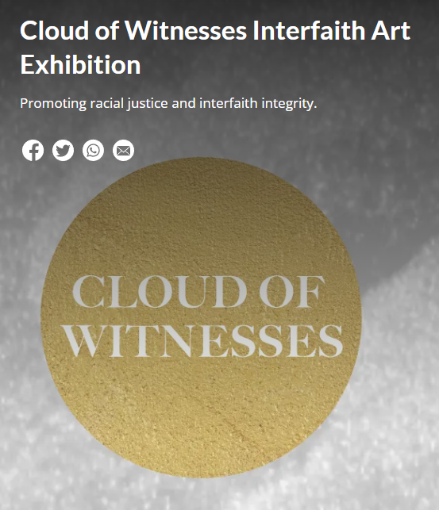
In the 2025 London Art exhibition ‘Cloud of Witnesses’ - 26 artists contributed some of their work. They explored faith, belief and doubt in relation to the Divine. From different religions to no religion, they show us some creative ways of exploring some of life’s biggest questions.
Notes:
In 2025, the Catholic Bishops’ Conference co-curated an art exhibition called ‘Cloud of Witnesses’, digitally available here: www.godwhospeaks.uk/cloud-of-witnesses-art-exhibition/ ‘The God who Speaks’ is a digital space where Catholic Biblical resources, insights, projects and visions are shared. For this art exhibition, artists were invited to show work which explored human searches for the divine in many and varied ways. Stunning work resulted, and the project enabled a link to be made to school RE. These lessons, four for primary RE and four for secondary RE, have been created to enable excellent RE which uses some of the art from the exhibition for the purposes of excellent school RE. Seeking to represent different visions and insights from interfaith integrities, the exhibition has created an ongoing conversation. These art and RE lessons share some of the work.

Slide 6
Searching for God? Secondary Lesson 2 Inter Faith Expressions In this lesson we will study Jewish art that examines ideas about God, then Muslim art that does the same thing. WHETHER you believe in God or not is not important here – the aim of the lesson is to understand the ideas of these two artistic expressions. TO Think for yourself.
Notes:
There are four primary and four secondary lessons in this project, which fit well together – but teachers are welcome to use some of them as they fit in with your own RE planning and schemes of work.
The partnership in creating these lessons with NATRE links powerfully to the Spirited Arts project NATRE runs each year. See examples and details here: https://www.natre.org.uk/about-natre/projects/spirited-arts/spirited-arts-gallery/2024/

Slide 7
Part 1 A Jewish example

Slide 8
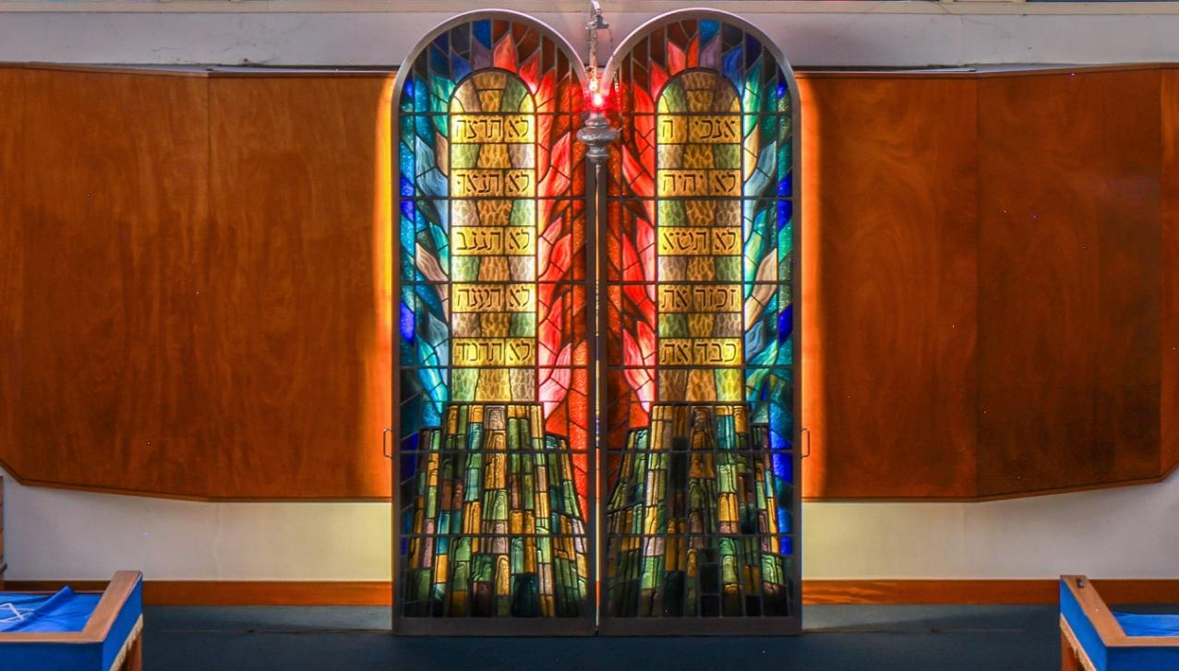
The Five Books of Moses, the Torah, are holy texts in the Jewish faith.
The Torah expresses the narratives of G-d and humanity in the famous stories of Adam and Eve, Abraham and Sarah, Jacob and his twin, Joseph and his famous many coloured coat.
Then, after centuries of being enslaved in Egypt, G-d sent Moses to bring the people to freedom and their Promised Land.
Imagine – tell your partner – how a modern synagogue, with a cupboard for the Torah scrolls, might express the Jewish vision of the divine. How would you design it?
Here are the cupboard doors from the synagogue in Brighton, Sussex.
What do you know about Moses?
A key figure in Jewish life, who led the ancient Hebrews, later called the Jewish people, out of slavery, maybe 34 centuries ago.
Two of the most famous stories of Moses are remembered in every synagogue. After a disaster in his early life, G-d called him back to be a liberator. The voice of the Almighty came from a flaming bush: ‘Tell the Pharoah, ‘Let my people go!’
After a great struggle, the freed slaves made a Covenant agreement with G-d and it was summarised in the Ten Commandments of Mount Sinai.
Notes:
Photo credit: The Twentieth Century Society John East / C20 Society
Excellent information about the window and synagogue here: https://c20society.org.uk/news/the-guernica-of-brighton-listing-bid-to-save-modernist-synagogue-and-holocaust-memorial-windows#menu/news

Slide 9
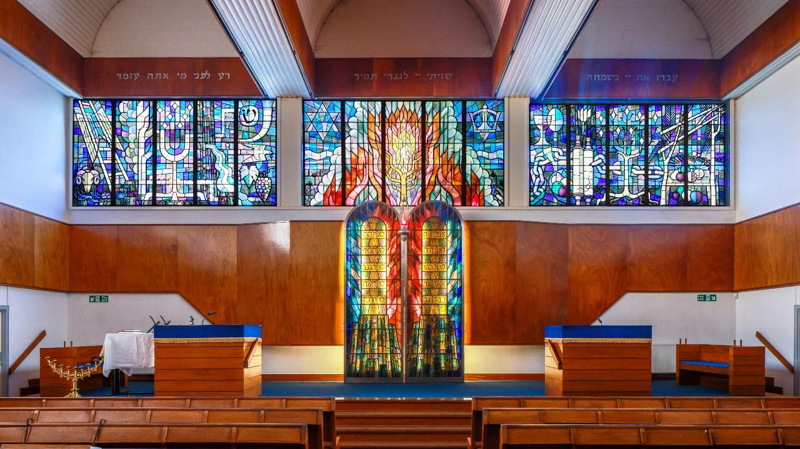
Imagine the interior of this synagogue, built in the 1960s. The doors of the Ark, the cupboard that holds the sacred Torah scrolls, resemble the stone tablets of the Ten Words of G-d. A wide window above the Ark shows the stories of the Torah, centred on the Burning Bush. Imagine it – describe your idea to your partner. Then take a look.
Notes:
Spend a bit of time just looking at this one – there are loads of symbols of Jewish Biblical narrative to find. The impact of the stained glass art can be high.
Photo credit: The Twentieth Century Society John East / C20 Society

Slide 10
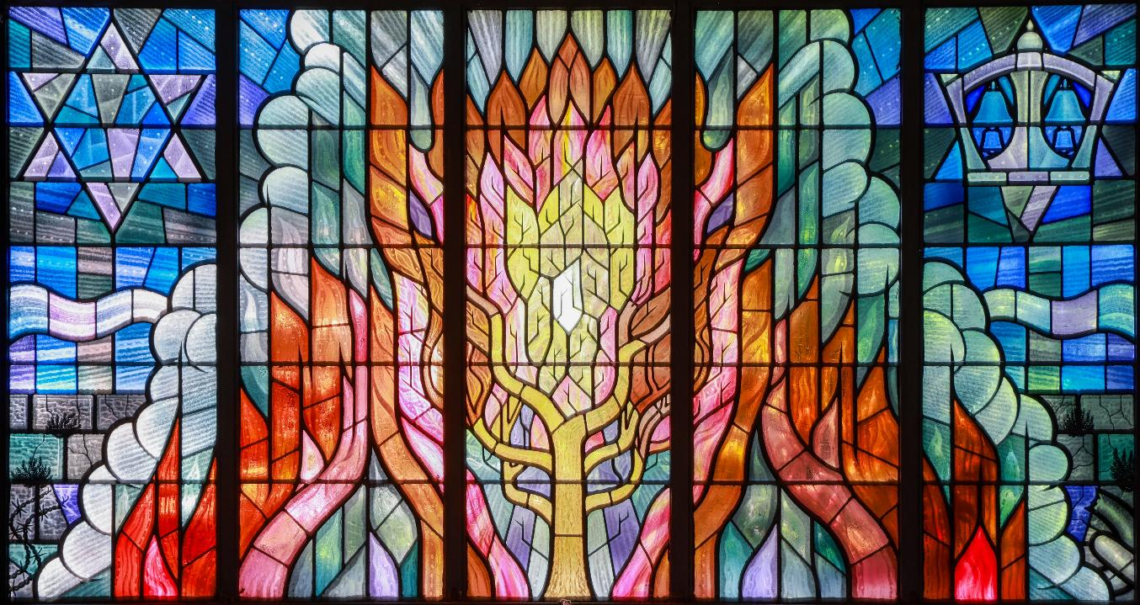
In the narrative of Exodus, Moses may feel old already and may feel he has wasted his life. But the Divine voice from the Burning Bush sends him back to Egypt to struggle again against oppression and slavery in the name of G-d. The encounter turns his life around.
Spiritual experiences where people hear the divine voice happen surprisingly often in sacred stories and are reported widely in human life.
Such experiences are famously impossible to put into words but can be very powerful.
This stained-glass in Brighton, synagogue uses every colour of the rainbow to express G-d’s powerful word to Moses: ‘Set the people Free.’
Notes:
Brighton Reform Synagogue: stained glass depicting the narrative of Moses and the Burning Bush.
Photo credit: The Twentieth Century Society John East / C20 Society
Discuss with the pupils what they link, find interesting, powerful, puzzling, deep, meaningful, spiritual or artistically admirable about the window. You could read the narrative with them, or watch a video version. Exodus 3
Thanks to Julia Diamond Conway for insider perspective on Jewish narrative and faith.

Slide 11
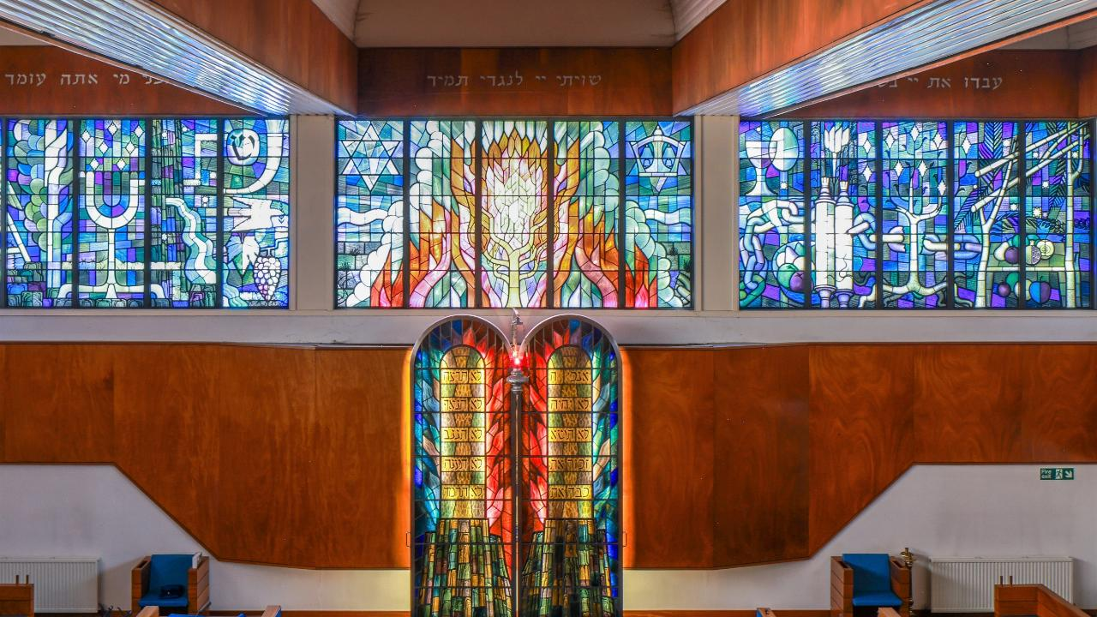
Notes:
Spend a bit of time just looking at this one – there are loads of symbols of Jewish Biblical narrative to find. The impact of the stained glass art can be high.
Photo credit: The Twentieth Century Society John East / C20 Society

Slide 12
Notes:
This really is an amazingly rich image, full of ideas and symbols of the story of the Jewish people in Jewish Scripture and in centuries of history. Spend a bit of time just looking at this one – there are loads of symbols of Jewish Biblical narrative to find. The impact of the stained-glass art can be high. It’s 40 feet – 14 metres – wide. It is a holocaust memorial window, and the oppression of Jewish people is symbolised by barbed wire and chains running all along its length.
Photo credit: The Twentieth Century Society John East / C20 Society Here are some of the symbols and biblical connections, from left to right:
Left panels: A ram for a sacrifice / Jacob’s ladder with angel wings / tree of life / seven branched menorah / water from the rock / the grapes of the promised land / Noah’s dove / the shofar / the name of the Almighty
Centre panels: star or shield of David / pillar of cloud / burning bush / the Ten Words
Right panels: Passover food / broken chains / crowned Torah scrolls / the fruit and wine of blessing / a hanukkah nine-branched candlestick / a shelter for the festival of Sukkot.

Slide 13
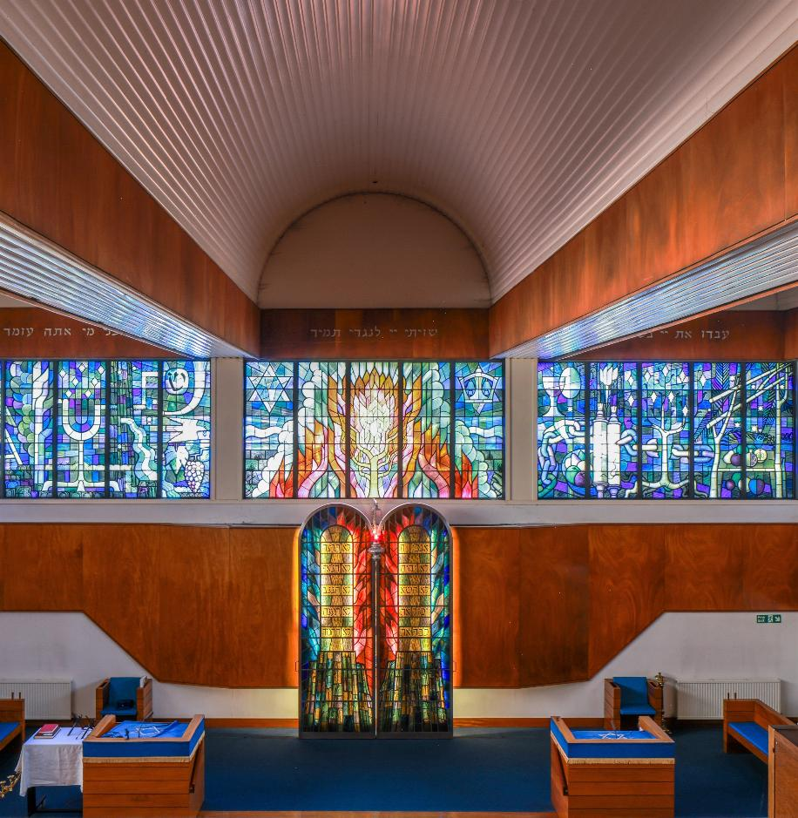
Can you see… some of the symbols and biblical connections, from left to right:
Left panels: A ram for a sacrifice / Jacob’s ladder with angel wings / tree of life / seven branched menorah / water from the rock / the grapes of the promised land / Noah’s dove / the shofar / the name of the Almighty
Centre panels: star or shield of David / pillar of cloud / burning bush / the Ten Words
Right panels: Passover food / broken chains / crowned Torah scrolls / the fruit and wine of blessing / a Hanukkah nine-branched candlestick / a shelter for the festival of Sukkot.
Notes:
These splendid photos, courtesy of The Twentieth Century Society John East / C20 Society, are full of learning potential.

Slide 14
Part two a muslim example

Slide 15
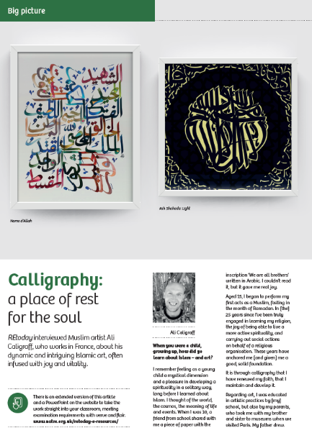
Read the interview from RE Today with French Islamic artist Ali Caligraff.
This part of the lesson will enable you to:
Understand Islamic Rules for making art: no images of God or of the Prophet.
Consider some examples of how the 99 Beautiful Names of Allah are presented in the work of an Islamic artist, Ali Caligraff.
Explain clearly and with examples how the 99 Names express understandings of Allah for Muslims.
Critically evaluate the work of Ali Caligraff in expressing Islamic spirituality.
Ali’s website is in French – but it has loads of examples of his work: www.ali-caligraff.com/

Slide 16
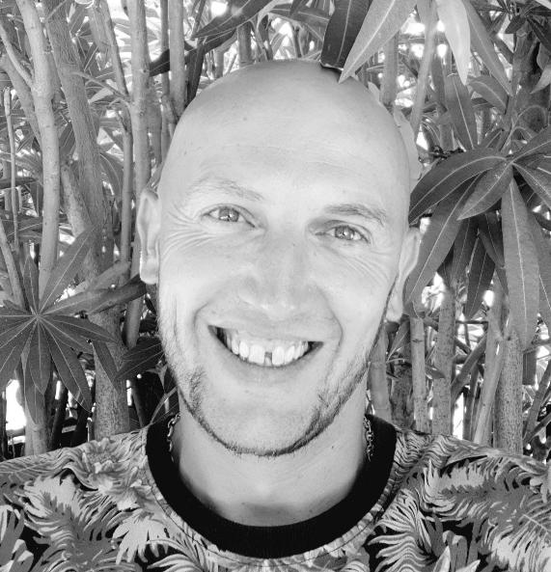
“I remember feeling as a young child a mystical dimension and a pleasure in developing a spirituality in a solitary way, long before I learned about Islam. I thought of the world, the cosmos, the meaning of life…
When I was 10, a friend from school shared with me a piece of paper with the inscription: "We are all brothers" written in Arabic. I couldn't read it, but it gave me real joy…
Aged 15, I began to perform my first acts as a Muslim, fasting in the month of Ramadan. In 25 years since I’ve been truly engaged in learning my religion, the joy of being able to live a more active spirituality and carrying out social actions on behalf of a religious organization. These years have anchored me, gave me a good, solid foundation.
It is through calligraphy that I have renewed my faith, that I maintain and develop it.”
What kind of art do you think Ali makes? Discuss with a partner how you think his work might look.

Slide 17
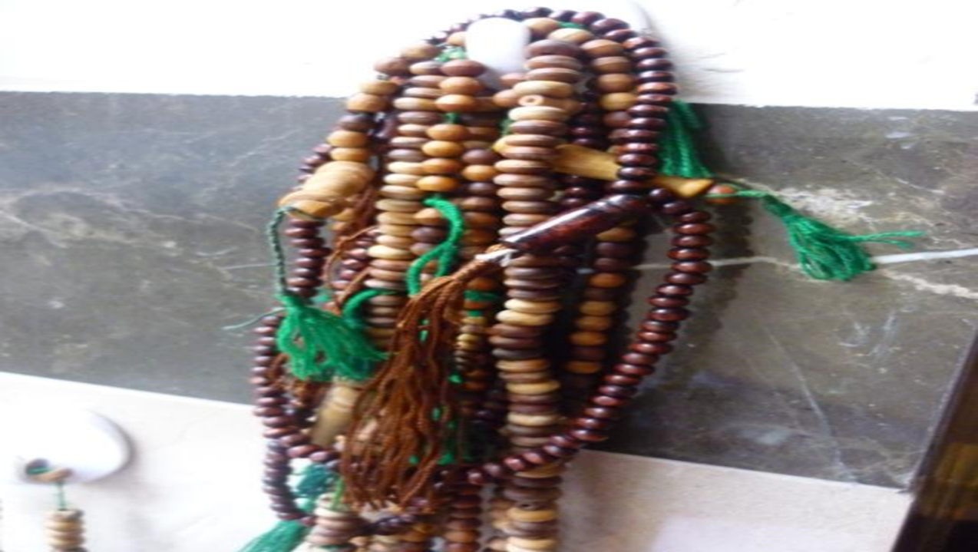
The 99 Beautiful Names of Allah
The Most or Entirely Merciful
The Bestower of Mercy
The King and Owner of Dominion
The Absolutely Pure
The Perfection and Giver of Peace
The One Who gives Security
The Guardian, The Witness, The Overseer
The All-Mighty
The Compeller, The Restorer
The Supreme, The Majestic
The Creator, The Maker
The Originator
The Fashioner
The All- and Oft-Forgiving
The Subduer, The Ever-Dominating
The Giver of Gifts
The Provider
The Opener, The Judge
In Islam, one way to understand Allah / God better is to think about his Beautiful Names. There are 99 of these known to humanity. One Hadith of the Prophet promises paradise to those who know the 99 names.
Some Muslims use prayer beads to remember and recite the 99 Names.
Islamic artists may use the Names to inspire their creativity.
Here are some of the Names, in English (there are different versions of some of the Arabic words in different lists).
Discuss the meanings of three or more with a partner: what do they show about Muslim beliefs to do with Allah?

Slide 18
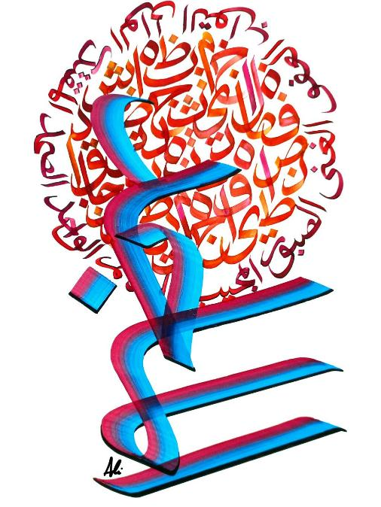
Al-Majid Allah is the Most Glorious
Ali says:
“Al Ghazali, Muslim theologian and philosopher from 1,000 years ago, affirmed that "One cannot conceive of the good without the beautiful", Islam is also an extraordinary civilization with a thousand riches: scientists, medics, historians, astronomers, mathematicians, architects and artists.”
Discuss this example of Ali’s work: How long would it take to make it? Does it show – in a small way – the glory of God? Does it show how to ‘make what is true look beautiful’? What do you like about it? What do you think of the colours chosen?
Notes:
Ali speaks in his interview about ‘making what is true also beautiful’ a key idea in interpreting Islamic art. Make sure students understand why this matters to Muslims.

Slide 19
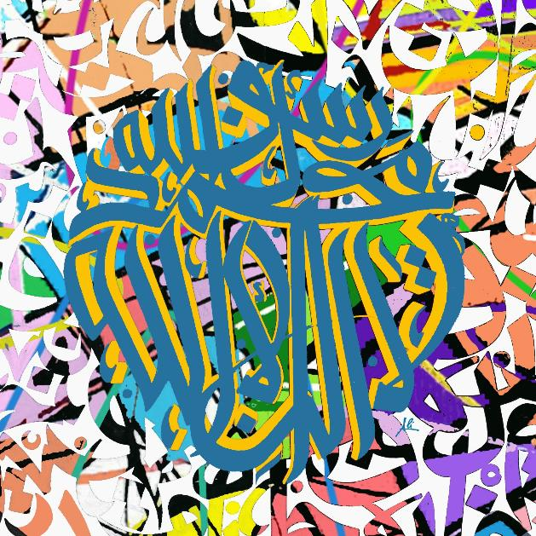
The Shahadah First pillar of Islam – belief in Allah and the Prophet
Ali: “Islam is our religion revealed by God to the Prophet Muhammad. Our religious practice is organised around the 5 pillars, and it refers to the divine Word through the holy Qur’an and to the collections of the words and deeds of our beloved prophet Muhammad, called hadiths.”
What colours are used in this artwork? The art has lots of connections to many different aspects of Islam – it seems to vibrate with different colours. What do you like about it?

Slide 20
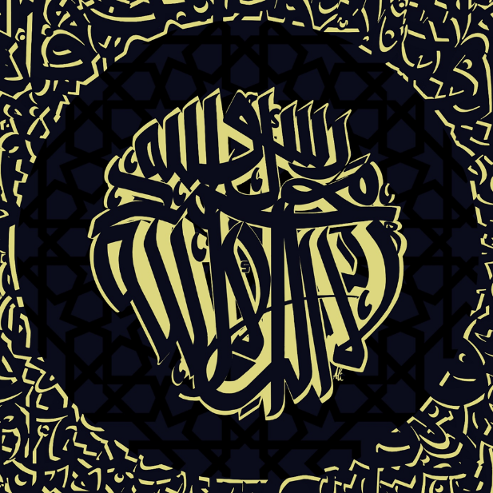
Shahadah: Light
Ali says: “My calligraphy is an expression of my spiritual experience and corresponds to this same experience of others, Muslims or not.
I repeatedly experience a strong but also fleeting feeling during my calligraphy sessions… I feel that my pen has fixed something…
I hope those who see it may appreciate the beauty, the justness and the harmony exuded by these works.” Ali Caligraff.
The words here are the statement Muslims make as the First Pillar of the faith – ‘there is no God but Allah and Muhammad is His Prophet’.
Why do you think Ali has created this example in just this way?

Slide 21
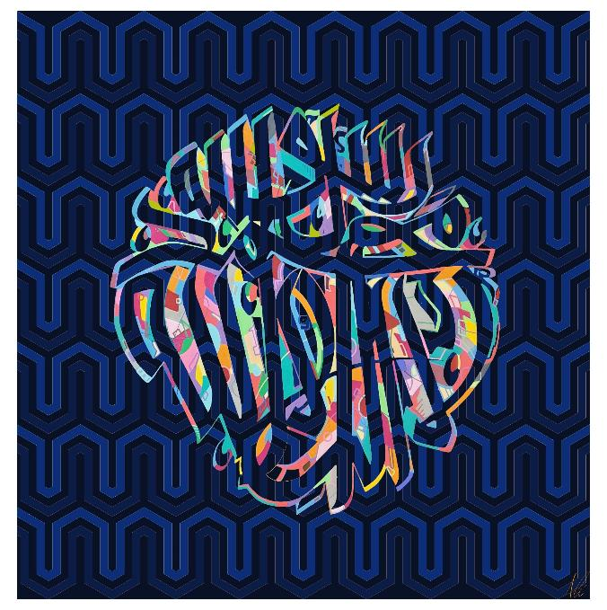
Shahadah: One God, Muhammad the Messenger
“The power of calligraphy lies above all in its dynamism which must stimulate the imagination. The spirituality of the beholder, and the composition must become one. That's what I'm aiming for. I am expressing here not only the word and its meaning, but a conception of the world and an energy to live it.” Ali Caligraff.
How do you think Ali has put energy into this artwork? Do you understand his aim? What do you like about this one?

Slide 22
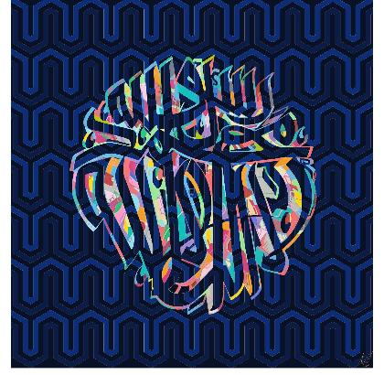

3 artworks of the Shahadah
Which do you like best and why?
Why is it important to Muslims to repeat the Shahadah?
What does Ali’s art tell you about Islamic commitments?
‘There is no God but Allah and Muhammad is the Prophet of Allah’: ‘Muslim belief is very simple. The religion is accessible to all’ What do you think?

Slide 23
“Calligraphy is a place of rest for my soul.”
“I have two jobs, or let's say two passions.
My first job is to intervene with people, groups and communities in order to reduce the tensions, violence and crises they may go through, and to enable them to find new responses to their difficulties and challenges.
And my second is Islamic calligraphy, a place of rest for the soul, of peace and of relationship to the Divine, to the beautiful, to the harmonious. In the history of Arabic and Islamic calligraphy, this double exercise, between a profession, a specific social function and the practice of calligraphy, is very common.
How does Ali see the link between his spiritual art and his work in helping people to reduce tensions, violence and prejudices?

Slide 24
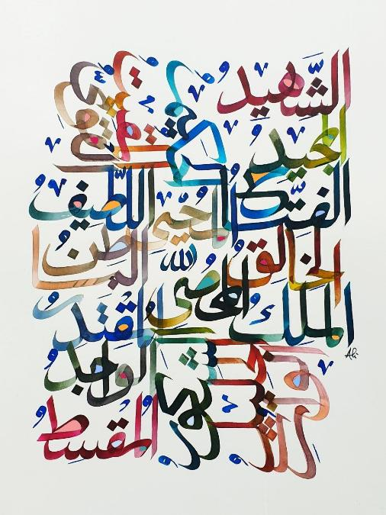
Noms d’Allah
This work shows a large number of the Names of Allah in Arabic on a single canvas.
The names are important partly because Muslims have rules for their art:
Never draw God because no one could ever show his divine splendour in mere paint, ink and paper.
Don’t draw the Prophet either.
Some Muslims don’t draw the companions of the prophet.
So Islamic art often uses letters, natural world motifs like leaves, patterns and colours – but not often figurative drawing. Note what Ali says about the power of art.

Slide 25
“I was educated in artistic practices by school and youth structures, but also by my parents who took me with my brother and sister to museums when we visited family in Paris.
My father drew. He painted canvases that my mother and sister collected. And even though I had never seen him paint, today I really understand what it gave him and what he expressed in it. There is a truth in painting and all the more so in calligraphy, the geometry of the soul expressed by the body.
As a teenager and young adult, I grew up and have been very active in urban cultures, starting with tag, graffiti, dance and then more fully rap. There is in these practices a vital energy which is expressed with force. These are the practices that have been my main artistic school.”
How can you see these influences in Ali’s work? Can you see ‘the soul expressed’? ‘Vital energy? What else do you see?

Slide 26
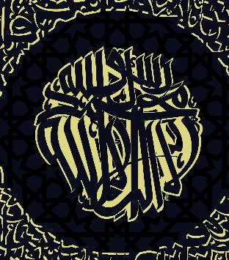
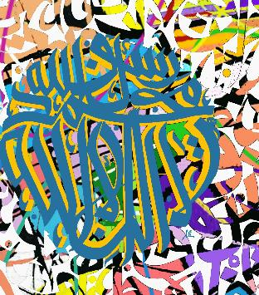
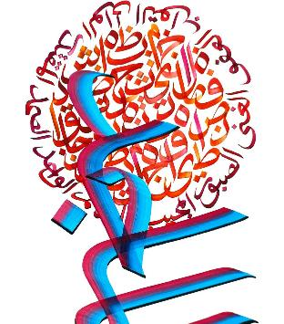
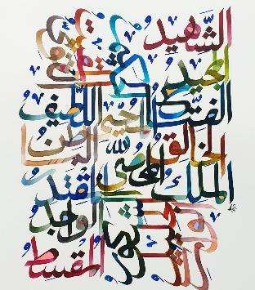
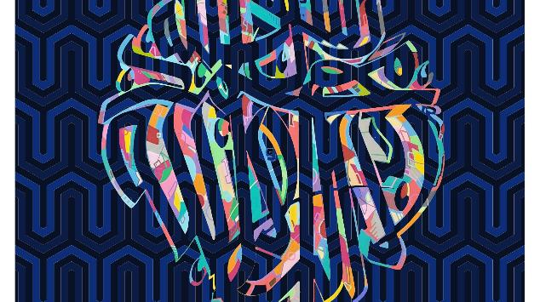
The Islamic Art of Ali Caligraff
Which is your favourite piece and why?
What have you learned from this presentation – about Islam, about art and about ideas of God?

Slide 27
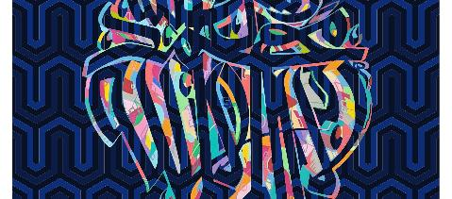
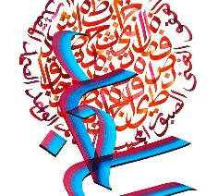
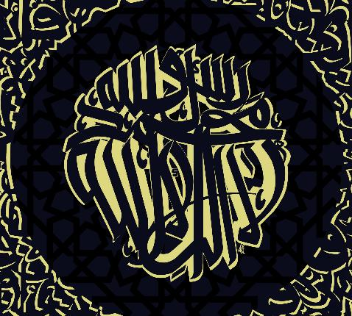
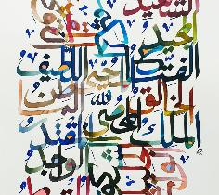
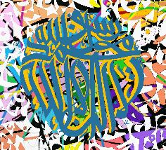
The Islamic Art of Ali Caligraff: Task
Discuss, then write:
Select two of the 5 artworks you have been exploring and write a paragraph about each to explain its Islamic meanings and your ideas about it.
How does Ali’s work express Muslim understandings of God?
Using quotes from his interview, explain what Ali says about the value of calligraphy in Islam.

Slide 28
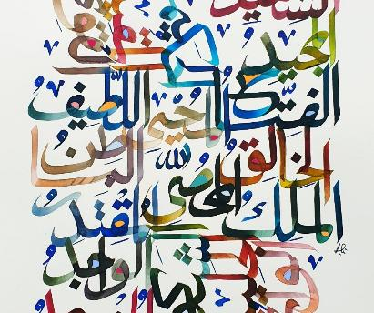
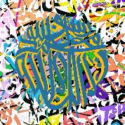
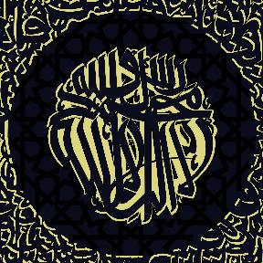
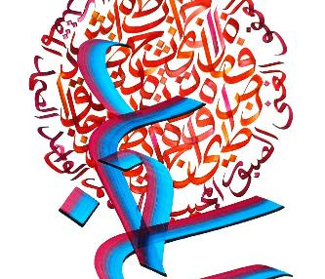
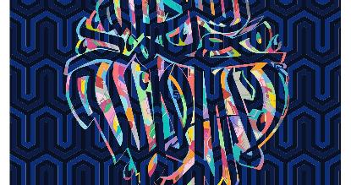
The Islamic Art of Ali Caligraff: Get creative yourself
Take a key sentence or text from Islam – or from another spiritual source.
Use English letters, not Arabic.
Create your own calligraphic expression of the text you chose.
Select colours, patterning and ways of shaping the letters carefully – sketch in pencil first, then move to your final piece.
Notes:
Please send examples of student work to me lat@retoday.org.uk. You might enter them for NATRE’s annual ‘Spirited Arts’ competition under the category ‘Where is God?’ Details from the NATRE website.

Slide 29
Searching for God
How could you compare the inter-faith ideas you have been looking at?
This is a big question, so it is broken down into some parts on the next slide.

Slide 30
Summing up the learning
What’s good about the Synagogue stained glass?
What’s good about Ali Caligraff’s Muslim calligraphy?
Is it true that you can understand people’s beliefs better from art than from arguments?
Do you think atheists’ responses to the artwork might be positive in some ways?
What is similar between Muslim and Jewish ideas in this art?
Notes:
This slide begins to sum up the learning, and the next slide reminds pupils what they have seen and studied. Use them both together. The writing frame is copiable from the NotePad.

Slide 31

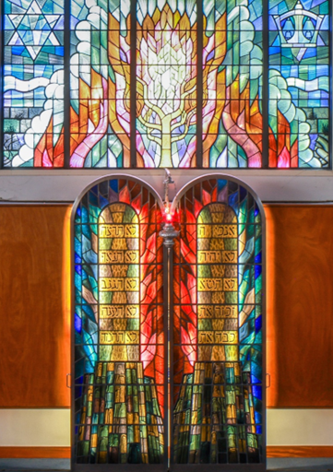
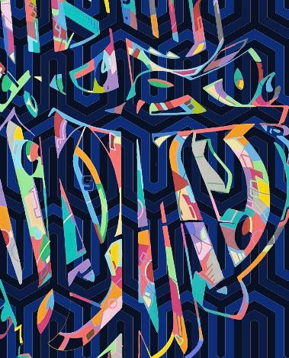
Comparing. What do you think? Which artwork has most meaning for you?
A. ‘I prefer the work of Ali Caligraff because it makes Muslim beliefs about God clear and beautiful.”
B. “I prefer the Synagogue stained-glass ideas of God because it makes sense of the stories of Moses.’
C. ‘I like both of these equally. People, expressing their varied beliefs with imagination - it makes you think about your own ideas.’
D. ‘I’m an atheist, so I disagree with both of these, but I still think the art has something to say about the beliefs.’
E. ‘I noticed a lot of similarities between Jewish and Muslim ideas.’
Notes:
Discussion of these ideas might be best in pairs to begin with and then as a whole group, facilitated by the teacher.

Slide 32
Examples of student work reflecting on questions of dialogue and truth
Rosa, Joshua, Annabelle and Krystal present their remarkable reflections on the search for spiritual truth in the context of inter-faith dialogue.
Ask pupils to pick a winner from these three contributions: which is the best example of creativity and discernment?

Slide 33
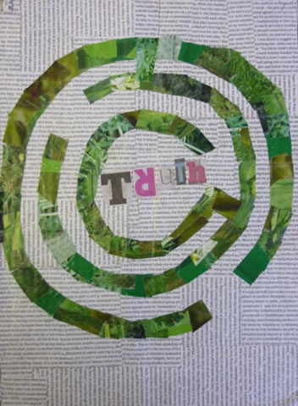
The Maze of Truth
Rosa, aged 12.
“My artwork represents the difficult search for truth. The jumbled up words in the background represent all the things that people say. Some things will be lies and others true. It's often very difficult to tell the difference between lies and truth. The maze represents how easy it is to get lost in the search for truth.
We can also get lost and more confused when we tell our own lies. It's easy to find yourself in a dead end if you tell lies. You can feel trapped there and struggle to find your way back to the truth. One way to the truth is to walk all the paths of the maze until you know them all. So listening to others is a way to the truth and the life.”

Slide 34
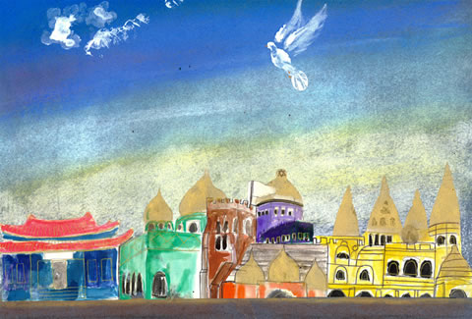
The Mystery of the Future Joshua, aged 12.
“My vision for the future is where all the places of worship are connected.
In my picture unity is shown by connecting each place, built next to each other. I have taken inspiration from Salvador Dali, an artist I really like.
I’ve used blended pastels to represent and create the feeling of mystery: can there be a future world where we have learned to comprehend the mysteries of each other's religions? Then as a collective they could promote peace and understanding. In the sky I have fingerprinted a dove of peace. I used ink for the places of worship, and gold for outlining. Left to right: temple, gurdwara, church, synagogue, mosque, mandir.”

Slide 35
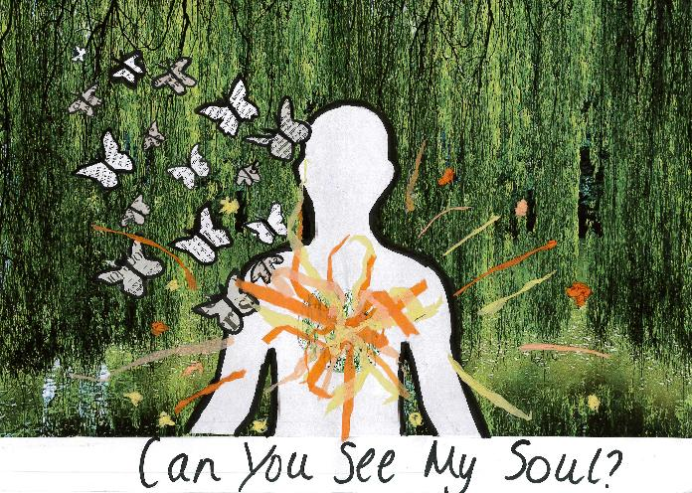
Can you see my soul? annabelle, aged 15.
“There might be debates about the meaning of the word ‘soul’ and whether souls are real. But in my work I am just using the idea.
I have shown a forest. The outline of my body includes a flaming heart, and the butterflies and sparks emerge from me, like symbols of my life.
I wonder if we can do better at looking at and listening to each other. If only we could see each other’s souls then we might make peace between ourselves.
Some people may not see your soul and so look straight through you like a window and see nothing. However, some people may see the wonders of a person and see their true soul and feel the love and warmth of the fire that we all have.”

Slide 36
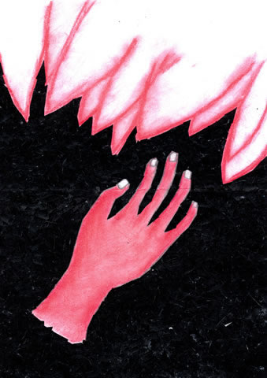
Life is Full of Spiritual Mysteries Krystal, aged 14.
“We ask so many questions, searching for so many answers: our life is pieced together with answers. These are the small bits of black card in the background. Are we getting closer to the truth or being pulled away? The faded red part at the top of my image symbolises religion: it is not clear what it is. To some it looks like flames, or flower petals, or the hem of an angel's dress. It is not clear what religion is, it is interpreted differently by different people. To some, religion is life, it is everything to them. To others, it is something to believe in only when bad things happen.
The more we question life, the more we could be leading ourselves away from the truth. How do we know what is the truth? We don't: we just assume that there is more to everything than meets the eye, turning simple questions into complex mysteries.
We are all looking for the truth together, but we don't find the truth easily.”

Slide 37
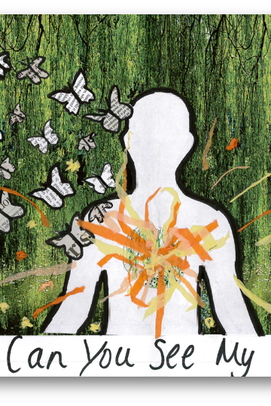
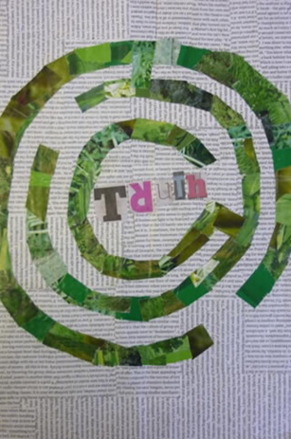
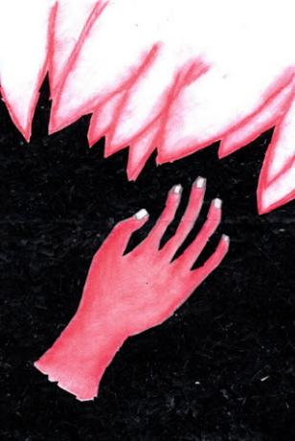
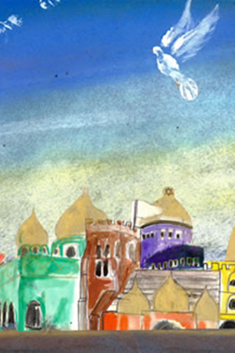
Pick your favourite of these 4 reflections on inter-faith dialogue
Notes:
Four amazing responses to questions of truth in interfaith contexts. We thank NATRE for the use of these which are from the Spirited Arts competition.

Slide 38



Partnership
Notes:
These lessons and resources have been created by Lat Blaylock and Fleur Dorrell in a partnership between the Catholic Bishops’ Conference through its work on the bible (‘The God who Speaks’), NATRE (who run the Spirited Arts competition) and RE Today. The lessons are free to use, and suitable for RE in any school, connecting in many ways to different schemes of work , wherever pupils use critical and creative skills to explore theological and spiritual questions. https://www.godwhospeaks.uk/
Respondents, users of the lessons, anyone who wants to send in samples of pupils’; work, please contact me, Lat Blaylock, on lat@retoday.org.uk

Slide 39
Connections to the Catholic RE Directory
The RE Directory invites all students to engage with an ambitious RE curriculum focused on multiple disciplines in the pursuit of truth. Creative, critical thinking about key religious and spiritual ideas, visions and practice are highlighted. These lesson ideas enable these aims.
This work gives pupils a chance to express ideas about encounters between religions and dialogue between people who disagree. This is Branch 6 of the RE Directory, e.g. for Year 7, here they can explore how different beliefs influence works of art. (RED p210).
In Year 8 pupils will consider questions about the purposes of dialogue, especially between people with radically different worldviews (RED p227).
By age 14 students will be able to extend this understanding of dialogue and encounter to include reflecting on the meaning of what they have learned for their own lives. (RED p247).
Students are asked in these lessons to discern and interpret artworks that link to beliefs and practices in the life of faith, and to consider how artists communicate beliefs effectively. (RED p238).
Notes:
Here are some connections to the RE Directory used in Catholic RE. They are illustrative rather than exhaustive and enable teachers to consider how to use these lessons in planned RE for 11-14s. They lessons are also usable by those working from many Agreed Syllabuses and other programmes of study, as well as with 14-16s taking Core RE courses or GCSE RS papers.
We invite you to share interesting examples of your pupils’ work: lat@retoday.org.uk

