Slide 1

Searching for God
Secondary Lesson 3
Solidarity: standing together
Creative and thoughtful RE Lessons which use inspirational art from the exhibition ‘Cloud of Witnesses’ CO-CURATED by ‘The God who Speaks.’
www.godwhospeaks.uk/cloud-of-witnesses-art-exhibition/
Notes:
In 2025, the Catholic Bishops’ Conference in partnership with St John’s Church, Waterloo and Art & Christianity ran an art exhibition called ‘Cloud of Witnesses’.
It represented different visions and insights from interfaith integrities. The exhibition was a big success. These art and RE lessons share some of their work. Artists were invited to portray art which explored human searches for the divine in many and varied ways. Stunning work resulted, and the project enabled a link to be made to school RE. These lessons, four for primary RE and four for secondary RE, have been created to enable excellent RE which uses some of the art from the exhibition for the purposes of excellent school RE.

Slide 2

Searching for God: Aims
These lessons aim to enable learners to: a. Think about art works that express big ideas about God. b. Develop broad minded and open-hearted responses to the ideas of others. c. Consider religious teachings about God in depth for themselves. d. Respond creatively for themselves to theological learning in RE.
RE Lessons which use inspirational art from the exhibition CO-CURATED BY ‘The God who Speaks’.
Notes:
The specific learning objectives of each of our four primary and four secondary lessons are given on the next slide, but these general aims fit in with the purposes of RE as they are articulated in various contexts, for Catholic schools, other schools with a religious character, community schools and academies. Teachers are invited to use these PPTs and the notepads that go with them containing additional resources, learning activities information and learning activities, in flexible ways that suit their own pupils. Seeking to represent different visions and insights from interfaith integrities, the exhibition ‘Cloud of Witnesses’ was a big success. These art and RE lessons share the work.

Slide 3
Searching for God: Aims
This lesson enables learners to: a. Think about art works that express big ideas about God and human solidarity. b. Develop broad minded and open-hearted responses to the ideas of others about how and why humans should stand together against evil. c. Consider religious teachings about God and human solidarity, in depth, for themselves. d. Respond creatively for themselves to learning about solidarity in RE.
RE Lessons which use inspirational art from the exhibition CO-CURATED BY ‘The God who Speaks’.
Notes:
The specific learning objectives of each of our four primary and four secondary lessons are given on the next slide, but these general aims fit in with the purposes of RE as they are articulated in various contexts, for Catholic schools, other schools with a religious character, community schools and academies. Teachers are invited to use these PPTs and the notepads that go with them containing additional resources, learning activities information and learning activities, in flexible ways that suit their own pupils. Seeking to represent different visions and insights from interfaith integrities, the exhibition ‘Cloud of Witnesses’ was a big success. These art and RE lessons share the work.

Slide 4
Searching for God: Solidarity
Solidarity – is sticking together, being solid as a body more than any
individual could be.
Many religions and visions of God hold beliefs about the ways God can bind human communities together: shared belief or faith, living in unity with One God are powerful ideas. Do we get strength if others stand with us?
In this lesson, we’ll look at examples of art that explore some ways in which faith can create unity for humanity – with God and with each other.
So far, that sounds quite comforting – but if humans are united, then do those who are rich, or who have privileges, or who are successful on their own need to make more space for those who are poor, or on the margins?
That might be challenging.
The second ‘digging deeper’ part of the lesson, and the third work of art here, looks specifically at the Eucharist as a ritual of solidarity: God comes to humanity in Christ, in bread and wine. And humans unite in sharing the Body and Blood of Christ.
Notes:
Introduce the work to pupils in these terms. You don’t have to use all four lessons in the sequence, though they will fit will with units of work about any theological topic in RE.
Expect pupils to gather and debate ideas in the first three lessons in ways that enable them to be creative for themselves in lesson 4. Referring to the final task throughout this mini-unit of RE will help all pupils to bring their learning together in a final piece of work at the end. It’s important that they can create work they are proud of: time and quality resources are a great help with this.

Slide 5
Searching for God?
Lesson 3
Solidarity?
‘We all stand together’
Er… do we?
Secondary
Notes:
There are four primary and four secondary lessons in this project, which fit well together – but teachers are welcome to use some of them as they fit in with your own RE planning and schemes of work.
The partnership in creating these lessons with NATRE links powerfully to the Spirited Arts project NATRE runs each year. See examples and details here: https://www.natre.org.uk/about-natre/projects/spirited-arts/spirited-arts-gallery/2024/

Slide 6
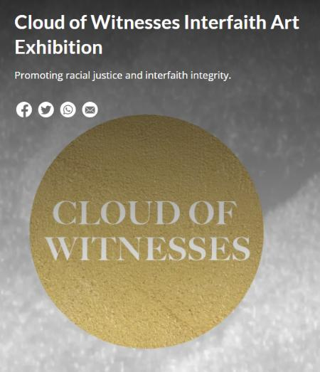
In the 2025 London Art exhibition ‘Cloud of Witnesses’ - 26 artists contributed some of their work.
They explored faith, belief and doubt in relation to the Divine.
From different religions to no religion, they show us some creative ways of exploring some of life’s biggest questions.
Notes:
In 2025, the Catholic Bishops’ Conference co-curated an art exhibition called ‘Cloud of Witnesses’, digitally available here: www.godwhospeaks.uk/cloud-of-witnesses-art-exhibition/
‘The God who Speaks’ is a digital space where Catholic Biblical resources, insights, projects and visions are shared.
For this art exhibition, artists were invited to show work which explored human searches for the divine in many and varied ways. Stunning work resulted, and the project enabled a link to be made to school RE. These lessons, four for primary RE and four for secondary RE, have been created to enable excellent RE which uses some of the art from the exhibition for the purposes of excellent school RE. Seeking to represent different visions and insights from interfaith integrities, the exhibition has created an ongoing conversation. These art and RE lessons share some of the work.

Slide 7
Searching for God: Solidarity
We’ll use three art works to think about questions like these:
Can humans and God find unity?
What do ancient stories say to us today about humans living in unity with each other – and maybe with God?
What does it mean for us to ‘all stand together’?
Why is evil more often defeated by solidarity than by individual heroes?
People who believe in god find human solidarity in their faith.
how do our artists reflect on this vision?
Notes:
This particular lesson engages with the Trinitarian Christian vision that ‘God was in Christ, reconciling the world to Himself’ and that Jesus of Nazareth is revealed in the Gospels to be the Christ, the Son of the Living God, God among us – the incarnation of the Divine. RE lessons don’t teach these ideas in any coercive way: pupils with all different beliefs will engage in this study, but a full-hearted and thoughtful appreciation of the depth of Christian belief about God in Jesus is in focus in this learning.

Slide 8
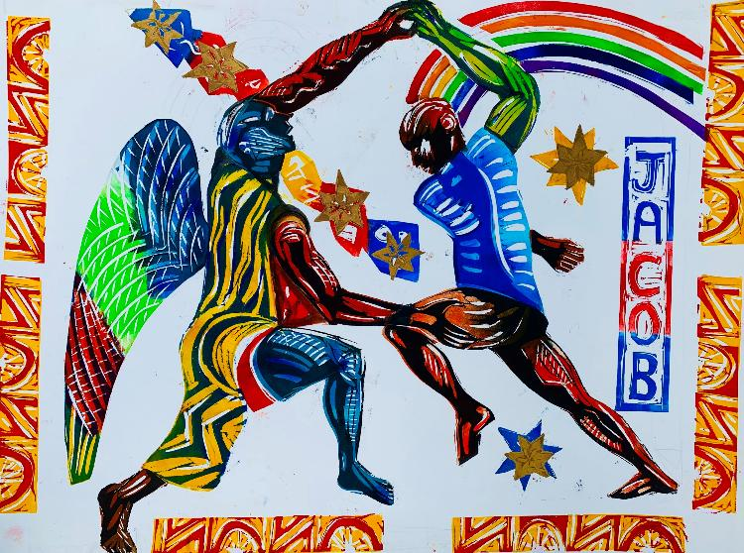
God and humanity: together?
Take 120 seconds to speak with your partner about this painting.
What might be going on?
Key words: Jacob. Wrestling. Angel.
Read the Bible story that inspired the art work on the next slide.
This unsettling story, maybe 38 centuries old, has inspired millions. Artists from Rembrandt and Gustave Dore to Paul Gauguin and Marc Chagall are among the thousands of images a google search for Jacob wrestling the angel’ offers. A strange story with a strange power.
What do you think of it?
Notes:
The theme of solidarity is introduced here: talk with your class about whether God is with us, and whether God is with us especially at moments of crisis in life. Jacob’s crisis in this story is that he has to face up to his own destructive behaviour from his earlier life.
You might look at some other artists’ expressions of the spirituality of this story – there are very many!

Slide 9

Jacob wrestles with an angel – or was it with God? A famous and mysterious story from Genesis 32
14 years after stealing his family blessings and running away from his brother Esau, Jacob returns to his ancestral home. He’s terrified: what might happen. Preparing to meet Esau he sends all his family ahead of him. He lies down to sleep, alone, on the bank of the River Jabbok.
A strange figure grabs him, and the two of them wrestle each other all night long. ‘Bless me!’ Jacob begs – thinking the figure is some kind of envoy from God. ‘I won’t stop fighting till you bless me.’
As dawn breaks, the midnight wrestler asks: ‘What’s your name?’ ‘Jacob answers, and the fighter tells him: ‘You won’t be called Jacob, the Twister; anymore. Your new name is Israel, the one with whom God struggles.’ The stranger dislocates Jacob’s hip: injured, he can only limp onwards.
Then, alone again, it dawns on Jacob that his all-night wrestling has been with an angel, or even with God! He names the place ‘Peniel’, which means ‘God’s face’. He muses to himself: ‘I’ve seen the face of God here and survived.’
He crosses the river and steps up to the need to be reconciled with his brother.
Notes:
I’ve written the story in a condensed form on the slide – but this is the actual text from Gen 32: Common English Bible. “Jacob got up during the night, took his two wives, his two women servants, and his eleven sons, and crossed the Jabbok River’s shallow water. He took them and everything that belonged to him, and he helped them cross the river. But Jacob stayed apart by himself, and a man wrestled with him until dawn broke. When the man saw that he couldn’t defeat Jacob, he grabbed Jacob’s thigh and tore a muscle in Jacob’s thigh as he wrestled with him. The man said, “Let me go because the dawn is breaking.”
But Jacob said, “I won’t let you go until you bless me.”
He said to Jacob, “What’s your name?” and he said, “Jacob.” Then he said, “Your name won’t be Jacob any longer, but Israel, because you struggled with God and with men and won.”
Jacob also asked and said, “Tell me your name.”
But he said, “Why do you ask for my name?” and he blessed Jacob there. Jacob named the place Peniel, “because I’ve seen God face-to-face, and my life has been saved.” The sun rose as Jacob passed Penuel, limping because of his thigh. Therefore, Israelites don’t eat the tendon attached to the thigh muscle to this day, because he grabbed Jacob’s thigh muscle at the tendon.”
Click the ‘speaker’ icon to play the voice recording of the narrative.

Slide 10
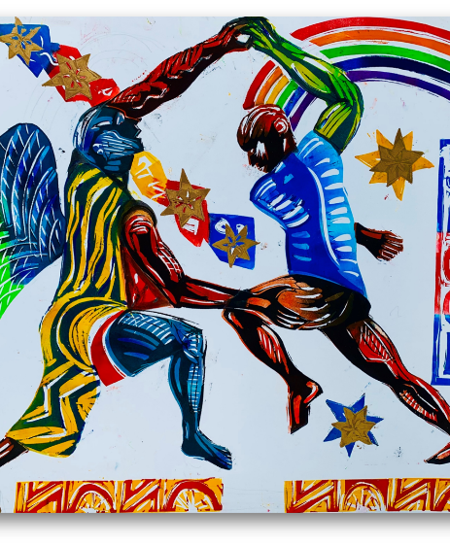
J.R. Bateson, Jacob wrestling with the Angel, 2024.
From Genesis www.johnbatesonpaintings.co.uk
John Bateson is a print maker and painter from Brixton in London. He learnt to paint from his mum, an artist, and his dad who illustrated children’s book. John describes himself as an urban artist, inspired by people in cities. His spiritual life is inspired by the Jesuits, and the spiritual exercises of St Ignatius Loyola. This involves reading Bible stories and asking: what if I was in these stories?
‘Jacob Wrestling with the Angel’ explores the strange encounter between wandering Jacob and the wrestling angel. John has imagined the encounter to be fierce and dramatic, muscular and exhausting.
Why has John added the rainbow colours to the Bible’s details of the story? Is Jacob learning in this story that it is not just himself who matters? Does the idea of ‘wrestling with God’ resonate with people today? Does solidarity with God mean we have to wrestle with God to find our path?
Notes:
The theme of solidarity is introduced here: talk with your class about whether God is with us, and whether God is with us especially at moments of crisis in life. Jacob’s crisis in this story is that he has to face up to his own destructive behaviour from his earlier life. He is discovering that he needs his brother, who he has treated so badly. He is returning to try and make a fresh start in his family. How does Bateson picture the relationship between Jacob and his ‘angel’? Between God and humans? The rainbow is maybe to be understood as a sign of God’s promise to bless Jacob’s future and change him – the rest of the narrative shows this in practice. The four questions at the end of the text might be for students to discuss in pairs and then feed back any interesting insights.

Slide 11
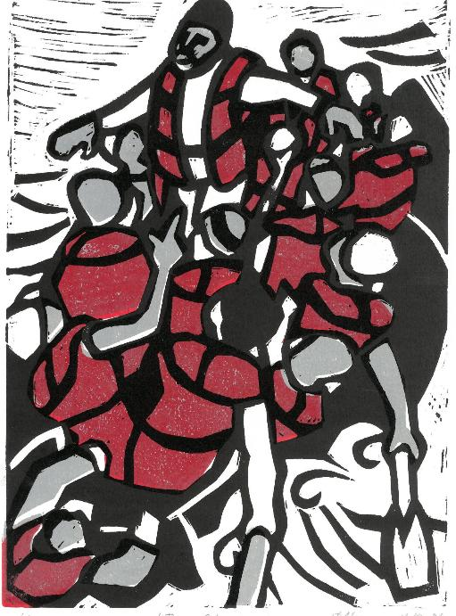
Have a good look at David Robinson’s print of a Bible story about Jesus before you read anything about it.
What colour is used?
What is happening?
What do you think the artist might be expressing?
Two narratives are connected by this painting, one from the Bible over 20 centuries ago, one from the news in the UK today.
Read and hear the Bible story on the next slide.

Slide 12
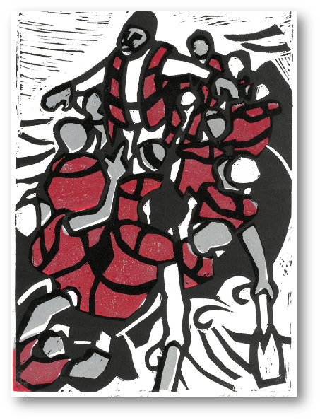
Jesus stops a storm - Mark 4:35-41 - Common English Bible.
Later that day, when evening came, Jesus said to them, “Let’s cross over to the other side of the lake.” They left the crowd and took him in the boat just as he was. Other boats followed along.
Gale-force winds arose, and waves crashed against the boat so that the boat was swamped. But Jesus was in the rear of the boat, sleeping on a pillow. They woke him up
and said, “Teacher, don’t you care that we’re drowning?”
He got up and gave orders to the wind, and he said to the lake, “Silence! Be still!” The wind settled down and there was a great calm. Jesus asked them, “Why are you frightened? Don’t you have faith yet?”
Overcome with awe, they said to each other,
“Who then is this? Even the wind and the sea obey him!”

Slide 13
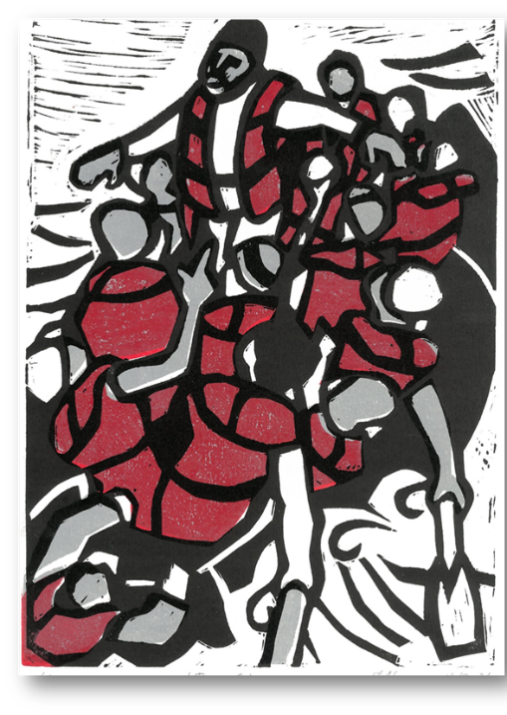
David Robinson,
Jesus Calms the Storm, 2024. www.davidrobinsonartist.com
David is a self-taught Christian artist from Porthcawl, Wales.
In this print of a famous story from Jesus’ life, the stilling of a deadly dangerous storm on the Sea of Galilee, David chooses to show Jesus not
in a fishing boat, but in a boat of displaced people. We see desperate people from diverse backgrounds making dangerous journeys across the Mediterranean or the Channel, with their orange-brown-red life jackets offering little protection from the dangerous high seas. Are we to imagine Jesus standing among them? In solidarity with them? Stilling the storms in their hearts?
The challenges of today – conflict, climate change, refugees seeking safety - seem overwhelming, like the storm in the Bible. Disciples of Jesus can feel lost and call out in despair. But when Jesus stands up, he gives a challenge, saying, ‘Where is your faith?’ For David, this is a call to action: to draw on faith, to stand up and share hope with others. To bring compassion and leadership where we can, to work through complex issues calmly and to look for Jesus in others. The power of God is seen where solidarity with those in deep need is found.
What do you like and dislike in this print and its meanings?
Notes:
It may be helpful to use the theme of solidarity to connect this artwork with the one about Jacob and the next one on the Eucharist.
David’s Church, Porthcawl Tabernacle, has a useful website. Learners might find more to help them interpret and contextualise his work here. https://glannauogwr.cymru/en/english/

Slide 14

The symbolism of eating together, remembering Jesus’ death, and committing to live as his community is full of ideas about the solidarities between God and humanity. The next slide shows a modern image of Jesus’ Last Supper.
Digging deeper – a 3rd artwork.
Eucharist as solidarity between God and humanity and between humans.
The central Christian act of worship is to share bread and wine, the body and blood of Christ, in the ritual of the Mass, the Eucharist, the Lord’s Supper or Holy Communion.
Notes:
https://thenounproject.com/icon/meal-4623583/ Free image from the Noun Project

Slide 15
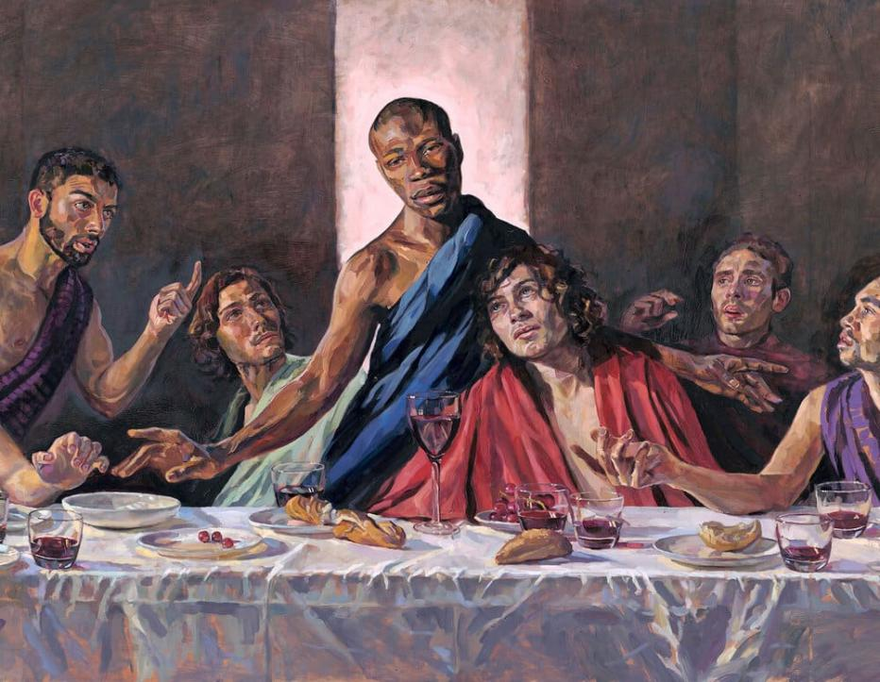
Digging deeper.
Christians hope that they can find solidarity with God and each other through the shared bread and wine of the eucharist.
Can remembering Jesus and experiencing divine presence in a faith community today unite humans?
Lorna May Wadsworth painted this image of Jesus’ Last Supper in 2009.
Notes:
Lorna says: “I knew I wanted Tafari to be my Jesus from the very first, as the conviction that I should attempt to create a painting tackling this theme was forming in my mind. I didn't really know why exactly, it was just as though something was telling me he was the one for the painting.
I knew that if I did try and paint a Last Supper I didn't want it to look like the 'received wisdom' of what such a painting should look like. In the canon of Western Art the acknowledged image of Jesus is Caucasian with brown hair and brown eyes, and indeed images that extol this physicality by artists such as Velazquez and Rubens are the paintings which speak to me most profoundly as images. Yet throughout History around the world people have painted Jesus in their own image.
My point isn't to propose a thesis of 'this the definitive face of Christ', I just didn't want to paint the cliche. As a female painter, if I were to logically follow Velazquez, Rubens and all the artists around the world who have painted Christ in their own image I would paint a woman! This I didn't want to do, so then who is my point of reference? To paint Christ as a black man is as meaningful or as meaningless as painting him as a white man. We don't know what Jesus looked like:
I had painted Tafari before, a large painting 4 foot square, for my Beautiful Boys exhibition, and people were drawn to something in his face and the expression in his eyes. I was surprised by their reactions and seemed to have caught something of which I wasn't even aware. I knew this quality was more important than skin colour or politics or anything else. Quite simply, I knew he could move people.

Slide 16
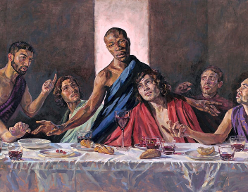
Jesus’ Last Supper with his disciples.
“While they were eating, Jesus took bread, blessed it, broke it, and gave it to the disciples and said, “Take and eat. This is my body.”
He took a cup, gave thanks, and gave it to them, saying, “Drink from this, all of you. This is my blood of the covenant, which is poured out for many so that their sins may be forgiven. I tell you, I won’t drink wine again until that day when I drink it in a new way with you in my Father’s kingdom.”
Then, after singing songs of praise, they went to the Mount of Olives.
Notes:
Click on the ‘speaker’ icon to hear the text read aloud.
This is St Mark’s account of the last supper.
Covenant – a key word – means ‘agreement’ and is translated ‘testament’. If it is an agreement between God-in-Jesus and his followers, then it is a sign of solidarity. Explore th eida: ask students if this is a solidarity story, and in what ways.

Slide 17
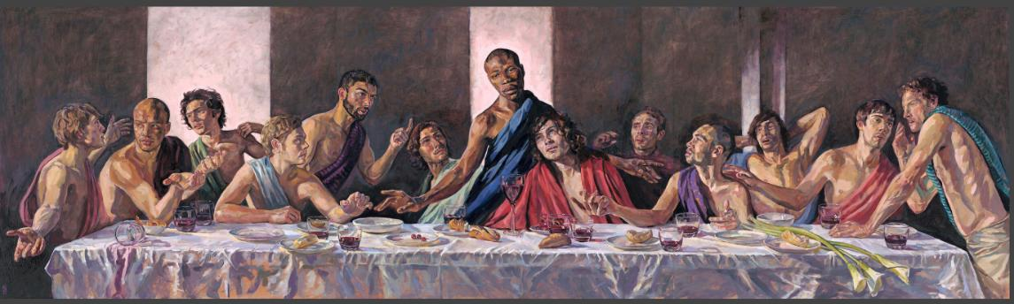
Lorna May Wadsworth’s painting of the Last Supper.
Notes:
Draw attention to the beauty, skill and power of this art, much more than a sum of its parts. Ask pupils: What three things do you like best about Lorna’s art? How does the artist use light? Darkness? How is each of the 12 disciples shown? What might their body language and facial expressions say about them in this moment? And how and why has Lorna shown Jesus just like this? What three words say what you notice in his face? The lily flower is often used as a sign of purity and new life in Christian art. Does Lorna show her three lilies to point towards what will happen next, the pure love of Jesus as he is crucified and the resurrection that will follow?

Slide 18
Lorna May Wadsworth, from Sheffield, painted her Last Supper on aluminium in 2009.
Lorna became famous with her paintings of great British figures like Margaret Thatcher and Sheffield’s David Blunkett. She says that she wants to paint what ‘the female gaze’ looks at – the opposite of a lot of art that is dominated by the male gaze. Her 2009 painting Jesus’ Last Supper reflects the composition of the iconic masterpiece by Leonardo Da Vinci from about 520 years ago.
The original painting is 12 feet wide. It can be seen in St George's Church in Nailsworth, Gloucestershire. Lorna used real people as her models, including Jamaican-born fashion model, Tafari Hinds, who was her model for Jesus. Painting a black Jesus is not a new idea - but is still controversial and challenging for some!
In 2020, after the killing of George Floyd and the rise of the ‘Black Lives Matter’ movement, Reverend Jeffrey John, Dean of St Albans Cathedral, asked to hang a fine art print of Lorna’s Last Supper in the Cathedral, to express solidarity with people who are victims of racism. Lorna agreed and she decided to offer to make further high-quality prints available to other churches.
Do you think gestures of solidarity like this are important in taking a stand against prejudice and persecution? Why or why not? Can art help persecuted people? How?
Notes:
Excellent further information available here: https://www.stalbanscathedral.org/news/st-albans-cathedral-black-lives-matter-prayer-installation

Slide 19
Lorna May Wadsworth’s painting of the Last Supper.
Meanings: which ones make sense to you?
“At The Last Supper we see the sacrifice of love Jesus is going to make, in solidarity with all humanity.”
“God the Creator came to Earth in Jesus, by the power of the Spirit, to rescue us from sin.”
“Ordinary things like bread and wine are turned into spiritually powerful signs of love, both then and now”
“At this last meal, God’s plan is revealed: we need to remember that through sacrifice, love wins.”
Notes:
Draw attention to the beauty, skill and power of this art, much more than a sum of its parts. Ask pupils: What three things do you like best about Lorna’s art? How does the artist use light? Darkness? How is each of the 12 disciples shown? What might their body language and facial expressions say about them in this moment? And how and why has Lorna shown Jesus just like this? What three words say what you notice in his face? The lily flower is often used as a sign of purity and new life in Christian art. Does Lorna show her three lilies to point towards what will happen next, the pure love of Jesus as he is crucified and the resurrection that will follow?
Discuss with the learners which of the interpretive sentences on the fader they find meaningful.

Slide 20
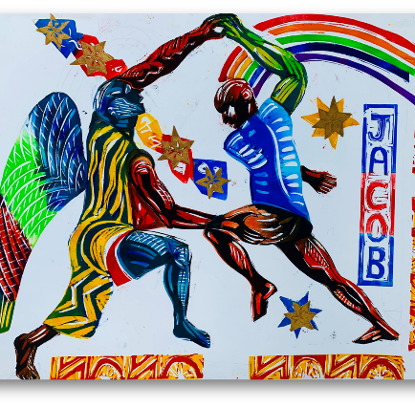
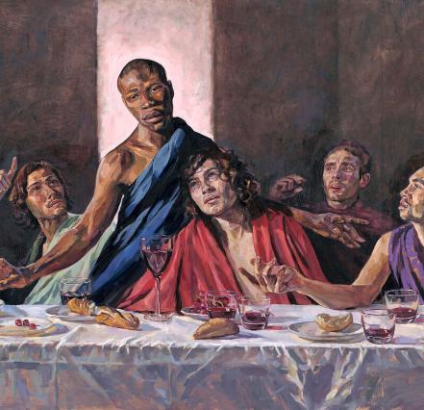
Solidarity: standing together against what is wrong.
From the next slide, select the three statements you most agree with about the idea of solidarity and share your ideas with a partner.
Notes:
This can also lead to a writing task of course. Please send examples to me – lat@retoday.org.uk

Slide 21


Here are 9 ideas about solidarity connected to this learning. Are there three you agree with most? Select them and explain your choice to a partner.
“The solidarity we need to oppose evil is illustrated well by the ‘Black Lives Matter’ movement.”
“Art can be used really well to express solidarity with oppressed people.”
“What does God require? He’s shown us:
Do justice. Love kindness. Walk with God.”
“I have experienced the power of solidarity in my own life. I can think of an example.”
“Solidarity notices the needs of others and refuses to accept evil. That makes it a kind of love.”
“I believe showing solidarity with victims of oppression is always good.”
“I like the idea that in Jacob’s story, God shows solidarity with humanity.”
“If Jesus were here today, he would help save the refugees in the small boats.”
“God became human, flesh and blood, in Jesus. When Christians remember Jesus with bread and wine, that’s an example of solidarity.”
Notes:
A fill in work booklet is provided to go with this lesson. A further creative task might invite pupils take the theme of ‘solidarity’ from scripture, life, interfaith ideas or their own favourite song lyrics about living together as one and create poetry or visual art based on the theme.

Slide 22

Searching for God: Solidarity
We used three artworks to think about big questions. What are your answers?
Can humans and God find unity?
What do ancient stories say to us today about humans living in unity with each other – and maybe with God? What does it mean for us to ‘all stand together’?
Why is evil more often defeated by solidarity than by individual heroes?
Is solidarity a kind of love?
Notes:
This particular lesson engages with the concept of solidarity in three different ways. Students can consider trinitarian Christian vision that ‘God was in Christ, reconciling the world to Himself’ and that Jesus of Nazareth is revealed in the Gospels to be the Christ, the Son of the Living God, God among us – the incarnation of the Divine. They can also consider whether being in solidarity with God and fellow humans is important, and what its meanings might be for them.

Slide 23
Some works of art from students using these lessons about solidarity.
Lloyd, 13, ‘Standing Together is the Right Answer’.
Amelia, 13, ‘Together to make 1’.
Hannah, 13, ‘Solidarity’.
Notes:
Thanks to all the teachers and pupils who tried out these lessons with such amazing results. Send me some of your pupils’ work to lat@retoday.org.uk

Slide 24
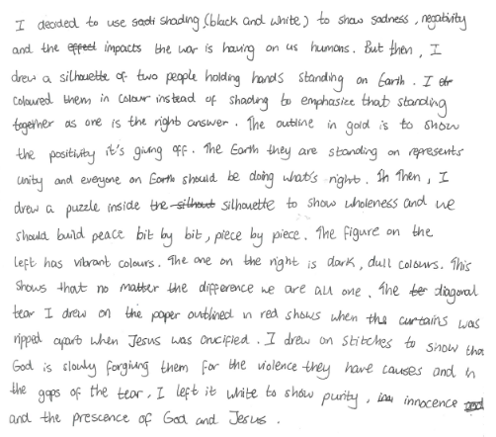
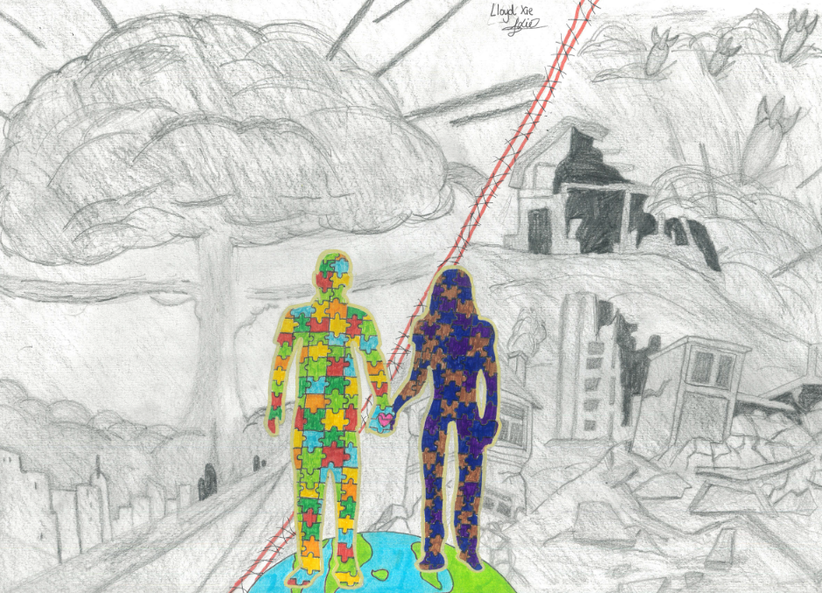
“Standing together is the right answer”
By Lloyd – he’s 13.

Slide 25
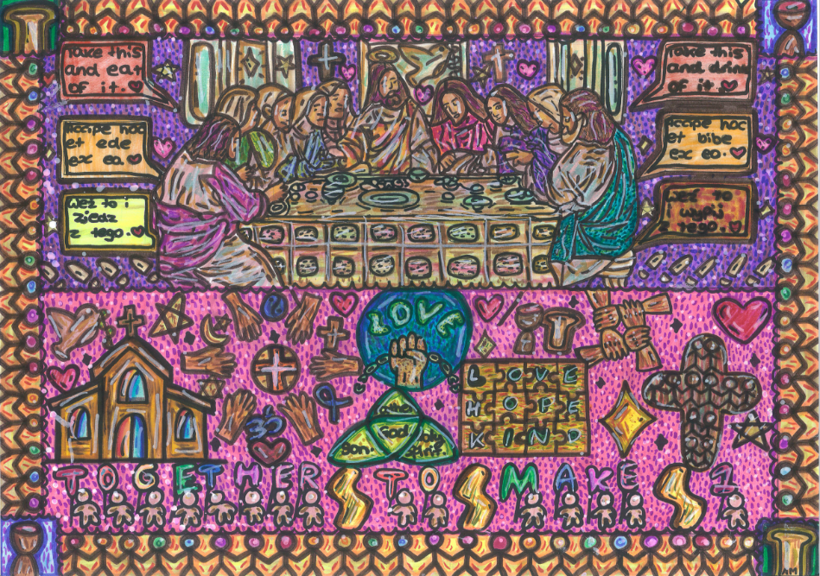
Amelia is 13. See her comments on this art on the next slide.

Slide 26
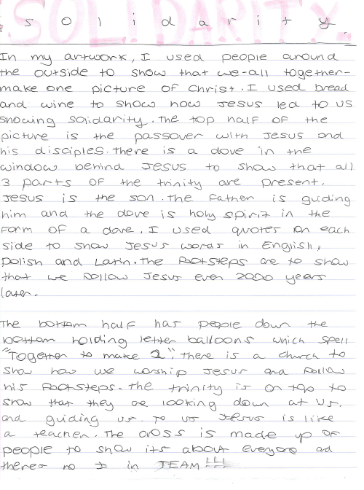

Amelia is 13.
‘Together to make 1’ reflects her Polish and English heritage.

Slide 27
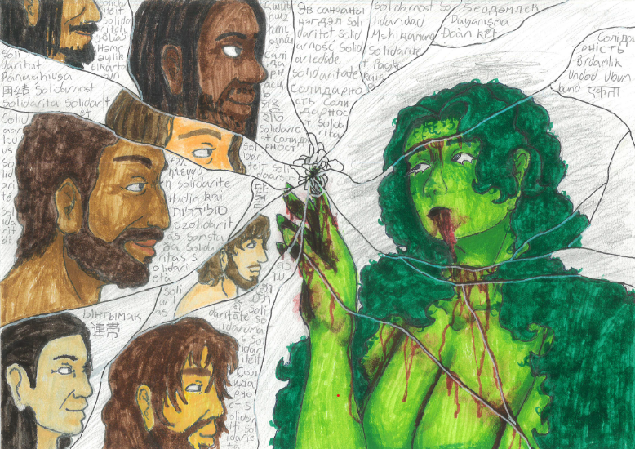
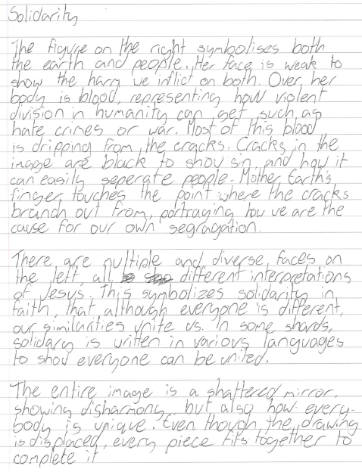
Hannah is 13.

Slide 28



Partnership
Notes:
These lessons and resources have been created by Lat Blaylock and Fleur Dorrell in a partnership between the Catholic Bishops’ Conference through its work on the bible (‘The God who Speaks’), NATRE (who run the Spirited Arts competition) and RE Today. The lessons are free to use, and suitable for RE in any school, connecting in many ways to different schemes of work , wherever pupils use critical and creative skills to explore theological and spiritual questions. https://www.godwhospeaks.uk/
Respondents, users of the lessons, anyone who wants to send in samples of pupils’; work, please contact me, Lat Blaylock, on lat@retoday.org.uk

Slide 29

Connections to the Catholic RE Directory
The RE Directory invites all students to engage with an ambitious RE curriculum focused on multiple disciplines in the pursuit of truth. Creative, critical thinking about key religious and spiritual ideas, visions and practice are highlighted. These lesson ideas enable these aims.
This work gives pupils a chance to express ideas about human unity, including concepts like fellowship and solidarity, the belief that we are all one. (RED p 207-208, 246).
In Year 8 pupils will consider questions related to the problem of suffering outlined in the ‘Desert to Garden’ Branch. (RED p 219-223).
By age 14 students will be able to extend this understanding reflecting on the idea that every human life is sacred and that the moral life has a communal dimension, discerning the meaning of what they have learned for their own lives. (RED p229).
Students are asked in these lessons to discern and interpret artworks that link to considering how artists communicate beliefs effectively. (RED p238).
Notes:
Here are some connections to the RE Directory used in Catholic RE. They are illustrative rather than exhaustive and enable teachers to consider how to use these lessons in planned RE for 11-14s. They lessons are also usable by those working from many Agreed Syllabuses and other programmes of study, as well as with 14-16s taking Core RE courses or GCSE RS papers.
We invite you to share interesting examples of your pupils’ work: lat@retoday.org.uk

