Slide 1

Searching for God
Secondary Lesson 4
Asking life’s big questions, exploring answers from faith and doubt.
Creative and thoughtful RE Lessons which use inspirational art from the exhibition ‘Cloud of Witnesses’ CO-CURATED by ‘The God who Speaks.’
www.godwhospeaks.uk/cloud-of-witnesses-art-exhibition/
Notes:
In 2025, the Catholic Bishops’ Conference in partnership with St John’s Church, Waterloo and Art & Christianity ran an art exhibition called ‘Cloud of Witnesses’.
It represented different visions and insights from interfaith integrities. The exhibition was a big success. These art and RE lessons share some of their work. Artists were invited to portray art which explored human searches for the divine in many and varied ways. Stunning work resulted, and the project enabled a link to be made to school RE. These lessons, four for primary RE and four for secondary RE, have been created to enable excellent RE which uses some of the art from the exhibition for the purposes of excellent school RE.

Slide 2
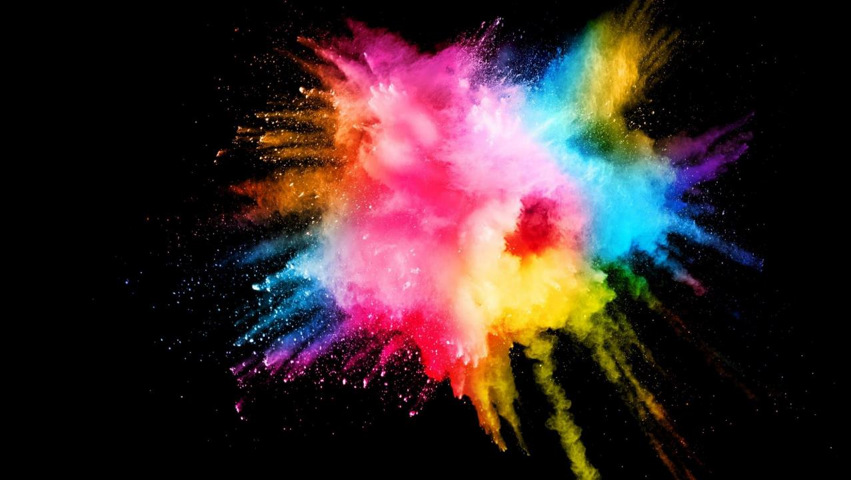
The Human Search: Aims
These lessons aim to enable learners to: a. Think about art works that express big ideas. b. Develop broad minded and open-hearted responses to the ideas of others. c. Consider religious teachings about life’s big questions in depth for themselves. d. Respond creatively for themselves to spiritual learning in RE.
RE Lessons which use inspirational art from the exhibition CO-CURATED BY ‘The God who Speaks’.
Notes:
The specific learning objectives of each of our four primary and four secondary lessons are given on the next slide, but these general aims fit in with the purposes of RE as they are articulated in various contexts, for Catholic schools, other schools with a religious character, community schools and academies. Teachers are invited to use these PPTs and the notepads that go with them containing additional resources, learning activities information and learning activities, in flexible ways that suit their own pupils. Seeking to represent different visions and insights from interfaith integrities, the exhibition ‘Cloud of Witnesses’ was a big success. These art and RE lessons share the work.

Slide 3
The Human Search.
This particular lesson enables learners to: a. Think about art works that respond to some of life’s great questions. b. Develop broad minded and open-hearted responses to some ideas about ‘life, the universe and everything’. c. Consider different answers to questions of origin (where do we come from?), values (what matters most?) and commitments (what do we want to change or preserve in the world?) and environment (how do we fit into the natural world?). d. Imagine their own responses to big questions of meaning.
RE Lessons which use inspirational art from the exhibition CO-CURATED BY ‘The God who Speaks’.
Notes:
The specific learning objectives for this secondary learning sequence connect to common themes in Religious Education at both KS3 and 4. Teachers are invited to use these PPTs and the notepads that go with them containing additional resources, learning activities information and learning activities, in flexible ways that suit their own pupils. Seeking to represent different visions and insights from interfaith integrities, the exhibition ‘Cloud of Witnesses’ was a big success. These art and RE lessons share the work – and give learners the opportunity to study ideas from Hindu, Muslim and Christian sources.

Slide 4
Searching for God? Lesson 4
Big questions: where are we from? What truth is there in ancient stories? How shall we love the Earth?
Can we find paradise?
Will there be peace?
Why do so many people pray so much?
Secondary
Notes:
There are four primary and four secondary lessons in this project, which fit well together – but teachers are welcome to use some of them as they fit in with your own RE planning and schemes of work.
The partnership in creating these lessons with NATRE links powerfully to the Spirited Arts project NATRE runs each year. See examples and details here: www.natre.org.uk/about-natre/projects/spirited-arts/spirited-arts-gallery/2024/

Slide 5
Big questions, big thinking.
Philosophy – the word means ‘love for wisdom’.
This learning sequence uses three brilliant modern art works made by people with very different worldviews to raise and explore some of life’s great questions.
These artworks raise big philosophical questions about our origins, about ancient scriptures and narratives, about our fragile Earth, about life beyond this life, about peace and prayer.
All religions – and non-religious worldviews – offer visions of being human that respond to these kinds of questions.
If you could ask the ‘being who knows everything’ any questions, what would you ask?
Notes:
Introduce the work to pupils in these terms. You don’t have to use all four lessons in the sequence, though they will fit will with units of work about any theological topic in RE.
Expect pupils to gather and debate ideas in the first three lessons in ways that enable them to be creative for themselves in lesson 4. Referring to the final task throughout this mini-unit of RE will help all pupils to bring their learning together in a final piece of work at the end. It’s important that they can create work they are proud of: time and quality resources are a great help with this.

Slide 6
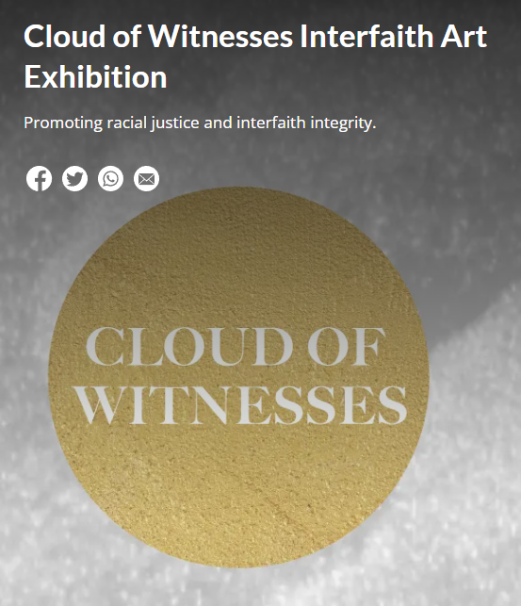
In the 2025 London Art exhibition ‘Cloud of Witnesses’ - 26 artists contributed some of their work.
They explored diversity of belief about God. It was an inter-faith project.
From different religions to no religion, they show us some creative ways of expressing ideas and beliefs about God.
Notes:
In 2025, the Catholic Bishops’ Conference co-curated an art exhibition called ‘Cloud of Witnesses’, digitally available here: www.godwhospeaks.uk/cloud-of-witnesses-art-exhibition/
‘The God who Speaks’ is a digital space where Catholic Biblical resources, insights, projects and visions are shared.
For this art exhibition, artists were invited to show work which explored human searches for the divine in many and varied ways. Stunning work resulted, and the project enabled a link to be made to school RE. These lessons, four for primary RE and four for secondary RE, have been created to enable excellent RE which uses some of the art from the exhibition for the purposes of excellent school RE. Seeking to represent different visions and insights from interfaith integrities, the exhibition has created an ongoing conversation. These art and RE lessons share some of the work.

Slide 7

Fill up the big question mark
Work in a group of four.
Consider what you would ask if you could ask ‘the one who knows everything’.
Which of these two questions is better?
One pupil wanted to ask:
‘Please can you tell me next week’s lottery numbers?’
Another asked:
‘Is my grandpa safe with you in heaven?’
In 5 minutes, fill the inside of the question mark with your biggest questions.
Compare yours with those of other groups.
Notes:
A copy of this big question mark between four students is needed. Blow it up to A3 size. The activity has proved extraordinarily fruitful as a simple learning tool. Take the response seriously – they will tell you a lot about your learners and their deeper thinking. Examples on the next slide.

Slide 8
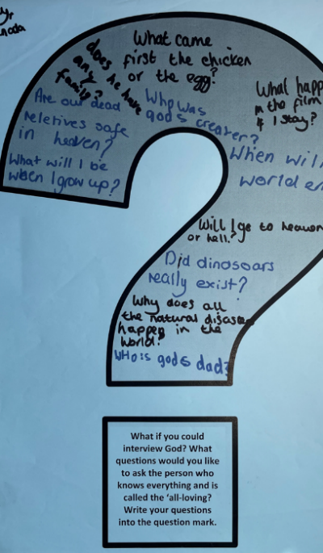
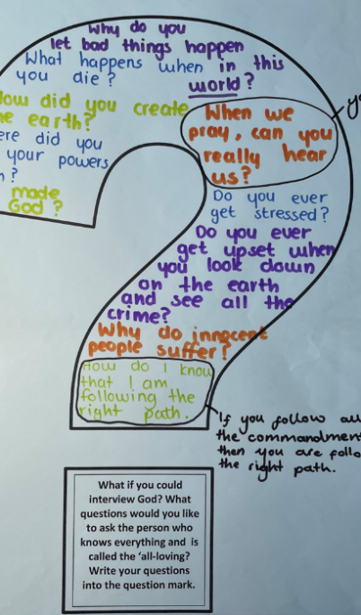
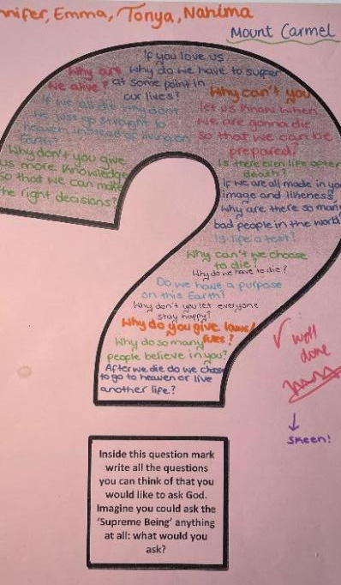
Notes:
The range and depth of these questions from 10-11-12YOs is fascinating. They challenge some of our current RE practice because instead of teaching ‘little religious facts’ they might ask us to provide learning around ‘big spiritual questions.’

Slide 9
Three works of art responding to big questions.
In this lesson we will study three art works that engage with big questions: you get the chance to think about how the artists are expressing meanings.
Can we have peace? Ian McKillop’s painting considers whether humanity can have peace. He wanted to paint an image about prayer, unity and humanity. He read about how Jesus prayed, just before his arrest.
Can you imagine this picture?
What makes us united? Jesus prays for us all to find unity and that truth would spread through all the earth. Iain imagined representatives of different races, genders, cultures and faiths sharing a cup of the Water of Life beneath olive leaves symbolising peace.
What prayer for love would you ask? The painting expresses a prayer that all who long for peace, truth, love and unity may live and work harmoniously for the new world Jesus imagined.
Speak to your partner for a minute and sketch for two minutes. If you were painting a picture to show what Iain is interested in, what would yours show? The next slide shows you Iain’s idea.
Digging deeper: at the end of the PPT, we look at a fourth painting that is asking some new questions.
Notes:
The sketching activity uses imagination to generate curiosity – it really works, so do give it the two minutes it takes…

Slide 10
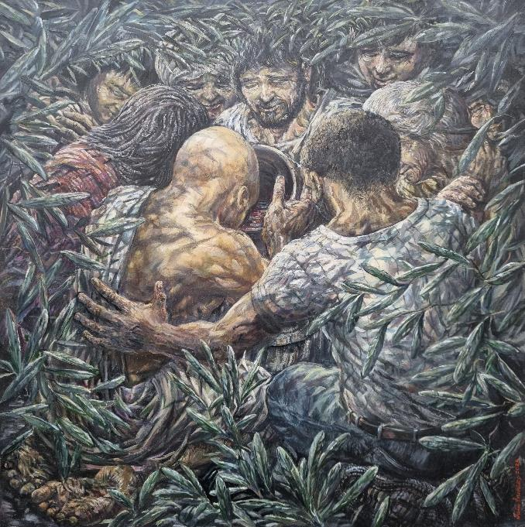
Iain Malcolm McKillop
‘May They Be One’ 2024.
Iain was born in Gloucester. He has studied art and art history, been a school teacher, and a lecturer, and is a Christian priest.
This is the fourth in a series of paintings exploring Jesus’ prayers on the night before he died. The image interprets the Bible teaching from John 17:20-26 where Jesus prays to God as his Father.
Jesus asks that all his followers may find unity and truth.
In the dense undergrowth of a garden,
8 interconnected figures from varied races, genders, cultures and faiths drink the water of life from a shared cup. Olive branches and leaves symbolise peace.
What do you admire about the work?
Notes:
More from Iain’s wide-ranging website on his Gethsemane paintings: https://mckillop.weebly.com/gethsemane.html

Slide 11
Three works of art responding to big questions.
The second work of art in this lesson is by Amber Khokhar, and explores questions like these: are earth and heaven connected? Does nature show us what God is like? What should we do to safeguard our environment – and our own future?
Amber uses palms trees as a symbol in this painting. Different faiths and spiritualities see trees as a sign of the divine or of the spiritual life – Muslims and Hindus, Christians and Jews all have this symbolism in their holy texts.
Amber’s painting (can you imagine it?) pictures the Earth at the bottom, and the light of hope or peace or truth at the top. Earth and the heavens are connected by loads of tall, slender palm trees, with patterned trunks and thousands of leaves. It’s a kind of heavenly image: are the trees from the Gardens of Paradise? Maybe.
Amber uses images of clouds, waves and sunlight to paint a picture with peace and holiness at its heart. The colours are blue, green, brown and yellow.
What do you admire about Amber’s work?
Speak to your partner for a minute and sketch for two minutes. If you were painting a picture to show what Amber is interested in, what would yours show? The next slide shows you Amber’s idea.
Notes:
The sketching activity uses imagination to generate curiosity – it really works, so do give it the two minutes it takes…

Slide 12
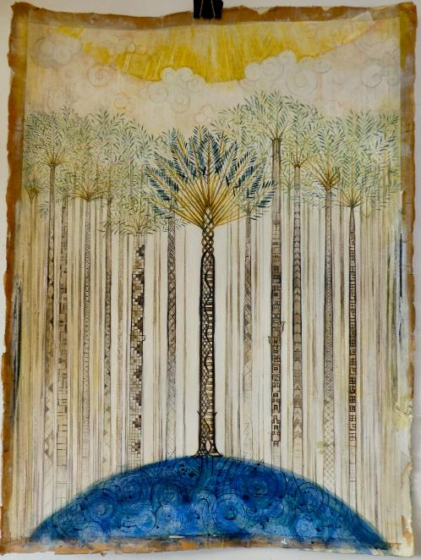
Amber Khokhar, Sacred Palm.
Mixed media, 2024.
Amber Khokhar is a London-based artist and designer. She blends traditional art with contemporary design.
She has studied art from all over the world, for example in Poland, in India and in the USA.
Amber’s paintings often feature palm trees, moving from shadow to light, evoking safe space. She says: “I use natural pigments to paint with, colours that are made from the earth to manifest the beauty of God.”
Discussion: What ideas does this painting provoke about the natural world? Do we humans attack nature? How do some defend nature? Does Amber show us a connection between earth and heaven? How? Some people find God much closer in nature than in a church or a temple – what do you think? Where is God to be found?
www.amberkhokhar.com
Notes:
Navigating the interplay between symbolism and global issues, the palm tree is a recurring motif in Amber Khokhar’s work, and which represents a duality that encapsulates both the splendour of nature and the depth of human impact. Serving as a potent reminder of the complex connections between environment, economics, and society.
An emblem of resilience, growth, and beauty, the palm tree stands tall as a representation of nature's majesty. Its elegant fronds reaching skywards mirrors our aspirations towards the heavens, towards a harmonious coexistence. The exploitation of this resource, often resulting in deforestation and ecological devastation, symbolizes the reckless pursuit of profit that disregards the delicate and phenomenal balance of our world.

Slide 13
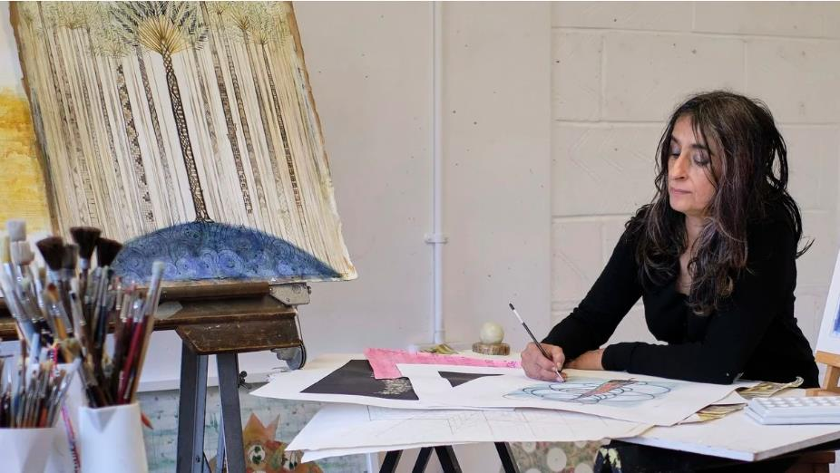
Amber at work in her studio.
One of her Sacred Palms artworks is on her easel.
Notes:
Amber at work in her studio with the Sacred Palms artwork visible.

Slide 14
Art responding to big questions: Artwork Number 3.
The third work of art in this lesson is by Raji Salan. It’s not simple! It explores questions like these: where do we come from? Is humanity a creation, or an accident? Random, or made from love? What do ancient stories of creation and origin say – and mean? What makes ‘myths’ powerful today?
Raji took an ancient Hindu story of creation. It goes (very briefly) like this.
“The god Vishnu slept for ages on a snake in the ocean. Nothing happened. Then the beautiful goddess Lakshmi came and massaged his feet. Vishnu dreamed up the universe!
Then a lotus flower grew from the god’s belly button. When it opened, the creator god Brahma, with four heads, was revealed in the flower. Looking all directions at once, seeing past and future, Brahma carried the four Vedas, Hindu scriptures, in his four hands. What a lot of power and vision!
Brahma began to create this universe!”
Many ancient societies passed creation myths down the centuries. These myths are not history or science – instead, stories like this tell us something deep about who we are, where we come from and why we matter.
Speak to your partner for a minute and sketch for two minutes. If you were painting a picture to show what Raji is interested in, what would yours show?
You will see Raji’s idea in a couple of slide’s time.
Notes:
Accept that this is one of the harder to see and understand artworks in the collection, but many students will enjoy decoding and responding to its layered meanings and subtle beauties.

Slide 15
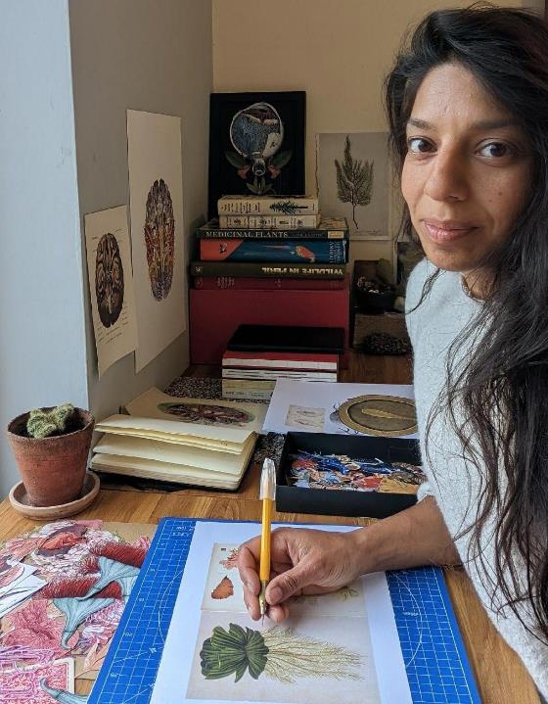
Q: You created ‘Vishnu and Laksmi dreaming the multiverse’ based on a Hindu creation narrative. How did this come about?
I love stories, mythologies that connect with nature. To understand them you have to suspend disbelief. That takes you on a really interesting journey. I learned about the ancient Hindu creation story of Vishnu and Lakshmi. When I looked at traditional Indian paintings of this story, I never thought to explore what was going on and why. Then I felt compelled to create my version.
Q2: Your image is very original. What led you to paint it in this way?
During my research I try to capture the essence of the story. That's how an artist can make sense of the world through their vision. This is why my work turns out the way it does - because it was created by me! My work reflects my interest in science as well as art. Symmetry fascinates me, so I cannot help using symmetry. When I read a mythical story, I pick out elements, symbols, characters that really have a purpose in the narrative.
Q3: Would you like to explain how different images in your painting connect to the Hindu creation story?
The white draped cloth represents Vishnu. The snake in which Vishnu is seated is wrapped around. The Eye become the universe. The lotus flower symbolises the connection of Vishnu's naval: he’s dreaming up the universe. The female hands represent Lakshmi, seated at the feet of Vishnu, massaging his feet. Without her female energy, Vishnu cannot dream up the universe, it is her action of massaging his feet that enables him to do this. So her hands become important in this story. The outcome – the universe - cannot happen unless all the elements come together. Nothing exists in isolation.
On the next slide is a very traditional image of the story. Work out what is what, then imagine how Raji has made a very fresh image.
Notes:
https://artstoheartsproject.com/raji-salan/ Permission may be needed.
Raji has given this project an interview, from which these quotes are extracts. If you want more depth in the work, then use the interview transcript from the notepad.

Slide 16
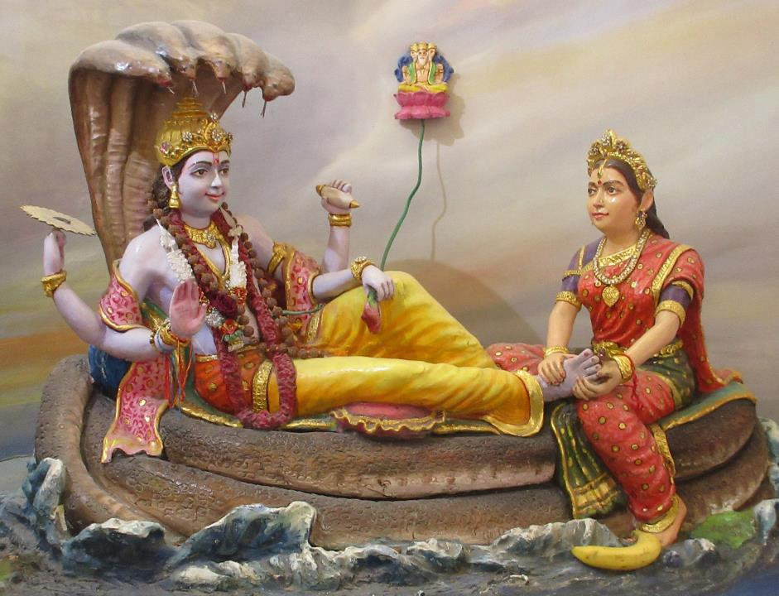
Can you spot…
The ocean
The mighty snake
The god Vishnu
The foot massage of the goddess Lakshmi
The lotus flower
The four-headed image of Brahma
In this myth, the messages are complex. What do you think this myth says about why the universe matters and our place within it?
Next you will see Raji’s super-original painting based on the same Hindu creation story.
Notes:
If it is the case that myths of origin tell us ‘who we are, where we come from and why we matter’ then this myth might be messaging the human race: out of deep time, embodying male and female energy, by divine love, you came, and you are important because in this universe reality – including humanity- is willed by the deities.

Slide 17
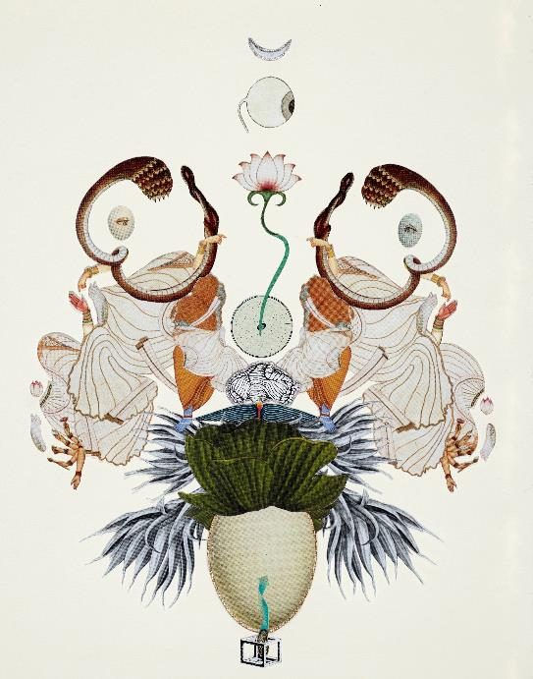
Can you spot…
The ocean?
The white draped cloth representing Vishnu?
The snake in which Vishnu is seated?
The Eye that becomes the universe?
The lotus flower connecting to Vishnu's naval?
The female hands representing Lakshmi?
Eggs?
Eyes?
In this myth, the messages are very complex.
What do you think this myth says about why the universe matters and our place within it?
Raji’s super-original painting is so different from the plaster-sculpture in the previous slide. But they are based on the same story. Compare them.
Notes:
Raji Salan’s picture of a Hindu creation narrative responds to the idea of finding god in this universe. Does the beginning of the universe speak to us about a creator? In many creation myths from numerous holy texts, students of religion find big themes: where did we come from? Why are we here? Are we descended from love, or merely random?

Slide 18
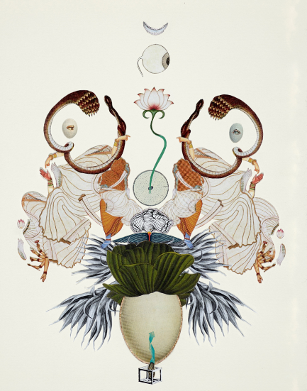

Similarities and differences?
Notes:
Similarities include hands, snake, flower, ocean, god and goddess, navel, flower. Differences – are they mostly stylistic?

Slide 19
Big questions!
In this lesson you studied three works of art asking questions like:
Can we make peace?
How should we care for the earth?
Where do we come from?
To finish, review your learning and make some judgements.
Look at work by other young artists.
People who believe in god disagree!
how do our artists reflect on this vision?
Notes:
There is a lot in this lesson – it might be worth splitting in two. The third work of art on Hindu creation narrative, is perhaps a separate lesson, in which case you could use the interview with Raji to deepen learners’ understanding.

Slide 20
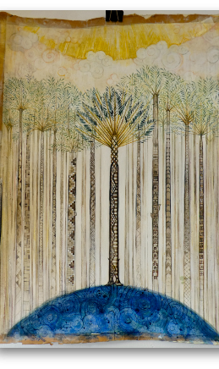
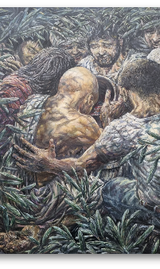
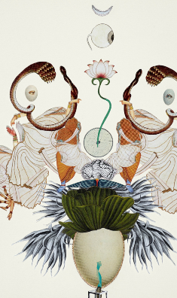
What did you notice? What did you think?
“The 3 paintings are all in the ‘open air’. They show us creativity in oceans, leaves, trees, earth, vegetation.”
“All three artists are working on big questions and ideas, but they actually paint natural things – in detail.”
“Would the three artists all consider their work is about Nature and about God?”
“Amber’s art is about trees in God’s creation. Raji focuses on the birth of the universe. Iain looks at our place in creation. So they are linked.”
Notes:
Encourage your students to connect the art to the Earth and think for themselves about ‘green spiritualities.’ Pope Francis led the world to notice that the planet is ‘our common home’ in his influential encyclical Laudate Si.

Slide 21
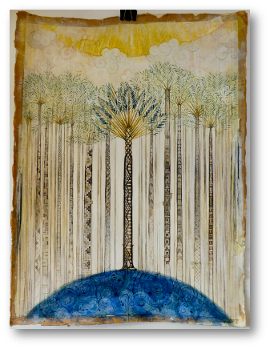
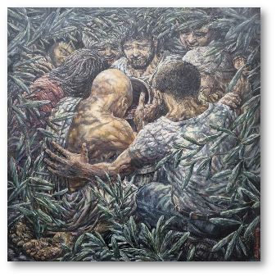
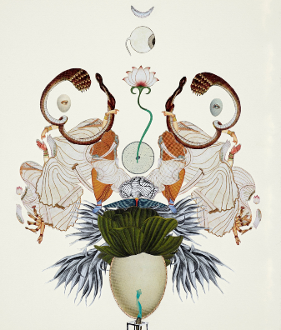
“Iain doesn’t suggest here that we can all ‘just get along.’ Cheap harmony like that soon falls to pieces. But I like the idea of growth in his brilliant painting.”
“I love the way Amber uses nature to make me think about my own engagement with God’s green earth. It’s beautiful.”
“Raji’s amazing originality made me think about my own beliefs about how the universe began. I like the idea that it began with a sensual foot massage.”

Slide 22
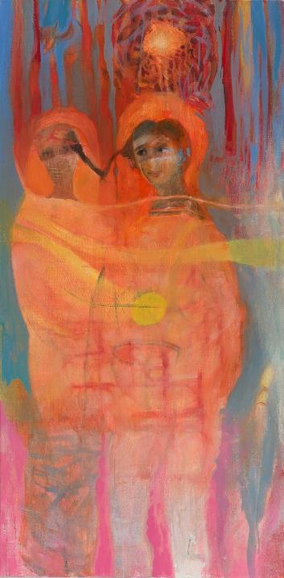
Digging deeper:
This painting requires you to look with some maturity. Ivilina Kouneva painted ‘Umbilical Cord’ in 2020. Just think for a moment about your belly button – it is a point of connection to your mum, of course. In this picture, the connection, or cord, is the plaited hair that links the two figures.
“Umbilical Cord” is the first of a series inspired by old Christian icons. These icons tell a visual story about the life of a saint or a martyr.
Ivilina wanted to make symbols of how mothers and daughters are intertwined and connected. She is interested in spiritual union.
Can you see how the hair of the two women is woven into one plait?
Our hair contains our DNA.
Jesus described God’s care for every person like this: ‘Even the hairs of your head have been counted!’
The next slide gives a close-up of the painting.
From the Balkans to Britain, Ivilina studied icons, paintings, of mothers and daughters who sacrificed themselves for faith or for humanity. https://ivilinakouneva.com/
Here is her work.
Notes:
‘Umbilical Cord’ is a piece of work to make pupils think about how they are linked – maybe to their own mothers, maybe to humanity. You might further the work by studying stories of Catholic mother and daughter saints. A most significant example is St. Anne, the mother of the Virgin Mary. Other examples of mother-daughter saints St. Paula and St. Eustochium, who worked with St. Jerome, and the family of St. Zélie Martin and her daughter St. Thérèse of Lisieux, who had several other sisters who became religious figures. This lesson enables the study of a fourth painting about these big questions: it is labelled ‘digging deeper’ because, in a way, it asks for more profound responses for the learners.

Slide 23

Ideas about this work. What do you think?
“She often paints figures that shimmer with light, merging nature and humanity.”
“I think this picture is about friendship and family, the opposite of loneliness. They look so close.”
“Some people think family is repression – the ties that bind us tie us down.
But here, it looks more like fellowship – or even love.”
“This is not an abstract painting at all but the colours matter more than the details, and so you see it is an expression of the bright light of loving connections.”
What do you think Ivilina is expressing?
Notes:
Ask students to express their own ideas about what Ivilina is expressing in this beautiful image. Note them down.
The artist says: “In my work the symbol of the umbilical cord is, in fact , the plated hairs. The shiny, golden ball is like a sacral gift from a mother to a daughter.”

Slide 24
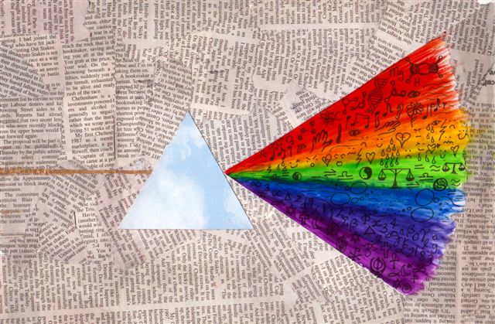
The search for God. Sam, 15.
“Amidst the millions of not so useful words humans have written about God, I have shown a prism. The light of God might be blinding for us, all too much. But the prism splits the blinding light into all colours. In the iridescent patterns of light through the prism I have included all the symbols of different faiths, spiritual paths and human insights I could.
I think it is like this: human minds are weak. Too weak to know God or see God. But religions and other pathways give us a break down of the truth. Maybe we can all see one colour, our own ideas. Maybe we can learn to see other colours, the ideas of others. I don’t think any of us can see it all.”
Notes:
As a finale to this learning, here is a brilliant piece of work from Spirited Arts. What do your pupils think? It is a kind of reflection on diversity and limitations of any one person’s insights – so it connects to what makes these different art works so valuable, as each artist expresses something profound from their own worldview.

Slide 25
From your learning in this lesson, choose 5 or more of these prompts to complete your responses.
My favourite of these artworks is… because…
One thing I learned from these artists is…
Learning from the paintings is interesting because…
Some people completely reject ancient myths, but I think…
Art sometimes gets you thinking deeply and this may be better than arguing about ideas. For example…
Can humanity live in harmony? I hope…
A green future for the Earth and humanity is important because…
We all have an umbilical cord, and we never think much about it! Art can make you think, and this work has made me think about…
There’s lots of beliefs about creation and where we come from. My thoughts…
Do these paintings have hidden messages for you about how we care for creation and how we care for each other? What hidden messages do you see?
Notes:
These kind of prompted writing activities give some flexibility, but focus student writing on depth and potential profundity. They work well. Letter I – about hidden messages – might be for all pupils to discuss.

Slide 26
Here are three examples of student reflections in art on ‘big questions’ See which you like the best.
Ahana, 11, asks: must we argue about God and faith?
Meghan, 12, asks: is there hope of God in suffering?
Joshua, 13, asks: what does it mean to look at the world with open minds?
Notes:
Thanks to NATRE and the student artists involved for these images and texts, used by permission.

Slide 27
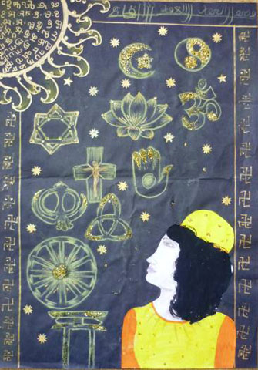
Must we argue?
Ahana, aged 11.
“My drawing represents a multi-cultural girl. She’s looking up to many different religious symbols. She thinks there is only One God, who is in every symbol and every religion,
but she is confused about the arguments people have about each other’s faiths and beliefs. WHY?????
Please people of the world be united and help us youth to make this world a better place.
The girl is looking up and thinking about the ‘ONLY GOD’,
just like me. I only want to think about ‘GOD’ who is the creator of this world.
Must we argue, or can we share ideas peacefully?”

Slide 28
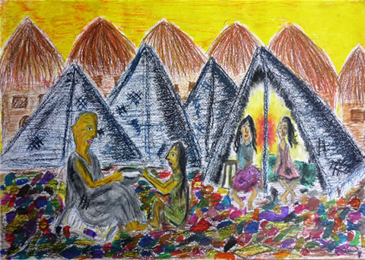
Reality and Hope: Is God Within? Meghan is 12. She explores the question: does the suffering of real life mean there is no God?
In the slums, where people just manage to eke out a living, rubbish and poverty is normal. But the godliness within people comes out even here. A man is sharing a bowl of gruel, his only food for the day, with a child. Two other children look at the scene. They live in a torn tent, with a small lamp, the only source of light in the darkness.
My picture shows reality: it tells us how vast numbers of people live in the world today, but however hard their lives get, they hope for better. God exists everywhere, in the actions of human beings.

Slide 29
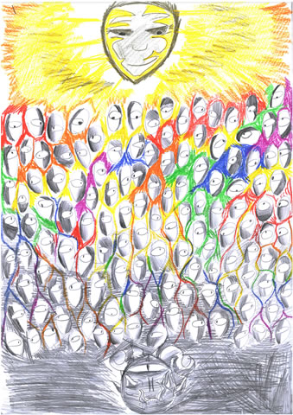
Open Minds Joshua, aged 13.
“At first glance you might think this picture is about light and dark or good and evil, or heaven and hell. It's not. The people in the middle all relate to each other with a different perspective. Every one of them has a light and dark side, and you see them all differently depending on where you are looking from! However, much you dislike someone, they have a light side too. Many of us forget this and sometimes we cannot forgive people for their darkness.
I've drawn all the people with one eye, as they have only one perspective. The same is true of my picture of Satan. Only God sees completely, and that's why the colour comes all from him, in what would otherwise be a very grey and colourless world. Even those closest to evil have colour and light reaching out to them: it reaches each person differently, which shows diversity, but deep down we all have the same needs. We are all the same 'shape'.
Remember: God really gave us two eyes to see everything. We should not live with one eye closed. Living spiritually means allowing the light and colour to be seen in us, and to look for the same in other people.”

Slide 30



Partnership
Notes:
These lessons and resources have been created by Lat Blaylock and Fleur Dorrell in a partnership between the Catholic Bishops’ Conference through its work on the bible (‘The God who Speaks’), NATRE (who run the Spirited Arts competition) and RE Today. The lessons are free to use, and suitable for RE in any school, connecting in many ways to different schemes of work , wherever pupils use critical and creative skills to explore theological and spiritual questions. https://www.godwhospeaks.uk/
Respondents, users of the lessons, anyone who wants to send in samples of pupils’; work, please contact me, Lat Blaylock, on lat@retoday.org.uk

Slide 31

Connections to the Catholic RE Directory
The RE Directory invites all students to engage with an ambitious RE curriculum focused on multiple disciplines in the pursuit of truth. Creative, critical thinking about key Christian ideas, visions and practice are highlighted. These lesson ideas enable these aims.
This work can contribute to students learning in Year 8 about key theological ideas from plural sources, so that they can use a range of accurate religious and philosophical vocabulary to show understanding of religions, beliefs and worldviews. (RED p226).
Students in Year 7 are asked to consider the statement that ‘God is beyond human understanding’ and take account of varied ideas as they respond. They are asked in these lessons to discern and respond for themselves, considering their own responses to artworks studied.
(RED p188, 191).
By age 14 students will have built up their understanding and skills in dialogue, so that they can discuss and listen to varied views about many ethical and philosophical questions. (RED, p246).
Notes:
These lessons and resources have been created by Lat Blaylock and Fleur Dorrell in a partnership between the Catholic Bishops’ Conference through its work on the Bible (‘The God who Speaks’), NATRE (who run the Spirited Arts competition) and RE Today. The lessons are free to use, and suitable for RE in any school, connecting in many ways to different schemes of work , wherever pupils use critical and creative skills to explore theological and spiritual questions. https://www.godwhospeaks.uk/
We also thank teachers and pupils who have been involved in developing and trying out the lessons: your contribution has greatly improved the project!
We invite you to share interesting examples of your pupils’ work: lat@retoday.org.uk

